Slide 1

Implementation of SQL injection using SQLMAP
BY:
M.ANIL KUMAR
K.VARUN KRISHNA
D.DEDEEPYA
K.SRI TEJA

Slide 2
Topics to be covered
ABSTRACT
INTRODUCTION
STEPS
SCREENSHOT
CONCLUSION

Slide 3
Abstract
SQL INJECTION also known as SQLI, is a code injection technique where an attacker executes harmful SQL queries which control any web application’s databases and information stored in it . It is the one of the most common web hacking technique.
The attacker can also control administration operations for that web application and recover the content present in that DBMS file system
SQLMAP is an open source penetration testing tool to detect and exploit SQL Injection flaws. SQLMAP is written in python and has got dynamic testing features. It can conduct tests for various database backends very efficiently. SQLMAP offers a highly flexible & modular operation for a web pentester.

Slide 4
Introduction
A SQL Injection attack consists of insertion or injection of a SQL query through the input data from the client to the application. When this SQL injection attack is successful , the sensitive data stored in the databases can be viewed and modified by the user.
SQL Injection Consequences includes :
Confidentiality: As the SQL databases hold the sensitive data, loss of confidentiality is a frequent problem
Authentication: If the authentication form of the web application is vulnerable to SQL injection, the user may log into the application without providing proper credentials.
Authorization: If authorization information is held in a SQL database, it may be possible to change this information through the successful exploitation of a SQL Injection vulnerability.
Integrity: Just as it may be possible to read sensitive information, it is also possible to make changes or even delete this information with a SQL Injection attack.

Slide 5
Steps
Install kali Linux on your virtual machine
https://youtu.be/pwYH0NNWWzU (reference)
SQL Injection using SQLMAP
Step 1 : INSTALL SQLMAP
SQLMAP comes pre – installed with kali linux, However, you can install sqlmap using the command
Usage
In this implementation, we will make use of a website that is designed with vulnerabilities for demonstration purposes:
As you can see, there is a GET request parameter (cat = 1) that can be changed by the user by modifying the value of cat. So this website might be vulnerable to SQL injection of this kind.
To test for this, we use SQLMAP. To look at the set of parameters that can be passed, type in the terminal,
sudo apt-get install sqlmap
http://testphp.vulnweb.com/listproducts.php?cat=1
sqlmap -h

Slide 6
Steps (cont..)
Step 2: List information about Tables present in a particular Database
To try and access any of the databases, we have to slightly modify our command. We now use -D to specify the name of the database that we wish to access, and once we have access to the database, we would want to see whether we can access the tables. For this, we use the –tables query. Let us access the acuart database.
Step 3: List information about the columns of a particular table
If we want to view the columns of a particular table, we can use the following command, in which we use -T to specify the table name, and –columns to query the column names. We will try to access the table ‘artists’.
sqlmap -u http://testphp.vulnweb.com/listproducts.php?cat=1 D acuart --tables
sqlmap -u http://testphp.vulnweb.com/listproducts.php?cat=1 -D acuart -T artists --columns

Slide 7
Steps (cont..)
Step 4: Dump the data from the columns Similarly, we can access the information in a specific column by using the following command, where -C can be used to specify multiple column name separated by a comma, and the –dump query retrieves the data
sqlmap -u http://testphp.vulnweb.com/listproducts.php?cat=1-D acuart -T artists -C aname –dump
For example If we consider a url like this :
http://testphp.vulnweb.com/listproducts.php?cat=1
Here as we can see there is a GET parameter which can be changed by modifying the value of cat by the user. So this kind of website might be vulnerable to SQL injection. .
For testing this website we use SQL Map.
->Firstly , we have to enter the web url that we want to check along with the -u parameter.
->Now typically, we would want to test whether it is possible to gain access to a database. So we use the –dbs option to do so. –dbs lists all the available databases and we can check the tables created in the database are in it’s original form or modified to know SQL Injection vulnerability. kind of website

Slide 8
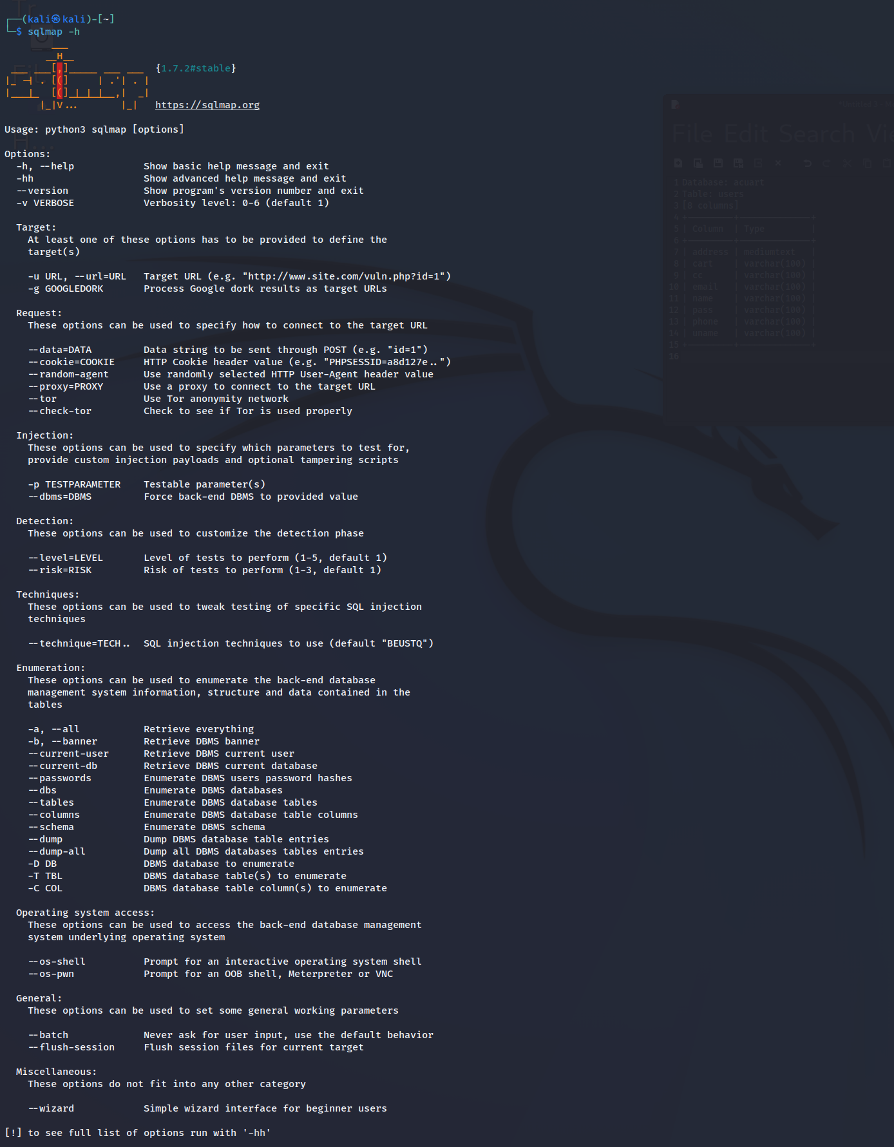
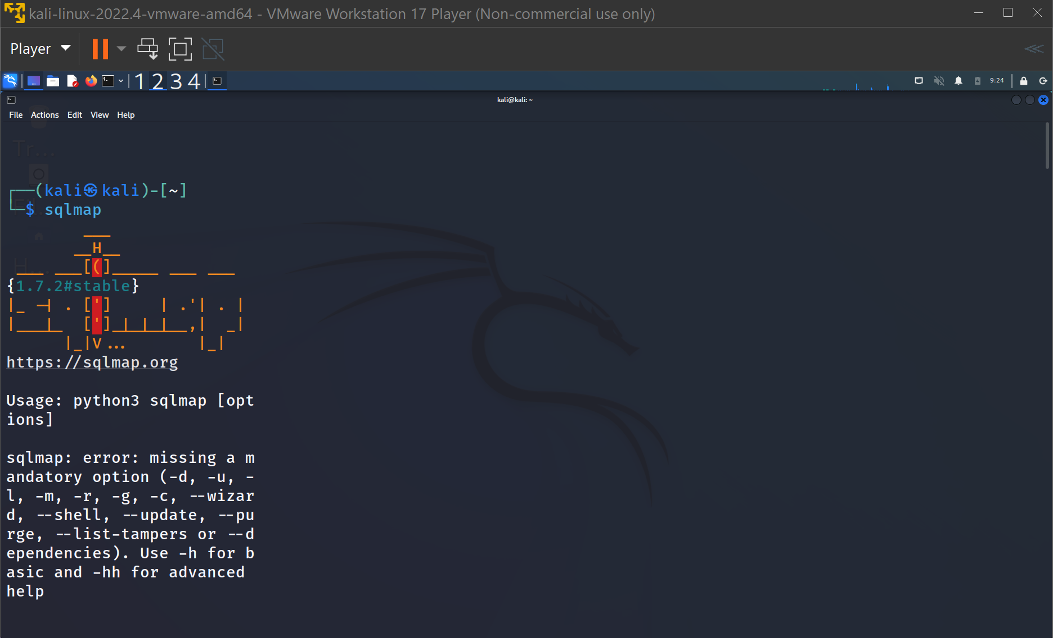
Screenshot
Checking whether sqlmap is installed or not
To look at the set of parameters that can be passed

Slide 9
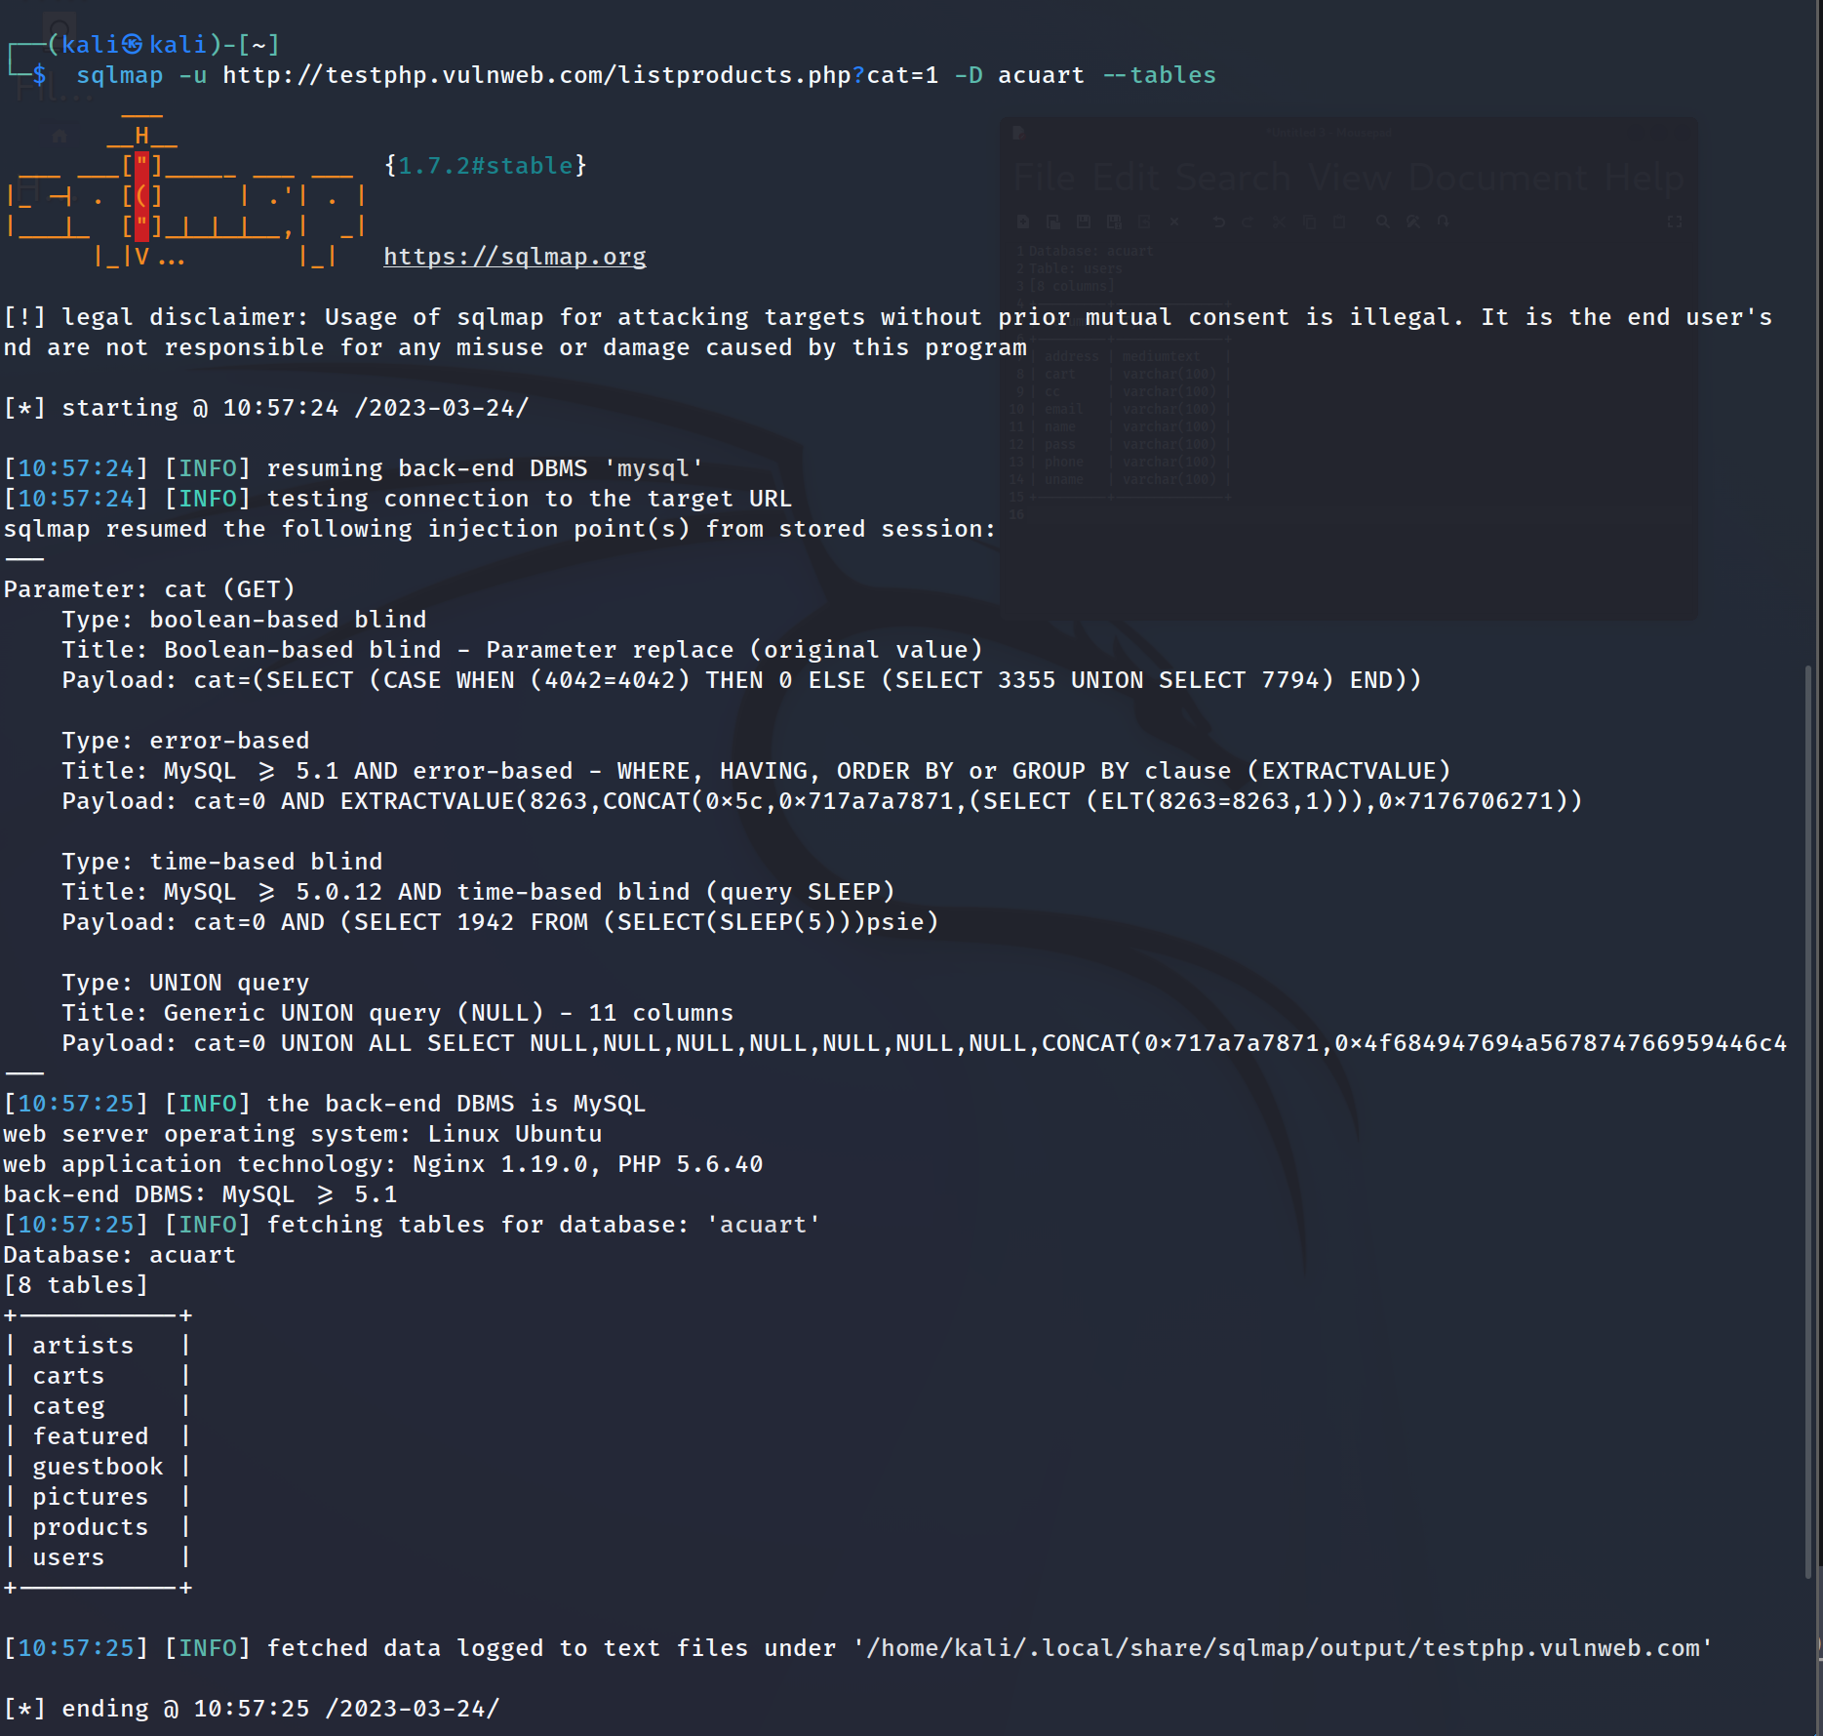
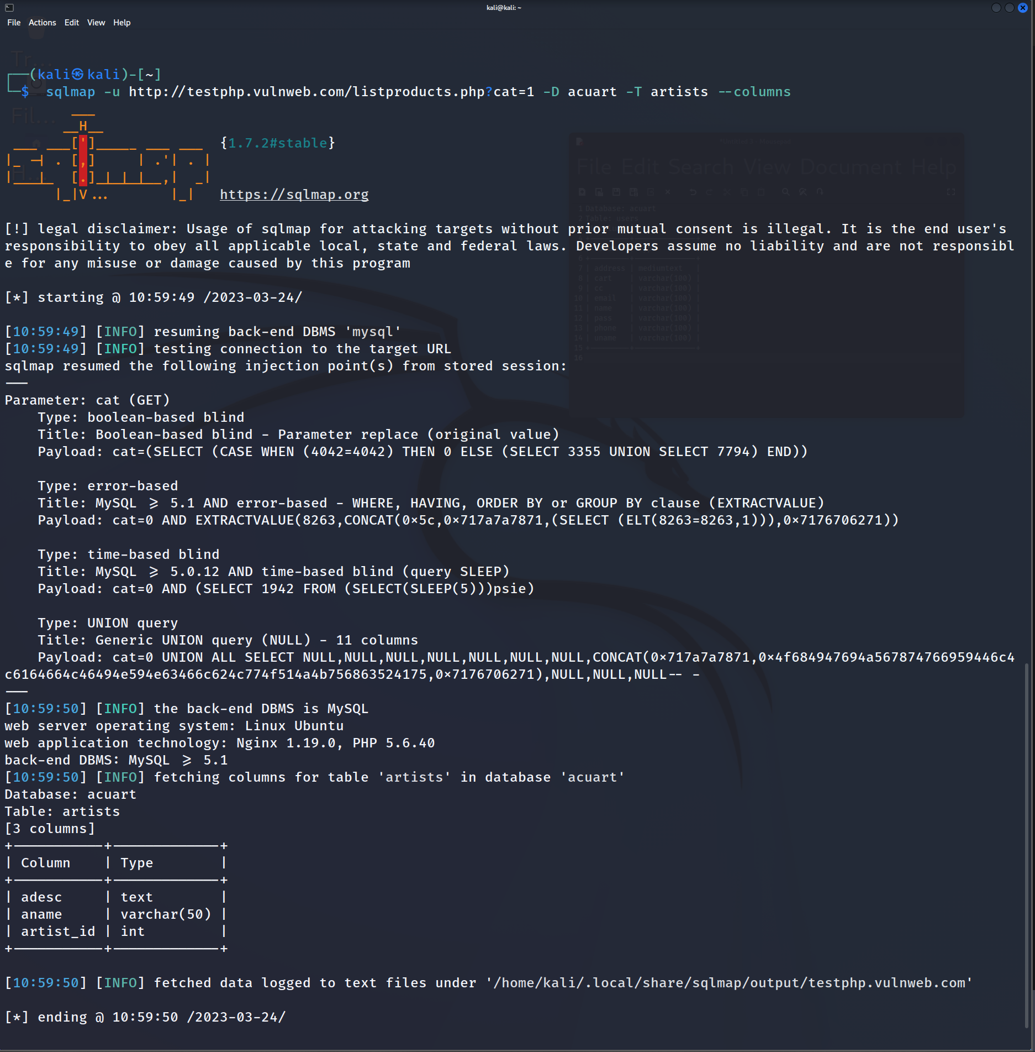
In the above picture, we see that 8 tables have been retrieved. So now we definitely know that the website is vulnerable.
List information about the columns of a particular table

Slide 10
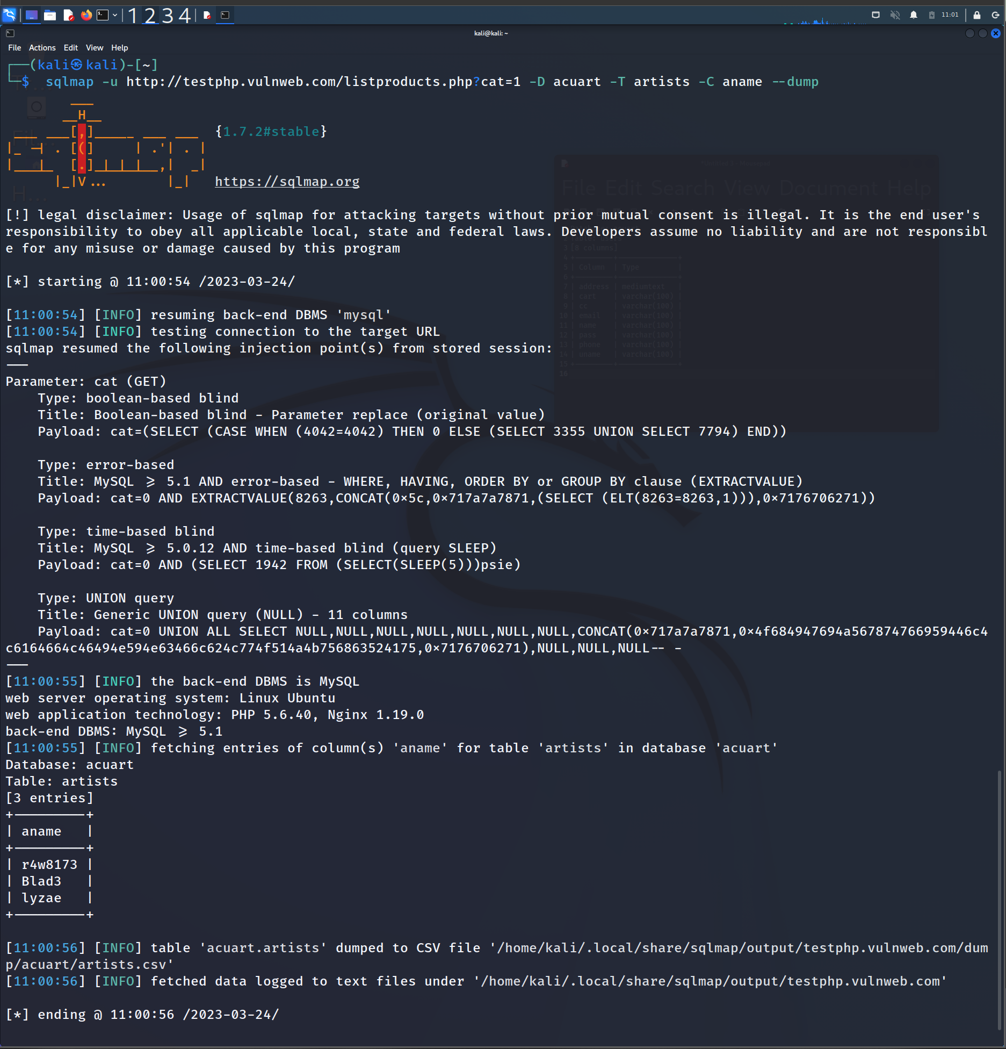
Dump the data from the columns

Slide 11
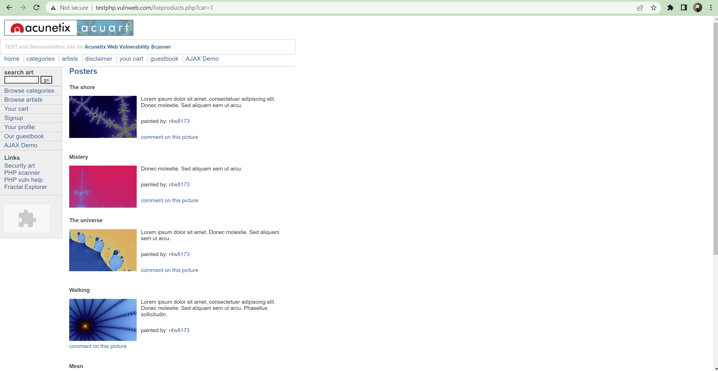
Conclusion
If you observe a web url that is of the form http://testphp.vulnweb.com/listproducts.php?cat=1, where the ‘GET’ parameter is in bold, then the website may be vulnerable to this mode of SQL injection, and an attacker may be able to gain access to information in the database. Furthermore, SQLMAP works when it is php based.
php backend with a GET parameter

Slide 12
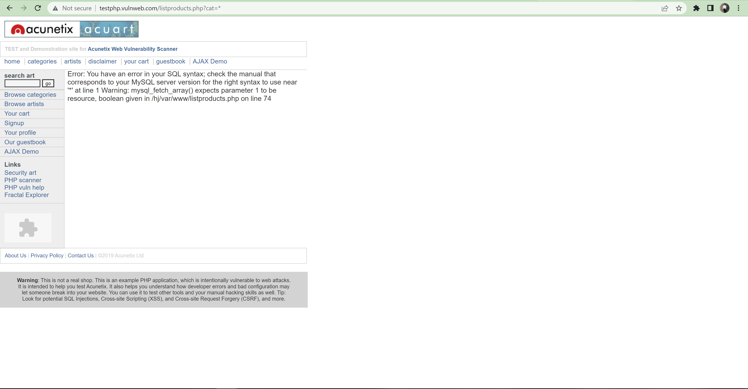
Parameter with value *
Error obtained on changing value of GET parameter to *
A simple test to check whether your website is vulnerable would be to replace the value in the get request parameter with an asterisk (*). For example, http://testphp.vulnweb.com/listproducts.php?cat=*
If this results in an error such as the error given above, then we can conclusively say that the website is vulnerable.

Slide 13
Thank you

