Slide 1
Project 1: Wikipedia Data Analysis
Ernie Chu

Slide 2
This year, which Wikipedia article got the most traffic on October 20th?
The main_page of Wikipedia was the most visited site on October 20th. There were 3,234,621 hits for the mobile site, and 2,726,387 hits for the desktop site. Combined, there were 5,961,008 views on that day.
The next slide shows the top 10 viewed articles on this date. I’ve shown the combined views in this table.

Slide 3
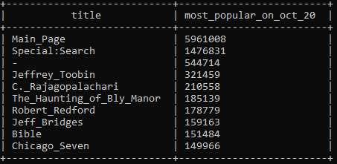
Top 10 Articles Viewed on October 20th

Slide 4
What English Wikipedia article has the largest fraction of its readers follow an internal link to another Wikipedia article?
I first compared the total number of views for a page to the entire month of September 2020 dataset to get more accurate data. I then took the number of times the article was labeled as a referrer to another as a link in the clickstream data set for September 2020. Since the clickstream data covers a month of data, the number of view totals in both files should be approximately the same.

Slide 5
What English Wikipedia article has the largest fraction of its readers follow an internal link to another Wikipedia article?
To get my answer, I divided the above number by the total number of views and multiplied by 100 to get a percentage. The article with the highest proportion of links click was Dune_(2020_film), at 93.95%.
I limited page popularity to a certain threshold to get reasonable results. I ended up choosing from within the top 100 most viewed articles in September 2020.
The next slide shows the top 10 articles with the highest proportion of internal links followed.

Slide 6
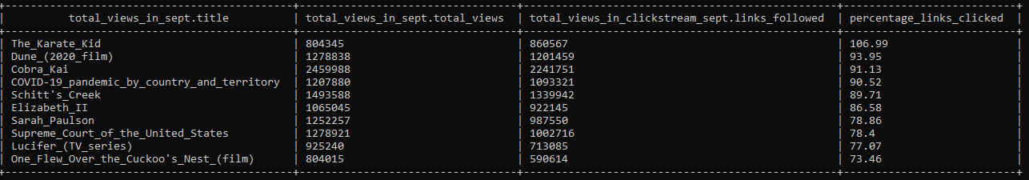
Top 10 Articles with Highest Proportion of Links Followed

Slide 7
What series of Wikipedia articles, starting with Hotel California, keeps the largest fraction of its readers clicking on internal links?
To find out, I query the next higher link in the chain starting with Hotel California. On this first time, ‘Hotel California’ is the URL to request. I get back the URL with the highest number of clicks from this origin. The new article is then set at the original requester, and the cycle repeats.
Here’s the table I used to generate the first link in the chain.

Slide 8
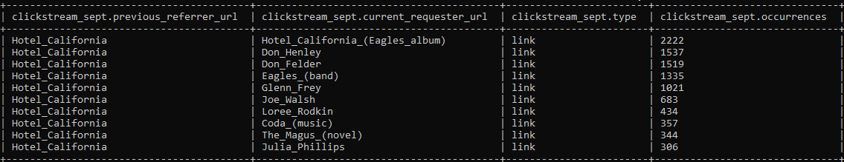
Top 10 Followed Articles From “Hotel_California”

Slide 9
First 5 Links From Hotel California
These are the first 5 iterations of this link following “Hotel California”.
Hotel_California_(Eagles_Album) (2222)
The_Long_Run_(album) (2127)
Eagles_Live (1333)
Eagles_Greatest_Hits,_Vol._2 (1136)
The_Very_Best_of_the_Eagles (996)
An interesting future application would involve applying Spark to find the full chain. This implementation would not retain the acyclic nature of traditional Hive MapReduce.

Slide 10
What is a Wikipedia article that is relatively more popular in the UK, the US, and Australia?
I ended up making a lot of simplifying assumptions in this question.
I reasoned that pages with more revisions were relatively more popular during their normal business hours, which I define on the following slide.These were UTC times, and I manually counted some point times for three articles I selected purposefully.

Slide 11
Definition of Peak Times for Question #5
On the following slides, I present some tables with colored boxes.
In green are Australian peak times, defined as 20:00 UTC to 04:00 UTC.
In red are US peak times, defined as 04:00 UTC to 10:30 UTC.
In yellow are UK peak times, defined as 10:30 UTC to 17:00 UTC.
In pink are other times left out, defined as 17:00 UTC to 20:00 UTC.

Slide 12
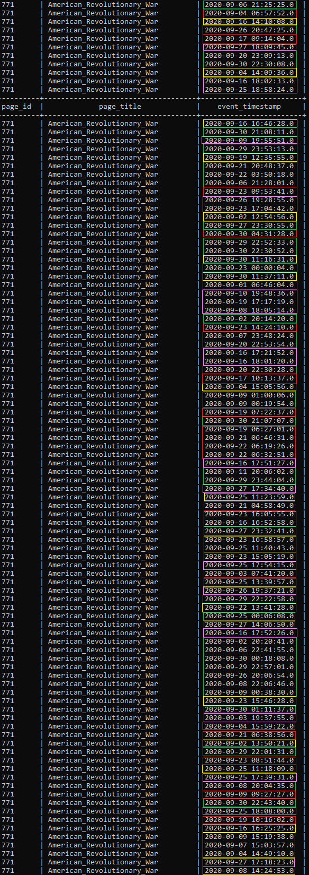
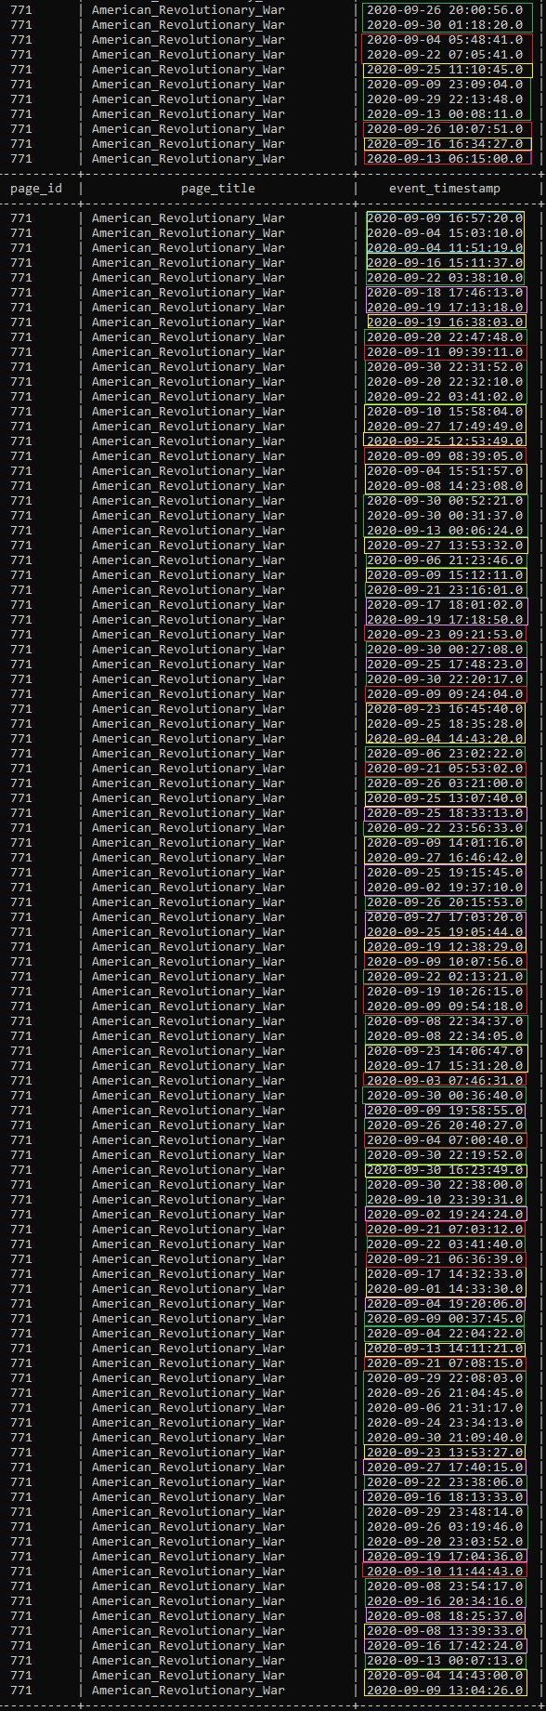
To the left is the table of all revision times for the article American_Revolutionary_War that took place in September 2019.
There are 80 times highlighted in green, 46 in red, 56 in yellow, and 37 in pink. As such, I concluded that the article American_Revolutionary_War was relatively more popular in Australia compared to the UK and America.
However, there is a high degree of uncertainty due to the times that fell outside of peak hours!

Slide 13
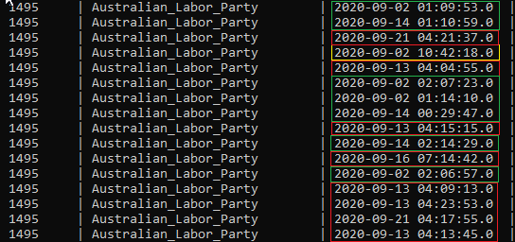
To the left is the table of all revision times for the article Australian_Labor_Party that took place in September 2019.
There are 7 times highlighted in green, 8 in red, 1 in yellow, and none in pink. As such, I concluded that the article Australian_Labor_Party was relatively more popular in America compared to the UK and Australia.

Slide 14
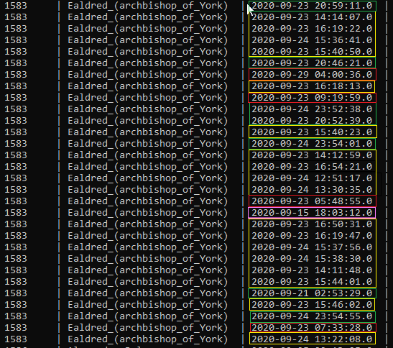
To the left is the table of all revision times for the article Ealdred_(archbishop_of_York) that took place in September 2019.
There are 7 times highlighted in green, 4 in red, 18 in yellow, and 1 in pink. As such, I concluded that the article Ealdred_(archbishop_of_York) was relatively more popular in the UK compared to America and Australia.

Slide 15
How many users will see the average vandalized Wikipedia page before the offending edit is reversed?
I assumed that all revision events in the edits data was activity towards reverting vandalism. In reality, there could be many reasons why articles are revised.
I then counted the total number of revision events (330,496) and the total number of views across all pages (6,660,118,635) in September of 2019. By dividing the total number of views by the total number of revision events, I found that roughly 20,152 users on average saw an article before every revision.
The next slide shows the HQL code that I wrote for this query.

Slide 16
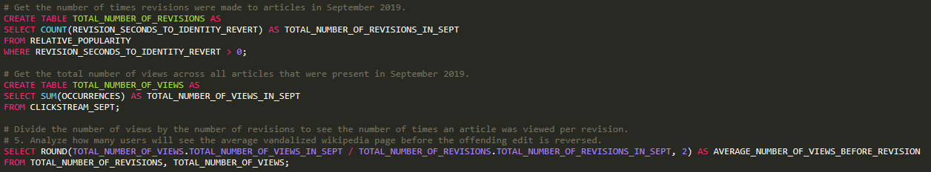
HQL: Average Views Before Vandalism Reverted

Slide 17



Tables and Internal Representation

Slide 18
Significant Limitations to Consider
The given average number is likely inaccurate, due to 2 major factors - activity from users and accuracy of data.
Many articles on Wikipedia are likely never vandalized and/or never revised. Likewise, many articles are frequently viewed, revised, and have high activity. Regarding data, I had very low confidence in the data that Wikipedia itself supplies - many “revision_seconds” records are in the positive and negative billions. Any analysis on this data is likely inaccurate and can’t really be taken too seriously.
Given better data, an interesting future experiment could be to see the bottom quartile (25th), median, and top quartile (75th) percentile as they relate to page views and revision activity.

Slide 19
What were the most popular articles in September 2019?
I was interested in finding out the most popular 10 articles on Wikipedia (en and en.m) during September 2019. Curiously, it ended up being - (dash), which we made a point of discussing in class. It got 7,171,434,364 views!
That’s 7 billion, 171 million, 434 thousand, 364 views - a lot!
The following table shows the top 10 most viewed pages in September 2019.

Slide 20
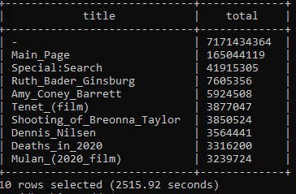
Top 10 Followed Viewed Articles in September 2019

Slide 21
Thanks for watching! Do you have any questions?

