Slide 1
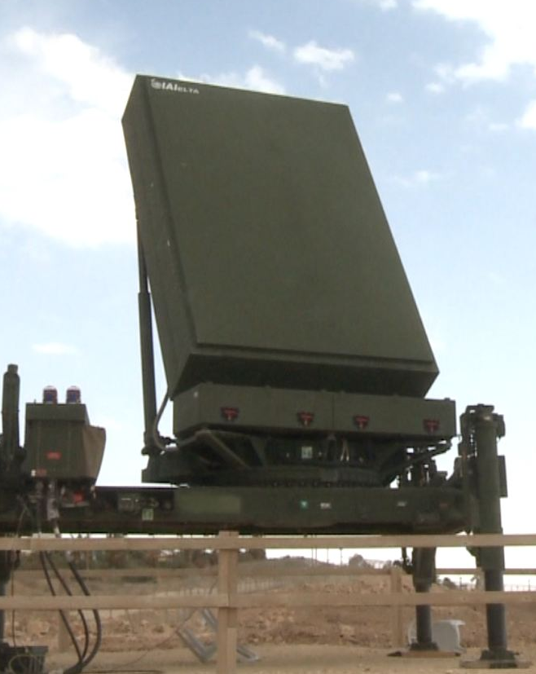
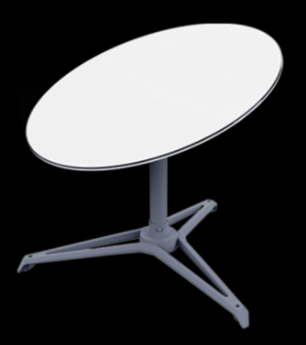
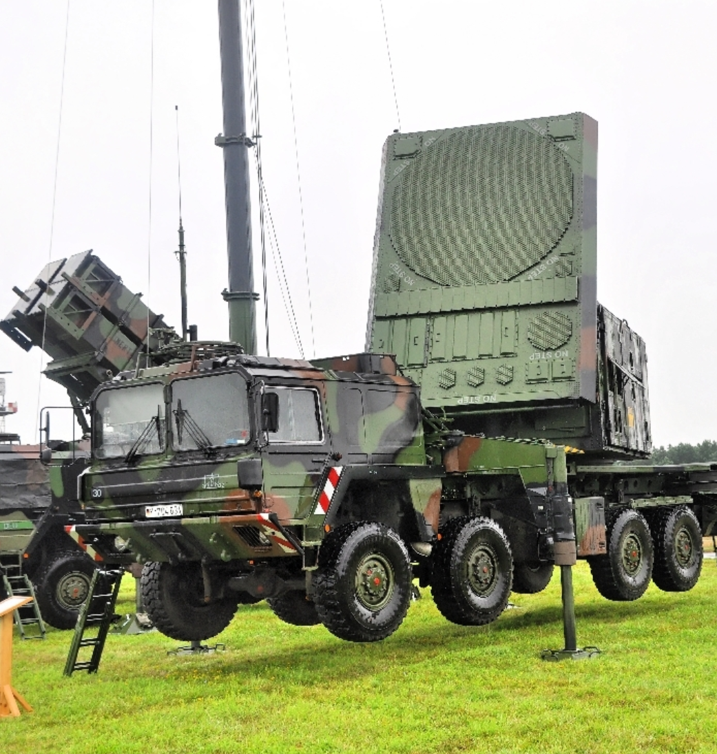
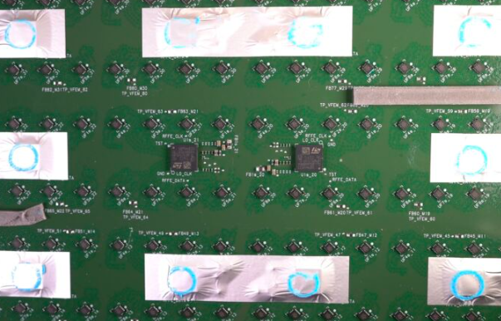
Subarray
Raytheon’s MIM-104 Patriot Radar
(PESA/Analog/Traditional Array)
~1969
ELM-2084 Israeli Multi-Mission Radar
(AESA/Fully Digital Array)
~2005
Starlink User Terminal, aka “Dishy”
(Hybrid Array)
~2022

