Slide 1
Models for Infinite Dimensions
April - 8 - 2022
Bella Wu
Kim
Lilo Yeh
Nick Leu
William Lin

Slide 2
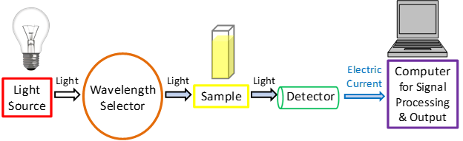
Project Motivation
Analyzing high-throughput experimental spectra is almost daily basis for scientists and engineers
Build deep learning model on functional data

Slide 3
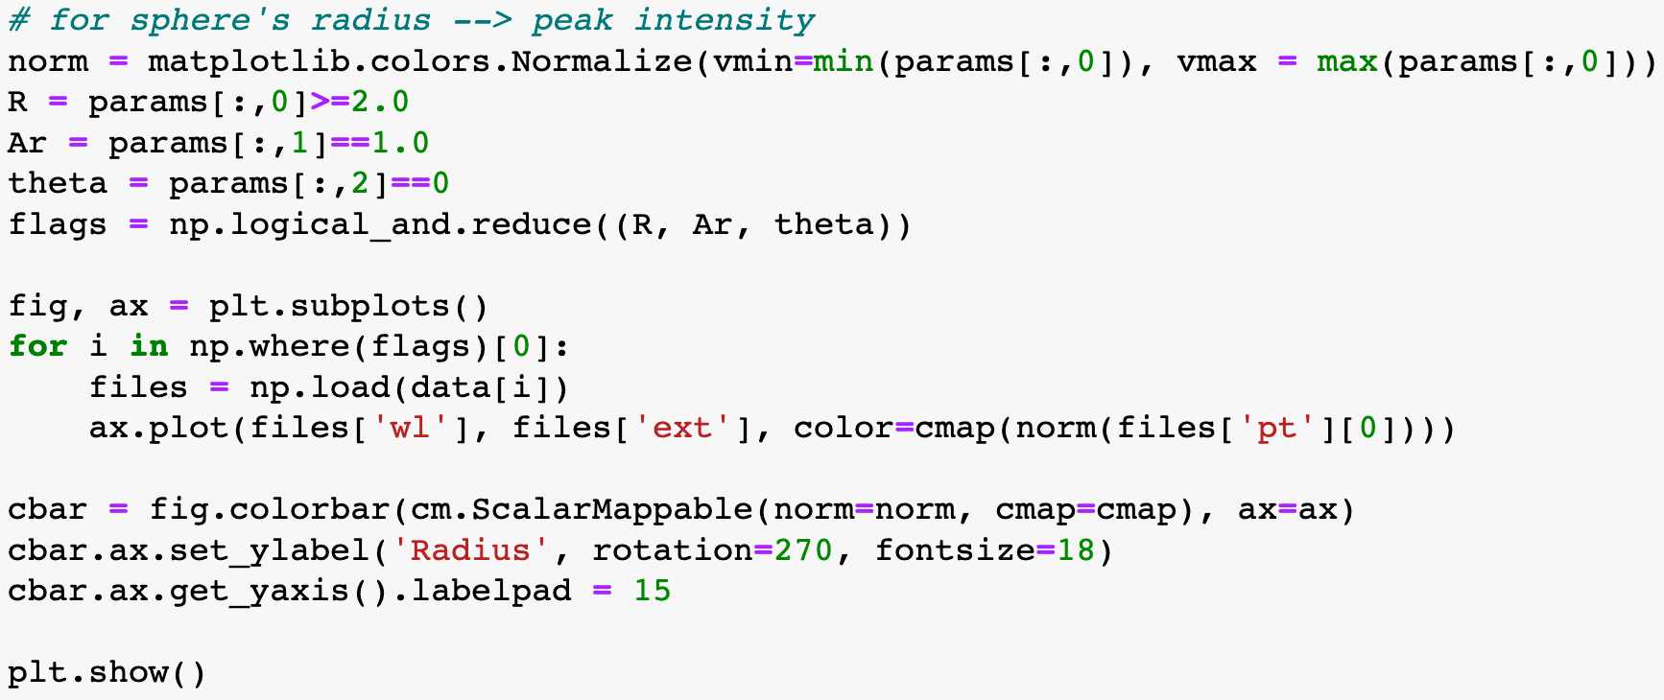
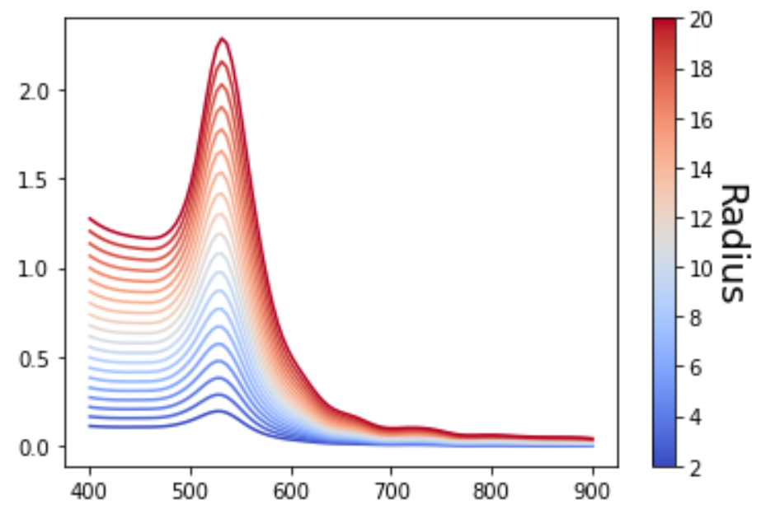
Datasets
In-house moderated physics-based simulators
Experimentally collected and published by Pozzo group
Notes:
simulated data: we know what to expect as an end product when we apply the proposed framework to the simulated datasets. Since this is an unsupervised method, we need that, in order to assess if the method is doing what we want to do.

Slide 4
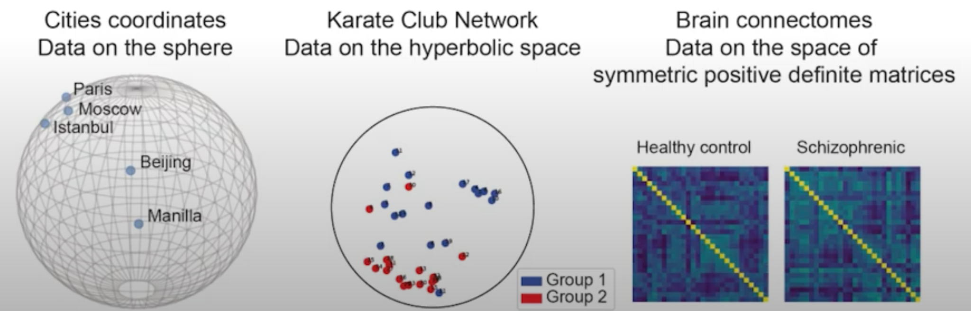
Geomstats
Computing with Data on Manifolds
Notes:
There are intuitive and practical advantages for modeling inputs, outputs and parameters on manifolds. First, computing on lower dimensional space leads to manipulation fewer degrees of freedom, which can potentially imply faster computations and less memory allocation.
Non-linear degrees of freedom that arise in a lower dimensional space often make more intuitive sense : cities on the earth are better localized giving their longitude and latitude their manifold coordinates than giving their position x,y,z in the 3D space

Slide 5

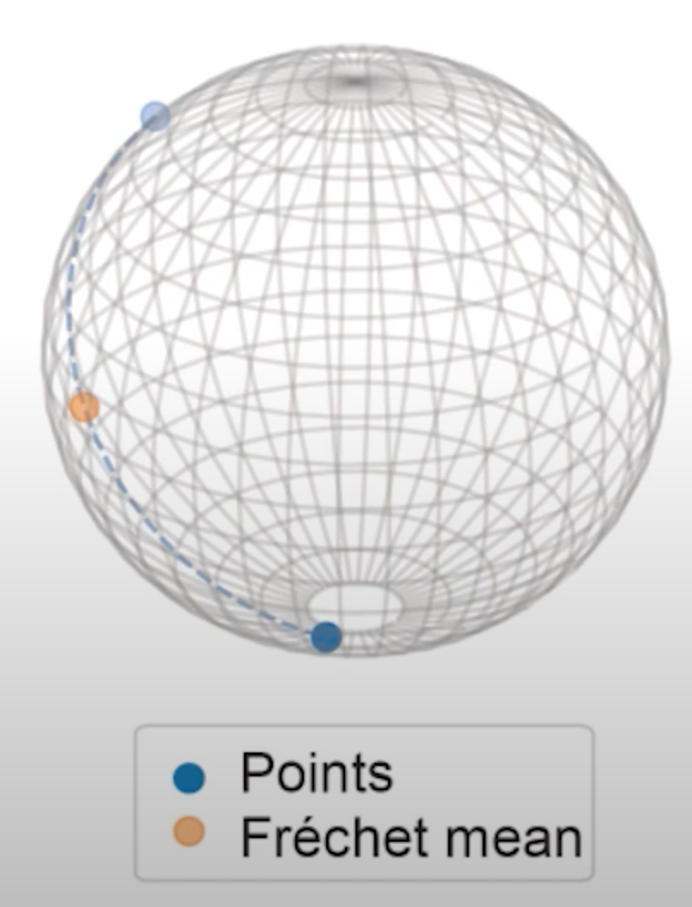
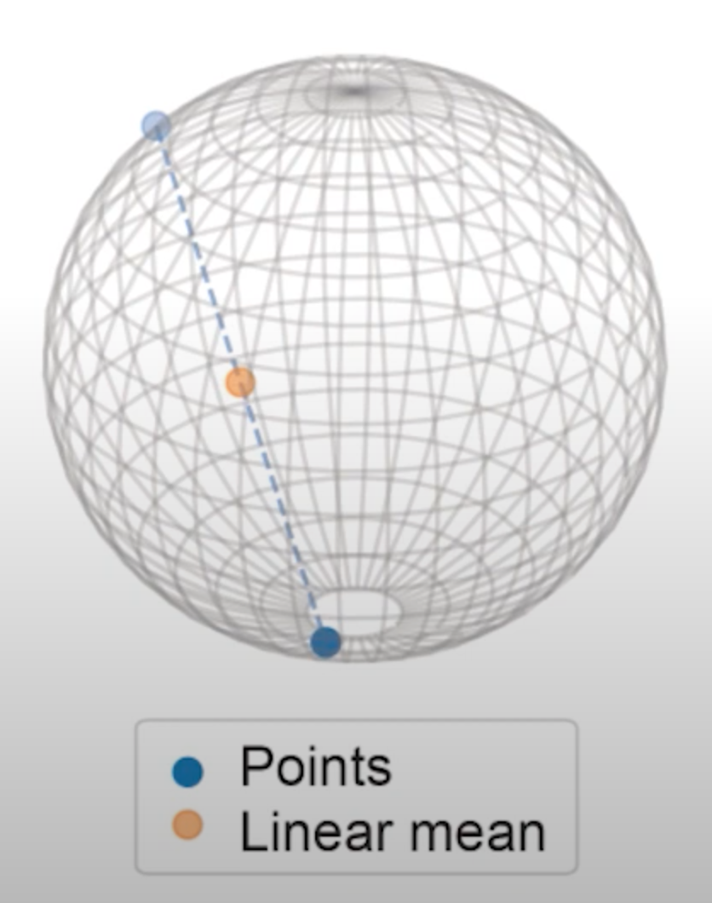
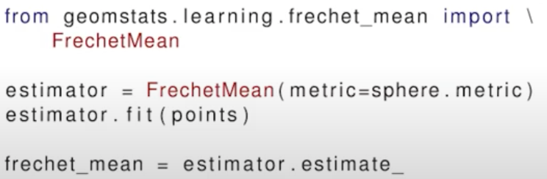
Why Geomstats : Example of mean
Definition of the mean indicate it’s linear
Definition of a manifold : space that can be curved : non-linear
Generalized definition: Frechet mean
Notes:
Take a very simple algorithm , the calculation of mean, as an example .
linear mean of data on a manifold does not necessarily belong to the manifold.
Use the definition of Frechet mean the mean value belongs to the manifolds. If we can generate mean we can surely generalize other learning algorithms.

Slide 6
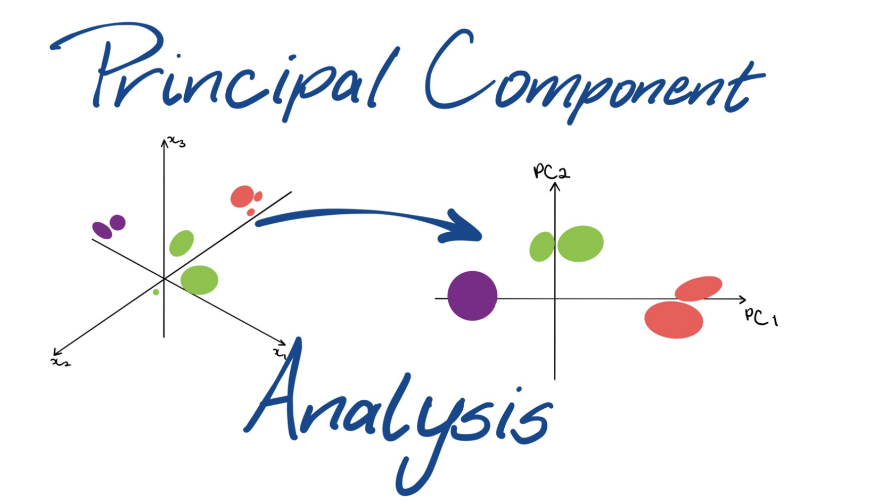
Principle Component Analysis
Multivariable PCA
Fuctional PCA
Tangent PCA

Slide 7
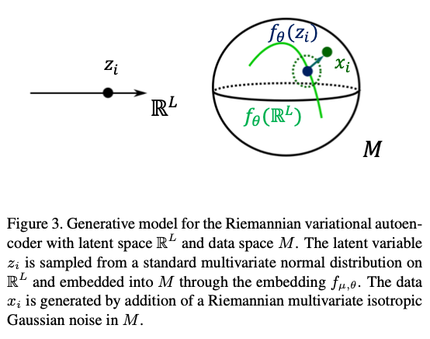
Variational Autoencoders
Riemannian Variational Autoencoders
An intrinsic generalization of VAE for data on Riemannian manifolds and an extension of probabilistic principal geodesic analysis to non-geodesic submanifolds

Slide 8

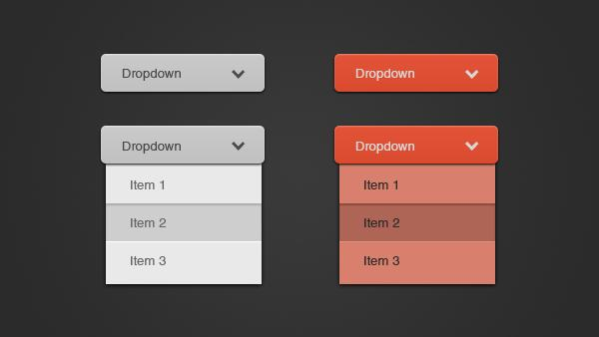
User Interface
Not everyone knows Python

