Slide 1
Title: "The Latest Progress of Research on the Social Risks and Regulation of International Artificial Intelligent in Medical Treatment Based on CiteSpace Method”
CSE438 : Task 2
Paper review by,
Name: Humayra Binte Jamal
ID: 20101591
ID: 20101591

Slide 2
Introduction
The document is from the "2020 IEEE Conference on Telecommunications, Optics, and Computer Science (TOCS)" held in Shenyang, China.
It addresses the application of AI intelligent technology in medical treatment, specifically focusing on social risks and regulations.
The study analyzes the literature landscape from 2000 to 2019, with a significant increase in publications from 2018 onwards.
The paper presents a ranking of the top 10 periodicals related to social risks and regulation in AI medical applications.
Key emphasis is given to "BMC MEDICAL ETHICS" as the leading periodical, focusing on biomedical research, clinical practice ethics, and open access availability.

Slide 3
Research Objectives
Literature Analysis: Conduct a comprehensive analysis of literature from 2000 to 2019, focusing on the social risks and regulation of AI in medical treatment.
Publication Trends: Explore the evolution of publication trends, noting a significant increase from 2018 onwards.
Periodical Ranking: Rank and identify the top 10 periodicals contributing to the field, with a spotlight on "BMC MEDICAL ETHICS."
Ethical Considerations: Emphasize the importance of ethical considerations in AI applications within biomedical research and clinical practice.
Methodology Exploration: Employ co-citation analysis and co-word analysis to delve into the internal structure of subject or theme research.
Thematic Clusters: Identify and analyze thematic clusters, including but not limited to robot therapists, genetic testing, ethical dilemmas, and standardization of AI medical devices.

Slide 4
Data Retrieval and Analysis
Data Source: Core set database of Web of Science (WOS) used for search and retrieval.
Retrieval Formula: Formulated to include keywords related to ethical issues, moral standards, supervision path, medical devices, medical artificial intelligence, artificial intelligence robot, social risk, and legal regulation.
Retrieval Parameters: Limited to English language, article type, and specified indices (SCI-EXPANDED, SSCI, CPCI-S, CPCI-SSH, CCR-EXPANDED, IC) from 2000 to 2019.
Retrieval Outcome: 789 literature records retrieved, followed by manual theme-based search, resulting in 128 related academic papers.
Analysis Method: Utilized CiteSpace 5.0 R4 SE software for visual analysis, generating virtualization maps for authors, organizations, nations, periodicals, co-cited literatures, and keywords.
Visualization Maps: Drawn to comprehensively analyze research hotspots related to social risks and regulation of AI technology in medical treatment, predicting the latest development trends.

Slide 5
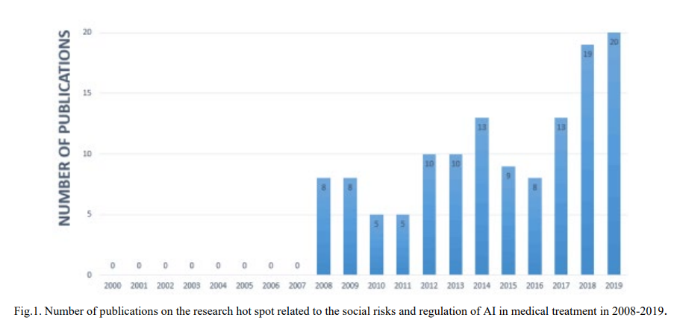
Key Findings
Publications (2000-2019): 128 papers, notable increase in 2018-2019.
Top Journals: BMC MEDICAL ETHICS, JOURNAL OF MEDICAL INTERNET RESEARCH stand out.
Country Contributions (2008-2019): USA leads, followed by UK, Netherlands, Canada.
Keywords: Focus on ethics, risk, informed consent, privacy, and AI-related themes.
Hot Spots (Clusters): Genetic testing-law, ethical dilemmas, and robot therapists in focus.
Authors (2008-2019): McCarty (USA) prolific; contributions from multiple countries.
High-Impact Periodicals: BMC MEDICAL ETHICS, JOURNAL OF MEDICAL INTERNET RESEARCH influential.
Research Trends (Timeline Map): Evolution: genetic testing, big data, ethical dilemmas, nanoscience applications.
Standardization Efforts: Global initiatives by ISO, IEC, ITU, IEEE, and FG-AI4H.

Slide 6
Limitations and Future Works
Limitations:
Limited Research Results: Acknowledges the scarcity of research results specifically focused on "social risks and regulation of AI + medical application."
Sparse Literature Retrieval: Points out the challenge in retrieving relevant literature, indicating only one publication found through the World of Science (WOS) database.
Future Works:
Call for further exploration in the neglected area.
Investigate ethical dynamics in AI-aided doctor-patient relationships.
Address legal and ethical challenges in master-slave and cooperative AI-medical interactions.
Examine the impact of EU's GDPR on AI in medical treatment.
Analyze global perspectives on AI in medical treatment regulations.
Monitor thematic cluster evolution for emerging trends in AI and medical treatment.

Slide 7
Conclusion
Recognizes limited research on "social risks and regulation of AI + medical application."
Highlights scarcity of literature, with only one WOS publication.
Urges further exploration to bridge the research gap.
Stresses the significance of ethical considerations in AI-aided medical treatment.
Recommends ongoing research on ethical reorganization and legal challenges.
Advocates studying GDPR impact on AI in medical treatment.
Calls for a global analysis of AI regulations in medical contexts.
Suggests continuous monitoring of thematic clusters for emerging trends.

Slide 8
THANK YOU

