Slide 1
Task 5: A Comparative Analysis of Machine Learning Models for Cardiovascular Disease Classification
Riza Asmat Mila- 20101590
Humayra Binte Jamal- 20101591
Sumya Afroj- 19301164
Maimuna Rahman-20101457
ST- Mehnaz Ara Fazal
RA- Md Humaion Kabir Mehedi

Slide 2
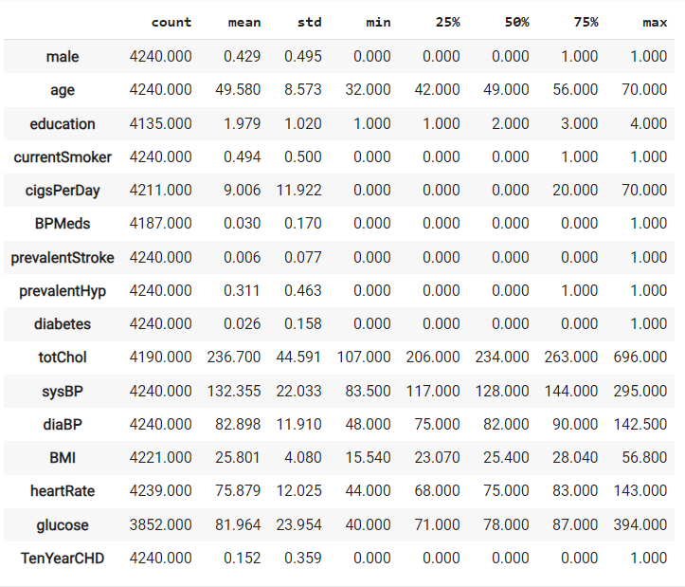
Data Analysis
To generate descriptive statistics of the Data Frame including statistics like count, mean, standard deviation, minimum, and maximum for each numeric column.

Slide 3
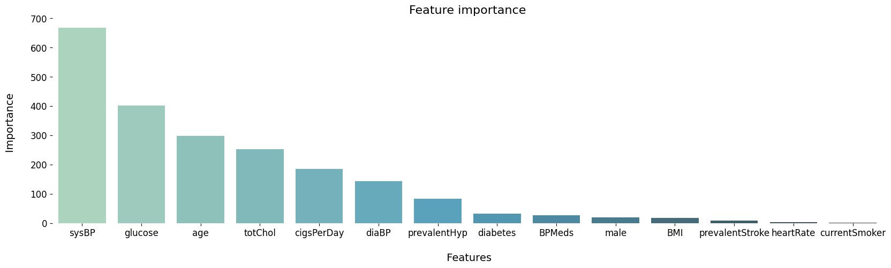
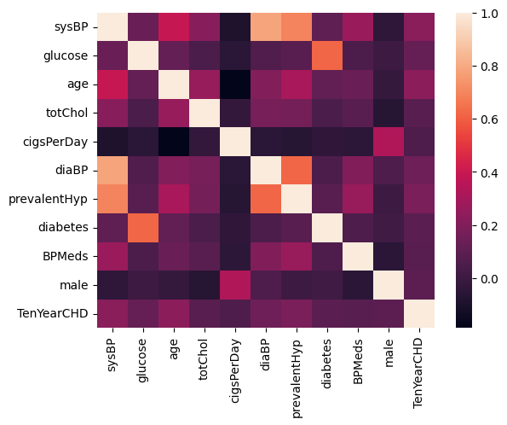
Feature Selection: To identify and extract the top 10 most relevant features for predicting heart disease risk
Correlation matrix: To explore relationships between different features

Slide 4
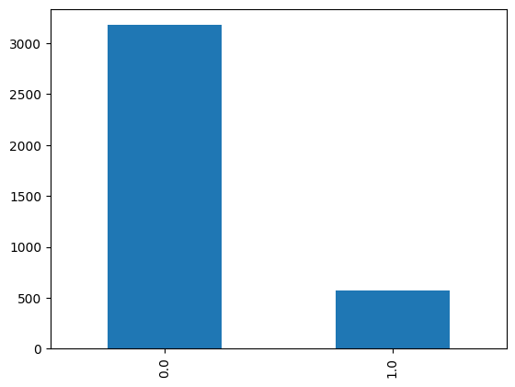
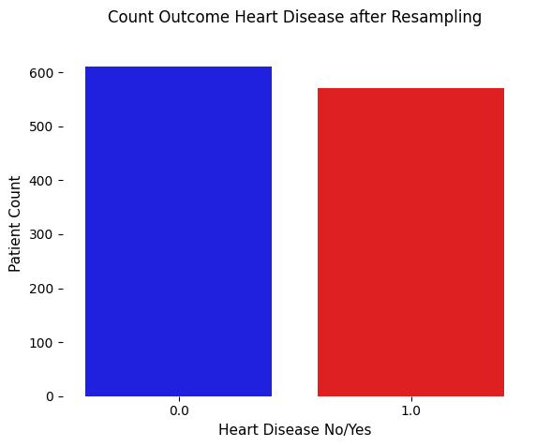
Fig: Undersampling( before vs after )
Undersampling: To solve the issue of an imbalanced distribution

Slide 5
Prototype Implementation
Model Selection:
Each algorithm's characteristics.
Rationale for choosing each model based on its capabilities.
Model Training:
Models trained on preprocessed dataset.
Consideration of age, blood pressure, cholesterol levels, and lifestyle choices.
Evaluation Metrics:
Accuracy: Overall correctness of the model.
Precision: Consistency of positive predictions.
Recall: Model's capacity to collect positive examples.
F1 Score: Balance between precision and recall.

Slide 6
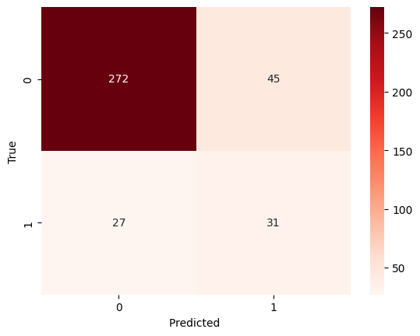
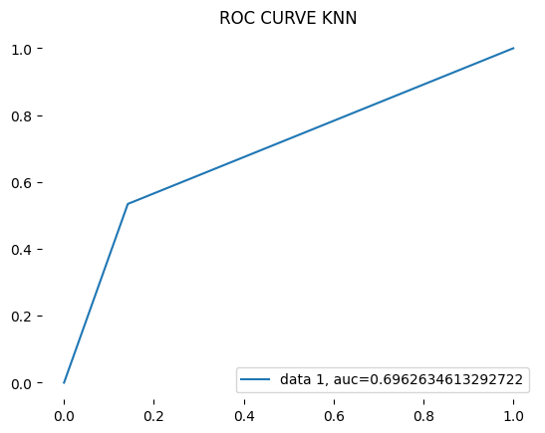
Result Analysis
Best Performing Model:
K-Nearest Neighbors (KNN) with:
Highest accuracy (80.0%).
Most balanced F1 score (46.8%).
Reliable cross-validated accuracy (83.73%).
Comparison with Other Models:
Random Forest and Decision Tree Classifier (DTC) with competitive results.
Multilayer Perceptron (MLP) and Naive Bayes with lower accuracy.
Support Vector Machine (SVM) and Logistic Regression (LogReg) with similar performance.
Additional Insights:
AUC ROC Curve scores to assess classification task performance.
Consideration of trade-offs between precision and recall.

Slide 7
THANK YOU

