Slide 1
Title: "Towards Data-Oriented Hospital Services: Data Mining-based Hospital Management”
CSE438 : Task 1
Paper review by,
Name: Humayra Binte Jamal
ID: 20101591

Slide 2
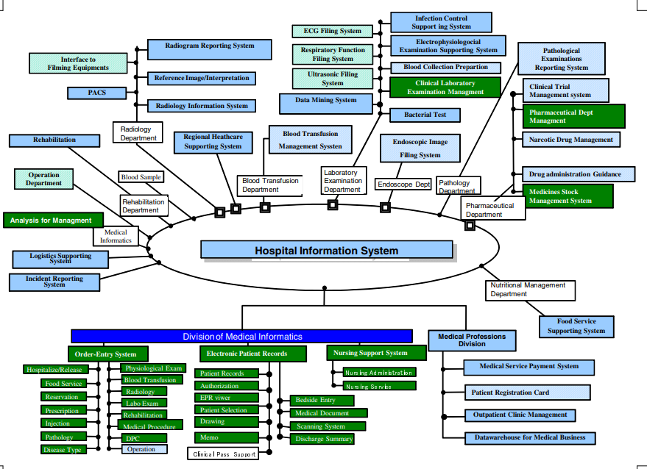
Introduction
The paper explores the evolution of clinical information storage in hospital systems over the past two decades, emphasizing the critical role of information systems encompassing diverse data. Despite rapid progress in electronic patient records, there is a notable gap in discussions about intelligent data reuse beyond the 1990s. The study underscores the potential of intelligent data reuse in providing a comprehensive understanding of university hospital characteristics. The ultimate goal is to demonstrate the power of exploratory data analysis techniques in supporting the long-term management of university hospitals through the effective reuse of stored data.

Slide 3
Research Objectives
Data Exploration:
Apply temporal data mining and exploratory data analysis to hospital management data.
Uncover Insights:
Extract meaningful patterns and insights from the accumulated hospital data.
Reuse of Stored Data:
Emphasize the potential power of reusing stored data for effective hospital management.
Overall Goal:
Provide a powerful tool for the long-term management of a university hospital through intelligent data analysis techniques.

Slide 4
Background
Evolution of Hospital Information Systems:
Electronic storage of clinical information in hospital information systems since the 1980s.
Multifaceted data accumulation, including accounting, laboratory, and patient records.
Significance of Information Systems:
Hospitals dependent on information systems for functioning.
Electronic patient records contribute to efficient information retrieval.
Lack of Data Reuse Discussion:
Despite rapid progress in electronic patient records, detailed discussions on data reuse are lacking.
Limited application of intelligent techniques like data mining and statistical methods until the 1990s.
Human vs. Computer-Based Data Analysis:
Distinction between human data analysis based on experience and computer-based analysis offering cross-sectional insights.
Intelligent reuse of hospital data expected to provide a comprehensive understanding of hospital characteristics.

Slide 5
Methodology
Data Source:
Utilized hospital information systems with a focus on Shimane University Hospital.
Basic Atom in HIS: Order
HIS operates around the basic unit of an "order," conveying medical instructions.
Visualizing Hospital Actions:
Employed exploratory data analysis to visualize and analyze trends in hospital activities.
Examined the temporal behavior of various orders, such as prescriptions, reservations, and records.
Analysis of Clinical Process:
Investigated the clinical process for long-term follow-up patients.
Analyzed trajectories and clusters to understand patterns in hospital actions.
Analysis of Hospital Management Data:
Applied statistical methods, including generalized linear models, to extract knowledge from Chiba University Hospital datasets.
Explored the relationships between NHI points, length of stay, and various factors.
Tool: Exploratory Data Analysis
Utilized exploratory data analysis techniques to gain insights from the hospital information system.

Slide 6
Analysis of Hospital Management Data
Data Source:
Combined discharge summaries and accounting information for a comprehensive analysis.
Variables Analyzed:
Explored relationships among NHI points and items in discharge summaries, including gender, age, occupation, outcome, length of stay, and diseases.
Correlation Findings:
Identified a strong correlation between the length of stay and NHI points, suggesting its significant impact on treatment costs.
Generalized Linear Model (GLM):
Applied GLM to study the influence of various factors on NHI points, including outcome, treatment method, major ICD-9 divisions, and categorized length of stay.
Profitability Analysis:
Explored the profitability of the university hospital in a quantitative manner.

Slide 7
Limitations and Future Work
Limitations:
Limited detailed discussion on data reuse despite two decades of electronic storage.
Initial application of intelligent techniques like data mining and statistical methods in the 1990s.
Lack of extensive exploration of electronic patient record data reuse.
Future Work:
Emphasizes the potential for more intelligent techniques in data reuse.
Proposes further analysis and exploration of factors influencing NHI points.
Suggests incorporating additional information into the hospital information system for more comprehensive analysis.

Slide 8
Conclusion:
Successful application of exploratory data analysis.
Demonstrated the power of reusing stored data for long-term hospital management.
Identified a strong correlation between length of stay and NHI points.
Highlighted profitability analysis potential through data integration.
Emphasized the need for advanced models and additional data integration.
Provides a foundational framework for quantitative hospital management analysis.

Slide 9
THANK YOU

