Slide 1
Mahfuza Maam ERP

Slide 2
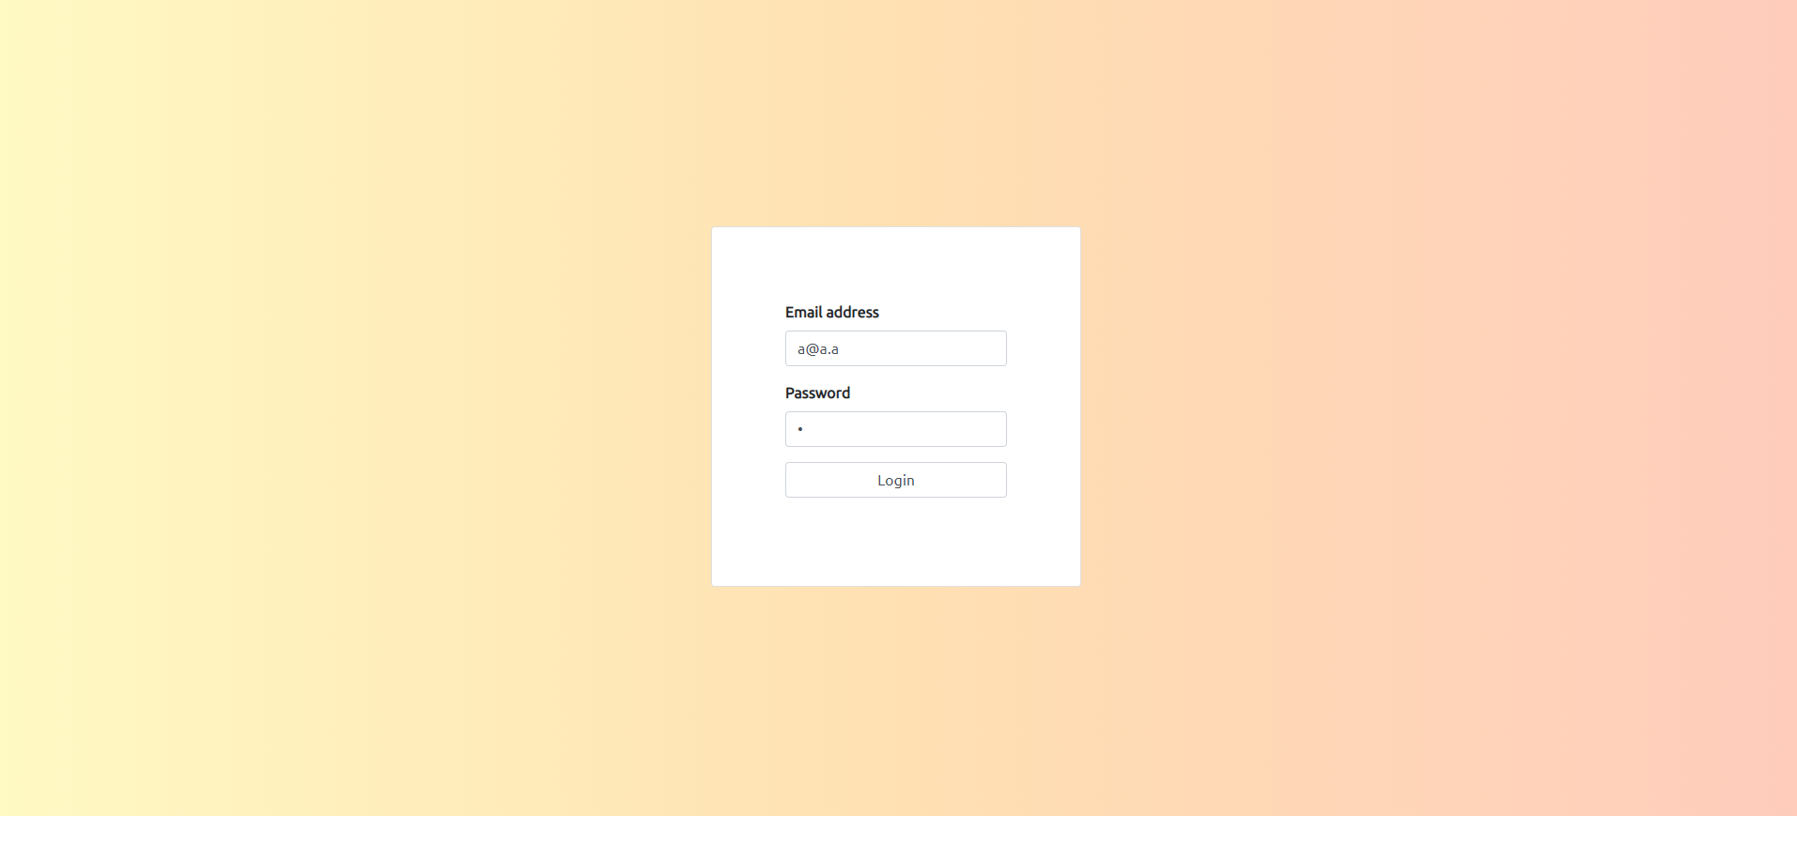
Login
Login for admin:
Email Address: a@a.a, Password: a
Email Address: admin2@admin2.admin2, Password: admin

Slide 3
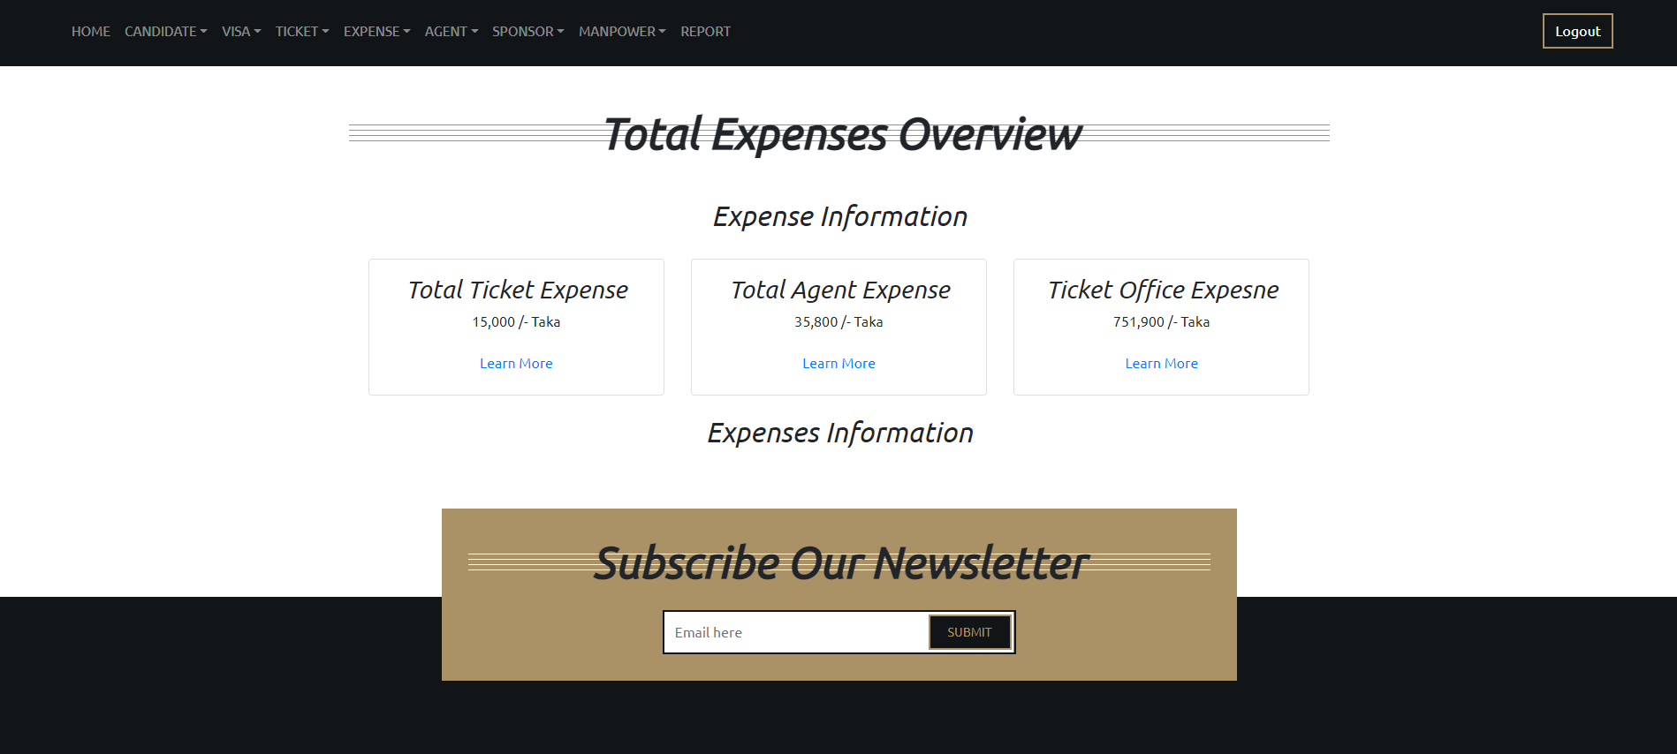
Front Page
Added Three Expense Information
Total Ticket Expense: Shows the sum of all the price of ticket.
Total Agent Expense: Shows the sum of all agent expense.
Total Office Expense: Shows the sum of all office expense.

Slide 4
Before Adding Candidate
Before adding candidate passport information three information have to be inserted first.
Number 1: Add Agent
Number 2: Add Sponsor
Number 3: Add Manpower Office
After adding these three fields they can be found in their respective list dropdown Menu.

Slide 5
Agent Expense
Agent Expense can be added for each agent individually.
Pay Date is for the date of Advance Payment.
Date for the each expense will be generated automatically and the date will be current date.
After adding expense details, any expense information can be found in the “Agent Expense List” dropdown from the “Agent” menu.

Slide 6
Adding Candidate
Candidate can be added by the “Add New Candidate” dropdown from “Candidate” menu.
The “Date of Birth” is calculated so that, only the date for age between 25 and 38 can be entered.
After selecting “Issue Date”, the minimum date for “Expiry Date” will be the date from one year of the “Issue Date”.
“Departure Date” and “Arrival Date” are optional field.
Any one of the field “Agent” or “Office” must be filled.
Filling “Agent” will make the candidate as normal.
Filling “Office” will make the candidate as “personal” and will be highlighted in the candidate list.
If “Police Verification” and “Passport Size Photo” are provided then their corresponding files have to be entered either as “pdf” or as “jpeg”.
After Submitting with all the information, each candidate can be found in the “Candidate List” dropdown from the “Candidate” menu.

Slide 7
Candidate List
In the “Candidate List” table three columns are calculated automatically.
DOB: It is calculated in years.
Passport Validity: It is calculated in “Years, Months and Days”
Amount of Experience: It is calculated in “Years, Months and Days”.
If “Amount of Experience” is less then one year, then “Training Card” has to be submitted form the “Training Card” column.

