Slide 1

TypeScript Fundamentals
.NET CORE

Slide 2
The goal of TypeScript is to be a static typechecker for JavaScript programs - in other words, a tool that runs before your code runs (static) to ensure that the types of the program are correct (typechecked).
HTTPS://WWW.TYPESCRIPTLANG.ORG/DOCS/HANDBOOK/INTRO.HTML#ABOUT-THIS-HANDBOOK

Slide 3
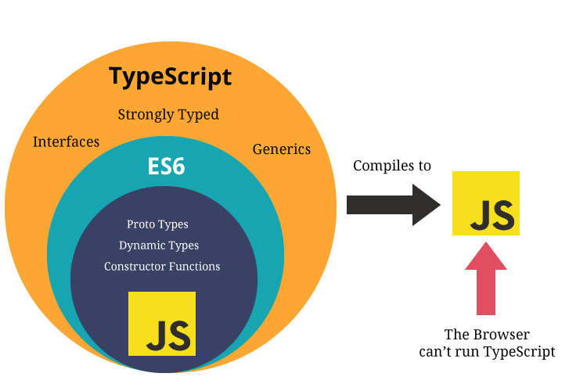
TypeScript – Overview https://www.typescriptlang.org/docs/handbook/typescript-from-scratch.html#typescript-a-static-type-checker https://angular.io/guide/glossary
Detecting errors in code without running it is referred to as Static Checking.
Determining what’s an error (and what’s not) based on the kinds of values being operated on is known as Type Checking.
TypeScript is a Static Type Checking language. It checks a program for errors before it’s run and does so based on the types of the values.
TypeScript is a Superset of JavaScript. All JavaScript syntax is legal within a .ts (TypeScript) file.
Remember that all JS questions also apply to TS.

Slide 4
TypeScript – Compiling vs Transpiling https://www.stevefenton.co.uk/2012/11/compiling-vs-transpiling/ https://code.visualstudio.com/docs/typescript/typescript-compiling https://www.typescriptlang.org/play
TypeScript is a typed superset of JavaScript that compiles to plain JavaScript. TypeScript enforces more strict typing and other rules that make JS more developer friendly. It offers classes, modules, type checking, and interfaces. TypeScript must be transpiled into JavaScript code.
What’s the difference between “Transpiling” and “Compiling”?
Compiling is the general term for taking source code written in one language and transforming into another
Transpiling is a specific term for taking source code written in one language and transforming into another language that has a similar level of abstraction, as opposed to a lower level language like IL.
Both compilers and transpilers can optimize the code as part of the process.
Click here to see TS and JS compared.

Slide 5
TypeScript – Types https://www.typescriptlang.org/docs/handbook/typescript-from-scratch.html
TypeScript adds rules about how different types can be used. TS infers the types of values and enforces these types throughout the program.
For example, JS allows division by an empty set while TS will not. The below example in JS will print NaN, but TS will give an error.
TypeScript’s type system rules are designed to allow ‘correct’ programs while catching as many common errors as possible.
When you move code from a JavaScript file to a TypeScript file, you might see:
type errors that are legitimate problems with the code, or
TypeScript is being overly conservative and the code is correct.

Slide 6
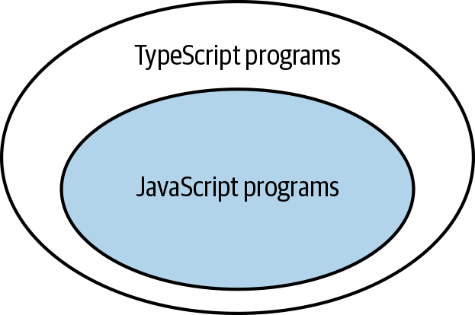
TypeScript – Erased Types https://www.typescriptlang.org/docs/handbook/typescript-from-scratch.html#erased-types
TypeScript (TS) preserves the runtime behavior of JavaScript (JS).
TS never changes the runtime behavior of JS code.
TS’s type system is erased on compilation. There is no persisted type information in the resulting JS code.
TS never changes the behavior of your program based on the types it inferred, so the type system has no bearing on how a program works once it’s running.
TS uses JS’s libraries so there’s no additional TS-specific framework to learn.

Slide 7
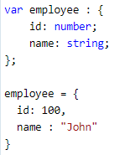


TypeScript Type Annotations https://www.tutorialsteacher.com/typescript/type-annotation
One of the main benefits of TypeScript over JavaScript is that you are allowed to explicitly specify the type of a variable. This is done with Type Annotations.
The Type Annotation is placed after the name of the variable (or parameter, property, etc)
TypeScript includes all the primitive types of JavaScript plus adds some new ones.

Slide 8
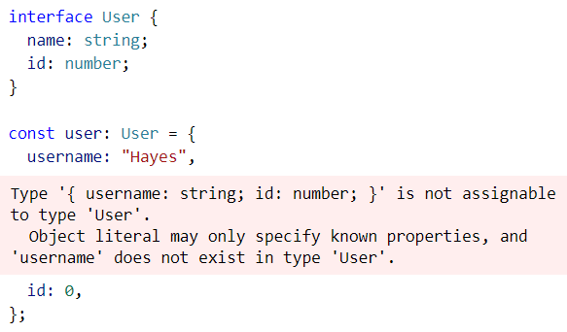
Type Definitions https://www.typescriptlang.org/docs/handbook/typescript-in-5-minutes.html#defining-types
TS infers most types
You can enforce strict typing by using an interface to declare a type of object. TS will enforce that typing.
TS supports classes and OOP.
An interface declaration can also be extended by classes and interfaces.
There are two syntaxes for building types: interface and type.
Usually, you will use interface.
Use type when you need specific features.

Slide 9
TypeScript – Primitive Types https://www.typescriptlang.org/docs/handbook/typescript-in-5-minutes.html#defining-types https://www.typescriptlang.org/docs/handbook/basic-types.html
While using all JS’s data types, TS extends JS’s types with a few of its own.
Type | Purpose
any | Allow any type
unknown | Ensure someone using the type declares what the type is. Unknown is the type-safe counterpart of any.
never | Represents the type of values that never occur. EX. never is the return type for a function expression that always throws an exception or one that never returns.
void | a function which returns undefined or has no return value

Slide 10
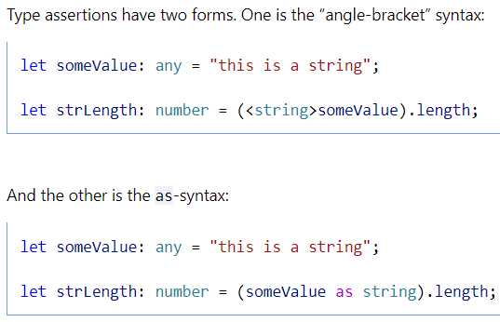
TypeScript – Type Assertions https://www.typescriptlang.org/docs/handbook/basic-types.html#type-assertions
You can use “Type Assertion” to assert the type of your data.
Type Assertion performs no special checking or restructuring of data.
It has no runtime impact and is used purely by the compiler.

Slide 11
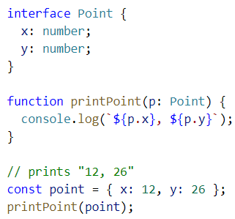
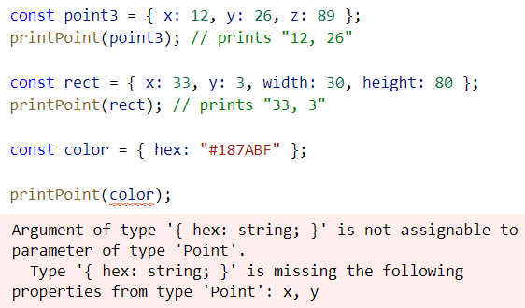
TypeScript – Structural Type System https://www.typescriptlang.org/docs/handbook/typescript-in-5-minutes.html#structural-type-system
A core principle of TypeScript is that type checking focuses on the shape (structure) that objects have. This is called “Structural Typing” (or sometimes “Duck Typing”). The compiler only checks that at least the variable names required are present in args passed and that they match the types required.
1. Declare an interface object.
Prints 2/3
Prints 2/4
2. Define a function that takes that object.
ERROR Result
3. Instantiate the object. Invoke the function.

Slide 12
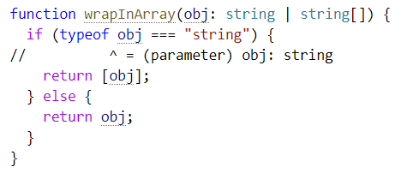
TypeScript – Composing Types https://www.typescriptlang.org/docs/handbook/typescript-in-5-minutes.html#composing-types
TypeScript understands how code can change what type a variable could be. You can use checks to verify the type at runtime and take appropriate action.
Type | Predicate
string | typeof s === “string”
number | typeof n === “number”
boolean | typeof b === “boolean”
undefined | typeof undefined === “undefined”
function | typeof f === “function”
array | Array.isArray(a)
A Union allows you to declare what the type could be.

Slide 13
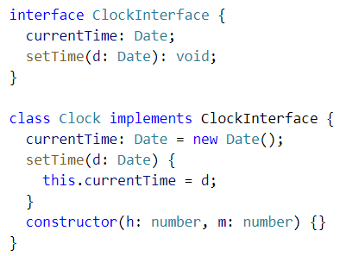
TypeScript Interfaces and Class Types https://www.typescriptlang.org/docs/handbook/interfaces.html#class-types
Interfaces explicitly enforce that a class meets a particular contract for properties and functions.
In TS, Interfaces only describe the public side of the class.

Slide 14
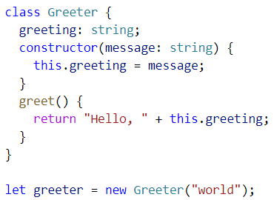
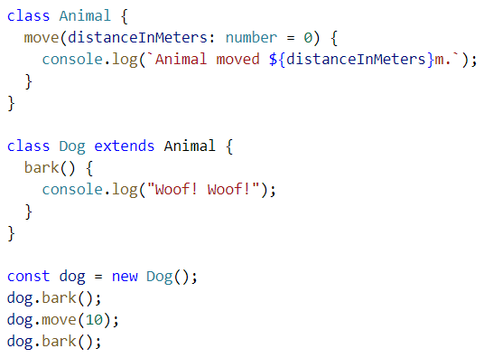
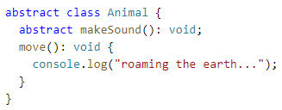
TypeScript Classes and Inheritance https://www.typescriptlang.org/docs/handbook/classes.html
TypeScript developers can use OOP techniques, and transpile them into JavaScript. As in C#, TS Abstract classes may only be inherited, not instantiated directly.

Slide 15
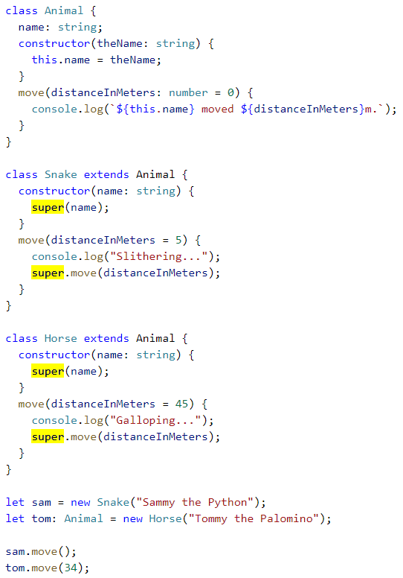
TypeScript Inheritance https://www.typescriptlang.org/docs/handbook/classes.html#inheritance
Each derived class that contains a constructor function must call super() to execute a constructor of the base class.
Before a property on this is accessed from within a constructor body, super() must be called.
This is identical to JS class inheritance in ES6.

Slide 16
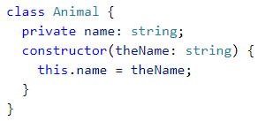

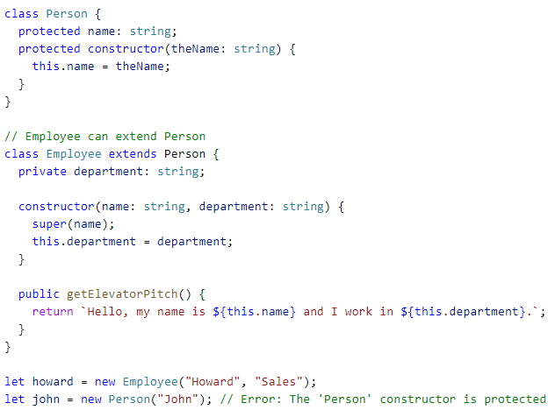
TypeScript – Class Property Modifiers https://www.typescriptlang.org/docs/handbook/classes.html#public-private-and-protected-modifiers
In TypeScript, each class member is public by default.
TypeScript supports the new JavaScript syntax for private fields (with #) and also has its own way to declare a member as being marked private.
Private fields cannot be accessed from outside of their containing classes.
Members declared protected can be accessed from within their class and deriving classes.
A constructor may also be marked protected. This means that the class cannot be instantiated outside of its containing class but can be extended.
Readonly properties must be initialized at their declaration or in the constructor.

Slide 17
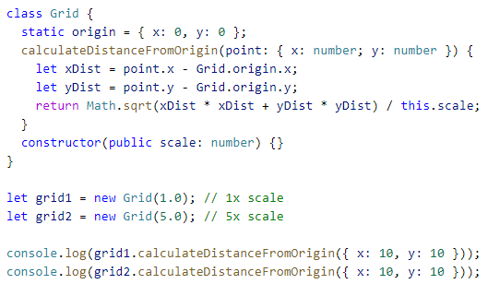
TypeScript – Static Class Properties https://www.typescriptlang.org/docs/handbook/classes.html#static-properties
Static members of a class are visible on the class itself rather than on the instances. Each instance accesses this shared value through prepending the name of the class.

Slide 18
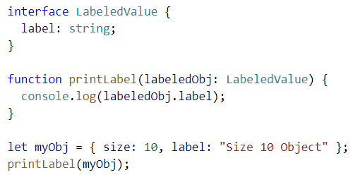
TypeScript Interfaces https://www.typescriptlang.org/docs/handbook/interfaces.html
Here, LabeledValue represents having a single property called label that is of type string.
It is not required to explicitly state that the object passed into a function implements an interface (as in other languages).
In TS, only the objects’ shape matters. If the object passed into the function meets the requirements listed (the shape), it is allowed.
Type checker does not require that properties come in any specific order.
The only requirement is that property names required by the interface must be present* AND have the required type.
*Mark a property optional with ‘?’ at the end of the property name.

Slide 19
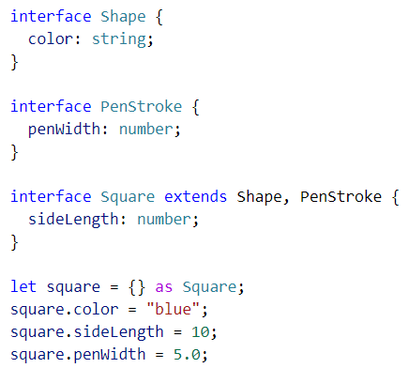
TypeScript – Extending Interfaces https://www.typescriptlang.org/docs/handbook/interfaces.html#extending-interfaces
Classes and Interfaces can extend Interfaces.
This allows you to copy the members of one interface into another interface (or class).

Slide 20
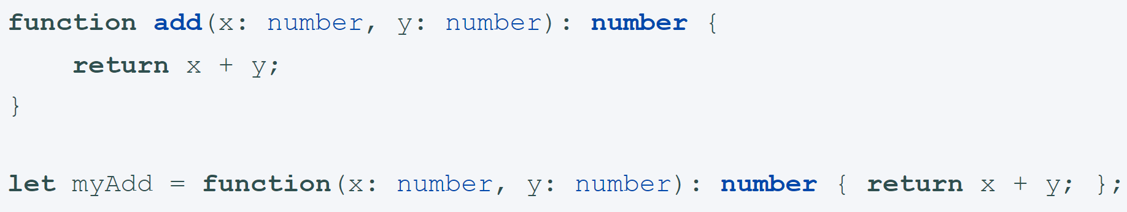
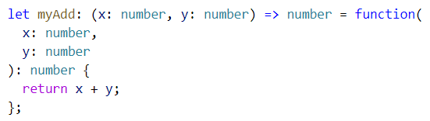
TypeScript Functions https://www.typescriptlang.org/docs/handbook/functions.html
As in JS, TypeScript functions can be named or anonymous functions. They can also refer to variables outside of the function body.
You can/should explicitly type the parameters of the function.
A function’s type has the same two parts: the type of the arguments and the return type. When writing out the whole function type, both parts are required.

Slide 21
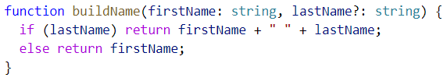


TypeScript Function Param Types https://www.typescriptlang.org/docs/handbook/functions.html#optional-and-default-parameters
In TS, every function parameter is assumed to be required by the function.
Make a parameter optional by placing a ‘?’ behind the parameter name.
Optional parameters must be last.
Give parameters default values with ‘= “value”’.
When the default parameter comes last, it is treated as optional.
Like all ES6 features, rest parameters also work in TS.
Rest parameters are treated as a boundless number of optional parameters. The compiler builds an array of the arguments passed in with the name given after the ellipsis (...). The ellipsis is also used in the type of the function with rest parameters.
Optional parameters
Default parameters
Rest parameters

Slide 22
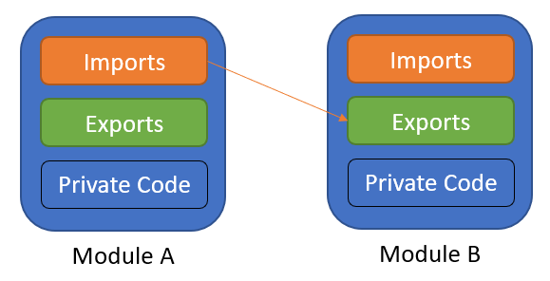
TypeScript Modules https://www.typescriptlang.org/docs/handbook/modules.html
TS shares the JS ES6 concept of Modules. Modules in TS have their own scope. Anything declared inside a module is not visible outside that module unless it is explicitly exported.
To consume a property exported from a different module, it must be imported using an import method.
The relationships between modules are specified in terms of imports and exports at the file level.
In TS, any file containing a top-level import or export is considered a module. A file without any top-level import or export declarations is treated as a script whose contents are available in the global scope (and therefore in modules as well).

Slide 23

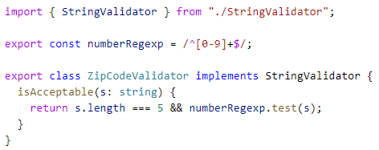
TypeScript - Exporting a Declaration https://www.typescriptlang.org/docs/handbook/modules.html#export
Any declaration (such as a variable, function, class, type alias, or interface) can be exported by adding the export keyword.
First, use the export keyword to make a class, function, or variable available to other modules from within the module (component).
Second, import the class, function, or variable into the module (component) where you want to implement it.

Slide 24
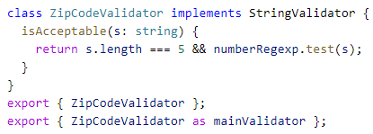
TypeScript - Export https://www.typescriptlang.org/docs/handbook/modules.html#export-statements
Export Statements allow you to rename the statement you want to export.

Slide 25


TypeScript Imports https://www.typescriptlang.org/docs/handbook/modules.html#import
Imports can also be renamed.

