Slide 1

Angular Fundamentals
.NET CORE

Slide 2
Angular is an application design framework and development platform for creating efficient and sophisticated single-page apps.
HTTPS://ANGULAR.IO/DOCS

Slide 3
TS/Angular Workspace SetUp https://angular.io/guide/setup-local https://code.visualstudio.com/docs/typescript/typescript-compiling https://code.visualstudio.com/docs/typescript/typescript-compiling https://angular.io/tutorial/toh-pt0#create-a-new-workspace-and-an-initial-application
Following the steps from here to create your first Angular App.
Make sure you have Node.js with node –v in Command Line. If not, go to nodejs.org to download it.
Install Angular CLI globally with npm install -g @angular/cli in Command Line.
Use ng new my-app-name to create a WorkSpace for your app and install the default Angular starter app.
Press enter to accept the defaults.
ng new installs the Angular npm packages needed.
Navigate in the CLI to your app folder. (cd my-app-name).
Use ng serve ––open (2 dashes) to launch the server and open the browser with the default sample project.
In VS Code, install the Angular Extension Pack to get more features.
Use this Angular Cheat Sheet for reference.

Slide 4
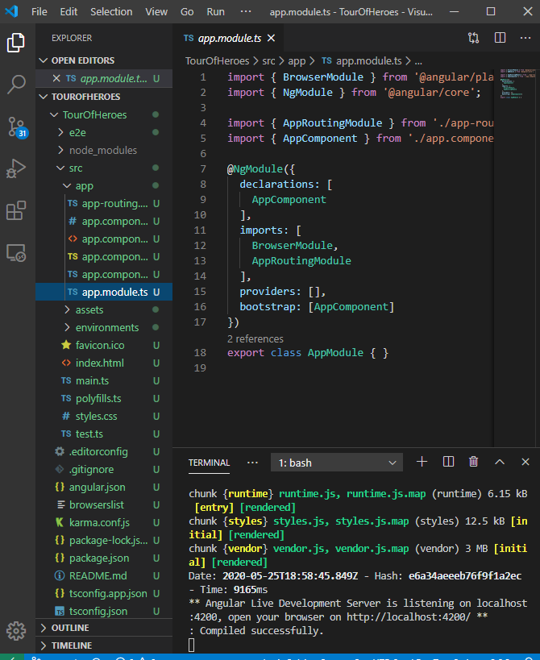
WorkSpace https://angular.io/tutorial/toh-pt0#set-up-your-environment
A workspace contains all the files for one or more projects. A project is the set of files that comprise an app, a library, or end-to-end (e2e) tests.

Slide 5
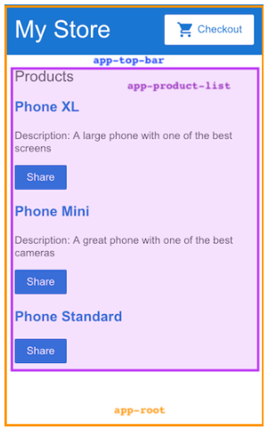
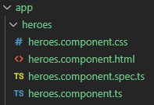
Components https://angular.io/tutorial/toh-pt0#set-up-your-environment https://angular.io/guide/component-interaction
Components are the fundamental building blocks of Angular applications. They display data on the screen, listen for user input, and take action based on that input.
An Angular application comprises a tree of components, in which each Angular component has a specific purpose and responsibility. In this example:
app-root (orange box) is the application shell. This is the first component to load and the parent of all other components. You can think of it as the base page.
app-top-bar (blue background) is the store name and checkout button.
app-product-list (purple box) is the product list that you modified in the previous section.

Slide 6
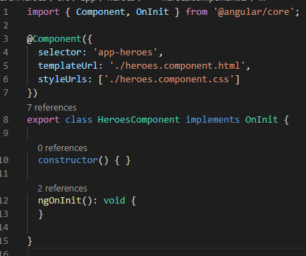
Angular Components https://angular.io/tutorial/toh-pt1#create-the-heroes-component
The CLI creates a new folder for each component and generates three files, .css, .ts, .html, inside it. User either the Angular helper (R-click the app folder) or the command ng generate component [name] to create a new component.
When creating a Component, always import the Component symbol from the Angular core library and annotate the component class with @Component. @Component is a decorator function that specifies the Angular metadata for the component:
The selector name to use for CSS and if importing this component into a .html page.
The relative .html location.
The relative .css location.
The class uses the export keyword. This makes the class available to import by other components.
ngOnInit() is a lifecycle hook. It’s a good place for component initialization logic like getting data from a Service.

Slide 7
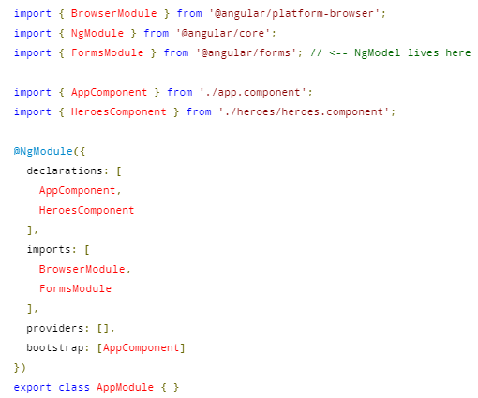
Connect a new Component https://angular.io/tutorial/toh-pt1#show-the-heroescomponent-view
Every component must be declared in the NgModule to function. When you declare a new component, Angular CLI automatically imports the new component into app.module.ts and declares it under the @NgModule.declarations array on generation.

Slide 8
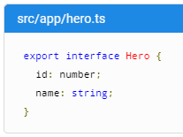

Create an interface https://angular.io/tutorial/toh-pt1#create-a-hero-interface
Interfaces are useful for when you want to define a class or object, then implement it in various places.
Create an interface with ng generate interface [name], or R-click the app folder => choose another schematic.
Then import that interface into the Component from the relative file location in which you want to use it.

Slide 9
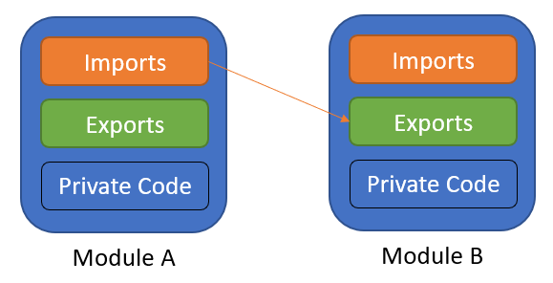
TypeScript Modules https://www.typescriptlang.org/docs/handbook/modules.html
TS shares the JS ES6 concept of Modules, distinct from Angular modules (NgModules) and working in parallel with them.
Modules in TS have their own scope. Anything declared inside a module is not visible outside that module unless it is explicitly exported.
To consume a property exported from a different module, it must be imported using an import method.
The relationships between modules are specified in terms of imports and exports at the file level.
In TS, any file containing a top-level import or export is considered a module. A file without any top-level import or export declarations is treated as a script whose contents are available in the global scope (and therefore in modules as well).

Slide 10

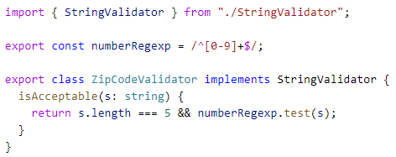
TypeScript - Exporting a Declaration https://www.typescriptlang.org/docs/handbook/modules.html#export
Any declaration (such as a variable, function, class, type alias, or interface) can be exported by adding the export keyword.
First, use the export keyword to make a class, function, or variable available to other modules from within the module (component).
Second, import the class, function, or variable into the module (component) where you want to implement it.

Slide 11
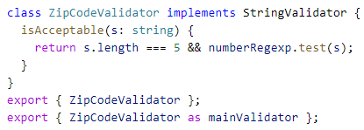
TypeScript - Export https://www.typescriptlang.org/docs/handbook/modules.html#export-statements
Export Statements allow you to rename the statement you want to export.

Slide 12


TypeScript Imports https://www.typescriptlang.org/docs/handbook/modules.html#import
Imports can also be renamed.

Slide 13
Angular Templates - Data Binding https://angular.io/tutorial/toh-pt1#two-way-binding
[(ngModel)] is Angular's two-way data binding syntax. It binds the property to the HTML so that data can flow in both directions: from the property to the textbox, and from the textbox back to the property.
ngModel isn’t available by default do you have to import its module into the app. ngModel belongs to FormsModule and you have to opt-in (import it) to use it.
@ngModule decorators have the needed metadata for the app to function.
The most important @NgModule decorator annotates the top-level AppModule class.
In app.module.ts, import the FormsModule.
Then, add FormsModule to the imports array in the same file.

Slide 14
Modeling – Data Binding https://angular.io/guide/template-syntax#property-binding https://angular.io/tutorial/toh-pt3#update-the-heroescomponent-template
The double curly braces ({{ }}) are Angular's interpolation binding syntax. This interpolation binding presents the component's property values inside the accompanying HTML Doc.
Property binding with [] around the property to be bound. This is one-way.
Event binding based on events like ‘click’ or ‘hover’ to methods in the .ts file) using ().
Two-Way Binding.

Slide 15
Angular Templates- Class Binding https://angular.io/guide/template-syntax#class-binding
You can add and remove CSS class names from an element's class attribute with a class binding.
To create a single class binding, start with the prefix class followed by a dot (.) and the name of the CSS class ( [class.foo]=“condition"). Angular adds the class when the bound expression is truthy, and it removes the class when the expression is falsy.

Slide 16
Angular Templates - Event Binding https://angular.io/tutorial/toh-pt2#add-a-click-event-binding https://angular.io/guide/template-syntax#event-binding
The parentheses, (), around click tell Angular to listen for the <li> element's click event. When the user clicks in the <li>, Angular executes the onSelect(hero) expression in the components .ts file.
Angular dynamically changes the HTML template markup when the conditions change.

Slide 17
Modeling – Decorators https://angular.io/guide/template-syntax#inputs-outputs https://docs.angularjs.org/guide/decorators
Decorators are used to separate modification or decoration of a class without modifying the original source code. In AngularJS, decorators are functions that allow a service, directive or filter to be modified prior to its usage.
@Component - This indicates that the following class is a component. It provides metadata about the component, including its selector, templates, and styles.
The selector identifies the component. The selector is the name you give the Angular component when it is rendered as an HTML element on the page. By convention, Angular component selectors begin with the prefix app-, followed by the component name.
The template and style filenames reference the HTML and CSS files that StackBlitz generates.

Slide 18
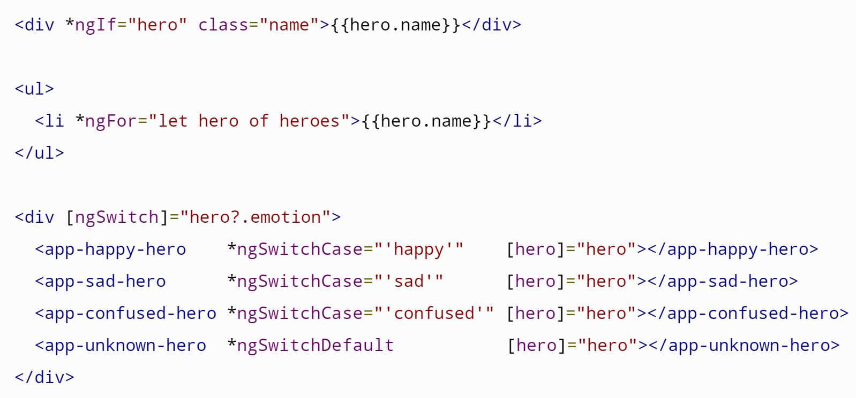
Structural Directives https://angular.io/api/common/NgIf https://angular.io/api/common/NgForOf https://angular.io/guide/template-syntax#ngSwitch https://angular.io/guide/structural-directives
Structural directives shape or reshape the DOM's structure, typically by adding, removing, and manipulating the elements to which they are attached. Directives with an asterisk, *, are structural directives.

Slide 19
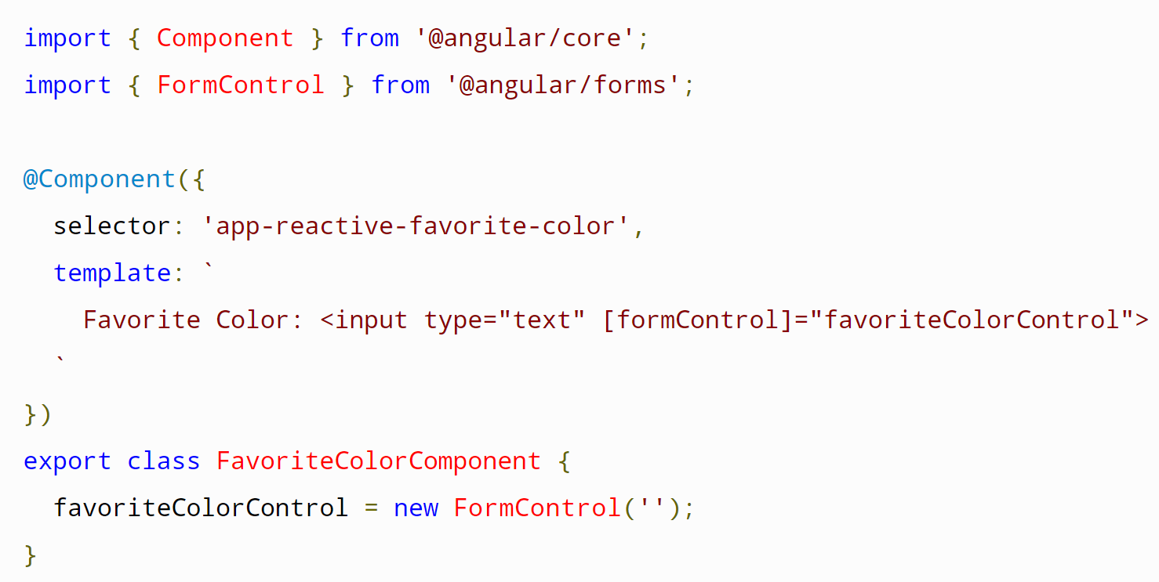
Angular Forms - Overview https://angular.io/start/start-forms#forms-in-angular https://angular.io/api/forms/FormBuilder https://angular.io/guide/forms-overview
Angular provides two different approaches to handling user input through forms: reactive and template-driven. Both capture user input events from the view (template), validate the user input, create a form model and data model to update, and provide a way to track changes.
Reactive forms are more robust: they're more scalable, reusable, and testable. If forms are a key part of your application, use reactive forms.
Template-driven forms are useful for adding a simple form to an app. They don't scale as well as reactive forms. If you have very basic form requirements and logic that can be managed solely in the template, use template-driven forms.
Reactive and template-driven forms both use a form model to track value changes between Angular forms and form input elements. The example to the right shows how the form model is defined and created.

Slide 20
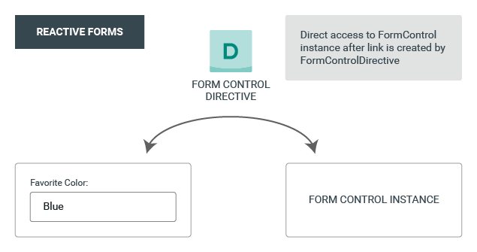
Reactive (Model-Driven) Forms https://angular.io/start/start-forms#forms-in-angular https://angular.io/api/forms/FormBuilder https://angular.io/guide/forms-overview
Reactive forms are built around observable streams, where form inputs and values are provided as streams of input values.
There are two parts to an Angular Reactive form:
the objects that live in the component to store and manage the form, and
the visualization of the form that lives in the template.
The ReactiveFormsModule provides the FormBuilder service.
The form model is the “source of truth”. The “source of truth” provides the value and status of the form element at a given point in time.

Slide 21

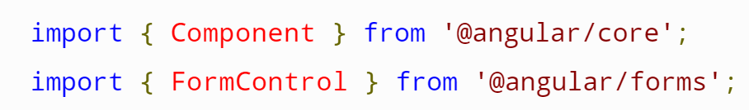
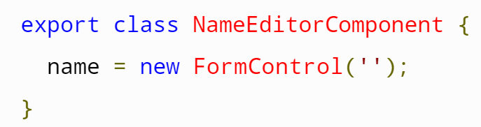

Reactive Form Setup https://angular.io/guide/reactive-forms#adding-a-basic-form-control
Import ReactiveFormsModule to app.module.ts with
import { ReactiveFormsModule } from '@angular/forms’;.
Generate the new component with
ng generate component [ComponentName].
Import FormControl into the new component with
import { FormControl } from '@angular/forms’;.
Set the initial value of the input field inside the component class declaration with
name = new FormControl(‘’);.
Add the control to the view Template with
<input type="text" [formControl]="name">
You can add the component to any parent component view template with
<app-name-editor></app-name-editor>
Now, whatever input you place in the input field will be transferred to the variable value in the component class.

Slide 22
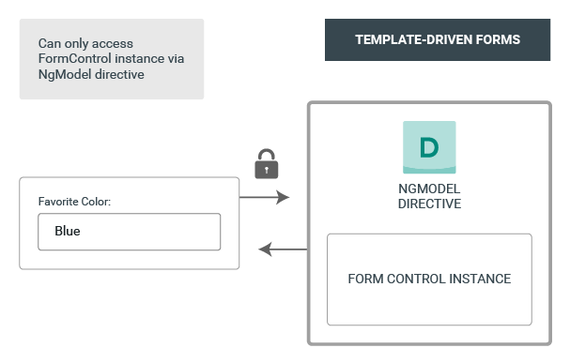
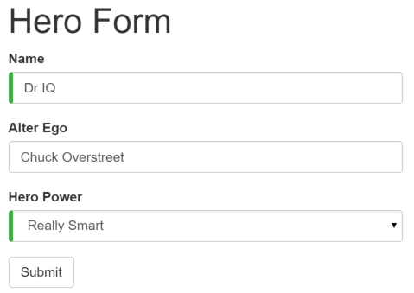
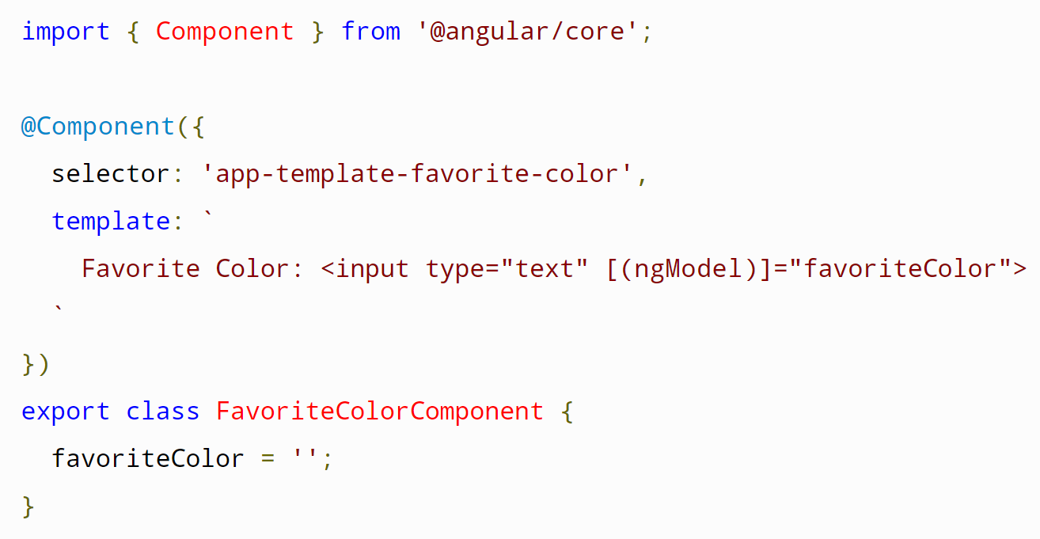
Template Driven Forms https://angular.io/start/start-forms#forms-in-angular https://angular.io/api/forms/FormBuilder https://angular.io/guide/forms-overview
You can build almost any form with an Angular template (login forms, contact forms).
You can lay out the controls creatively, bind them to data, specify validation rules and display validation errors, and much more.
Angular makes the process easy by handling many of the repetitive, boilerplate tasks you'd otherwise wrestle with yourself.

Slide 23

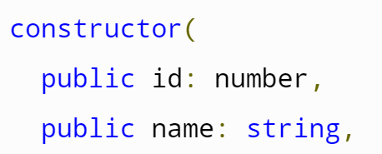


Template Driven Forms
Setup https://angular.io/guide/forms#introduction-to-template-driven-forms
Create a new class with
ng generate class [className].
Add some properties like as id, etc.
Create a form Component with
ng generate component HeroForm
Import the class into the new component with
import { Hero } from '../hero';
Add an instance to the class model in the component with
model = new Hero(18, 'Dr IQ’, etc……)

Slide 24
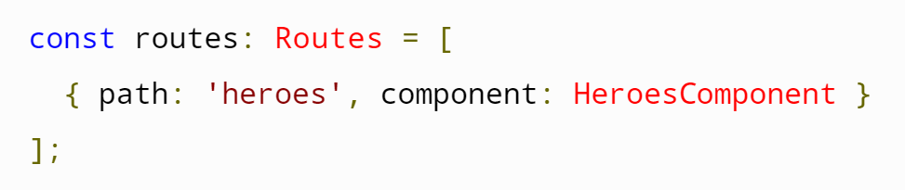
Angular Routing https://angular.io/start/start-routing https://angular.io/guide/router https://angular.io/start/start-data#services
Register a route in app.module.ts. A route associates one (or more) URL paths with a component.
The RouterLink directive in the .html template gives the router control over the anchor element. Put RouterLink in the <a> element where you want to redirect to another (registered) URL.
Inject the ActivatedRoute into the constructor of the component where it will be used. It is specific to each routed component that the Angular Router loads. By injecting the ActivatedRoute, you are configuring the component to use a service.

Slide 25
Angular Routing https://angular.io/start/start-routing https://angular.io/guide/router
Routes tell the Router which view to display when a user clicks a link.
A typical Angular Route has two properties:
path: a string that matches the URL in the browser address bar.
component: the component that the router should create when navigating to this route.
The @NgModule (in app-routing.module.ts) metadata initializes the router and starts it listening for browser location changes.
The forRoot() method supplies the service providers and directives needed for routing, and performs the initial navigation based on the current browser URL

Slide 26
Routing Step-by-step https://angular.io/tutorial/toh-pt5#add-the-approutingmodule
Add a module called app-routing with
ng generate module app-routing --flat --module=app
Make sure RouterModule and Routes are imported into app-routing.module with
import { RouterModule, Routes } from '@angular/router’;
Also import whatever component (from its relative location) you will be routing to into app-routing.module.ts
You can delete the CommonModule references and declarations array.
Configure routes in const routes: Routes = [ { path:’link’, component: AssociatedComponent }]; in app-routing.module
Add imports: [ RouterModule.forRoot(routes) ], under @NgModule.
Also under @NgModule add exports: [ RouterModule ].
Add <a routerLink="/[link]">NameOfLink</a> to whatever page you want to add a link to.
Add …

Slide 27
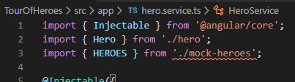
Dependency Injection – Services and Injectables https://angular.io/guide/glossary#dependency-injection-di https://angular.io/guide/dependency-injection
Components shouldn't fetch or save data directly. They should delegate data access to a Service. A Service can get data from anywhere—a web service, local storage, or a mock data source.
Services are an integral part of Angular applications. In Angular, a service is an instance of a class that you can make available to any part of your application using Angular's dependency injection system.
Services are the place where you share data between parts of your application. The Service is your portal to persist data and have methods to access that data.
You can use services to share data across components.
The @Injectable() decorator accepts a metadata object for the service, the same way the @Component() decorator does for component classes.

Slide 28
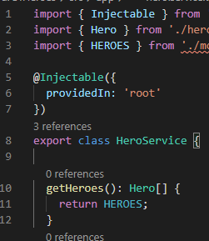
Dependency Injection – Services and Injectables https://angular.io/tutorial/toh-pt4#provide-the-heroservice https://angular.io/guide/dependency-injection
You must make the Service available to the dependency injection system before Angular can inject it into the Component by registering a provider.
By default, the Angular CLI command ng generate service registers a provider with the root injector for your Service by including provider metadata that’s provided in: 'root' in the @Injectable() decorator of the Service Component.
When a Service is provided at the root level, Angular creates a single, shared instance of the Service and injects it into any class that asks for it.
Angular will also remove any unused Services.

Slide 29

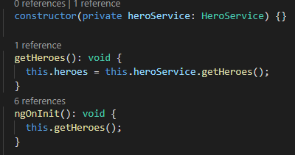
Angular – How to Use DI to Get a Service https://angular.io/tutorial/toh-pt4
To create a service to access your stored data,
Create a Service with
ng generate service [serviceName].
Import the Injectable symbol into the Service component. This allows the Service to be injected into any other Component.
import { Injectable } from '@angular/core’;
Import the Service into the Component where it will be used with
import { ServiceName } from ‘../relative.location’;.
Inject the Service into the constructor of the Component where it will be used with
constructor(private ServiceVariableName: ServiceName) {}.
Now you can access the Services functions with dot notation!
Best Practice is to use ngOnInit() to access and retrieve data from the service on instantiation of the Component instead of retrieving it in the constructor.

