Slide 1
DEPARTMENT OF ELECTRICAL AND ELECTRONICS
ENGINEERING
18EEP301L-MINOR PROJECT-III
FINAL REVIEW
AUTOMATIC FAULT DETECTION IN ELECTRICAL APPLIANCES IN AI
YEAR/ SEMESTER – III/V
BATCH NUMBER : 21
DATE : 29.11.2024
GUIDED BY:
Mrs. S.Kiruthika,
Assistant professor/EEE
PRESENTED BY: PALANIAPPAN N (927622BEE080)
PRAVEENA T (927622BEE084)
SANJANAA SHRI M (927622BEE096)

Slide 2
LIST OF CONTENTS
Abstract
Objective
Existing System
Proposed Solution
Block Diagram
Components used
Components Description
Working Explanation
Future Implementation
Cost Estimation
References

Slide 3
ABSTRACT
This project explores the development and implementation of an advanced system for automatic fault detection in electrical appliances using Artificial Intelligence (AI). As electrical appliances become increasingly sophisticated, traditional fault detection methods often fall short in terms of efficiency and accuracy. This research aims to address these limitations by advanced AI technologies to enhance the reliability and performance of fault detection systems. This project offers numerous benefits, including preventive maintenance, reduced downtime, increased appliance lifespan, and enhanced user safety.

Slide 4
OBJECTIVE
The primary objective of this project is to design and implement an Artificial Intelligence (AI)-powered fault detection system to predict and prevent electrical appliance failures, minimizing downtime and maintenance costs, while enhancing overall appliance reliability, efficiency, and customer satisfaction. To achieve this, the system will utilize real-time monitoring and data collection from electrical appliances, and an automated alert and notification system for maintenance scheduling. The system will also integrate with existing maintenance management systems.

Slide 5
EXISTING SYSYTEM
Existing systems for fault detection in electrical appliances have traditionally relied on manual methods, including visual inspections, scheduled maintenance, and customer-reported fault reporting. While these approaches have been effective to some extent, they have significant limitations. Visual inspections, for instance, are time-consuming, labour-intensive, and often reliant on human expertise, resulting in high labour costs. Scheduled maintenance, on the other hand, can lead to inefficient resource allocation, as maintenance personnel may be deployed unnecessarily, only to find no issues. Furthermore, fault reporting by customers can be delayed, leading to prolonged downtime and decreased appliance lifespan.

Slide 6
PROPOSED SOLUTION
Introducing the Intelligent Fault Detection and Predictive Maintenance System (IFD-PMS), a cutting-edge solution designed to revolutionize fault detection and maintenance scheduling for electrical appliances. By harnessing the power of Artificial Intelligence (AI), Internet of Things (IoT), it ensures optimal appliance performance, reduces downtime, and minimizes maintenance costs. The system comprises IoT sensors to monitor temperature, vibration, current, and voltage, a cloud-based data analytics platform for processing and analysis,, and a notification system for automated alerts.

Slide 7
BLOCK DIAGRAM
SE
SE
SE
SE
DATA ACQUISITION
DATA PREPROCESSING
ANOMALY DETECTION
SENSORS
SE
FAULT CLASSIFICATION
SE
USER NOTIFICATION

Slide 8
COMPONENTS USED
Temperature Sensor
Vibration Sensors
Communication Modules
Transformer
Relay

Slide 9
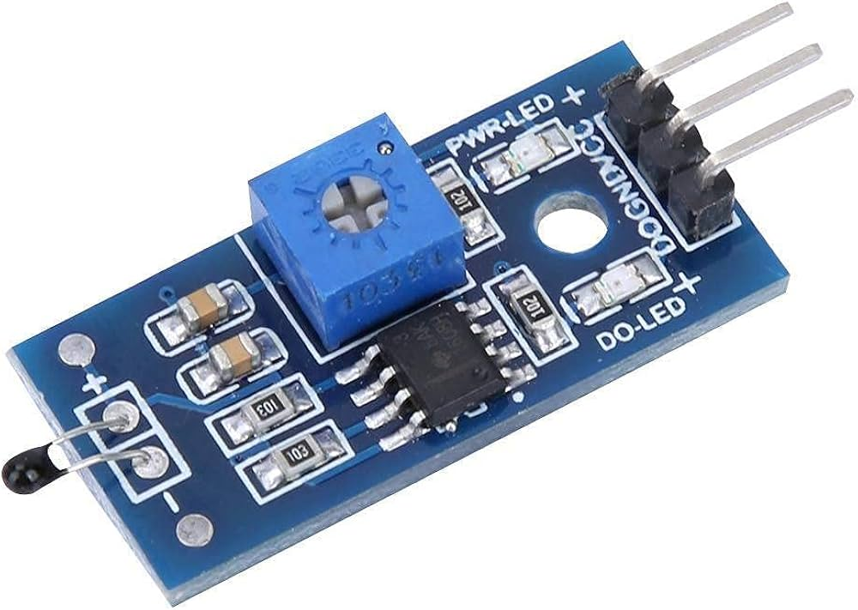
COMPONENTS DESCRIPTION
TEMPERATURE SENSOR
Their primary purpose is to measure temperature changes in appliances, equipment, or environments, detecting abnormal increases to prevent damage or failure. By monitoring temperature, these sensors enable thermal management, regulating temperature to maintain optimal performance and efficiency.

Slide 10
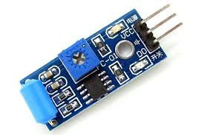
VIBRATION SENSOR
Vibration sensors are widely used for machinery condition monitoring, predictive maintenance, quality control, structural health monitoring, and aerospace and defence applications. The benefits of vibration sensors include reduced downtime, increased equipment lifespan, improved maintenance efficiency, enhanced safety, and cost savings. Their primary purpose is to detect potential equipment failures, reducing downtime and maintenance costs.

Slide 11
FUTURE IMPLEMENTATION
Manufacturing: Predictive maintenance for smart factories.
Healthcare: Predictive equipment maintenance for improved patient care.
Transportation: Real-time monitoring for autonomous vehicles.
Energy: Predictive maintenance for renewable energy systems.
Consumer Electronics: Predictive maintenance for household appliances.

Slide 12
WORKING
Sensors monitor equipment performance in real-time.
Data Acquisition System collects and transmits data to computing devices.
Computing devices process data using machine learning algorithms and algorithms analyse patterns, trends, and anomalies.
System detects anomalies and potential faults.
Alerts maintenance personnel via communication modules.

Slide 13
WORKING
System predicts maintenance requirements based on data analysis.
Schedules maintenance tasks to minimize downtime.
System learns from historical data and adapts algorithms.
Improves fault detection and predictive maintenance accuracy.

Slide 14
COST ESTIMATION
S.NO | COMPONENTS | QUANTITY | COST
1 | Temperature Sensor | 1 | 200
2 | Current Sensor | 1 | 150
3 | Vibration Sensor | 1 | 200
4 | Communication Modules | 1 | 700
5 | Microcontrollers | 1 | 150
6 | Data Loggers | 1 | 1000
TOTAL | 2400

Slide 15
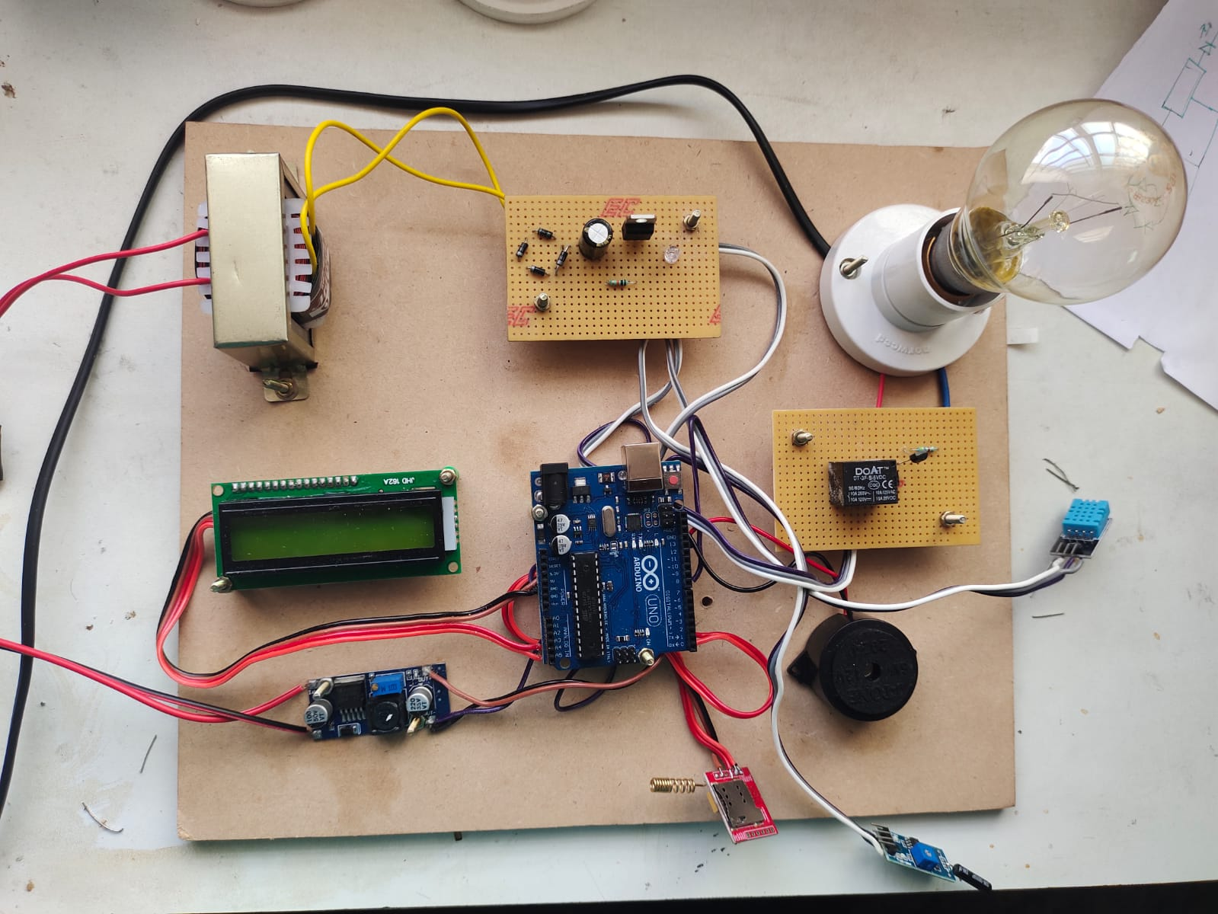
HARDWARE KIT

Slide 16
REFERENCES
"A Review on Predictive Maintenance for Industrial Equipment" (2020) - IEEE Access.
"Intelligent Fault Detection and Diagnosis Using Machine Learning" (2019) - Journal of Intelligent Manufacturing.
"Predictive Maintenance Using Machine Learning and IoT" (2018) - International Journal of Advanced Research in Computer Science.

Slide 17


