Slide 1
Week4

Slide 2
SDLC (Software Development LifeCycle)
Waterfall
Agile
  Scrum

Slide 3
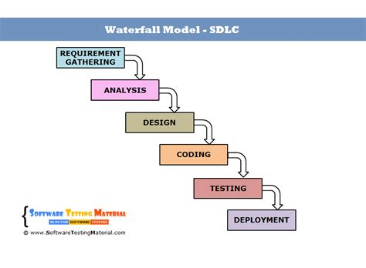
Waterfall
“risky” no feedback until the end of the project
Progress is seen as going downwards
You have to finish a step to get to the next step
Suitable for small projects
More intuitive
Less overhead
simpler

Slide 4
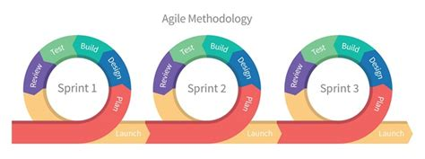
Agile
Minimizes “risk”, maximizing ROI (Return of Investment)
More adaptable to business scenarios
More flexible, more points of inspection
More complicated

Slide 5
waterfall
Time
Agile
Agile
Agile
Agile

Slide 6
Scrum
Agile Framework/ Agile Methodology
Scrum Roles: Scrum Master, Product Owner, Development Team (3-9 per team)
Sprint: 1-4 week “timebox” allotted to make one iteration
Scrum Artifacts: Product Backlog, Sprint Backlog, Burndown/up chart
Meetings: Sprint planning meeting, Standup Meeting / Daily Scrum, Sprint Review, Sprint Retrospective

Slide 7
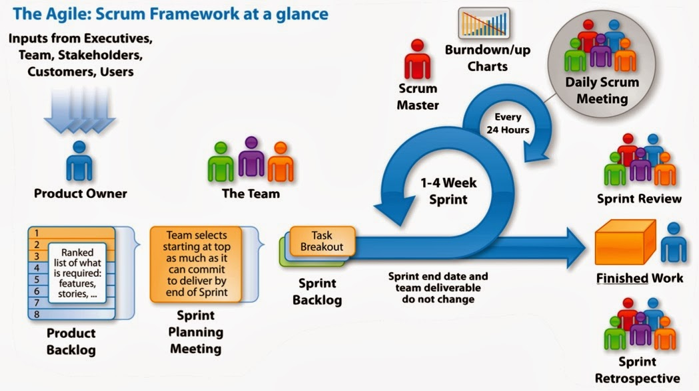

Slide 8
User Stories
As a user, I can retrieve a particular pirate using its ID.
As an admin, I can delete a user.

Slide 9
JS (JavaScript)
What problem does JS try to solve?
  Complexity/rigidity of tradition OOP languages ->Ease of use
  Written by Brandon Eich in 1995 for Netscape…. Before that web pages were kinda boring (HTML/CSS)
  We don’t like PHP…
  Things were too slow -> speed things up (do something on a webpage without reloading)
  Having to learn different tools -> applicable in different paradigms, different use cases

Slide 10

Front End
Back End
Browsers
Node.js

Slide 11
Java vs JavaScript (browser)
Java =/= JS
JVM
V8 engine
JRE
Google Chrome Browser

Slide 12
Java vs Node.js
Java =/= JS
JVM
V8 engine
JRE
Node.js

Slide 13
Different ways you could make your frontend
Server-Side Rendering
  Backend Server render your Front End (same origin) (MVC)
Client-Side Rendering
  Node.js environment (different origin)

