Slide 1
Week 7 Spring Boot and Microservices

Slide 2
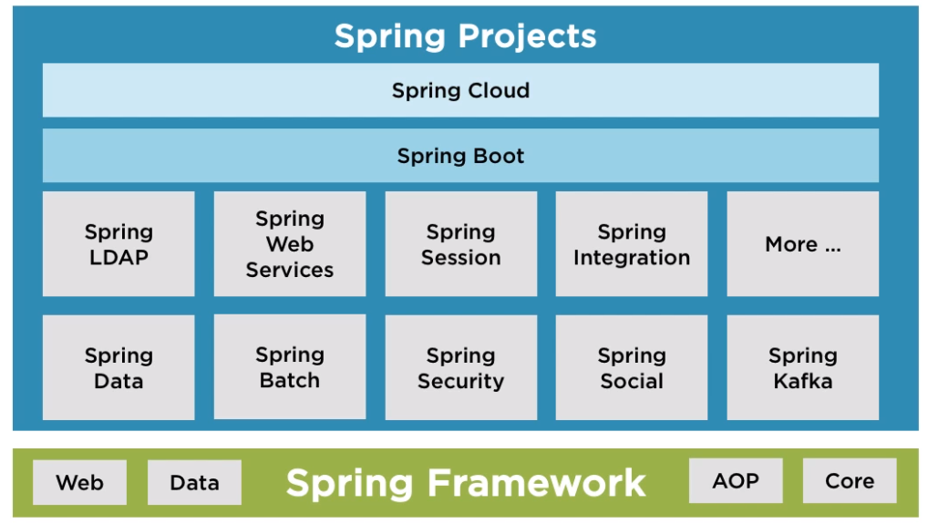

Slide 3
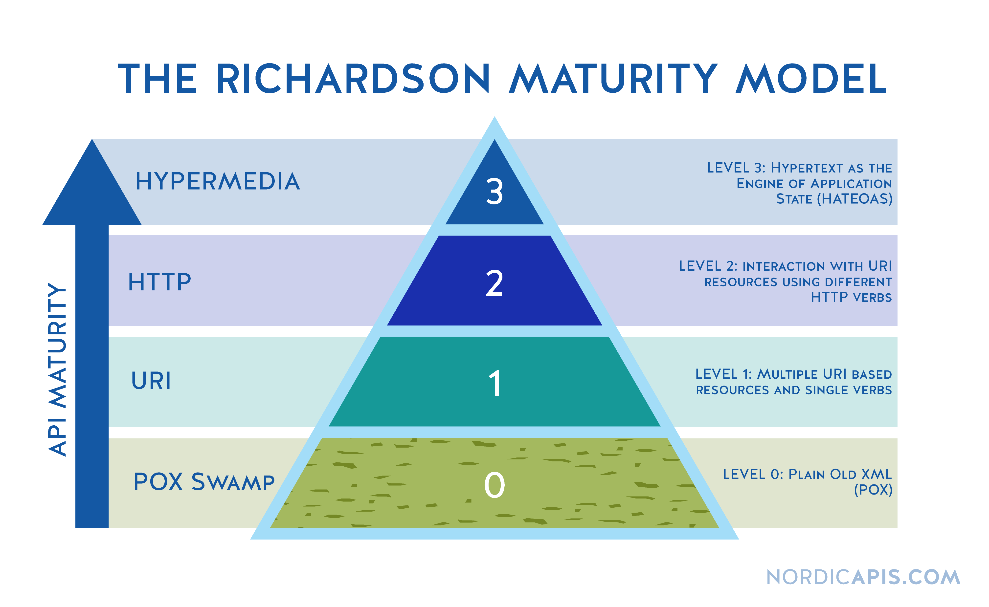
Richardson Maturity Model

Slide 4
SOA
Compared with MSA as an alternative to monolithic
Separate into components
MSA is within an individual project
SOA is across projects
Core appeal is reuse
Abstraction of “services” into reusable parts that can be consumed by several consumers

Slide 5
SOA Continued
Web UI
Mobile UI
Transaction Service

Slide 6
SOA more…
Old Angular
New React
Spring App
(API for managing pirates)

Slide 7
Monolithic architectures
Tight coupling
Self-reliant
Handling all of the services in one place
If one breaks, the whole thing is broken
More difficult to maintain for large apps
Starts off easy when small
Slow, unscalable, unreliable, unflexible
Hard to test and upgrade

Slide 8
Microservices architecture
MSA is an approach to discovering a single app as a suite of smaller services and each of the small services are running on its own process and communicate with various mechanisms
Easier to maintain
Fault tolerance (resistance to failure)
Loose coupling
Can be independently deployed
Organized around business processes (service for payments, service for inventory, etc.)
Large complex apps
Modularity, easy to read develop and test, scalability, good for devops
Higher chance of failure (at all)
Harder to test more complex interactions between components
Potentially higher latency, separation

Slide 9
Monolith vs Microservice
Monolith
Suitable for small apps
More Simple
Less Expensive Team
Must scale everything evenly
Simple deployments
$$- Better for smaller apps
More waterfall oriented
Large teams for large apps
Tight-couple
Microservices
Suitable for enterprise app if they are more complex
More complex
Potentially more bugs
More Resources
More Testing
More Expensive Team
Scaling- Scales better because you can scale out only
Complex deployments
$$ - Better for very large applications regarding maintenance, infrastructure, computing resources etc.
Better for scrum with large applications
“right-sized” teams
Polyglot Architecture
Loose-couple

Slide 10
What are we breaking when we move to MSA?
Different locations and deployments (client having to know multiple locations)
Solution: API Gateway -> Netflix Zuul or Spring Cloud Gateway
Services knowing each other’s location
Solution: Service Registry -> Netflix Eureka or Spring Cloud Consul (does more than service registry)
Multiple languages -> APIs
Multiple points of failure (less change of overall failure, higher change of A failure)
Recovering from a failure (Fault Tolerance)
Circuit Breaker Design Pattern -> Netflix Hystrix
Load Balancing: Netflix Ribbon (Client Side Load balancing)
Distributed Configuration – Spring Cloud Config
DB – Lacking Consistency, different dialects/types of db
Solution: Messaging Queues (Rabbit MQ, Apache Kafka, AWS SQS/SNS )
“Eventual Consistency” is used to remedy consistency issues across dbs
Timing/Communication -> Messaging Queues

Slide 11
Spring Cloud
An umbrella term that refers to a set of technologies that help you do microservices with Spring Boot Aplications

Slide 12
Netflix OSS
Yes, that Netflix
The make open-source software, some of which is really helpful for supporting MS structures
Eureka, Zuul, Hystrix, Ribbon, etc.

Slide 13
Proposed Architecture
Pirate Service 1
Pirate Server
Migrate
Pirate Service 2
Pirate Service 3

Slide 14


“Real world” example
Gateway
(Zuul/Spring Cloud Gateway)
User Service
Product Service
Service Registry
(Eureka)
React Client
Orders
Service
Spring Cloud Config
Processing Orders
Service

Slide 15
Alternate “Real world” example
React Client
Backend

Slide 16
Server-Side Load Balancing
User Service
Proxy
User Service
User Service
User Service

Slide 17
Client Load Balancing
User Service
Client
User Service
User Service
User Service

Slide 18
Client vs Server Side LB
Server
Proxy server (“extra hop”)
Involves more latency
Appropriate whether or not you trust the client
Monolith and Microservices
Client
No proxy server
Less latency
Only appropriate if you trust the client
Usually, Microservices

Slide 19
Backend
Backend
Backend
Backend Service
React Client
Proxy Server
Other Backend Service
Other Backend Service
Other Backend Service
Other Backend Service

Slide 20
Not Messaging Queues (HTTP request)
Consumer
Producer
Consumer
Consumer

Slide 21
Messaging Queues
Consumer
Messaging Queue
Producer
message
Consumer
Consumer

Slide 22
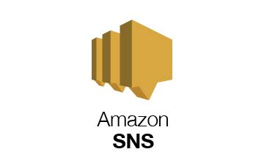
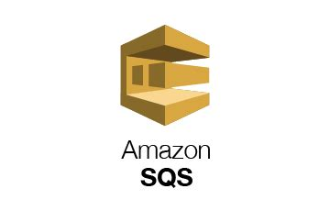
Proposed Architecture for MS Pirate App
React Client
Service Registry
(Eureka)
Pirate Server
Hire Pirate Service
Hire Service Processor

Slide 23
Proposed Architecture for MS Pirate App – no queue
React Client
Service Registry
(Eureka)
Pirate Server
Hire Pirate Service
Hire Service Processor

Slide 24
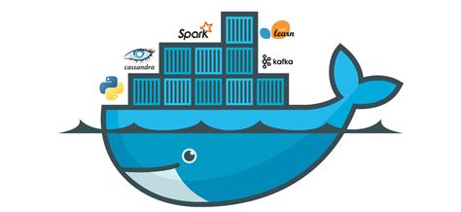
Docker

Slide 25
Virtual Machine
App
App
Libraries and Dependencies
Libraries and Dependencies
Guest OS 1
Guest OS 2
Hypervisor
OS
Hardware

Slide 26
Containerization
Docker Container
Docker Container
Docker Container
SB App
SB App
SB App
Java 8
Java 8
Java 8
Docker Engine
OS
Hardware

Slide 27
Workflow for Docker
Dockerfile
Docker Image
docker container
docker build
docker run
jar
Java –jar “name-of-jar”

Slide 28
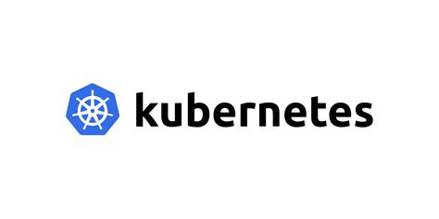
Pirate server + Docker + Kubernetes
Manifest.yaml
Pirate Server
Pirate Server
Pirate Server

