Slide 1
Employee Data Analysis using Excel
STUDENT NAME:SWETHA.G
REGISTER NO:312220418 NM USER ID :asunm1725312220418
DEPARTMENT:B.COM(GENERAL)
COLLEGE:APOLLO ARTS AND SCIENCE COLLEGE NORTH CHENNAI

Slide 2
PROJECT TITLE
Employee Performance Analysis using Excel

Slide 3


AGENDA
Problem Statement
Project Overview
End Users
Our Solution and Proposition
Dataset Description
Modelling Approach
Results and Discussion
Conclusion
3/21/2024 Annual Review

Slide 4

PROBLEM STATEMENT
AVERAGE RATE SALARY NO.OF PRESENT NO.OF ABSENT
WORKING DAYS AND TO CALCULATE TOTAL NET SALARY

Slide 5

PROJECT OVERVIEW
THE OUTPUT OF THE PROJECT IS TO CREAT A PIE CHART AFTER THE EXCEL WORKOUT .IN THE EXCEL SHEET WE HAVE TO SOLVE THE CALCULATE OF NAME ,SALARTY OF THE PERSON , NO.OF PRESENT NO.OF ABSENT,AND TOTAL WORKING DAYS AT LAST WE HAVE INSERT A FORMULA AND CALCULATE THE NET SALARY

Slide 6

WHO ARE THE END USERS?
CREATED PIE CHT AND EXCEL SHEET

Slide 7

OUR SOLUTION AND ITS VALUE PROPOSITION
EQUATION=(=E2/K2*L2)

Slide 8
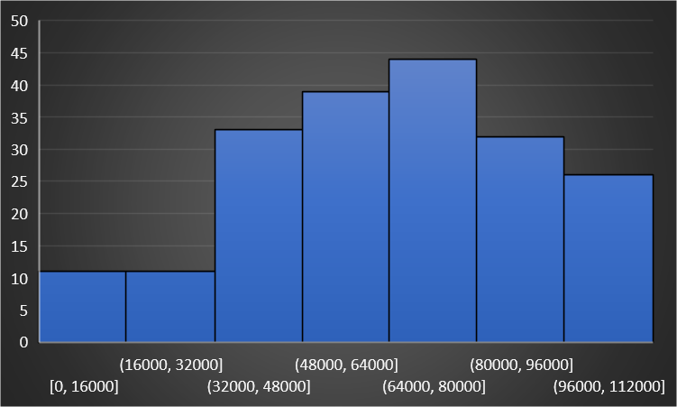
Dataset Description

Slide 9

THE "WOW" IN OUR SOLUTION
OUR SOLUTION IS TO FINDING THE NET SALARY OF THE EMPLOYEE
3/21/2024 Annual Review
9

Slide 10
MODELLING
THROUGH EXCEL IN BAR CHART
10

Slide 11
RESULTS
THE RESULT IS THE HIGHEST SALARY IS 68000
11

Slide 12
conclusion
WE FIND THE SALARY

