Slide 1
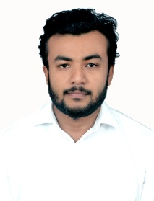


ASISH KUMAR SAHOO ASSOCIATE SOFTWARE ENGINEER – Power Platform | Sharepoint MOBILE: +91-7978979831 EMAIL: Asish.Kumar.Sahoo@gds.ey.com
PL-900
Background
I have joined this organization as an Associate Analyst, and serving since 24th of January 2022, and have a total of 1.5 years of experience
I joined this organization in the year 2022 , and i have been allocated Hyderabad ,Telangana,500084.
I completed my matriculation in the year 2014, +2 science in the year 2016, and have completed my bachelors degree in technology, in the year 2020.
Experience
Worked on SharePoint Online.
Worked on Canvas PowerApps development.
Worked on Power Automate .
Hands on React an-d API Creation.
Trained in RPA,HTML,REACT, POWERAPPS & POWERAUTOMATE provided from the company end.
Projects
GOOSE PORTAL
Worked on a client assignment for creating interactive user interface for displaying the business data and FAQ for the new user coming into EY .
Technology Used: Sharepoint , REACT
Role : Developer
GDS AUTOMATION
Worked on an internal assignment for creating interactive user interface for displaying the data by amalgamating all the service line at one place .
Technology Used: PowerApps, Power Automate, SharePoint online
Role : Developer
Skills
Front-end HTML5, CSS 3
Design & Development Microsoft Share Point online
Microsoft Power App and Power Automate

