Slide 1
Tiger Jump: Development of UST Student Career Portal using Angular.js and Java RESTful
Bravo, Adrian L.
Carbon, John Matthew H.
Leano, Alvin B.
Tan, Ron Bryan S.
Llamas, Jairus Ferdinand

Slide 2
CHAPTER 1
Introduction

Slide 3
INTRODUCTION
The Counseling and Career Development Center needs a website that will make the students’ job application more efficient and well-prepared. The website will be part of the guidance department’s plan in strengthening the relationship of the university with the partner companies and increasing the employability of the students.

Slide 4
INTRODUCTION
Did you know?
Average of 500,000 college graduates annually

Slide 5
Only 50,000 has a job that matches their college degree

Slide 6
PROBLEMS NOTICED
There is a high-level of competition in the job market today
High unemployment of fresh college graduates.
Job Mismatch

Slide 7
PROJECT CONTEXT
Job seekers use the Internet to make job searching easier.
Having a partner company is a significant factor in a student’s job application, especially when internship and employment are the discussion.

Slide 8
PURPOSE
Create a website that will help UST students be prepared for their job application
Help students explore about the different job opportunities in some companies

Slide 9
DESCRIPTION
User Interface
Design similar to OFAD’s website and Gurus Patio
Login account needed for access
2 UIs: Student and Admin
Included features like Newsfeed, Search Functionality, Portfolio Editor, and Content Editor

Slide 10
DESCRIPTION
Technology
Use of Angular.js, Java RESTful, MySQL

Slide 11
Prototype

Slide 12

PROTOTYPE
LOGIN
www.ustcareerportal.com
CAREER PORTAL
STUDENT NO.
PASSWORD
LOGIN

Slide 13
PROTOTYPE
LOGIN
www.ustcareerportal.com
CAREER PORTAL
2012042076
••••••••••
LOGIN

Slide 14
PROTOTYPE
LOGIN
www.ustcareerportal.com
CAREER PORTAL
2010000001
••••••••••
LOGIN

Slide 15
PROTOTYPE
STUDENT HOME
www.ustcareerportal.com/home
>
HOME
PORTFOLIO
EXPLORE
JOB POST
ABOUT
LOGOUT
NEWS FEED
ANNOUNCEMENTS
>
NAME OF ARTICLE
Brief Description
>
>
RECENT ACTIVITIES
>

Slide 16
PROTOTYPE
PROFILE
www.ustcareerportal.com/profile
>
HOME
PORTFOLIO
EXPLORE
JOB POST
ABOUT
LOGOUT
PHOTO
FULL NAME
PROFESSIONAL HEADLINE
ADDRESS
CONTACT NUMBER
Education
>

Slide 17
PROTOTYPE
PROFILE
www.ustcareerportal.com/profile
>
HOME
PORTFOLIO
EXPLORE
JOB POST
ABOUT
LOGOUT
Skills
Awards
>

Slide 18
PROTOTYPE
PROFILE
www.ustcareerportal.com/profile
>
HOME
PORTFOLIO
EXPLORE
JOB POST
ABOUT
LOGOUT
Experience
Certificates
>

Slide 19
PROTOTYPE
PROFILE
www.ustcareerportal.com/profile
>
HOME
PORTFOLIO
EXPLORE
JOB POST
ABOUT
LOGOUT
Honors & Awards
Seminars Attended
>

Slide 20
PROTOTYPE
PROFILE
www.ustcareerportal.com/profile
>
HOME
PORTFOLIO
EXPLORE
JOB POST
ABOUT
LOGOUT
Seminars Attended
EDIT
>

Slide 21
PROTOTYPE
PROFILE
www.ustcareerportal.com/profile
>
HOME
PORTFOLIO
EXPLORE
JOB POST
ABOUT
LOGOUT
Seminars Attended
CANCEL
SAVE
>

Slide 22
PROTOTYPE
EXPLORE
www.ustcareerportal.com/explore
>
HOME
PORTFOLIO
EXPLORE
JOB POST
ABOUT
LOGOUT
Search Job Skills, Location, or Position
PICK A PROGRAM
IT
>

Slide 23
PROTOTYPE
EXPLORE
www.ustcareerportal.com/explore
>
HOME
PORTFOLIO
EXPLORE
JOB POST
ABOUT
LOGOUT
Search Job Skills, Location, or Position
PICK A PROGRAM
IT
>

Slide 24

PROTOTYPE
EXPLORE
www.ustcareerportal.com/explore
>
HOME
PORTFOLIO
EXPLORE
JOB POST
ABOUT
LOGOUT
Search Job Skills, Location, or Position
CHOOSE A COMPANY
A
B
C
D
COMPANY A
COMPANY B
COMPANY C
COMPANY D
E
F
G
H
COMPANY E
COMPANY F
COMPANY G
COMPANY H
>

Slide 25
PROTOTYPE
EXPLORE
www.ustcareerportal.com/explore
>
HOME
PORTFOLIO
EXPLORE
JOB POST
ABOUT
LOGOUT
Search Job Skills, Location, or Position
COMPANY NAME
JOB FOR
INFORMATION TECHNOLOGY
>
PHOTO
DESCRIPTION
BACKGROUND
DESCRIPTION
COMPANY LINK
SEND RESUME
>

Slide 26
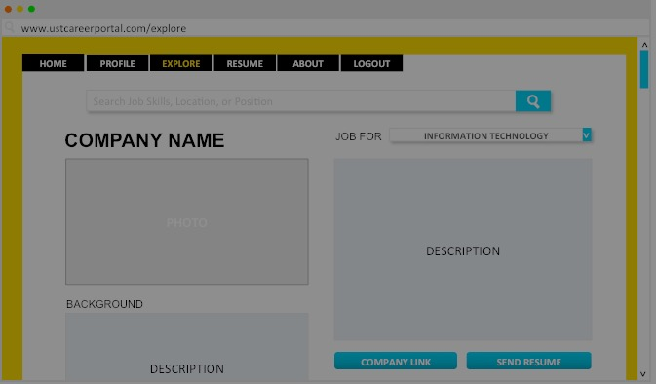
PROTOTYPE
EXPLORE

Slide 27
PROTOTYPE
EXPLORE
Sending successful!
OK

Slide 28
PROTOTYPE
EXPLORE
Operation Aborted
OK

Slide 29
PROTOTYPE
EXPLORE
www.ustcareerportal.com/explore
>
HOME
PORTFOLIO
EXPLORE
JOB POST
ABOUT
LOGOUT
Web Developer
PICK A PROGRAM
IT
>

Slide 30
PROTOTYPE
EXPLORE
www.ustcareerportal.com/explore
>
HOME
PORTFOLIO
EXPLORE
JOB POST
ABOUT
LOGOUT
Web Developer
RESULT
A
B
C
D
COMPANY A
COMPANY B
COMPANY C
COMPANY D
E
F
COMPANY E
COMPANY F
>

Slide 31
PROTOTYPE
RESUME
www.ustcareerportal.com/resume
>
HOME
PORTFOLIO
EXPLORE
JOB POST
ABOUT
LOGOUT
JOB POST
>
>

Slide 32
PROTOTYPE
ABOUT
www.ustcareerportal.com/about
>
HOME
PORTFOLIO
EXPLORE
JOB POST
ABOUT
LOGOUT
ABOUT
DESCRIPTION
>

Slide 33
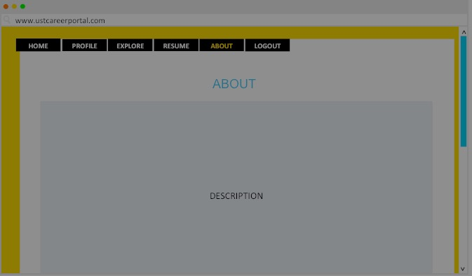
PROTOTYPE
LOGOUT
Are you sure you want to logout?
YES
NO

Slide 34
PROTOTYPE
EXPLORE
Attach Resume
BROWSE
SEND
CANCEL

Slide 35
PROTOTYPE
EXPLORE
Attach Resume
BROWSE
myResume.pdf x
SEND
CANCEL

Slide 36
PROTOTYPE
EXPLORE
Are you sure you want to send your profile?
SEND
CANCEL

Slide 37
PROTOTYPE
EXPLORE
Profile sent.
OK

Slide 38
PROTOTYPE
ADMIN HOME
www.ustcareerportal.com/homeadmin
>
HOME
COMPANIES
JOB POSTS
ANNOUNCEMENTS
LOGOUT
REMINDERS
>

Slide 39
PROTOTYPE
COMPANY LIST
www.ustcareerportal.com/companies
>
HOME
COMPANIES
JOB POSTS
ANNOUNCEMENTS
LOGOUT
LIST OF COMPANIES
Name | Description | Locations | Email
>
>
>
>
EDIT
>

Slide 40
PROTOTYPE
JOB POST LIST
www.ustcareerportal.com/jobposts
>
HOME
COMPANIES
JOB POSTS
ANNOUNCEMENTS
LOGOUT
LIST OF JOB POSTS
Company | Job
>
>
>
>
EDIT
>

Slide 41
PROTOTYPE
ADMIN HOME
www.ustcareerportal.com/announcements
>
HOME
COMPANIES
JOB POSTS
ANNOUNCEMENTS
LOGOUT
LIST OF ANNOUNCEMENTS
To | From | Message
>
>
>
>
EDIT
>

Slide 42
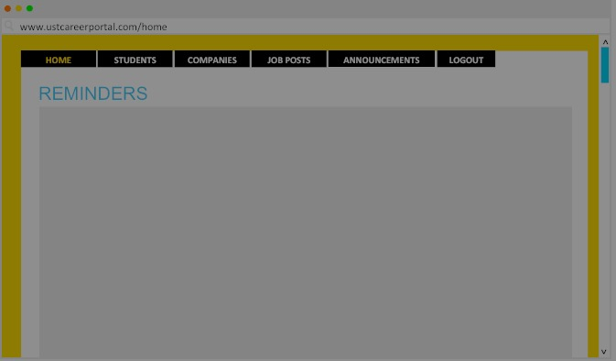
PROTOTYPE
ADMIN HOME
Are you sure you want to logout?
YES
NO

Slide 43
OBJECTIVES
To inform the students about the different companies associated with the University of Santo Tomas
To prepare students for their career application with helpful articles and section(s) within the website

Slide 44
OBJECTIVES
To enable students to edit his/her online portfolio
To provide students a way to send his/her portfolio to a desired company via email service
To create a search functionality for finding a job position, location, or skill related to the company’s information

Slide 45
SCOPE & LIMITATIONS
The study focuses only on the graduating batch of UST IT students
The website is designed for desktop users
Prefer to use the latest versions of Safari, Mozilla Firefox, Google Chrome, and Internet Explorer.

Slide 46
CHAPTER 2
Review of Related Literature, Study, and System

Slide 47
Synthesis
Relevance of the Project
Technologies used in the development process.

Slide 48
CHAPTER 3
Methodology

Slide 49
DEV’T METHODOLOGY
The proponents also used the agile development. Some procedures are careful planning then development to testing and finally deployment.

Slide 50
INTRODUCTION
FUNCTIONAL REQUIREMENTS
No | Requirement
FR1 | User login needed to access website
FR2 | System must be able to search for a company by its job position, location, or skill
FR3 | User able to edit the profile section for information sending purposes
FR4 | Display a list of companies a student can apply to
FR5 | Display the announcements from the guidance departments
FR6 | Display links of articles with topics relating to careers

Slide 51
INTRODUCTION
FUNCTIONAL REQUIREMENTS
No | Requirement
FR7 | Display relevant information of a company with its job requirements
FR8 | Convert profile into word or pdf file
FR9 | Admin able to add, edit, or delete a company profile
FR10 | Admin able to add, edit, or delete announcements
FR11 | Admin able to add, edit, or delete job post

Slide 52
INTRODUCTION
NON-FUNCTIONAL REQUIREMENTS
No | Type | Requirement
NFR1 | Stability | Continuous operation by the website as long as UST host website is Online.
NFR2 | Privacy | The student can only access his/her profile.
NFR3 | Portability | Can be used on any computer platform as long as there is a stable internet access.
NFR4 | Security | User authentication and authorization.
NFR5 | Audit Trail (logs) | Each database table record needs to have record created for date/user and a record modified user/date

Slide 53
SYSTEM REQUIREMENTS
Internet Connection
Processor: i5-i7 Intel Core Processor
RAM: 4gb-8gb
Graphics: NVIDIA Graphics and Intel HD
Display: 13” and 15.6”

Slide 54
SYSTEM SPECIFICATION
Operating System: Preferably Windows 8.1 Pro and Mac OS X Yosemite
Web Browsers: Preferably the latest versions of Safari, Google Chrome, Mozilla Firefox and Internet Explorer

Slide 55
PLANNING
The proponents will need to cooperate with the guidance department, the technical adviser, and STePs in creating the website.
Delegation of tasks among members would be based on each proponents skill and specialization

Slide 56
DEVELOPMENT
This step is where the team will try to materialize what they have designed in the previous step

Slide 57
MAINTENANCE
The administrators would keep on updates and maintenance of the website after the proponent’s completion of the project. Any problems that the team will encounter after deployment will lead back to planning for future updates to prevent further user dissatisfaction.

Slide 58
End of Presentation

