Slide 1
Presentation for CS744
Team name: FALCONS
Team member: Chaohui Xu, Yifan Gu, Sheng Zhang

Slide 2
Project Planning
Tools: Visual Studio Code
Technology: Linux, Node.js, MongoDB, HTML5, CSS3, ECMAScript 2015
Project Develop Method: Agile Method.

Slide 3
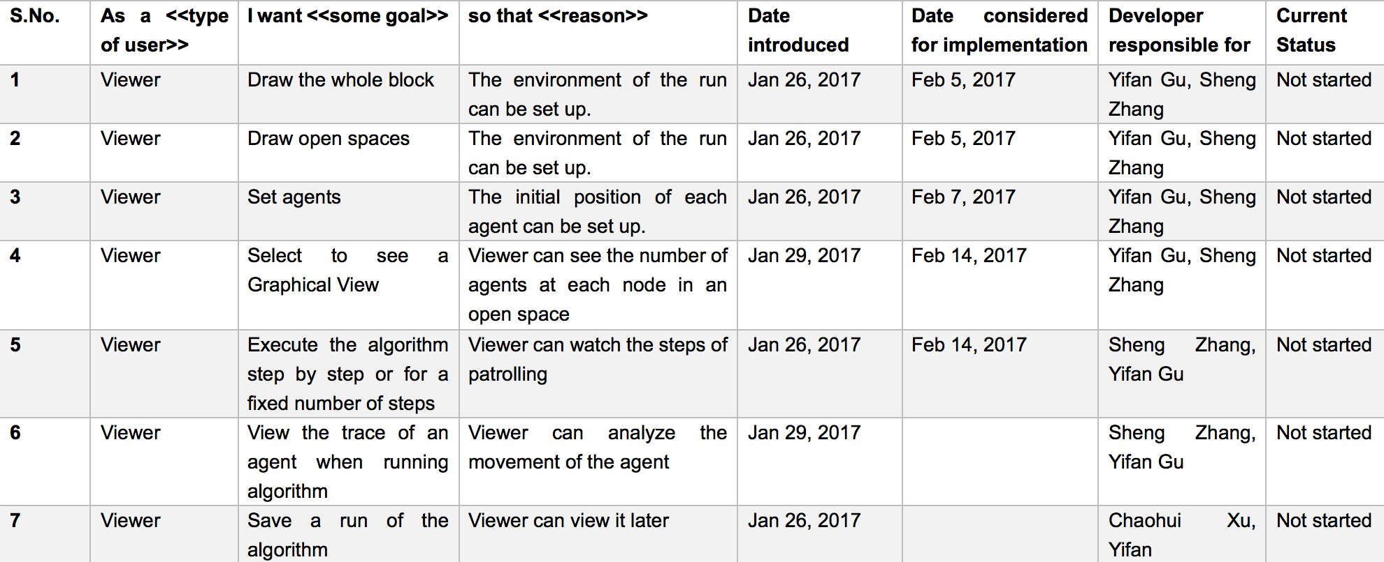
User Stories

Slide 4
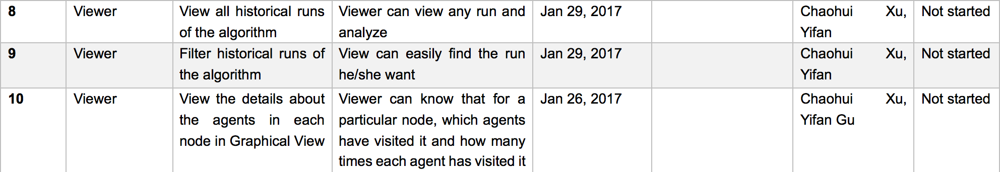
User Stories

Slide 5
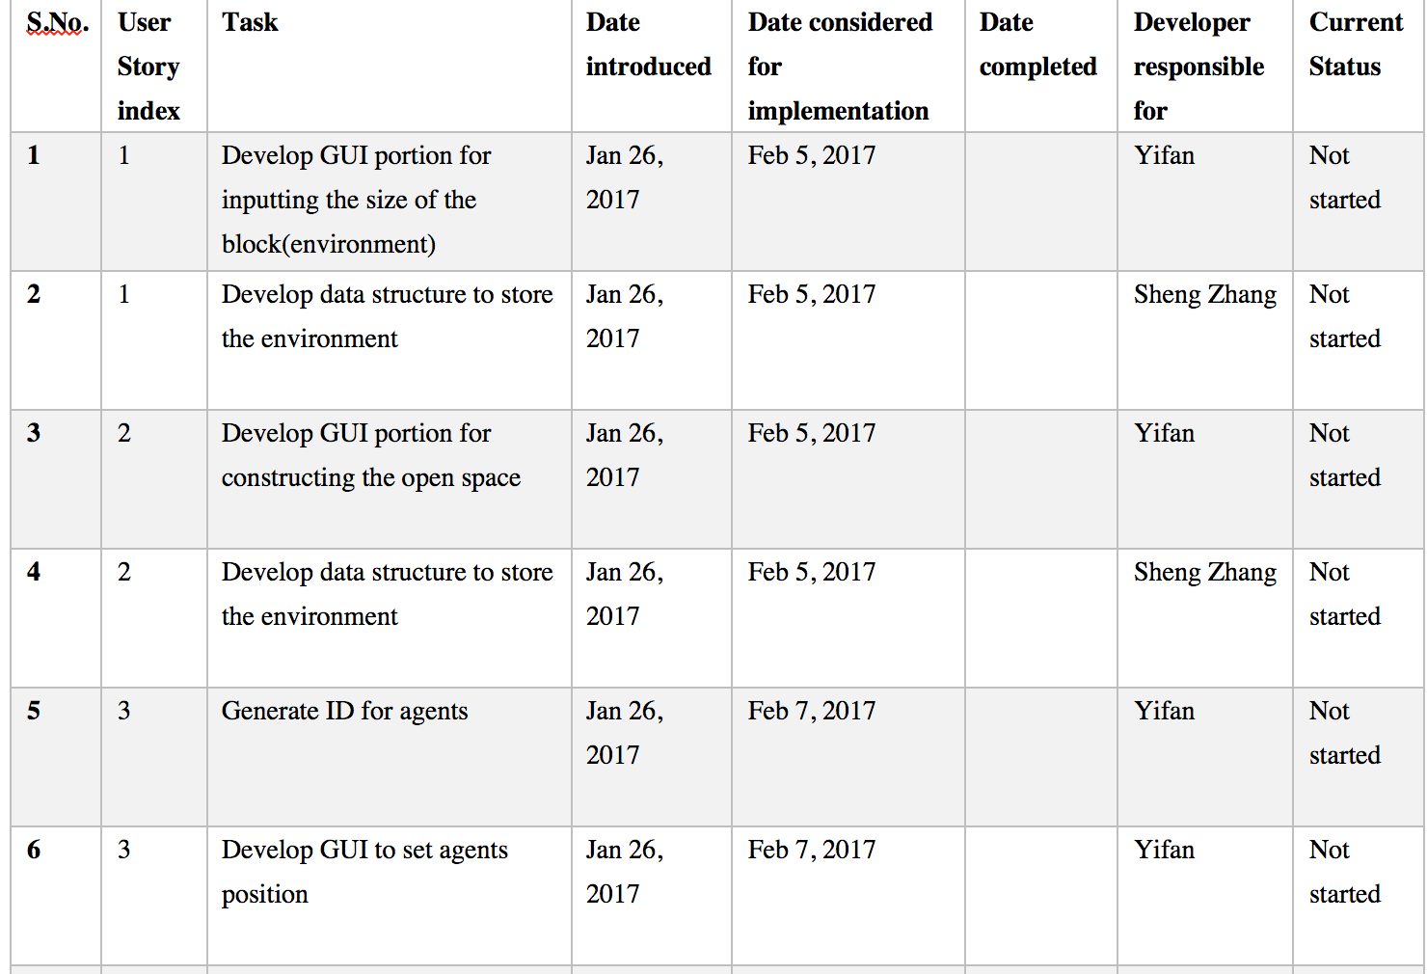
Sprints

Slide 6
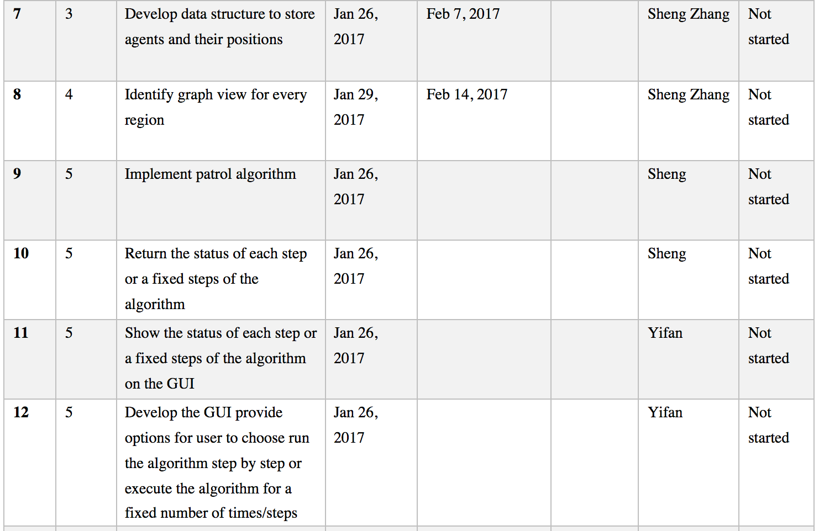
Sprints

Slide 7
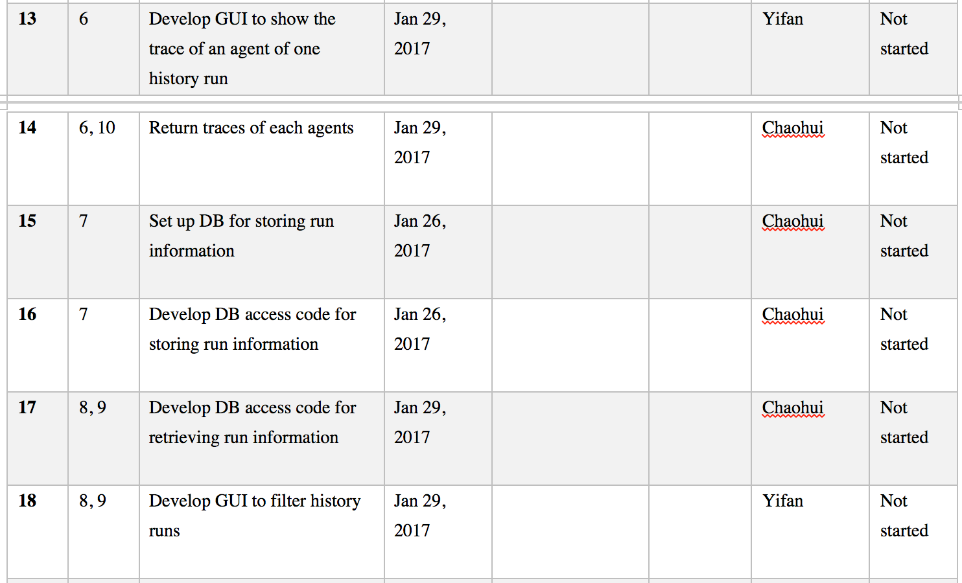
Sprints

Slide 8
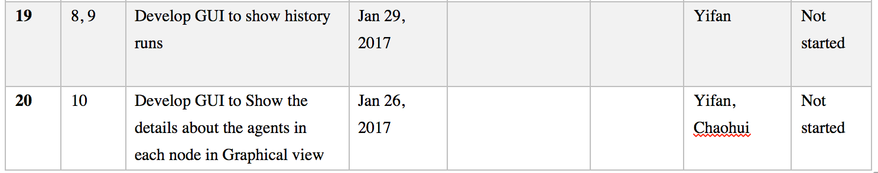
Sprints

