Slide 1
Visualizing Multi-agent Patrolling
Team: Falcons
Members: Yifan gu, sheng zhang, chaohui xu

Slide 2
Feedback
Suggested improvements:
The target list in graph view needs to be fixed so that it matches with the selected algorithm.
It is better to demonstrate different configurations of the environment using file uploading rather than drawing a new environment every time.
Meeting Logs:
OK.
Documents:
There is no user story corresponding to the algorithm implementation.
The status of the last two user stories are left blank. It should be “completed” or at least “in progress”.
Task #30 is too vague.

Slide 3
Plan of actions on the feedback
Fix the target list in graph view.
Demonstrate different configurations of the environment using file uploading.
Update the status of user stories and tasks.
Update vague tasks and make them more concrete.

Slide 4
User Stories
Updated:
Load environment file
Filter historical runs of the algorithm
View the target list in Graph view

Slide 5
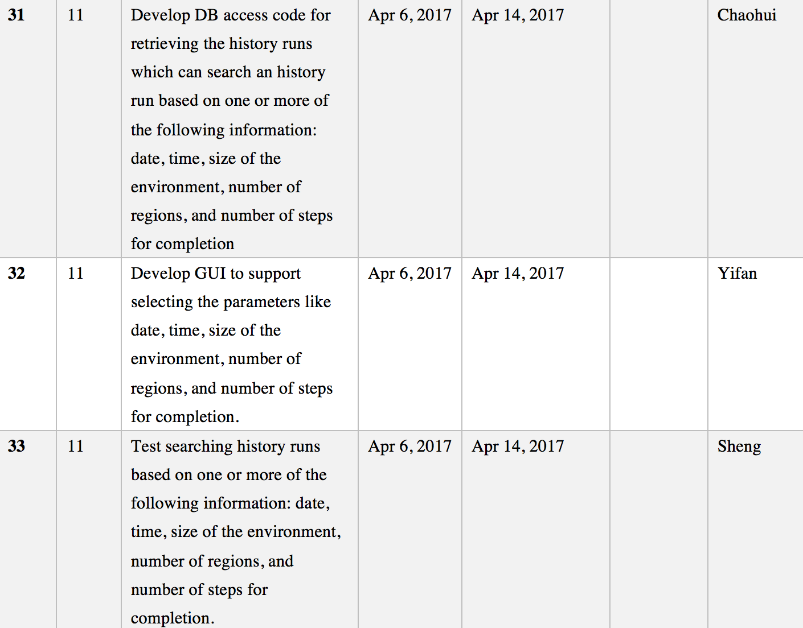
Sprint Tasks
Filter historical runs of the algorithm

Slide 6
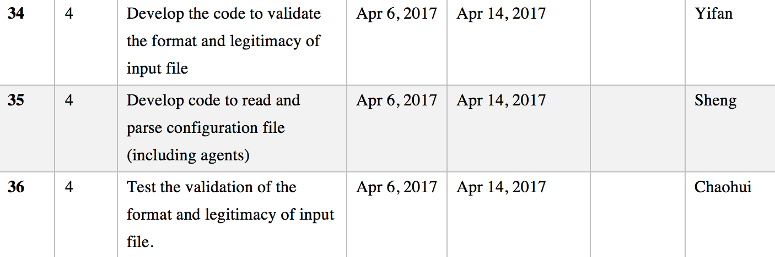
Sprint Tasks
Load environment file

Slide 7
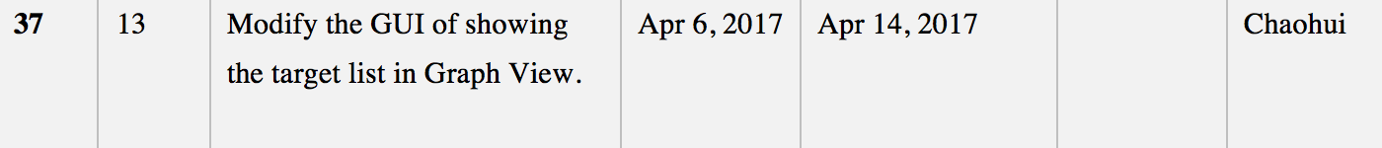
Sprint Tasks
View the target list in Graph view

Slide 8
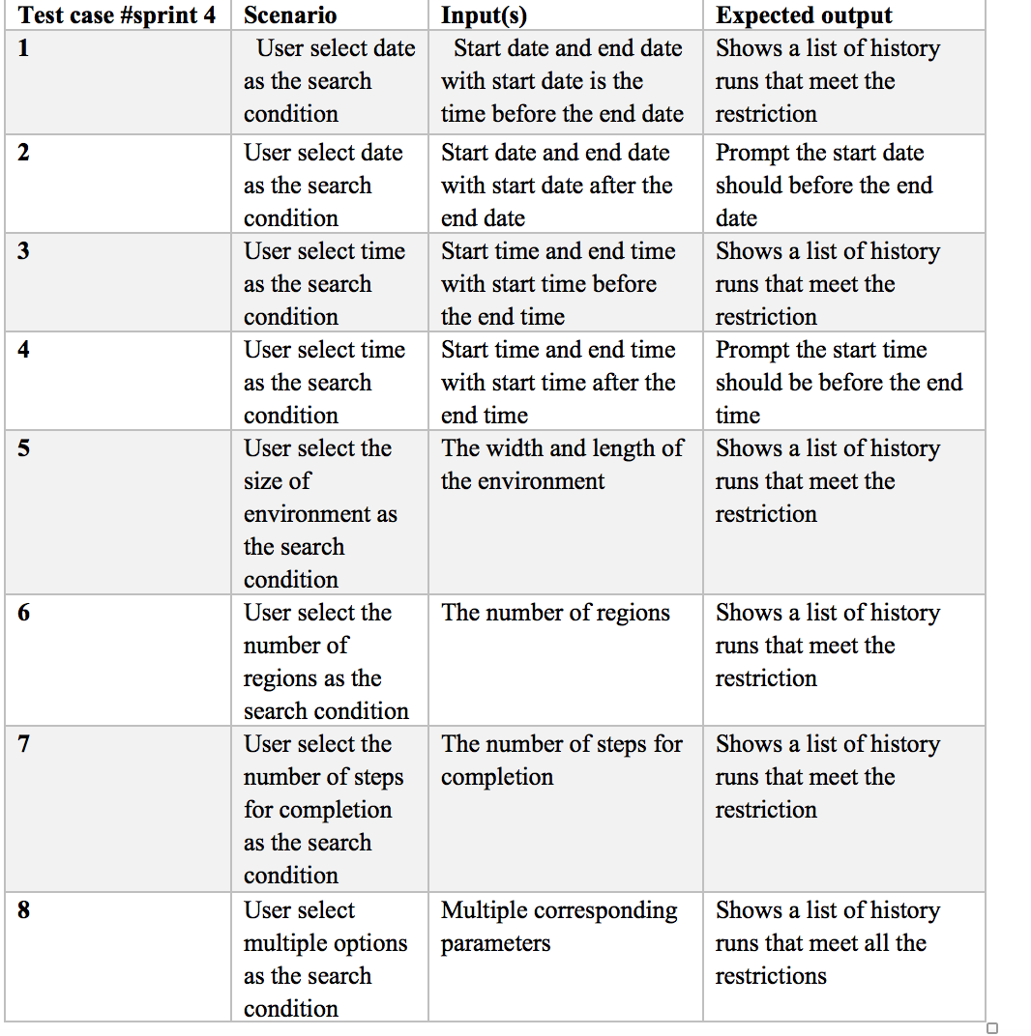
Test Cases for Sprint Task 31
Develop DB access code for retrieving the old runs which can search an old run based on one or more of the following information: date, time, size of the environment, number of regions, and number of steps for completion

Slide 9
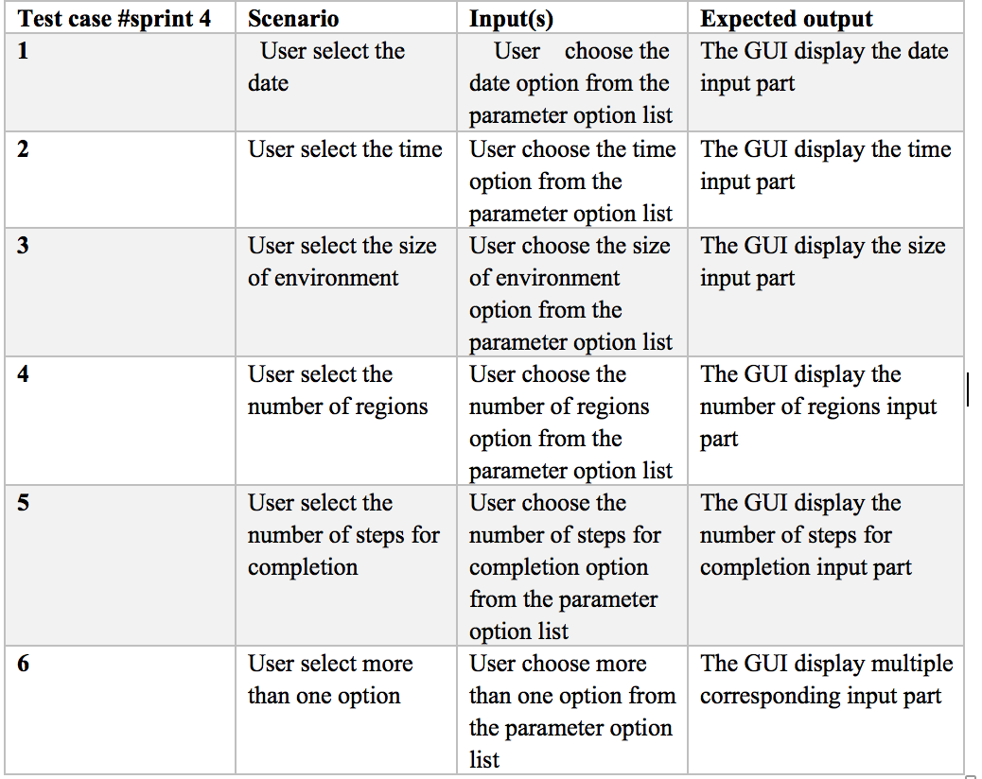
Test Cases for Sprint Task 32
Develop GUI to support selecting the parameters like date, time, size of the environment, number of regions, and number of steps for completion

Slide 10
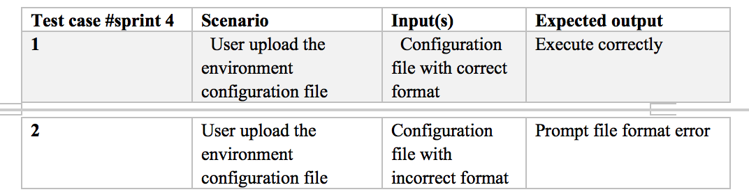
Test Cases for Sprint Task 33
Validating the format and legitimacy of inputting file

