Slide 1
Visualizing Multi-agent Patrolling
Team: Falcons
Members: Yifan gu, sheng zhang, chaohui xu

Slide 2
User Stories
Execute the algorithm step by step or for a fixed number of steps
User Choose an algorithm to run
User view the target list in Graph view

Slide 3
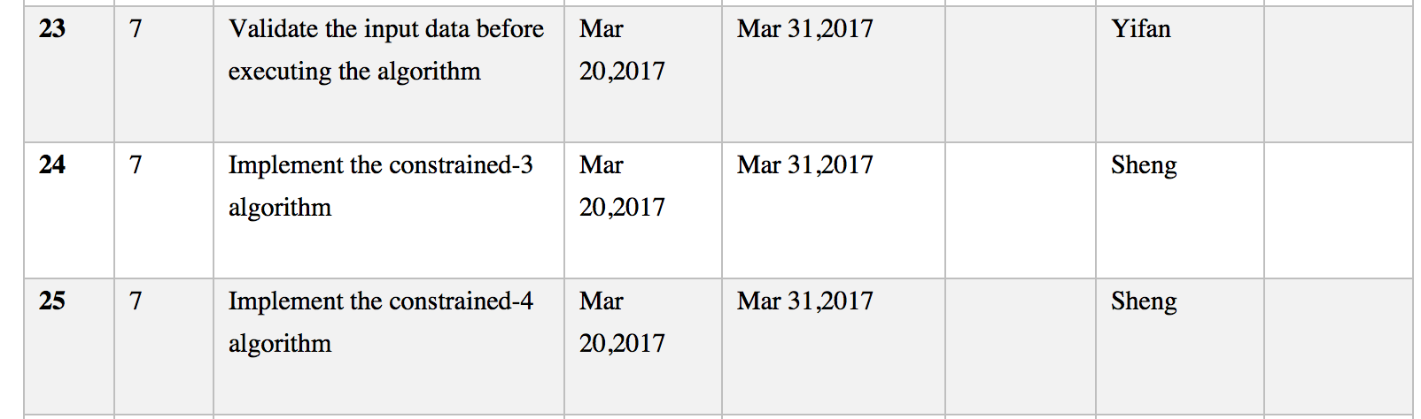
Sprint Tasks
Execute the algorithm step by step or for a fixed number of steps

Slide 4

Sprint Tasks
User Choose an algorithm to run

Slide 5
Sprint Tasks
User view the target list in Graph view

Slide 6
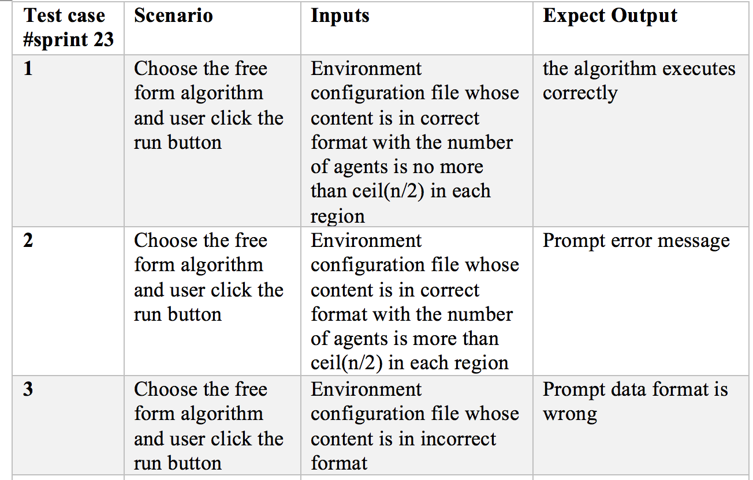
Test cases for sprint task 23- validate the input data before executing the algorithm

Slide 7
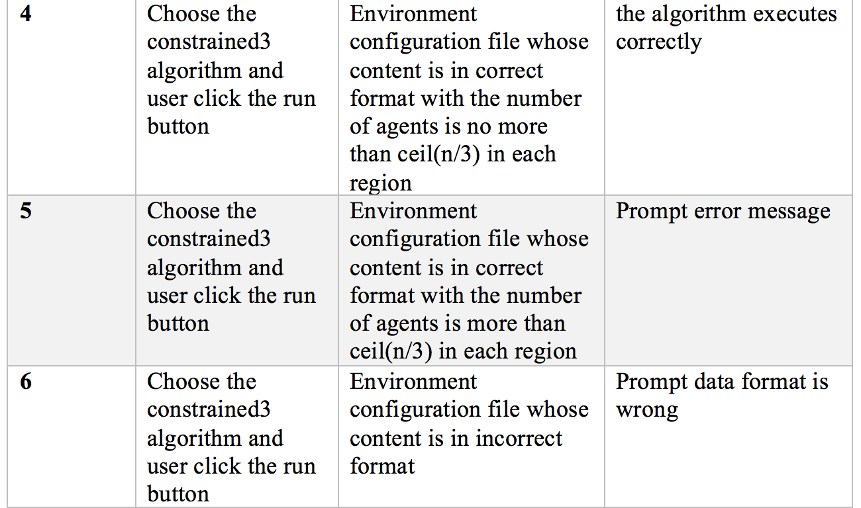
Test cases for sprint task 23- validate the input data before executing the algorithm

Slide 8
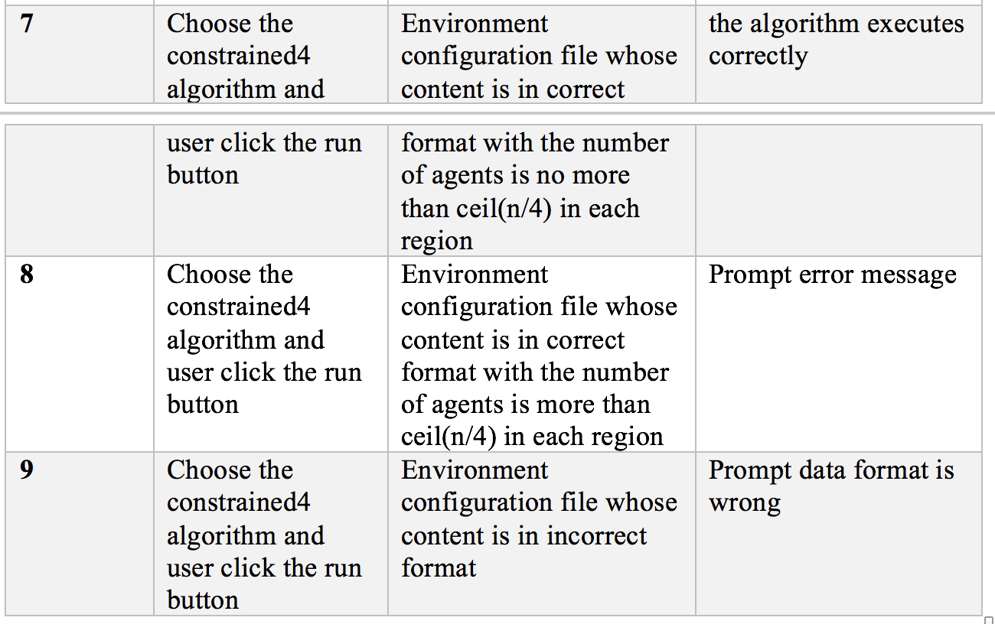
Test cases for sprint task 23- validate the input data before executing the algorithm

