Slide 1
Visualizing Multi-agent Patrolling
Team: Falcons
Members: Yifan gu, sheng zhang, chaohui xu

Slide 2
Feedback
In Observations: File uploading was demonstrated in the previous sprint but was not used this time .
In Suggested improvements: Did a good job.
In Meeting Logs: Professor strongly recommend to have a meeting on the day of the demo or the previous day so that we can confirm what tasks were pending and how they are resolved, whether or not any decision made to postpone certain things and so on.
In Documents: User stories are good, but in sprint tasks there is no task associated with testing. And professor recommend that we should include more test cases. Keep all the test cases in a document and When submit documents, should include all the test case for every spring task .

Slide 3
Plan of actions on the feedback
Showing all the required functionality when we do the demo
Have one more meeting before the demo.
Design more test cases and test the product thoroughly.
Add tasks associated with testing in the sprint tasks

Slide 4
User Stories
Updated:
Execute the algorithm step by step or for a fixed number of steps
Newly added:
User Choose an algorithm to run
User view the target list in Graph view

Slide 5
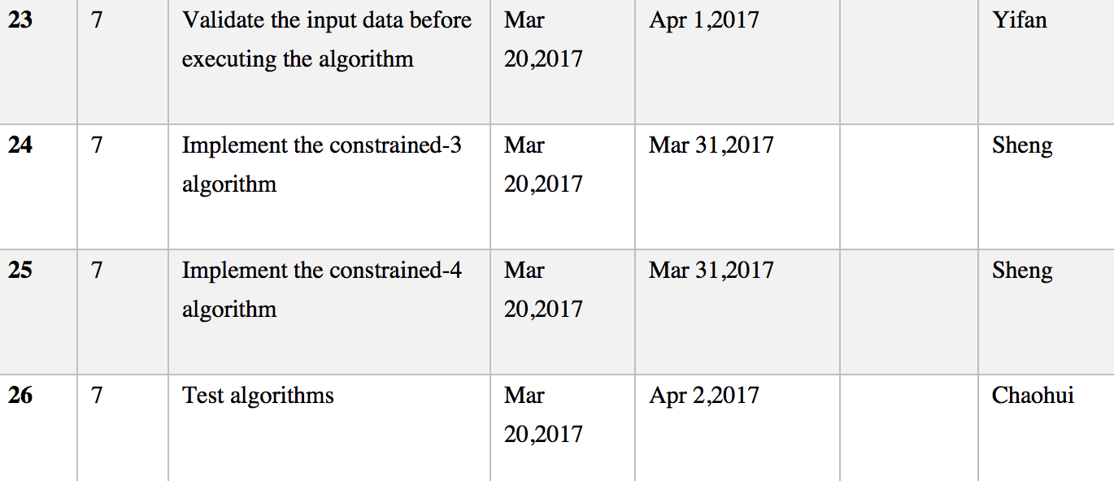
Sprint Tasks
Execute the algorithm step by step or for a fixed number of steps

Slide 6
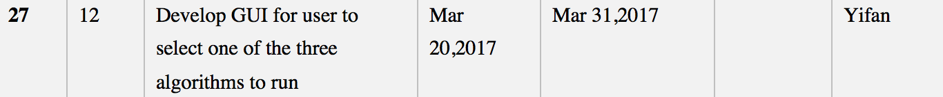
Sprint Tasks
User Choose an algorithm to run

Slide 7
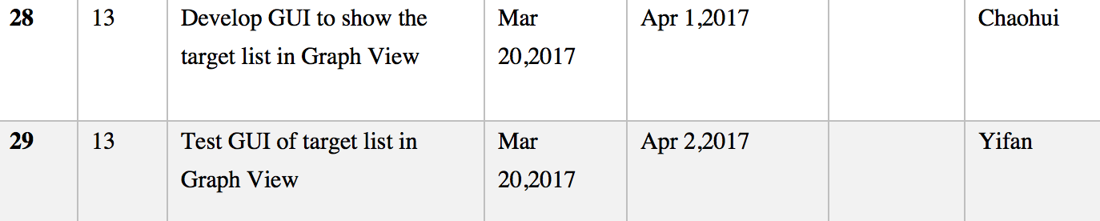
Sprint Tasks
User view the target list in Graph view

Slide 8
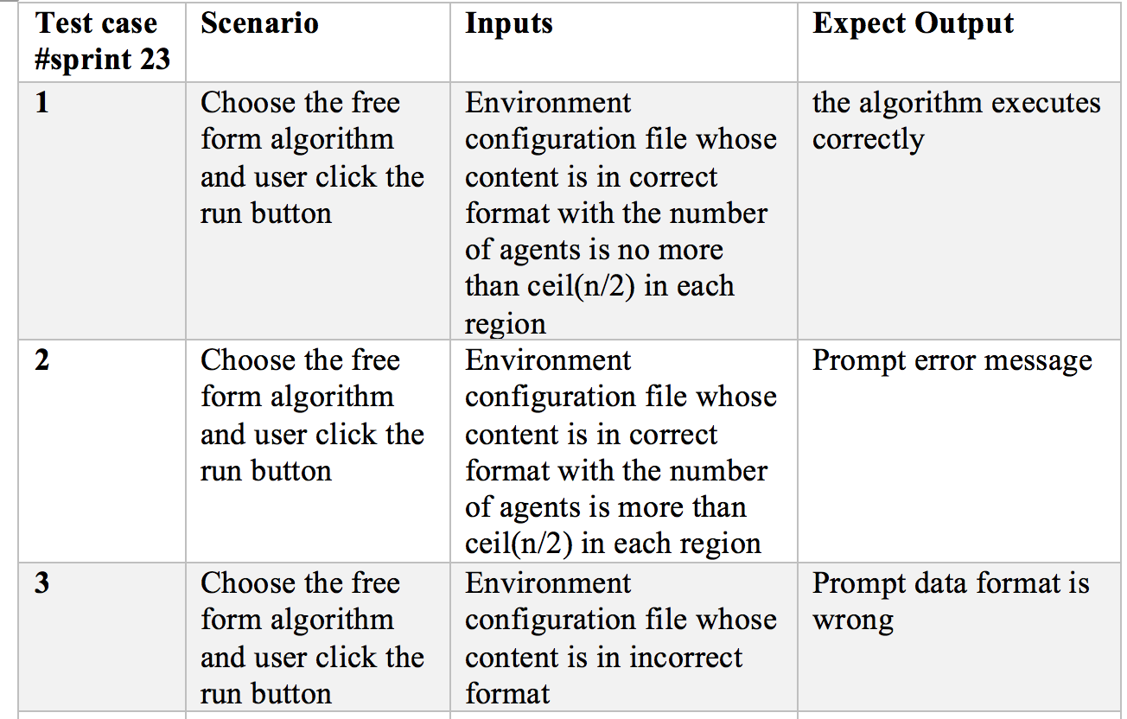
Test cases for sprint task 23- validate the input data before executing the algorithm

Slide 9
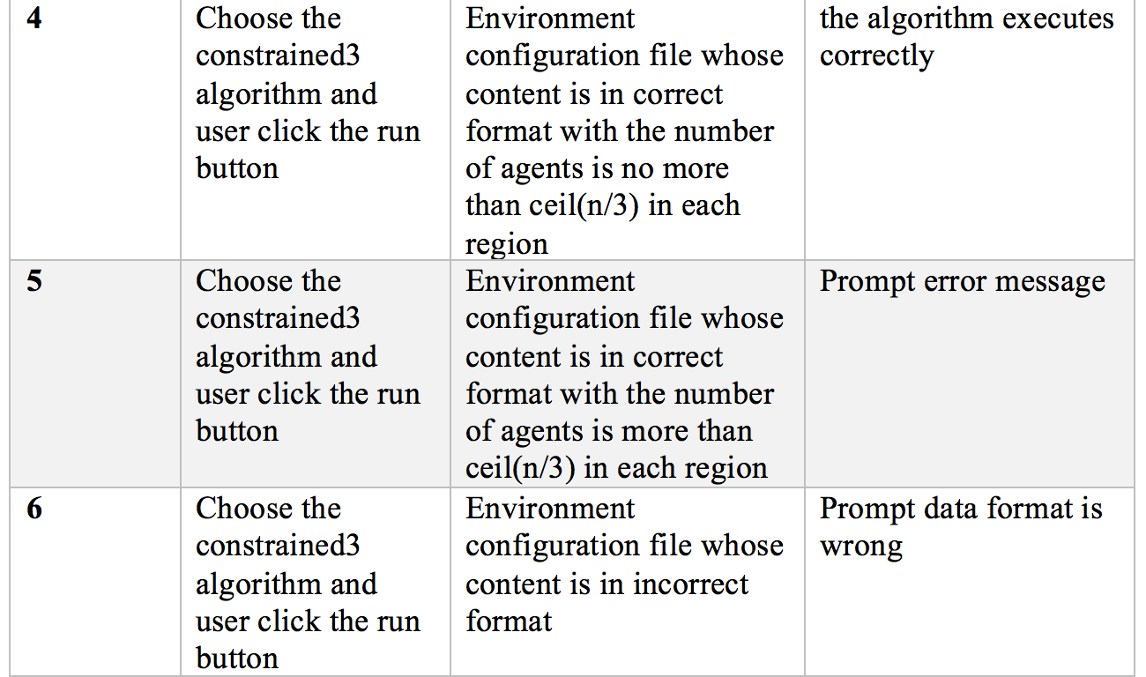
Test cases for sprint task 23- validate the input data before executing the algorithm

Slide 10
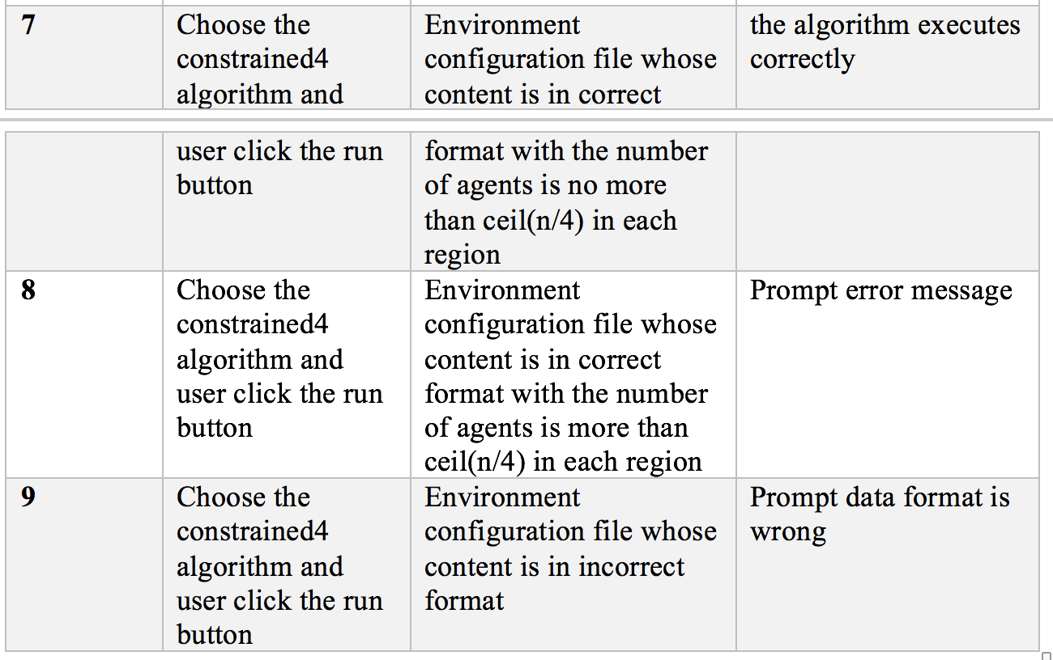
Test cases for sprint task 23- validate the input data before executing the algorithm

