Slide 1
Visualizing Multi-agent Patrolling
Team: Falcons
Members: Yifan gu, sheng zhang, chaohui xu

Slide 2
Feedback
Suggested improvements:
Make sure that error messages are specific to the incident and are useful for debugging.
Make sure that the algorithm is selected first before uploading a file.
The target list display must show the current target for each agent even before the very step of the algorithm is executed.
Meeting Logs:
OK.
Documents:
In the sprint tasks document, task #31 has inconsistent dates .
Only submitted the test cases for sprint #5.

Slide 3
Plan of actions on the feedback
Fix the target list in graph view.
Make sure that the algorithm is selected first before uploading a file.
Make error messages more specific and useful
Finish the sprint task as soon as possible, so that we have enough time to do testing
When submitting the files, make sure the testing file is integrated.

Slide 4
User Stories
Updated:
Load environment file
Filter historical runs of the algorithm
View the target list in Graph view

Slide 5
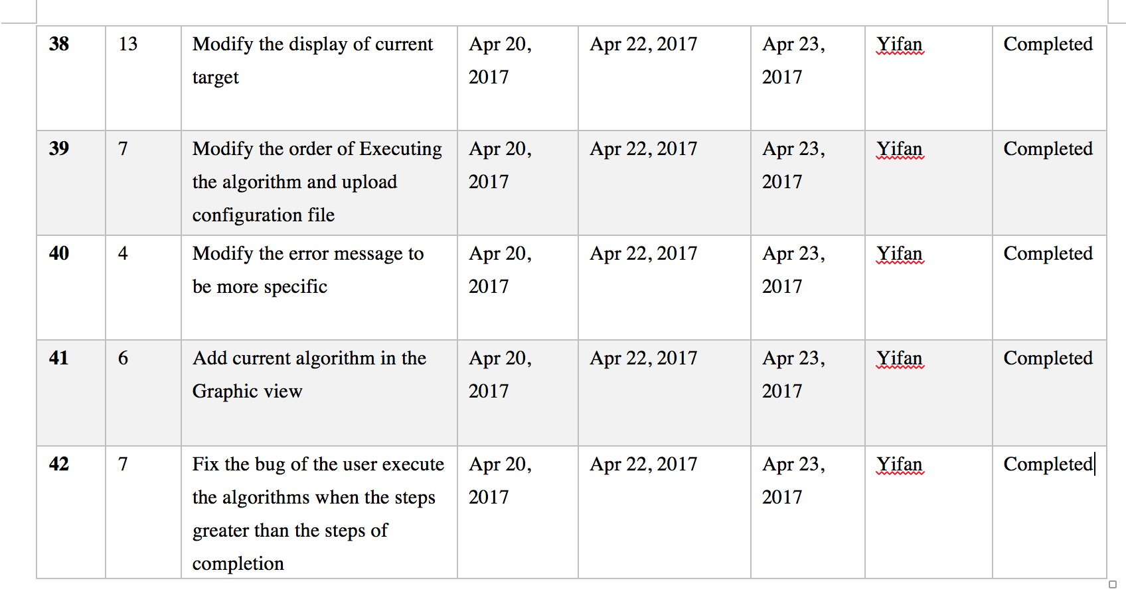
Sprint Tasks

Slide 6
Test Cases for Sprint Task 31
Develop DB access code for retrieving the old runs which can search an old run based on one or more of the following information: date, time, size of the environment, number of regions, and number of steps for completion

Slide 7
Test Cases for Sprint Task 32
Develop GUI to support selecting the parameters like date, time, size of the environment, number of regions, and number of steps for completion

Slide 8
Test Cases for Sprint Task 33
Validating the format and legitimacy of inputting file

