Slide 1
Visualizing Multi-agent Patrolling
team: Falcons
Members: Yifan gu, sheng zhang, chaohui xu

Slide 2
Feedback
In observation, it’s an good job overall as most functions were demonstrated and the GUI itself is resizable.
In suggested improvements, it’s a very good demo as almost everything on the GUI was implemented as expected.
In meeting logs, there is a gap almost a week between the two meeting logs. The last meeting log doesn’t mention the problems appeared in the previous meeting log if they are resolved.
In the document, the test case document doesn’t show adequate number of test cases.

Slide 3
Plan of actions on the feedback
Have one more meeting in one sprint.
Design more test cases
Test the product thoroughly
Change the algorithm to meet the requirements (strengthened in class)

Slide 4
User stories for this sprint
User views the details about the agents in each node in graphical view.
User saves a run of the algorithm.
User views all historical runs of the algorithm.
User filters historical runs of the algorithm.

Slide 5
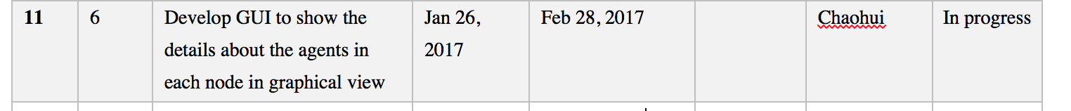
Sprint tasks
User views the details about the agents in each node in graphical view:

Slide 6
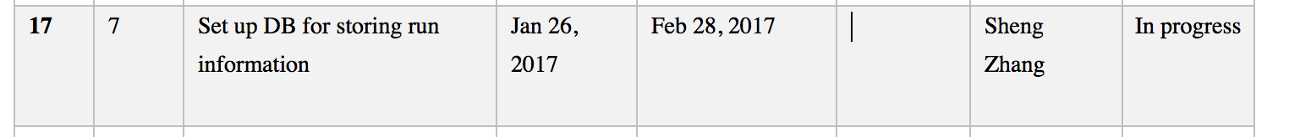
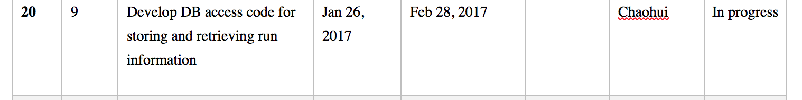
Sprint tasks
User saves a run of the algorithm

Slide 7
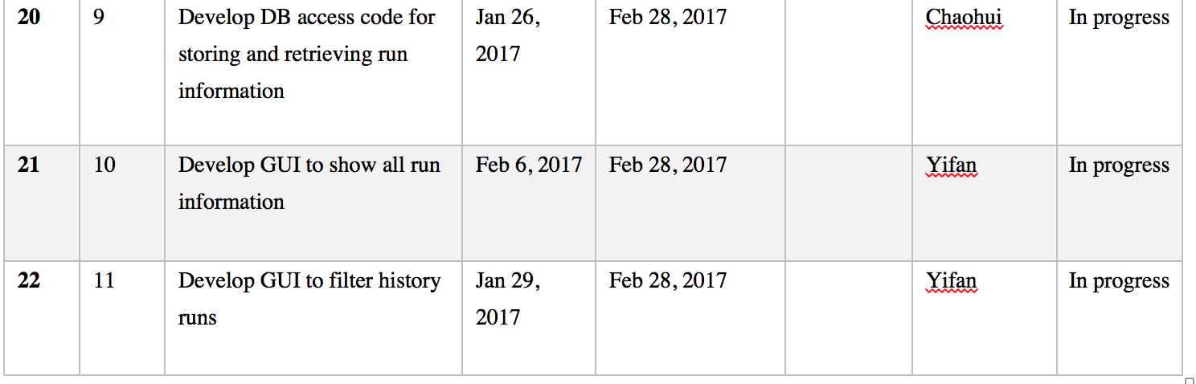
Sprint tasks
User views all historical runs of the algorithm.
User filter historical runs of the algorithm.

Slide 8
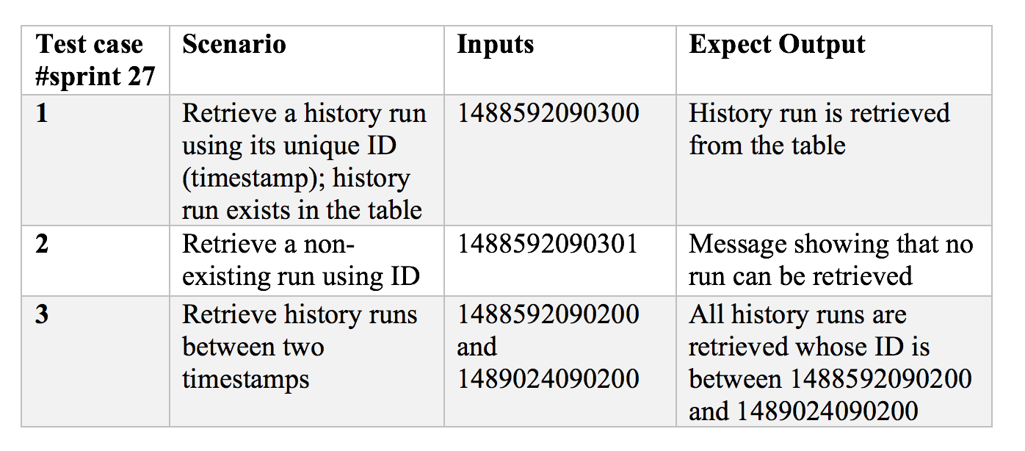
Test cases
Consider the sprint task # 27 – Develop DB access code for storing and retrieving run information

Slide 9
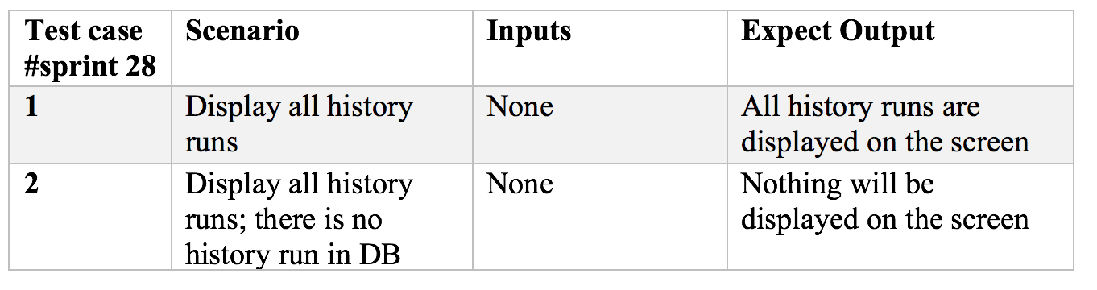
Test cases
Consider the sprint task #28 – develop GUI to show all run information

Slide 10
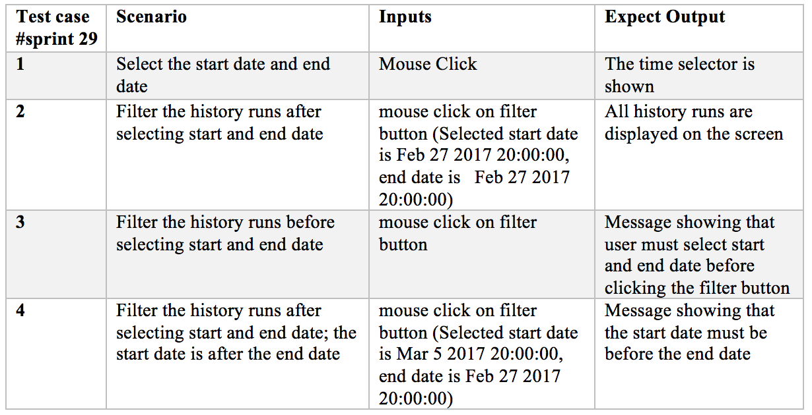
Test cases
Consider the sprint task #29 – develop GUI to filter history runs

