Slide 1

GLS Web designing Pvt.Ltd

Slide 2
Index:
No: | Topic
1. | Introduction
2. | Tools Used
3. | Introduction to Webdesigning
4. | Welcome to HTML
5. | Basic HTML Document Structure
6. | Tags Used
7. | Explaining Different Tags
8. | Inserting and Altering Images
9. | Project Code
10. | Putting it Altogether
11. | Group Members

Slide 3

Introduction:
GLS Web Designing Pvt.Ltd founded in 2014 and moving forward in teaching web Designing, PHP, ASP,JSP,perl to students across Andhra Pradesh. We are growing year by year with support of our trainers and students. We are thankful to everyone who has been a part of our success.

Slide 4


Tools used:
Personal Computer with Internet Connectivity.
Note Pad.
Web Browser(Google Chrome or Internet Explorer).

Slide 5

Introduction to web design:
Web design is the visual aesthetics and page layout of a website. It goes hand-in-hand with web development in the creation of a static website or dynamic web application.
Web design encompasses many different skills and disciplines in the production and maintenance of websites. The different areas of web design include web graphic design; interface design; authoring, including standardized code and proprietary software; user experience design; and search engine optimization.

Slide 6

Welcome to HTML:
HTML stands for Hyper Text Markup Language. Unlike a scripting or programming language that uses scripts to perform functions, a markup language uses tags to identify content.
Here is an example of an HTML tag:
<p> I'm a paragraph </p>.
The ability to code using HTML is essential for any web professional. Acquiring this skill should be the starting point for anyone who is learning how to create content for the web.
The <html> Tag: Although various versions have been released over the years, HTML basics remain the same.

Slide 7
Basic HTML Document Structure:
Everything in an HTML document is surrounded by the <html> tag.
HTML describes the structure of a Web page.
HTML consists of a series of elements.
These elements tell the browser how to display the content.
HTML elements label pieces of content such as "this is a heading", "this is a paragraph", "this is a link", etc.

Slide 8
Tags used:
The <html> Tag : Although various versions have been released over the years, HTML basics remain the same. The structure of an HTML document has been compared with that of a sandwich. As a sandwich has two slices of bread, the HTML document has opening and closing HTML tags. These tags, like the bread in a sandwich, surround everything else:<html> …</html>
The <head> Tag: Immediately following the opening HTML tag, you'll find the head of the document, which is identified by opening and closing head tags. The head of an HTML file contains all of the non-visual elements that help make the page work.<html> <head>…</head> </html>

Slide 9
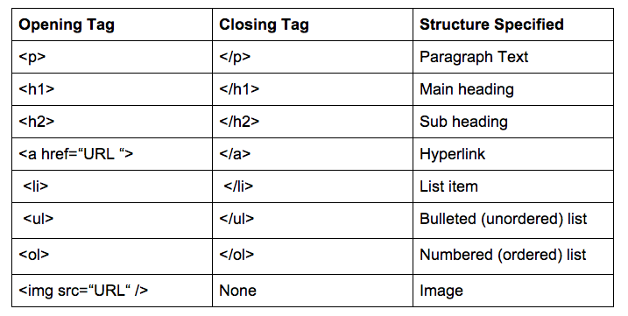
Tags used:
The <body> Tag: The body tag follows the head tag. All visual-structural elements are contained within the body tag. Headings, paragraphs, lists, quotes, images, and links are just a few of the elements that can be contained within the body tag. Basic HTML Structure:<html> <head>….</head> <body> …</body> </html> .The <body> tag defines the main content of the HTML document.

Slide 10
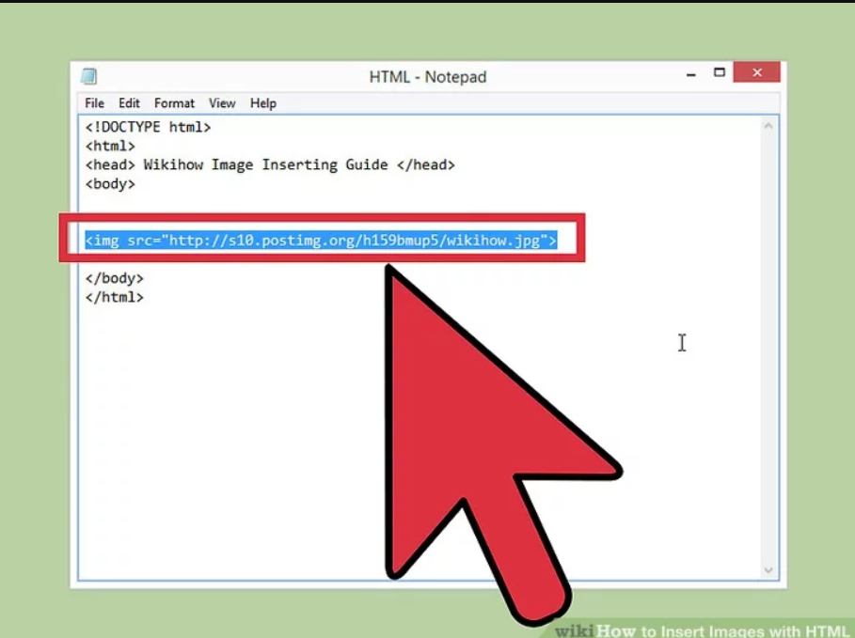
Inserting and Altering Images:
Images can improve the design and the appearance of a web page.
The html <img> tag is used to insert image in an webpage.
Images are not technically inserted into a web page; images are linked to web pages. The <img> tag creates a holding space for the referenced image.
The <img> tag has two required attributes:
src - Specifies the path to the image.
alt - Specifies an alternate text for the image

Slide 11
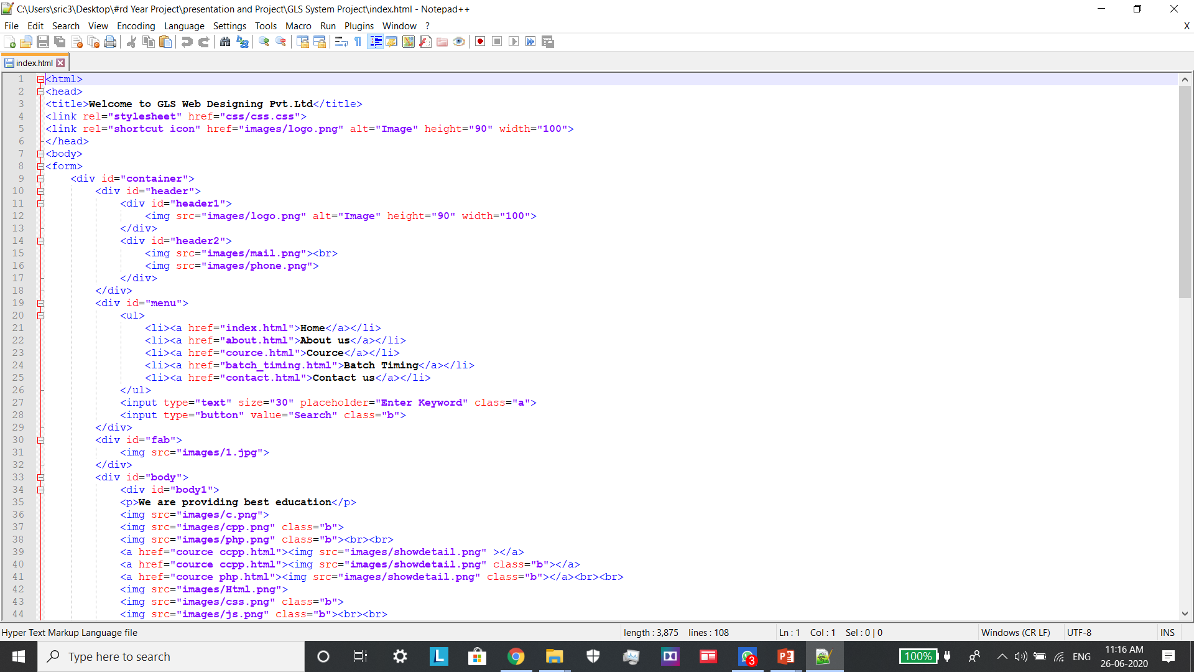
Project Code:
Home Page:

Slide 12
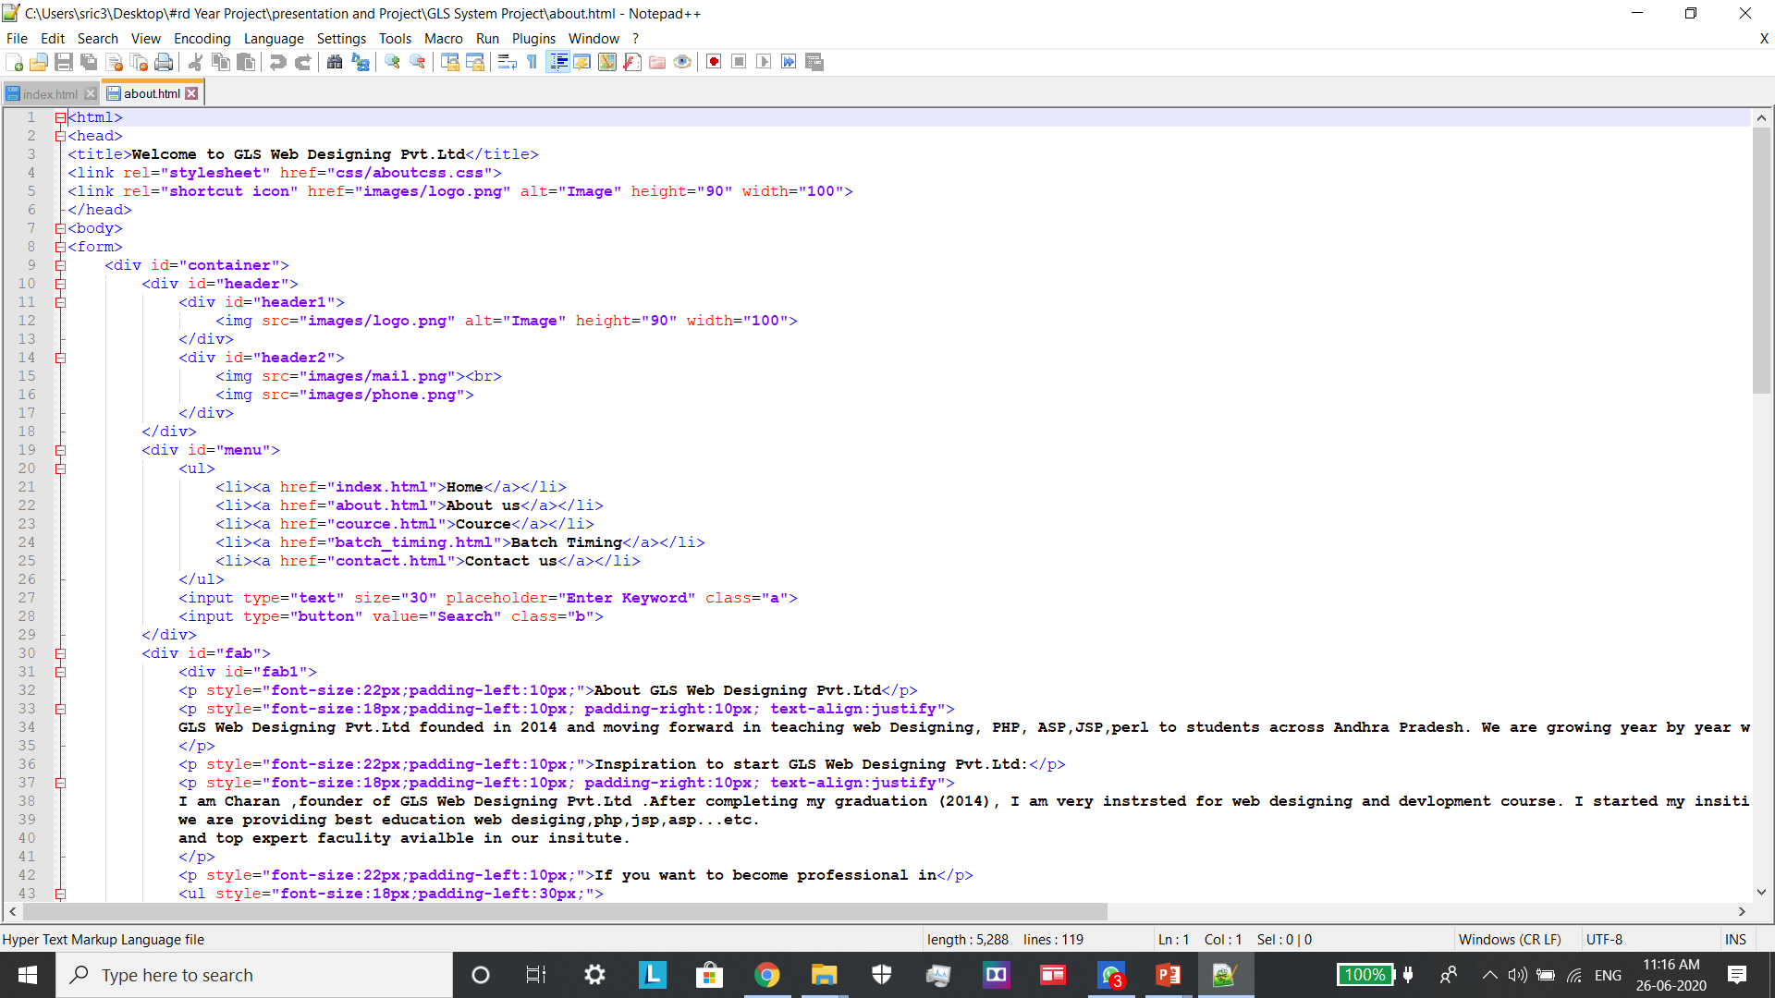
Project code:
About.Html:

Slide 13
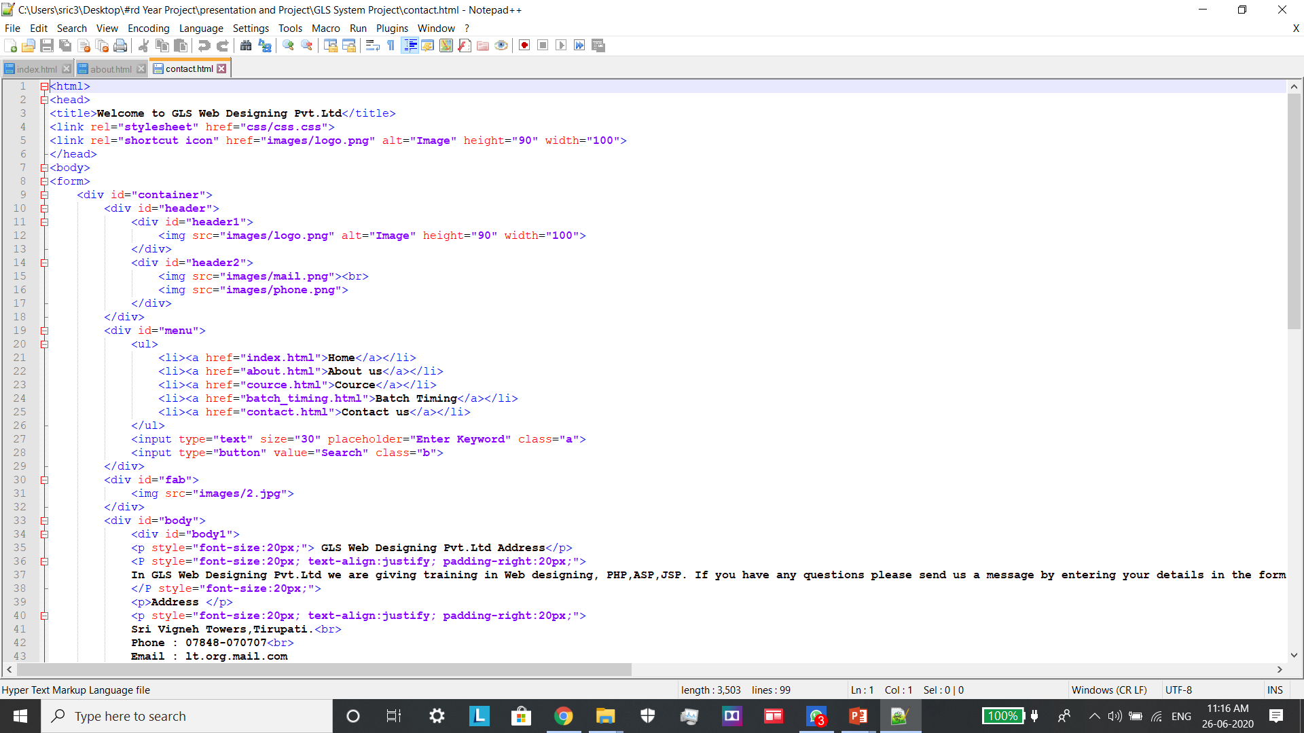
Project code:
Contact.html:

Slide 14
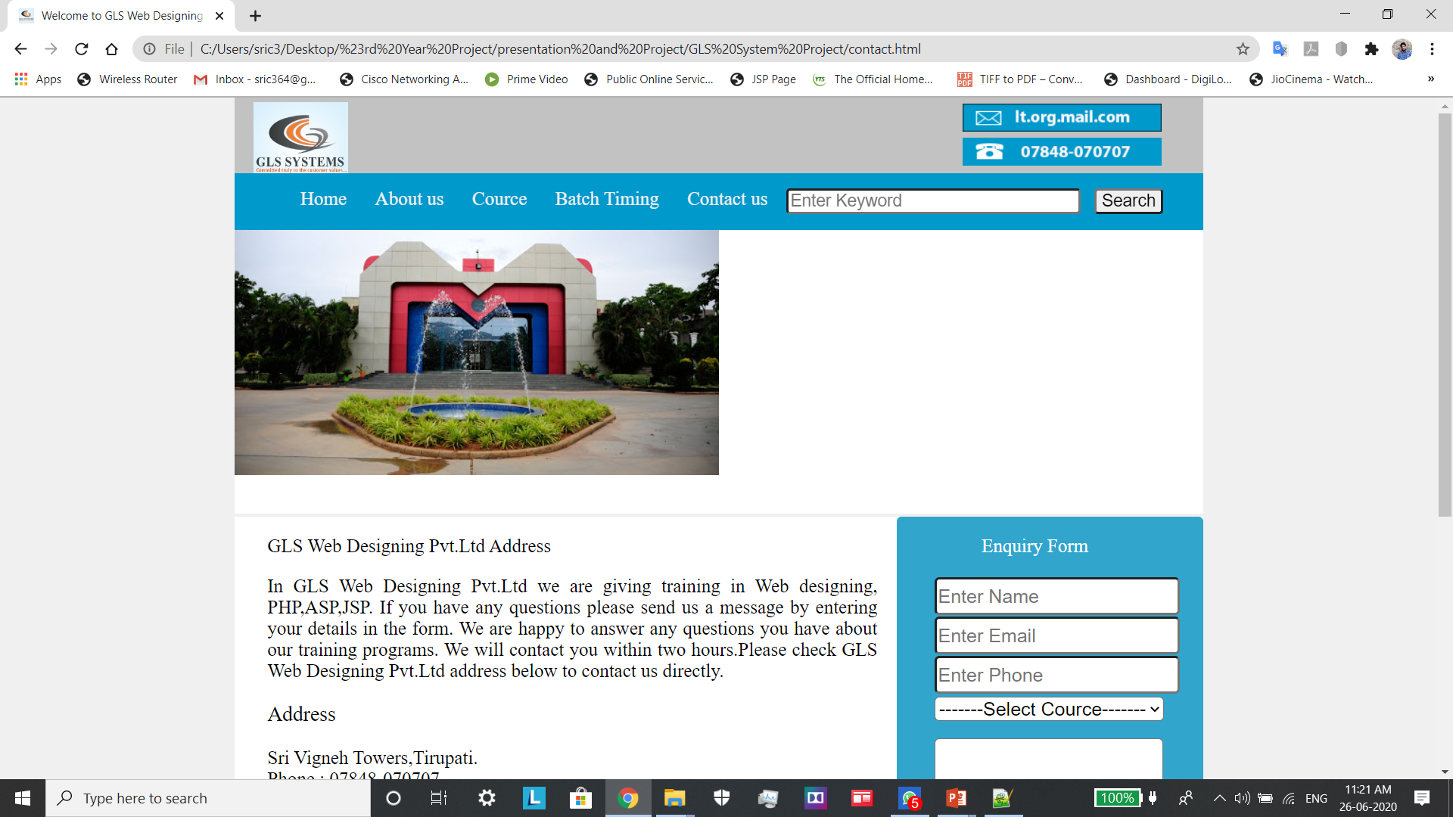
Putting it altogether:

Slide 15
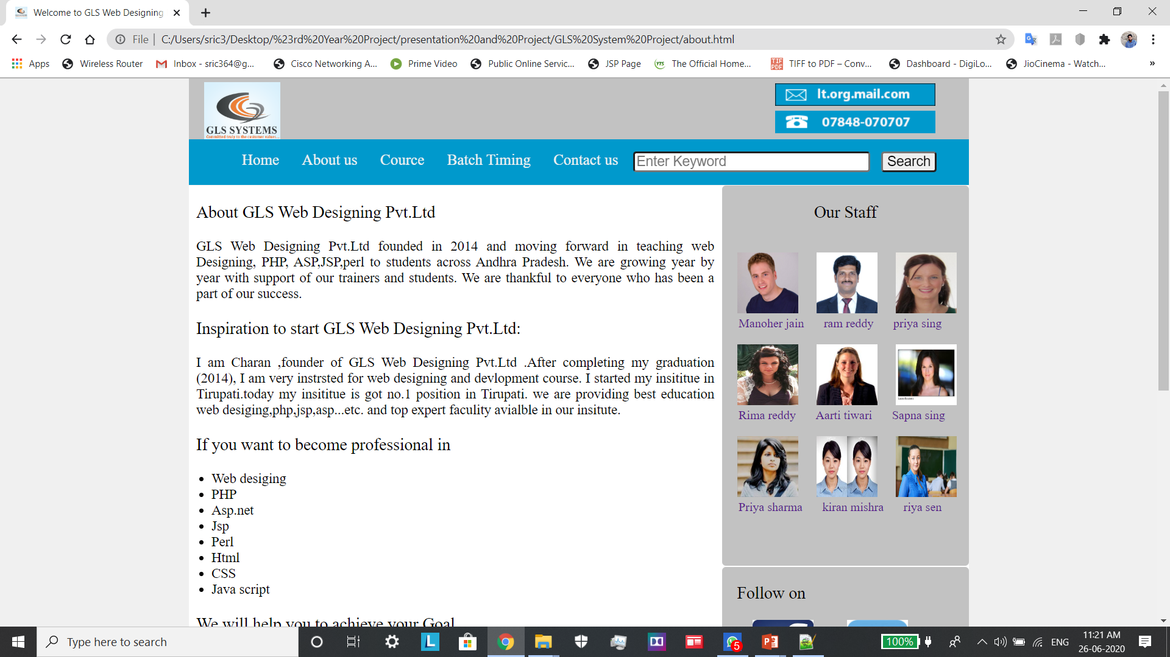
Putting it altogether:

Slide 16
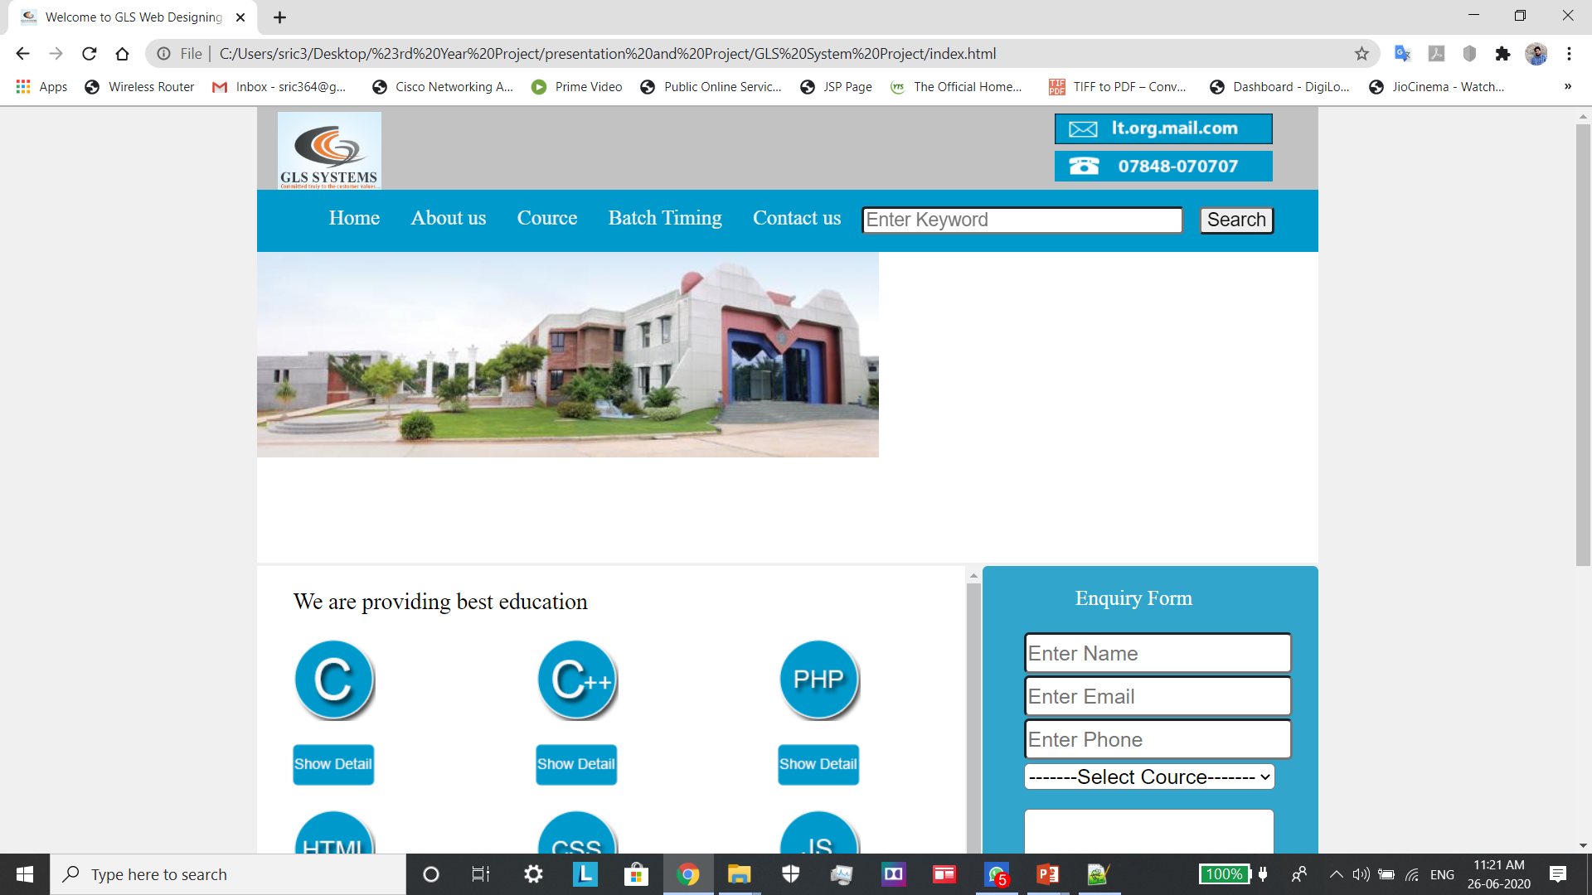
Putting it altogether:

Slide 17
Group Members:
Name: | Roll No:
1. N.S.Charan | 17291-CM-032
2. P. Jahnavi reddy | 17291-CM-036
3. V. Sudharshan Reddy | 17291-CM-056
4. S. Karishma | 17291-CM-047
5. P.Akshaya | 17291-CM-040
6. k. Mounish Reddy | 17291-CM-021
7. V.Vaishnavi | 17291-CM-053
8. P. Vivek | 17291-CM-038
9. P. Leela Sree | 17291-CM-035
10. K. SivaSundar Das | 17291-CM-022
11. M. Vinitha | 17291-CM-030

