Slide 1
Maths For AI
Junchao Chen

Slide 2
Matrix
See a group of data as vectors
In my view, the classification is just to measure the similarity of two or more vectors
Try to describe things in numeric and see as vectors
Matrix
A table contains multiple vectors
Base operation: Add, multiply, transpose, inverse

Slide 3
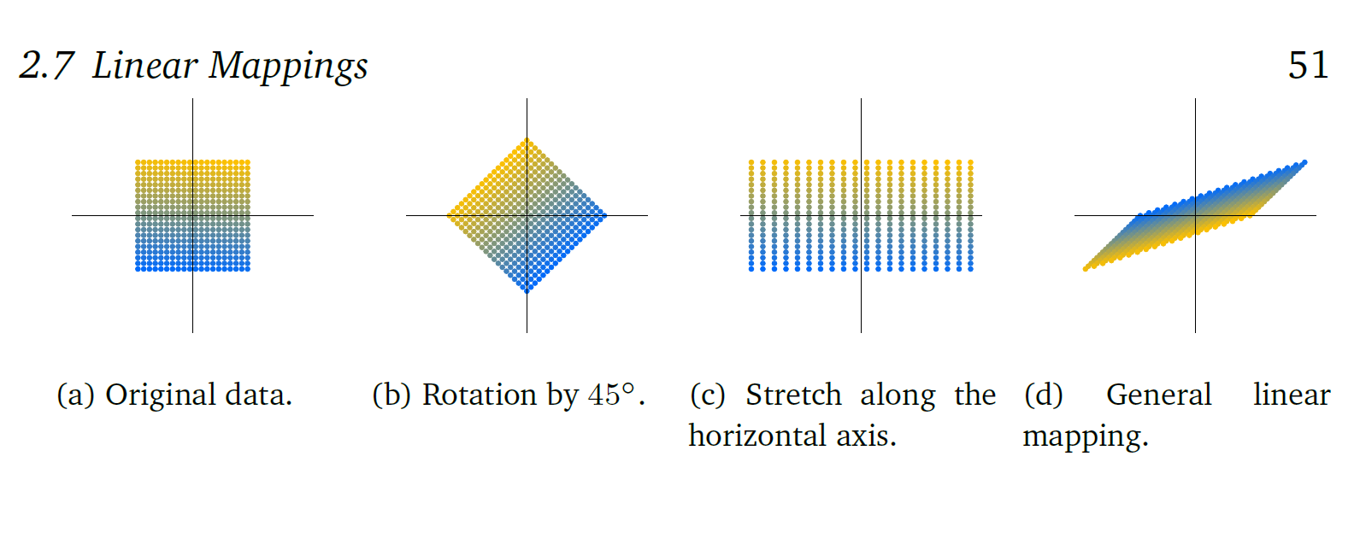
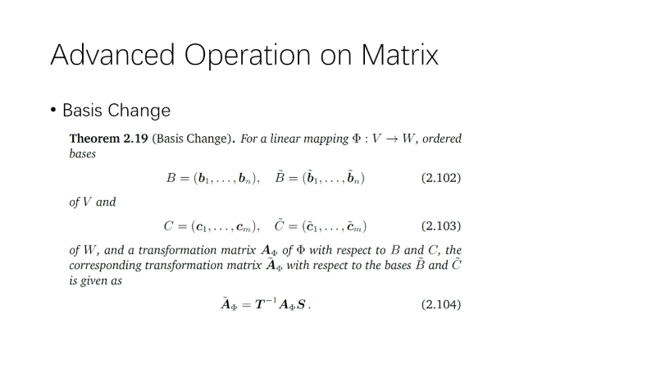
Advanced Operation on Matrix
Transformation

Slide 4
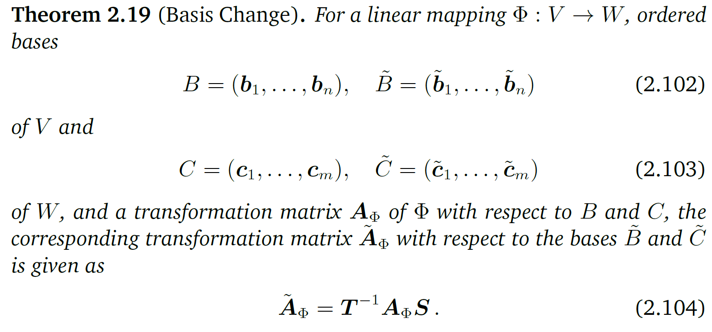
Advanced Operation on Matrix
Basis Change

Slide 5
Norms
In conclude, Norm is used to make some discrete data have a normalization
Already known, nothing new

Slide 6
Useful Methods for ML
Matrix Calculus
Back Propagation
Norm
Normalization
LMS
Regression
Likelihood
Classification

