Slide 1

CS224W Recitation: A Tutorial of SNAP
Chenguang Zhu

Slide 2
What is SNAP？
Stanford Network Analysis Project (SNAP)
A network analysis and graph mining library
C++ based
Manipulates large graphs, calculates structural properties, generates graphs, and supports attributes on nodes and edges
More info on http://snap.stanford.edu

Slide 3
Content
Installation
Data structures in SNAP
Graph manipulation in SNAP
Datasets in SNAP
Plotting in SNAP
Q&A

Slide 4
Content
Installation
Data structures in SNAP
Graph manipulation in SNAP
Datasets in SNAP
Plotting in SNAP
Q&A

Slide 5

Download
1. Go to http://snap.stanford.edu/snap/download.html
2. Download the latest SNAP version (v2.1)

Slide 6
Download
SNAP is also available from github
Example (under Mac command line)
1. Get git client
sudo port install git-core
2. Clone the repository
git clone https://github.com/snap-stanford/snap.git
A snap folder will then be downloaded with all the source code

Slide 7
Installation (Windows)
1. Unzip
2. Go to subfolder “examples”
3. Open project “SnapExamples-VS10.sln” (Visual Studio required)

Slide 8
Installation (Linux/Mac)
If your system is Linux-based, use the Makefile in the same folder
For Mac, there’s snap-examples.xcodeproj for Xcode.
You can refer to any Makefile and Makefile.ex in folders in “examples”, e.g. examples/cascades

Slide 9
Where to run
Stanford computing resources
http://itservices.stanford.edu/service/sharedcomputing/environments
ssh to corn.stanford.edu
No. of Computers | Model | OS | Processor | RAM | Disk
30 | Sun Blade X6240 | Ubuntu GNU/Linux | 8-core 2.7 GHz AMD Opteron (2384) | 32 GB | 10 GB swap, 75 GB temp

Slide 10
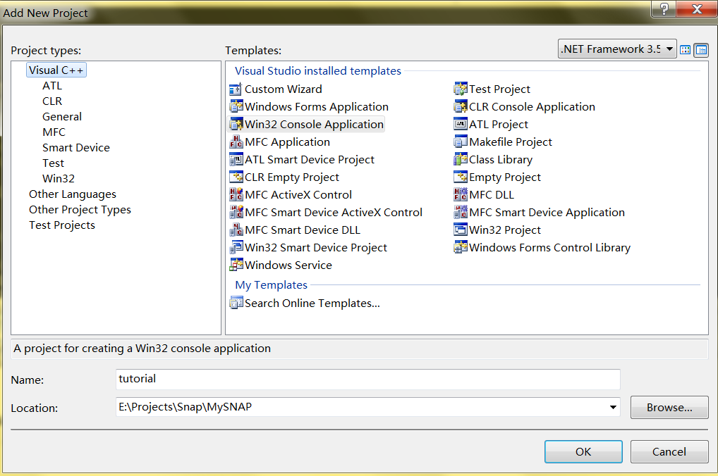
Create Your Own Project
Open Visual Studio and create a project

Slide 11
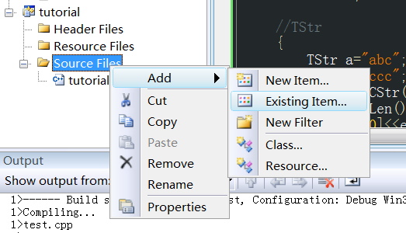
Create Your
Own Project (Windows)
Add line “#include Snap.h” into your main program
#include <stdio.h>
#include “Snap.h“
…
Include YOUR_SNAP_PATH/snap-core/Snap.h & Snap.cpp into your project

Slide 12
Add Path
Add path to the Snap library code
YOUR-SNAP-PATH/glib-core
YOUR-SNAP-PATH/snap-core
YOUR-SNAP-PATH/snap-adv
Right-click on your project and go to “Properties”
Go to Configuration Properties→ C/C++→ General→ Edit “Additional Include Directories”

Slide 13
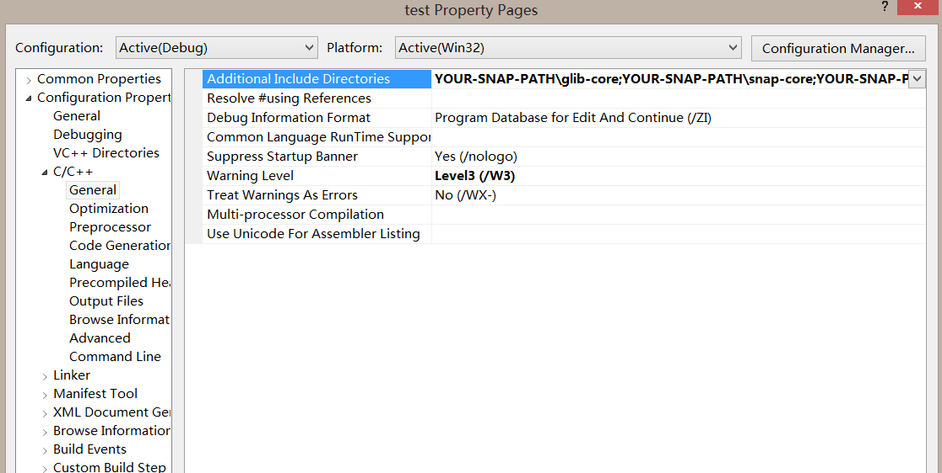

Slide 14
Create Your Own Project
Due to the settings of SNAP, the character set must be set to Multi-byte
Right-click on your project and go to “Properties”
Go to Configuration Properties→ General→ Projects Defaults → Character Set → Select “Use Multi-Byte Character Set”

Slide 15
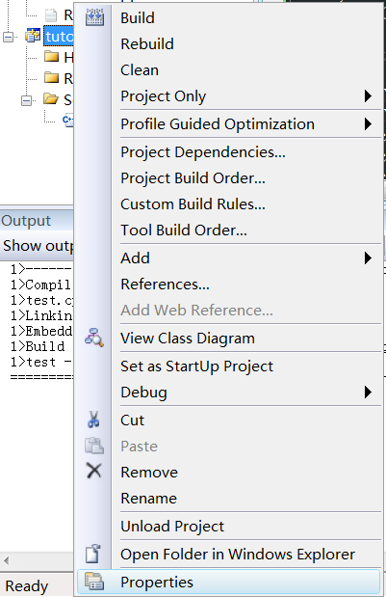

Slide 16
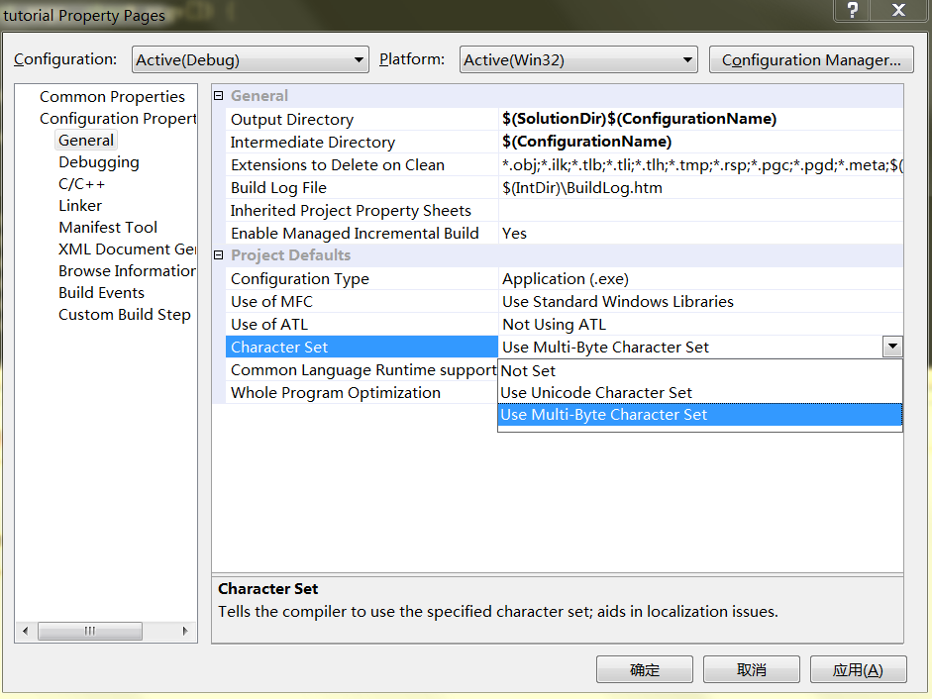

Slide 17
Create Project under Linux/Mac
Create a folder like myproj in the snap directory (where snap-core, snap-adv .. are)
Write code, e.g. myproj.cpp, in myproj folder
Copy Makefile from tutorials folder to myproj folder, change the definition of DEMOS to your code name, e.g. DEMOS = myproj
Make

Slide 18
Content
Installation
Data structures in SNAP
Graph manipulation in SNAP
Datasets in SNAP
Plotting in SNAP
Q&A

Slide 19
What’s In SNAP？
Data structures (In subfolder “glib-*”):
STL-like library
Contains basic data structures, like vectors, hash-tables and strings
Provides serialization for loading and saving
Network analysis library (In subfolder “snap-*”)
Network generation, manipulation
Example applications (In subfolder “examples”)
Small sample applications that demonstrate functionality

Slide 20
Data Structures
In subfolder “glib-core”
More info in glib-core/ds.h
Numbers:
Integers: TInt
Real number: TFlt
Example:
TInt a=5; cout<<a<<endl;
Note: in C style, use printf(“%d\n”, a.Val);

Slide 21
Basic Structures
String: TStr
Examples:
TStr a="abc";
TStr b="ccc";
cout<<a.CStr()<<endl; (char*) --- abc
cout<<a.Len()<<endl; --- 3
cout<<a[0]<<endl; --- a
cout<<(a==b)<<endl; --- 0

Slide 22
Combination
Pair
TPair<Type1, Type2> (Type can also be complex structures like TVec, TPair…)
E.g. TPair<TInt, TFlt> a; a.Val1=…; a.Val2=…;
List of shorthand (in ds.h)
typedef TPair<TInt, TInt> TIntPr;
typedef TPair<TInt, TIntPr> TIntIntPrPr;
Triple
TTriple<Type1, Type2, Type3>

Slide 23
Vectors
TVec<Type>
Example:
TVec<TInt> a;
a.Add(10);
a.Add(20);
a.Add(30);
cout<<a[0]<<endl; --- 10
cout<<a.Len()<<endl; --- 3
Similarly, “Type” can be complex structures like TVec< TVec< TVec<TFlt> > >

Slide 24
Hash Tables
THash<key type, value type>
Key is the unique index, value is associated with key
KeyId is index into the array that stores key-value pairs
Next (collision in hash)
KeyId | 0 | 1 | 2
Key | “David” | “Ann” | “Jason”
Value | 100 | 89 | 95

Slide 25
Hash Tables
Example:
THash<TInt, TStr> a;
a.AddDat(12, “abc”);
a.AddDat(34,“def”);
cout<<a.GetKey(0)<<endl; ---- 12
for (int i=0; i<2; ++i)
cout<<a[i].CStr()<<endl; ---- abc
---- def
cout<<a.GetKeyId(12)<<endl; ---- 0
cout<<a.GetDat(34).CStr()<<endl; ----- def

Slide 26
Hash Tables
When key is of string type: THash<TStr, …>, a more space-efficient way is to use TStrHash<…>
Example: TStrHash<TInt>
Uses string pool, saves more space

Slide 27
Hash Sets
In case only key is needed, use THashSet
Example:
THashSet<TInt> a;
a.AddKey(12);
a.AddKey(34);
a.AddKey(56);
cout<<a.GetKey(2)<<endl; --- 56

Slide 28
Saving and Loading
Binary files
Much quicker to save/load
Memory efficient
Save:
{TFOut fout("a.bin");
a.Save(fout);}
Load:
{TFIn fin("a.bin");
a.Load(fin);}

Slide 29
Useful Data Structure(1): Time
TSecTm
Manipulates time
Supports comparison, calculation in different time units, obtaining current time…
DEMO: demo-TSecTm.cpp

Slide 30
Useful Data Structure(2): Generate Distribution
TRnd class
Generate lots of distributions
Example:
TRnd a;
//exponential distribution
for (int i=0; i<10; ++i)
cout<<a.GetExpDev(1)<<endl;
DEMO: demo-TRnd.cpp

Slide 31
Useful Data Structure(3): Calculating Statistics
In glib-core/xmath.h
Multiple classes
Calculating moments, correlation coefficients, t-test …
Demo: demo-XMath.cpp

Slide 32
Content
Installation
Data structures in SNAP
Graph manipulation in SNAP
Datasets in SNAP
Plotting in SNAP
Q&A

Slide 33
What’s In SNAP？
Data structures (In subfolder “glib-*”):
STL-like library
Contains basic data structures, like vectors, hash-tables and strings
Provides serialization for loading and saving
Network analysis library (In subfolder “snap-*”)
Network generation, manipulation
Example applications (In subfolder “examples”)
Small sample applications that demonstrate functionality

Slide 34
Graph Type
TUNGraph: undirected graph with no multi-edge
TNGraph: directed graph with no multi-edge
TNEGraph: directed graph with multi-edge

Slide 35
Network Type
TNodeNet<TNodeData>: directed graph with TNodeData object for each node
TNodeEDatNet<TNodeData, TEdgeData>: directed graph with TNodeData on each node and TEdgeData on each edge
TNodeEdgeNet<TNodeData, TEdgeData>: directed multi-edge graph with TNodeData on each node and TEdgeData on each edge

Slide 36
Network Type
TNodeNet<TNodeData>: directed graph with TNodeData object for each node
TNodeEDatNet<TNodeData, TEdgeData>: directed graph with TNodeData on each node and TEdgeData on each edge
TNodeEdgeNet<TNodeData, TEdgeData>: directed multi-edge graph with TNodeData on each node and TEdgeData on each edge
When you want to use saving/loading function, you have to write Save and Load
Demo: NodeNet.cpp

Slide 37
Example
Smart pointer: Count the number of pointers to an object. Release things automatically when the count→0
Use smart pointer whenever possible
typedef TPt<TNGraph> PNGraph
Add node before edges
Example:
PNGraph Graph = TNGraph::New();
Graph->AddNode(1);
Graph->AddNode(5);
Graph->AddEdge(1,5);

Slide 38
Example
Use smart pointer whenever possible
typedef TPt<TNGraph> PNGraph
Add node before edges
Example:
PNGraph Graph = TNGraph::New();
Graph->AddNode(1);
Graph->AddNode(5);
Graph->AddEdge(1,5);
Demo: demo-Gnm.cpp

Slide 39
Establish A Graph
Generate graph with specific properties
Use TSnap::Gen…
TSnap::GenRndGnm (G_{nm} (Erdős–Rényi) graph)
TSnap::GenForestFire (Forest Fire Model)
TSnap::GenPrefAttach (Preferential Attachment)
Example:
// create a directed random graph on 100 nodes and 1k edges
PNGraph Graph = TSnap::GenRndGnm<PNGraph>(100, 1000);

Slide 40
1. Traverse a graph
// traverse the nodes
for (TNGraph::TNodeI NI=Graph->BegNI(); NI<Graph->EndNI(); NI++)
printf("%d %d %d\n", NI.GetId(), NI.GetOutDeg(), NI.GetInDeg());
// traverse the edges
for (TNGraph::TEdgeI EI=Graph->BegEI(); EI<Graph->EndEI(); EI++)
printf("edge (%d, %d)\n", EI.GetSrcNId(), EI.GetDstNId());
// we can traverse the edges also like this
for (TNGraph::TNodeI NI=Graph->BegNI(); NI<Graph->EndNI(); NI++)
for (int e = 0; e < NI.GetOutDeg(); e++)
printf("edge (%d %d)\n", NI.GetId(), NI.GetOutNId(e));
Notes:
TNodeI is a subclass inside TNGraph

Slide 41
2. Get properties of a graph
// generate a network using Forest Fire model
PNGraph G = TSnap::GenForestFire(1000, 0.35, 0.35);
// convert to undirected graph TUNGraph
PUNGraph UG = TSnap::ConvertGraph<PUNGraph, PNGraph> (G);
// get largest weakly connected component of G
PNGraph WccG = TSnap::GetMxWcc(G);
// get a subgraph induced on nodes {0,1,2,3,4}
PNGraph SubG = TSnap::GetSubGraph (G, TIntV::GetV(0,1,2,3,4));
Demo: demo-getCC.cpp
Notes:
Demonstrate:
PNGraph G = TSnap::GenRndGnm<PNGraph>(100,50);
// convert to undirected graph TUNGraph
PUNGraph UG = TSnap::ConvertGraph<PUNGraph>(G);
// get largest weakly connected component of G
PNGraph WccG = TSnap::GetMxWcc(G);
printf("largest wcc size=%d\n", WccG->GetNodes());

Slide 42
Play With A Graph
TVec<TPair<TInt, TInt> > CntV; // vector of pairs of integers (size, count)
//get distribution of connected components (component size, count)
TSnap::GetWccSzCnt(G, CntV);
// get degree distribution pairs (degree, count)
TSnap::GetOutDegCnt(G, CntV);

Slide 43
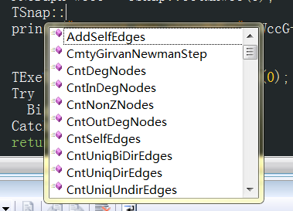
More…
Explore namespace TSnap

Slide 44
What’s In SNAP？
Data structures (In subfolder “glib-*”):
STL-like library
Contains basic data structures, like vectors, hash-tables and strings
Provides serialization for loading and saving
Network analysis library (In subfolder “snap-*”)
Network generation, manipulation
Example applications (In subfolder “examples”)
Small sample applications that demonstrate functionality

Slide 45
Example Applications
Cascades: Simulate SI model on a network
Cliques: Clique Percolation Method for detecting overlapping communities
ForestFire: ForestFire graph generative model
TestGraph: Demonstrates basic functionality of the library

Slide 46
Content
Installation
Data structures in SNAP
Graph manipulation in SNAP
Datasets in SNAP
Plotting in SNAP
Q&A

Slide 47
Datasets In SNAP
http://snap.stanford.edu/data/index.html
Some examples:
Social networks: online social networks, edges represent interactions between people
Citation networks: nodes represent papers, edges represent citations
Collaboration networks: nodes represent scientists, edges represent collaborations (co-authoring a paper)
Amazon networks : nodes represent products and edges link commonly co-purchased products
Twitter and Memetracker : Memetracker phrases, links and 467 million Tweets

Slide 48
Datasets in SNAP
Example file (as20graph.txt in subfolder examples)
# Directed Node Graph
# Autonomous systems (graph is undirected, each edge is saved twice)
# Nodes: 6474 Edges: 26467
# SrcNId DstNId
1 3
1 6
1 32
1 48
1 63
1 70
…

Slide 49
Loading/Saving
Loading:
PUNGraph g=TSnap::LoadEdgeList<PUNGraph>(“as20graph.txt”,0,1);
0 is the column id for source node
1 is the column id for target node
Saving
TSnap::SaveEdgeList<PUNGraph>(g, “as20graph.txt”, ””);
Not as efficient as loading and saving in binary form
g->Save(TFOut(“graph.bin”));

Slide 50
Content
Installation
Data structures in SNAP
Graph manipulation in SNAP
Datasets in SNAP
Plotting in SNAP
Q&A

Slide 51
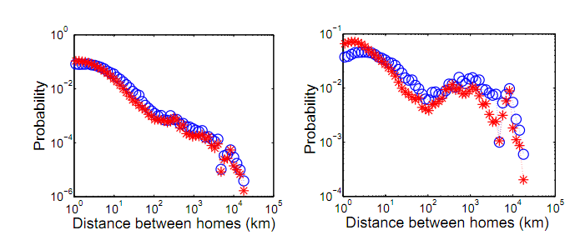
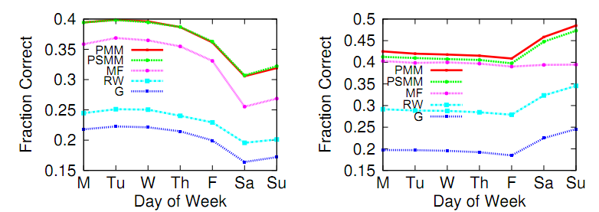
Want To Draw？
Last topic: making a plot in SNAP

Slide 52
Want To Draw？
Steps:
Install Gnuplot from http://www.gnuplot.info/
Make sure that the path containing wgnuplot.exe (for Windows) or gnuplot (for Linux) is in your environmental variable $PATH.
Example:
TVec<TPair<TFlt, TFlt > > XY1, XY2; …
TGnuPlot Gp(“file name”, “title name");
Gp.AddPlot(XY1, gpwLinesPoints, “curve1");
Gp.AddPlot(XY2, gpwPoints, “curve2");
Gp.SetXYLabel(“x-axis name", “y-axis name”);
Gp.SavePng(); //or Gp.SaveEps();

Slide 53

Gnuplot
After executing, three files generated
.plt file is the plotting command for gnuplot
.tab file contains the data
.png or .eps is the plot
Demo: demo-Gnuplot.cpp

Slide 54
Visualize Your Graph
Use TGraphViz
Need to install GraphViz software first http://www.graphviz.org/
Add GraphViz path to environment variable
Visualize graph with contents

Slide 55
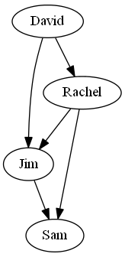
PNGraph g=TNGraph::New();
g->AddNode(1); g->AddNode(2);
g->AddNode(3); g->AddNode(4);
g->AddEdge(1,2); g->AddEdge(2,3);
g->AddEdge(1,3); g->AddEdge(2,4);
g->AddEdge(3,4);
TIntStrH name;
name.AddDat(1)="David";
name.AddDat(2)=“Rachel";
name.AddDat(3)="Jim";
name.AddDat(4)="Sam";
TSnap::DrawGViz<PNGraph>(g, gvlDot, "gviz_plot.png", "", name);

Slide 56
Thank you!
Any questions?

