Slide 1
NodeXL的改進與應用Project Review II
授課老師: 李允中老師
組長: B99902066 蔡宗翰
組員: d98944002 林映孜, d02922030 范哲誠, d02944010 呂俊宏
b99902032 黃奕軻, b99902123 廖尉棠, b99902025 吳佳倫
b99902100 劉宗瑋

Slide 2
Project 進度的檢討
透過Project Build Dependence 找出先後順序
22 project file, more than 476 class(including test & unit testing)
Design issue(20140304)
Standalone program , 將NodeXL可以在Execl 外的程式獨立執行。
New algorithm Design
New design issues(20140311)
In Algorithms project, the project call external program “SnapGraphMetricCalculator.exe” to calculate GraphMetric. This maybe was the performance issues 1.
Layouts maybe another the performance issues 2.

Slide 3
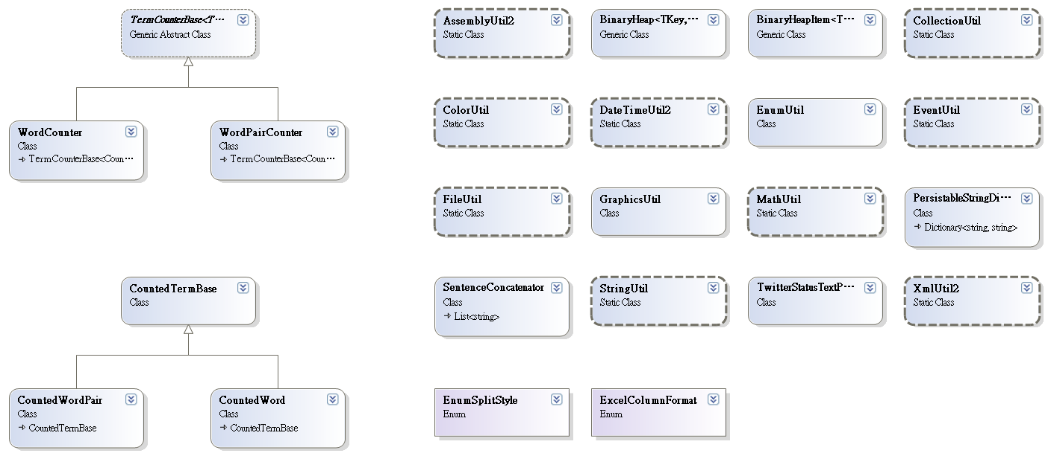
Util
Notes:
24

Slide 4
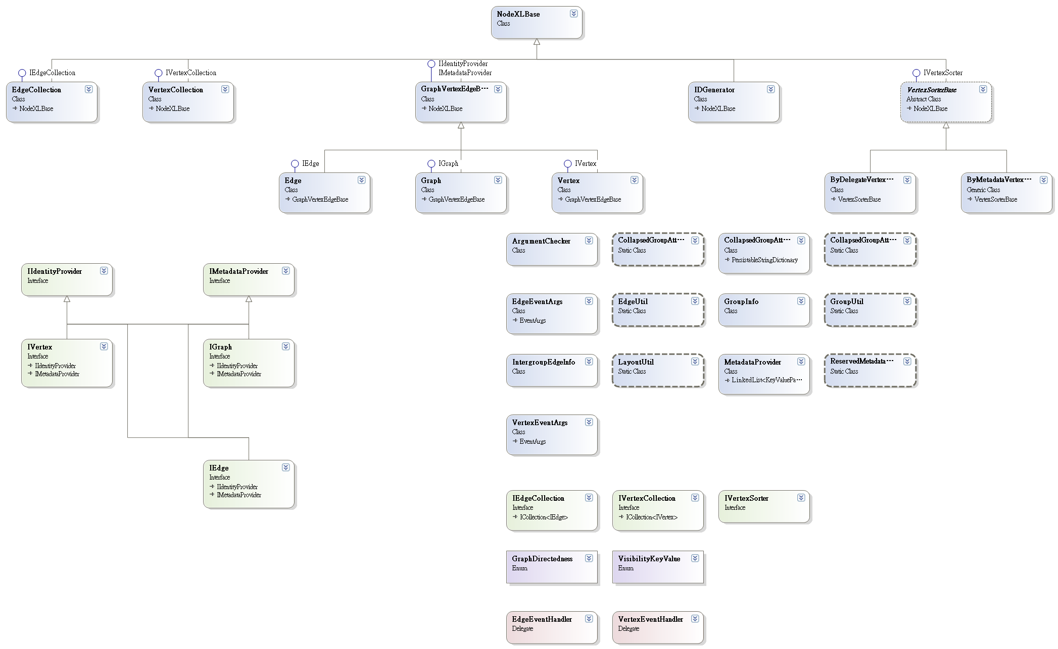
Core
Notes:
24+36 = 60

Slide 5
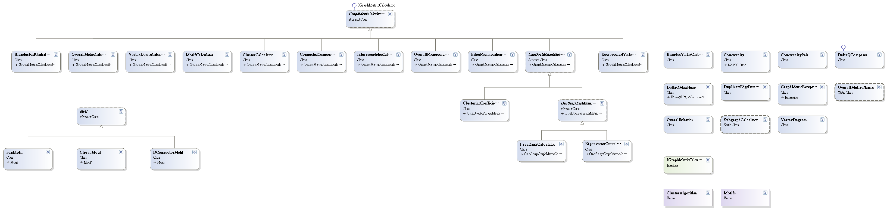
Algorithms
Notes:
60+34= 94

Slide 6
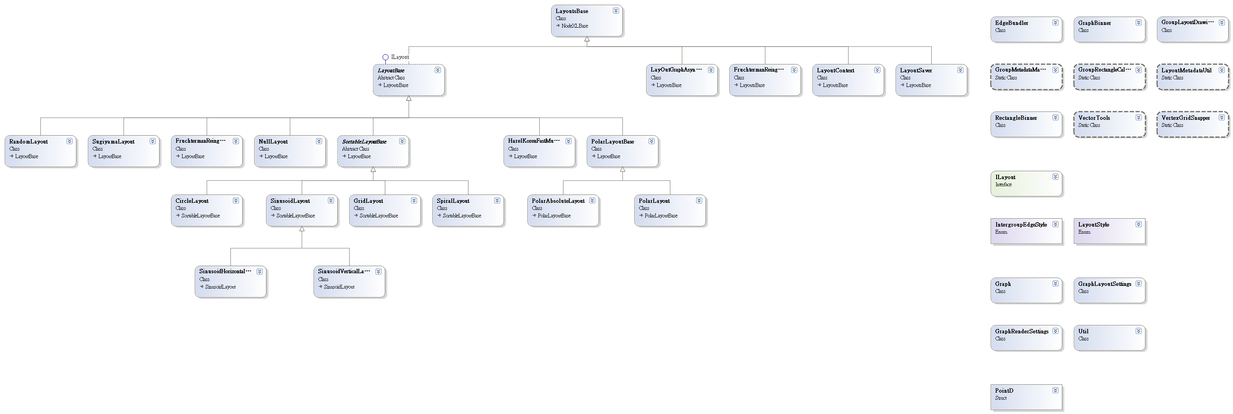
Layouts
Notes:
94+38 = 132

Slide 7
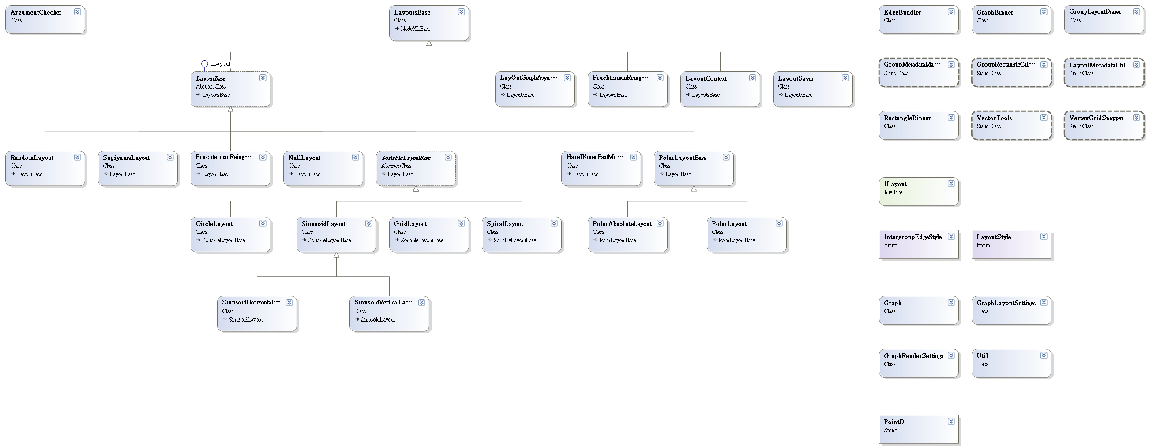
WpfVisualization
Notes:
132+39 = 171

Slide 8

ExcelTemplatePlugIns
Notes:
171+2 = 173

Slide 9
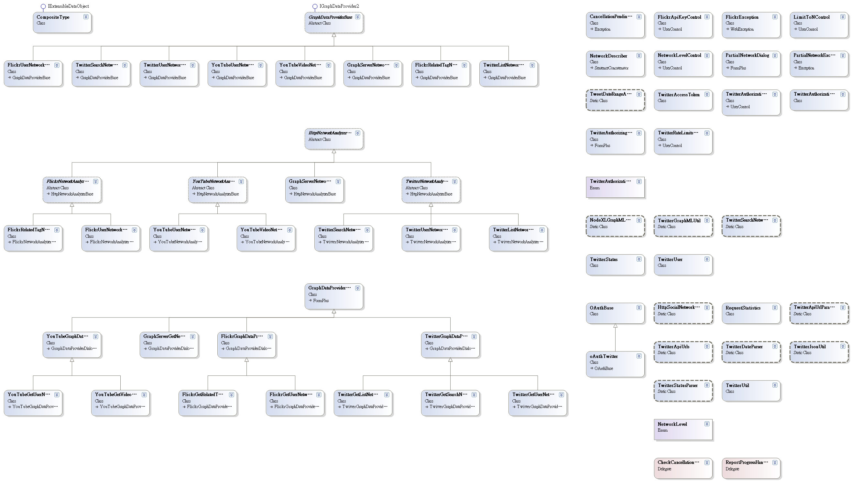
GraphDataProviders
Notes:
173 + 67 = 240

Slide 10
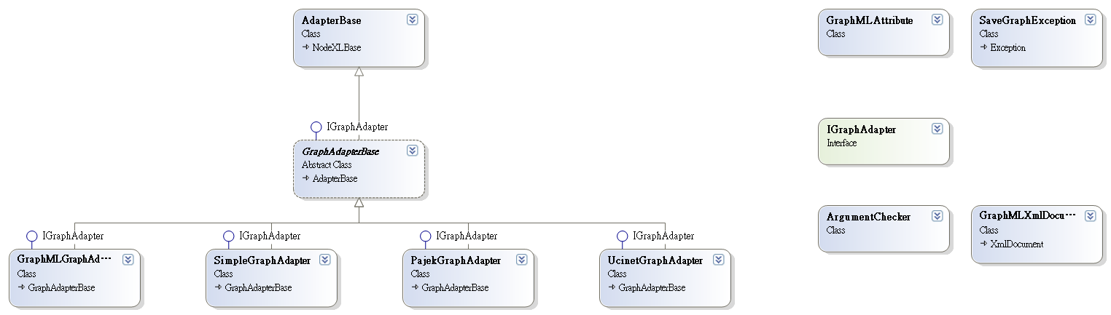
Adapters
Notes:
240+ 11 = 251

Slide 11
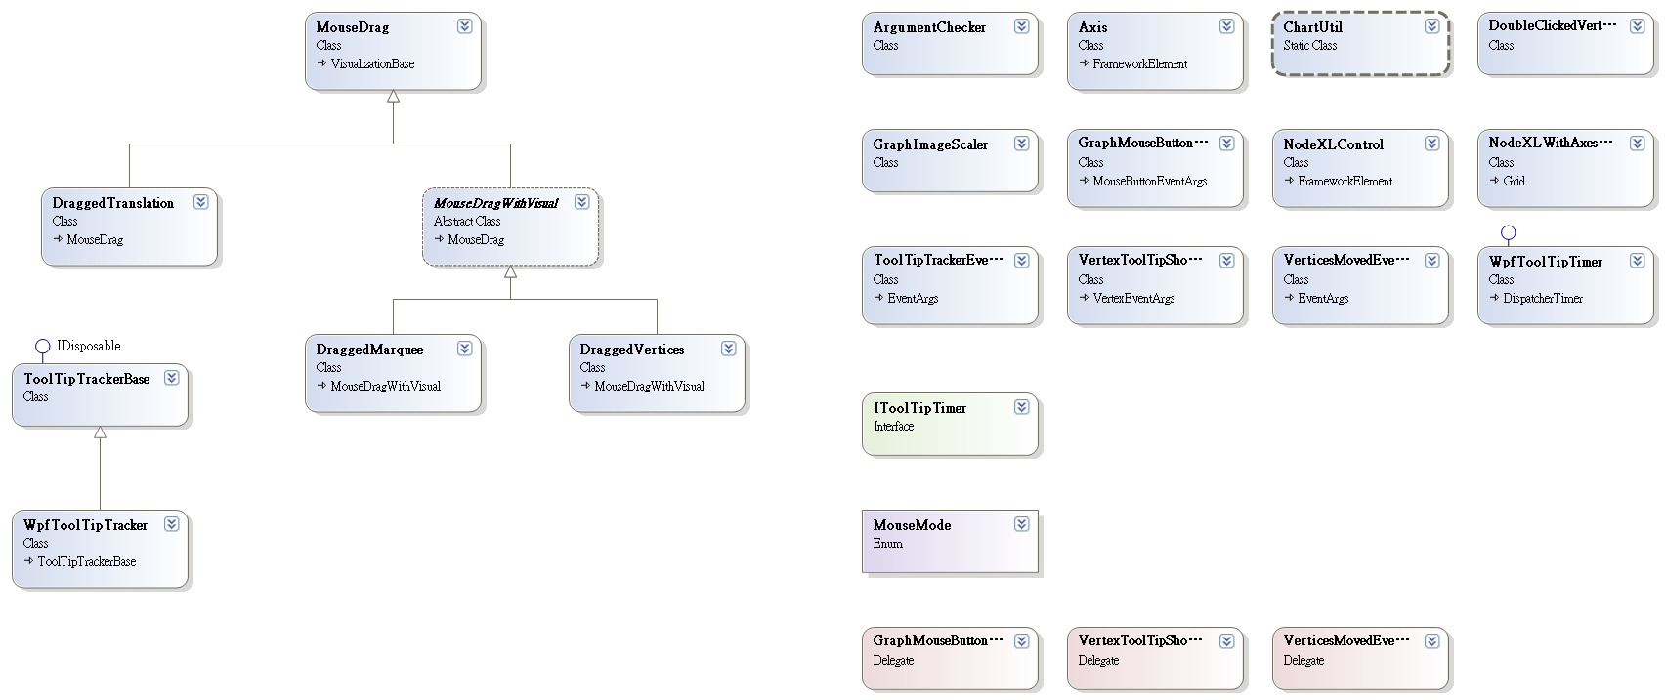
WpfControl
Notes:
251 + 24 = 275

Slide 12
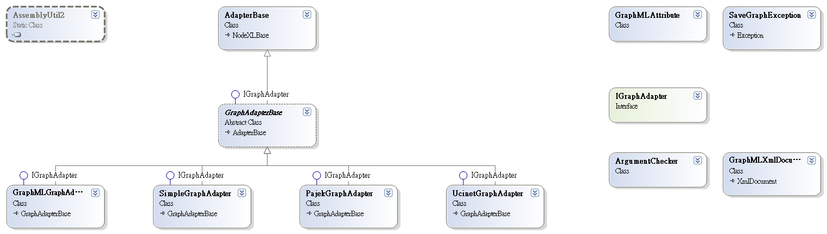
ExcelTemplateRegisterUser
Notes:
275 + 12 = 287

Slide 13
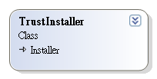
ExcelTemplateSetupTrustInstaller
Notes:
287 +1 = 288

Slide 14
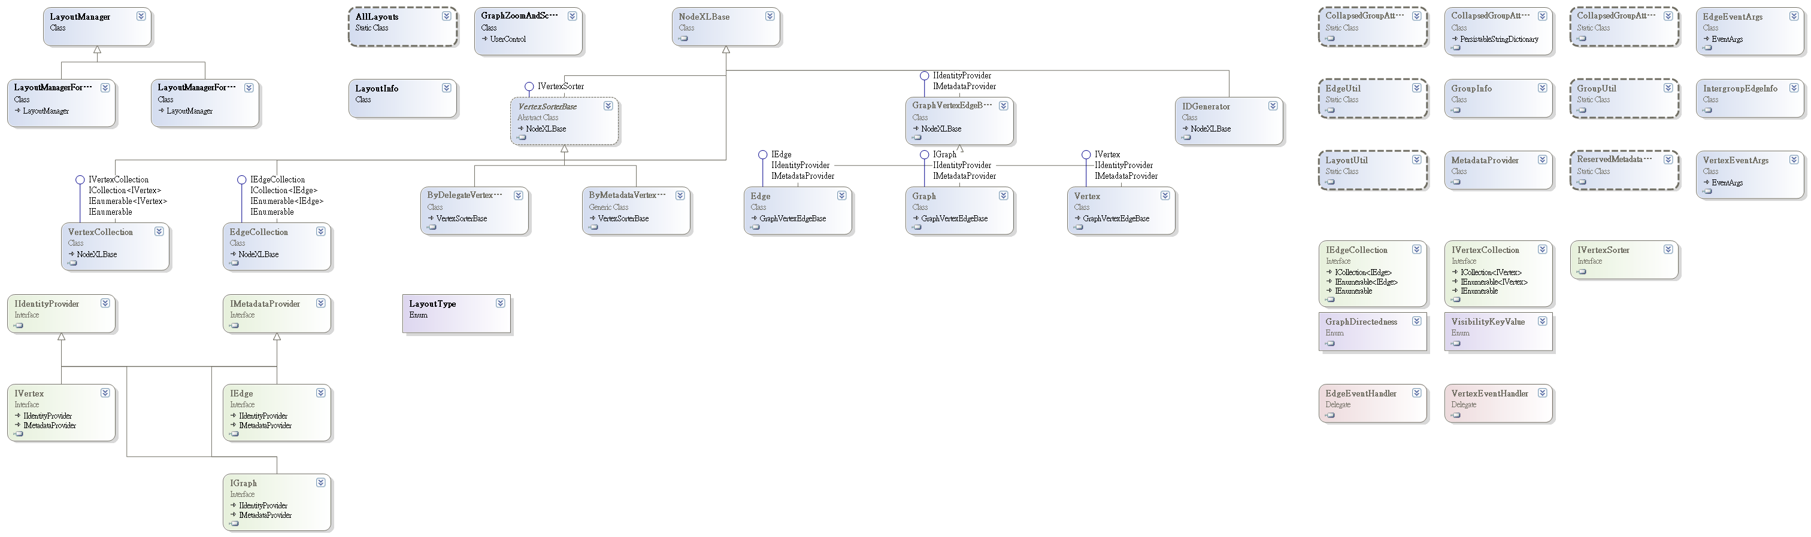
ApplicationUtil
Notes:
288+ 42 = 330

Slide 15
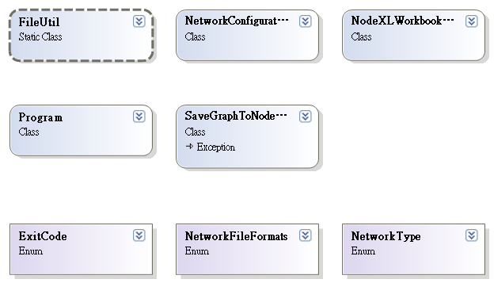
NetworkServer
Notes:
330 + 8 = 338

Slide 16
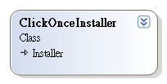
ExcelTemplateSetupClickOnceInstaller
Notes:
338 +1 = 339

Slide 17
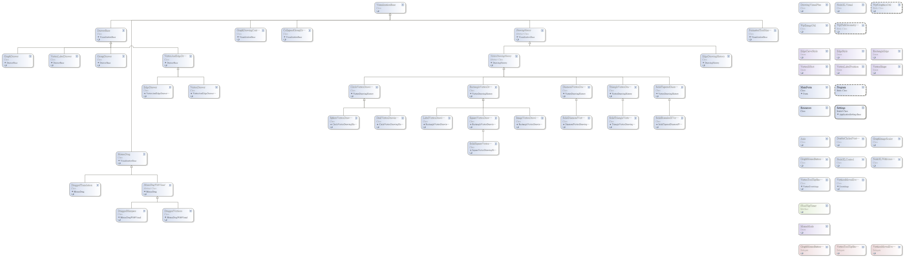
TestWpfNodeXLControl
Notes:
339 + 61 = 400

Slide 18
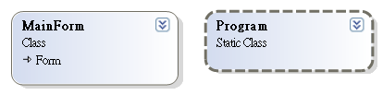
TestGraphDataProviders
Notes:
400 +2 = 402

Slide 19
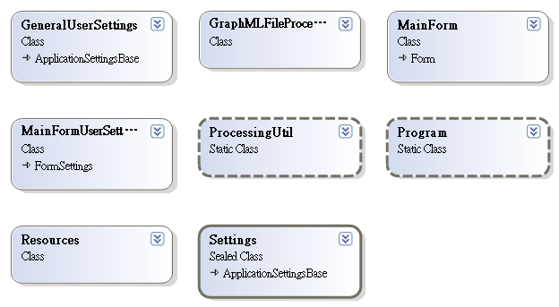
GraphMLFileProcessor
Notes:
402 + 8 = 410

Slide 20
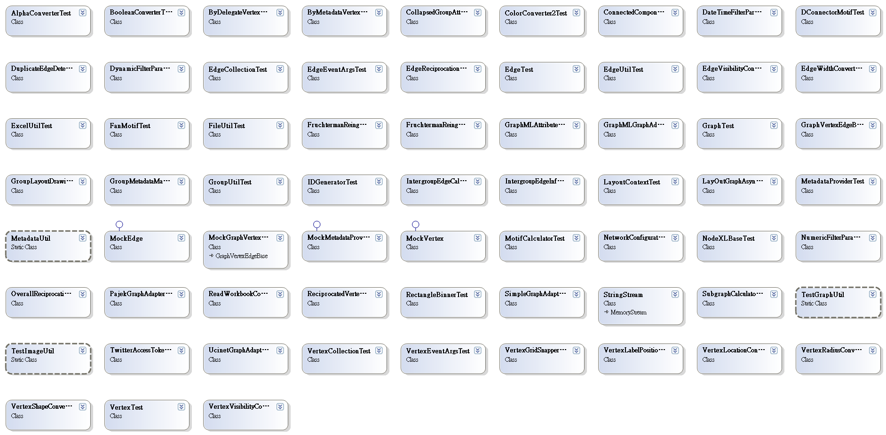
UnitTests
Notes:
410 + 66 = 476

