Slide 1
HW1 – Initial Design
Team 3
B99902066 蔡宗翰 D98944002 林映孜
D02922030 范哲誠 D02944010 呂俊宏
B99902032 黃奕軻 B99902123 廖尉棠
B99902025 吳佳倫 B99902100 劉宗瑋

Slide 2
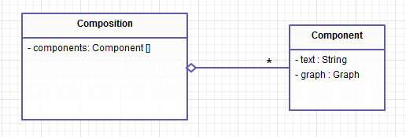

Slide 3
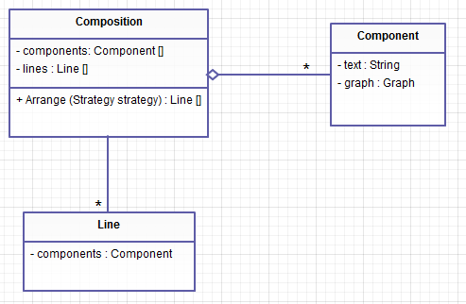

Slide 4
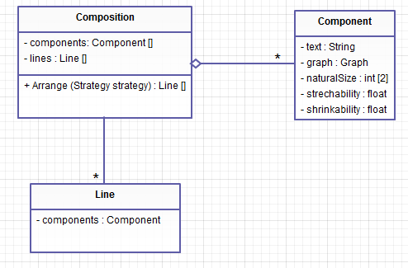

Slide 5
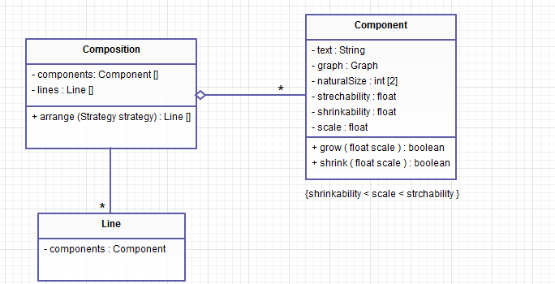

Slide 6
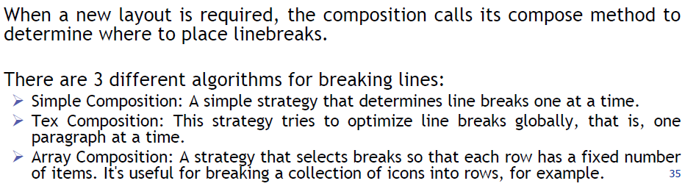
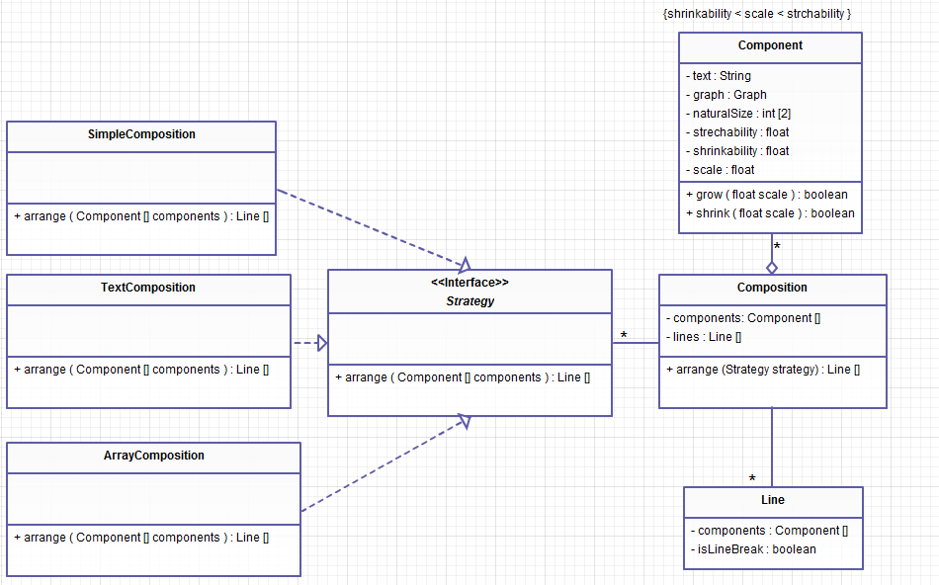

Slide 7
arrange(Component [] components){
foreach components{
if(determine())
insertLineBreak();
}
}
arrange(Component [] components){
foreach paragraph{
insertLineBreak();
}
}
arrange(Component [] components){
foreach components{
if(determine())
insertLineBreak();
}
}

