Slide 1
Hw9-1

Slide 2
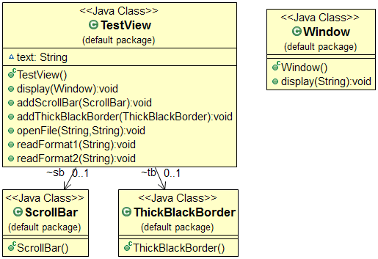
Direct Code

Slide 3
We have a TextView object that displays text in a window.
Initial Design
Window
TextView
-object : TextView
1
1
-text : string
+dsiplay()
{
display text;
}

Slide 4
TextView has no scroll bars by default, because we might not always need them.
TextView
Window
ScrollBar
1
1
-scrollbar : ScrollBar [ ]
-text : string
1
0…*
-object : TextView
+show()
+dsiplay()
{
display scrollbar;
}
{
dispaly text;
for each i in scrollbar
scrollbar[i].show()
}

Slide 5
We can also add a thick black border around the TextView.
TextView
ScrollBar
Window
1
0…*
1
1
-scrollbar : ScrollBar [ ]
-border : Blackborder
-text : string
-object : TextView
+show()
+dsiplay()
1
0…1
Blackborder
-borderSize: int
{
display scrollbar;
}
+setBlackBorder(size:int)
+show()
{
dispaly text;
for each i in scrollbar
scrollbar[i].show();
if(border!=NULL)
border.show();
}
{
display border;
}
{
borderSize=size;
}

Slide 6
It is highly likely that we will support various file formats for display in the future.
TextView
ScrollBar
Window
1
0…*
1
1
-scrollbar : ScrollBar [ ]
-border : Blackborder
-text : string
-object : TextView
+show()
+dsiplay()
+formatTransform(format : string)
1
0…1
{
dispaly text;
for each i in scrollbar
scrollbar[i].show();
if(border!=NULL)
border.show();
}
Blackborder
-borderSize: int
{
display scrollbar;
}
+setBlackBorder(size:int)
+show()
{
display border;
}
{
borderSize=size;
}
{
switch(format){
case format1:
text=readformat(format1);
case format2:
text=readformat(format2);
}
}

Slide 7
Design Principle : Encapsulate what varies.
The code that changes has been encapsulated as a class?
Need abstraction?
Act-1: Encapsulate What Varies, methods and its corresponding attributes
NO
NO
Yes
Yes
Need composition?
Act- 2: Abstract Common
Behaviors (with a same signature) into Interfaces
or Abstract Classes
NO
Yes
Act-3: Compose or Delegate Abstract Behaviors
Design Principle : Program to an interface, not an implementation
Yes
NO
Design Principle : Depend on abstractions. Do not depend on concrete classes
Need composition?

Slide 8
Encapulation
TextView
{
switch(format){
case format1:
text=readformat(format1);
case format2:
text=readformat(format2);
}
}
-scrollbar : ScrollBar [ ]
-border : Blackborder
-text : string
+dsiplay()
+formatTransform(format : string)
Format_1
Format_2
+read(path : string) : string
+read(path : string) : string

Slide 9
Design Principle : Encapsulate what varies.
The code that changes has been encapsulated as a class?
Need abstraction?
Act-1: Encapsulate What Varies, methods and its corresponding attributes
NO
NO
Yes
Yes
Need composition?
Act- 2: Abstract Common
Behaviors (with a same signature) into Interfaces
or Abstract Classes
NO
Yes
Act-3: Compose or Delegate Abstract Behaviors
Design Principle : Program to an interface, not an implementation
Yes
NO
Design Principle : Depend on abstractions. Do not depend on concrete classes
Need composition?

Slide 10
Abstraction
<<interface>>
DisplayComponent
<<interface>>
Format
+read(path:string) : string
+show()
Format_1
Format_2
ScrollBar
Blackborder
-borderSize: int
+read(path : string) : string
+read(path : string) : string
+show()
+setBlackBorder(size:int)
+show()

Slide 11
Design Principle : Encapsulate what varies.
The code that changes has been encapsulated as a class?
Need abstraction?
Act-1: Encapsulate What Varies, methods and its corresponding attributes
NO
NO
Yes
Yes
Need composition?
Act- 2: Abstract Common
Behaviors (with a same signature) into Interfaces
or Abstract Classes
NO
Yes
Act-3: Compose or Delegate Abstract Behaviors
Design Principle : Program to an interface, not an implementation
Yes
NO
Design Principle : Depend on abstractions. Do not depend on concrete classes
Need composition?

Slide 12
TextView
<<interface>>
DisplayComponent
Window
-object : TextView
1
1
-text : string
-component : DisplayComponent[]
-format : Format
1
*
+show()
+dsiplay(path:string)
1
{
text=format.read(path);
display text;
for each i in compnent[]
compnent[i].show();
}
ScrollBar
Blackborder
*
-borderSize: int
<<interface>>
Format
+show()
+setBlackBorder(size:int)
+show()
+read(path:string) : string
{
display scrollbar;
}
{
display border;
}
Format_1
Format_2
+read(path : string) : string
+read(path : string) : string
{
borderSize=size;
}

