Slide 1
Team3 3/4 Homework
組長: B99902066 蔡宗翰
組員: D98944002 林映孜, D02922030 范哲誠 D02944010 呂俊宏 B99902032 黃奕軻
B99902123 廖尉棠, B99902025 吳佳倫
B99902100 劉宗瑋

Slide 2
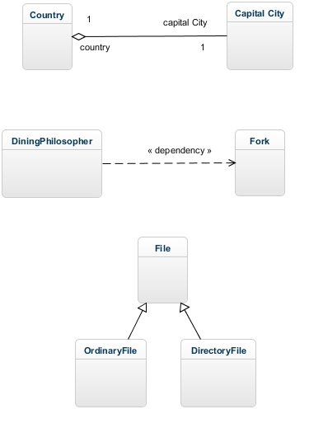
1. A country has a capital city.

Slide 3
2. A dining philosopher is using a fork.
<<use>>

Slide 4
3.A file is an ordinary file or a directory file. V1

Slide 5
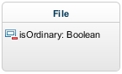
3.A file is an ordinary file or a directory file. V2

