Slide 1
Homework 6
Group 3

Slide 2
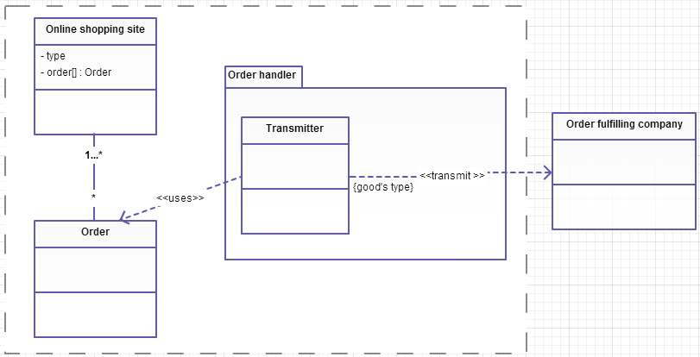
Design the order handling functionality for a different type of an online shopping site that transmits orders to different order fulfilling companies based on the type of the goods ordered.

Slide 3
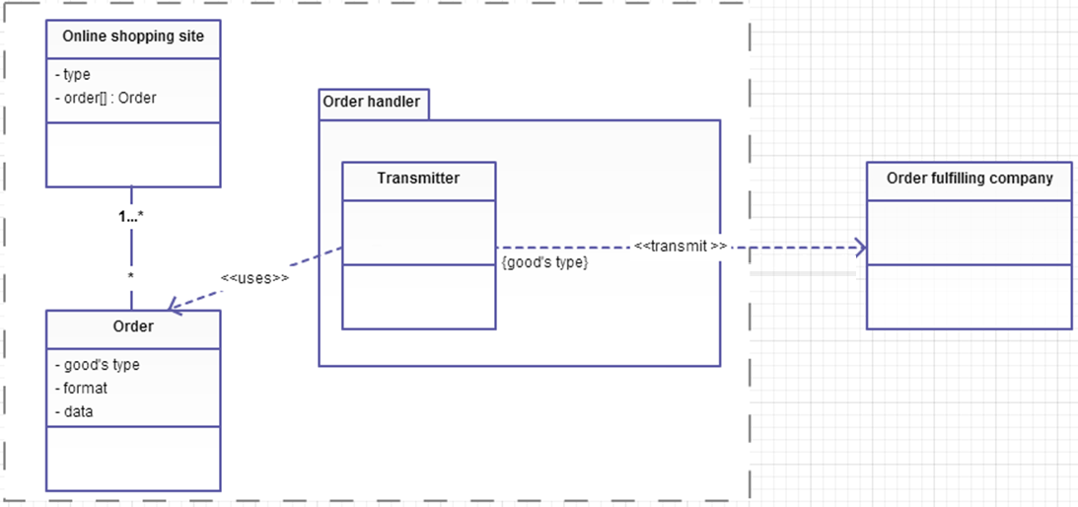
Suppose that the group of order processing companies can be classified into three categories based on the format of the order information they expect to receive.

Slide 4
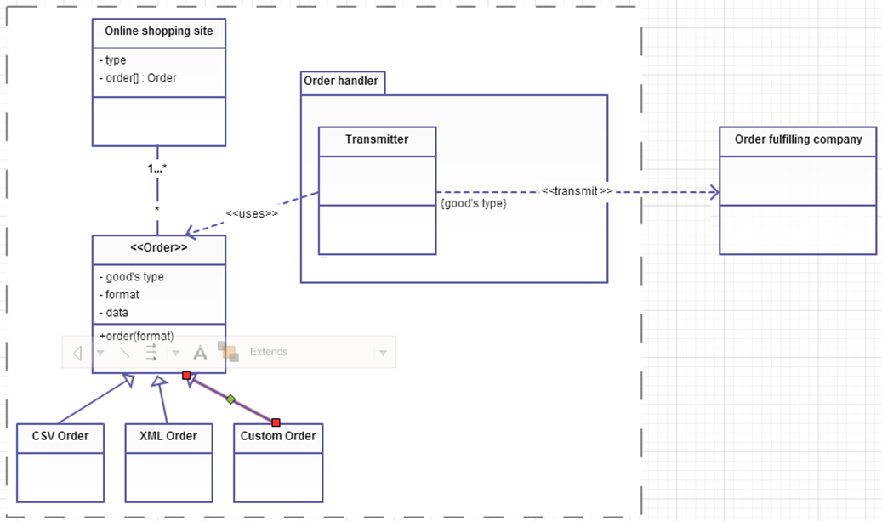
These formats include comma-separated value (CSV), XML and a custom object.

Slide 5
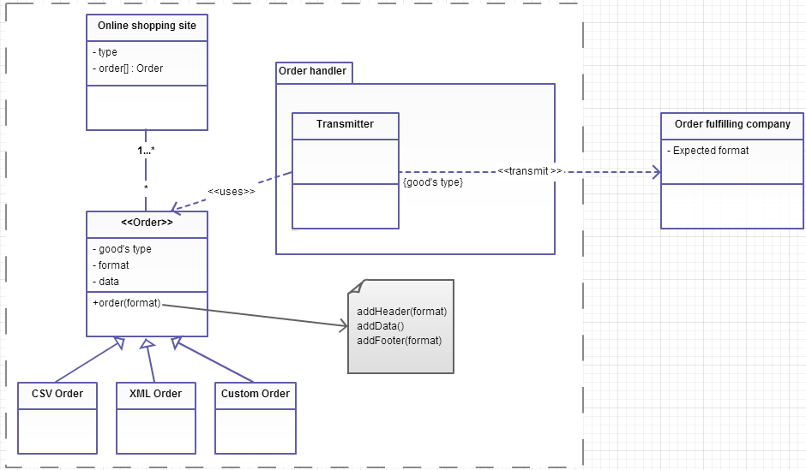
When the order information is transformed into one of these formats, appropriate header and footer information that is specific to a format needs to be added to the order data.
The series of steps required for the creation of
an Order object can be summarized as follows:
Create the header specific to the format
Add the order data
Create the footer specific to the format

