Slide 1
NodeXL的改進與應用
組長: B99902066 蔡宗翰
組員: d98944002 林映孜, d02922030 范哲誠, d02944010 呂俊宏
b99902032 黃奕軻, b99902123 廖尉棠, b99902025 吳佳倫

Slide 2
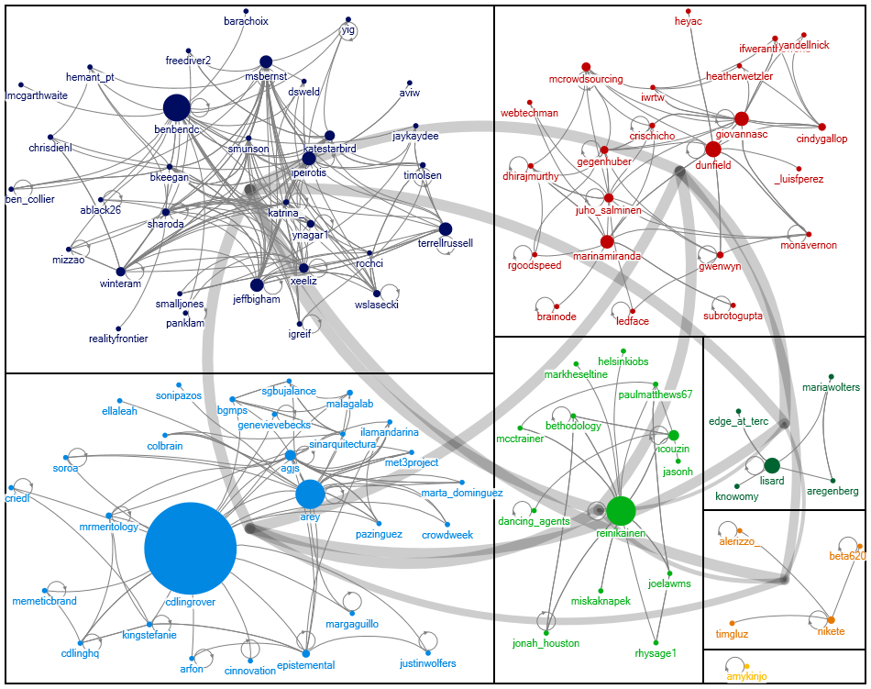
前言
NodeXL is a powerful and easy-to-use interactive network visualization and analysis tool that leverages the widely available MS Excel application as the platform for representing generic graph data, performing advanced network analysis and visual exploration of networks. The tool supports multiple social network data providers that import graph data (nodes and edge lists) into the Excel spreadsheet.
3-Levels of Analysis
1. Micro Level - Ego-analysis: Examine where individuals stand in the network; Reveal individuals who occupy key positions
2. Meso Level: Analyze the network structure or “architecture” of the network; Reveal clusters
3. Macro Level: Examine how the network is changing over time; Reveal macro structures (economic, managerial) that influence the change/stability of a network

Slide 3
But
因為是Execl 的plug-in ，因此，產生資料筆數讀取，回應速率，…等的限制。
Algorithm 開發因為受限於Execl的讀取方式，因此Algorithm 開發不易。
在讀取social network 資料時，很容易產生Out of memory的Error

Slide 4
Team Project Requirement
將NodeXL可以在Execl 外的程式獨立執行。
Test Case, 讀入Facebook 上音樂粉絲團的資料，透過歌手-粉絲，發文-粉絲，發文-回文及歌曲-粉絲等幾種拓樸關係進行視覺化分析。
開發新的algorithm interface 與1~2種Algorithm
Test Case, 將社群網絡的分析資料結合時間序列分析，讓社群網絡分析產生時間軸的關係

