Slide 1
Nodexl Improvement
TEAM3
組長:
B99902066 蔡宗翰
組員:
D98944002 林映孜 D02922030 范哲誠 D02944010 呂俊宏
B99902032 黃奕軻 B99902025 吳佳倫
B99902100 劉宗瑋

Slide 2
Outline
Goal
Requirements
System architecture
Class Diagrams
Initial Design
Design Issues
Re-Design
(partial unit test code)
WBS
Actual Effort
Encountered Problems

Slide 3
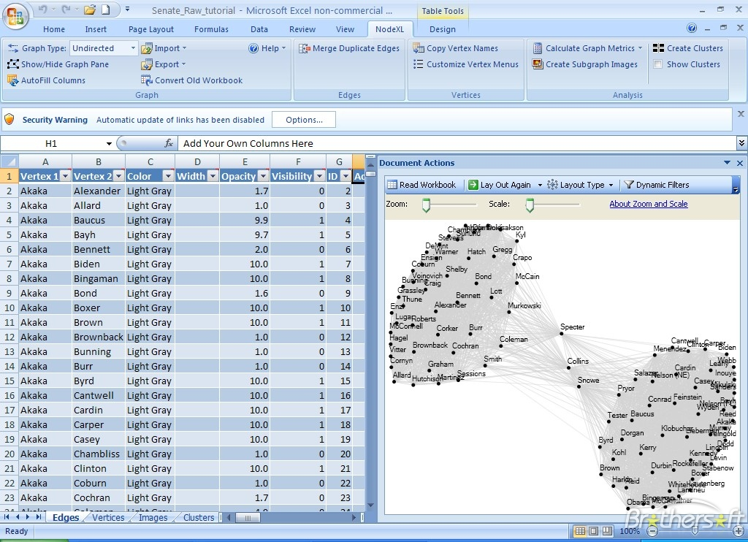
Goal
We have used NodeXL, a open source program which can fetch data from Social Network Service(SNS) and explore network graphs.

Slide 4
Goal
There are some improvements we want to work on NodeXL -
Make it stand alone from MS Excel, create a UI specifically designed for NodeXL.
Save fetched SNS data and calculated metrics in database to prevent redoing such time-costing jobs.
Lower the memory usage, and expect faster computation.

Slide 5
Requirements – DataImporter
Functional Requirement
R1.1 | UI can save settings in ImporterSettings
R1.1.1 | UI can select SNS which can be fetched in ImporterSettings
R1.1.2 | UI can select url/target/user which can be fetched in ImporterSettings
R1.1.3 | UI can select items/columns which can be fetched in ImporterSettings
R1.2 | Importer can import data from selected SNS
R1.2.1 | Importer can import data from Facebook
R1.2.2 | Importer can import data from Twitter
R1.2.3 | Importer can import data from Youtube
R1.2.4 | Importer can import data from Flickr
R1.3 | Importer can load data from file(graphML)
R1.4 | Core can load settings and execute with corresponding concrete importer.

Slide 6
Graph Storage Management
Non-Functional Requirement
R2.1 | Memory usage should be more efficient than original NodeXL
Functional Requirement
R2.2 | Table Design
R2.2.1 | Design Table Naming method
R2.2.2 | Design Different Social Media table schema & primary key
R2.2.2.1 | Facebook Schema
R2.2.3 | Design Index method
R2.3 | Table Function
R2.3.1 | List Tables
R2.3.2 | Add Table
R2.3.3 | Delete Table
R2.3.4 | Select Table
R.2.3.5 | UI Design
R2.4 | Filter rows by derived restriction
R2.5 | Save graph structure to DB(new table)
R2.6 | Convert selected data to "Graph" structure according to Settings
R2.6.1 | UI can select which column of the data to be used as vertices and save them in Settings
R2.6.2 | User can Match an (weighted) edge according to relationship between vertices (select edge) and save in Settings

Slide 7
Graph Representation
Non-Functional Requirement
 | Unify the Rectangle to the same type: System.Windows.Rect (WPF)
Functional Requirement
R5.1 | NodeXL has a view to show graph on it
R5.1.1 | To show graph on the view, we first layout the graph then draw them on the view
R5.2 | When layouting, we specify the location of each vertex in the graph according to the layout context and layout type.
R5.2.1 | The types of layouts includes: CircleLayout,GridLayout, Random Layout, SinusoidLayout, etc.
R5.2.2 | The layout type is selected by the user
R5.2.3 | We can only plot one type of layout for a graph at one time.
R5.2.4 | It is easy to add new types of layouts.
R5.2.5 | The layout context describe the width,height of the layout view.
R5.2.6 | The location of each vertex contains the x,y coordinates
R5.3 | When drawing graph, we draw the vertices and edges in the graph on the view according the layout context and the properties of vertices and edges
R5.3.1 | The vertices and edge in the graph can be draw with different color, border
R5.3.2 | The used color are depend on user's selection
R5.4 | The user is able to Export current layout view into image file

Slide 8
UI
Functional Requirement
R6.1 | There are 3 section in the application : 1. Toolbar on the top. and below the toolbar - 2. Table on the left 3. Graph on the right
R6.1.1 | User can choose to load data from file, database or SNS importer.
R6.1.2 | After the data is loaded, user can choose which column of the data to be vertices and input restrictions to filter rows.
R6.1.3 | User can choose to export the data to image file or graphML file (need to specify the file path)
R6.1.4 | User can select multiple metric to be computed at once (check box)
R6.1.5 | Once the metrics are computed, user can use one of the metrics to autofill columns(color, width, style, opacity, visibility, label)
R6.1.10 | There is a dropdown list widget, which includes the layout that user can choose.
R6.1.6 | User can select a layout from dropdown list.
R6.1.7 | User can refresh the graph
R6.1.8 | User can Show/hide table
R6.1.9 | User can Show/hide graph

Slide 9
Internal Interface Requirements(IIR)
Internal Interface Requirements
IIR1 | Importer read setting info from UI
IIR2 | Imorted data is stored to DataBase
IIR3 | Graph can ask data from DataBase
IIR4 | UI can ask Mertic to compute metrics
IIR5 | Layout can get data from Graph to show.
IIR6 | Layout can ask for setting info from UI.
IIR7 | After computated, Layout can notify UI to render the result.
IIR8 | Metric can ask data from Graph
IIR9 | UI can ask Importer to Import data and save in DB.
IIR10 | UI can select which Metric to be calculated and save in settings.

Slide 10
Outer Interface Requirement(OIR)
Outer Interface Requirement
OIR1 | Importer use "SocialNetworkImporter" to get data from SNS
OIR2 | DataBase use “MySQL" to save and fetch data.

Slide 11
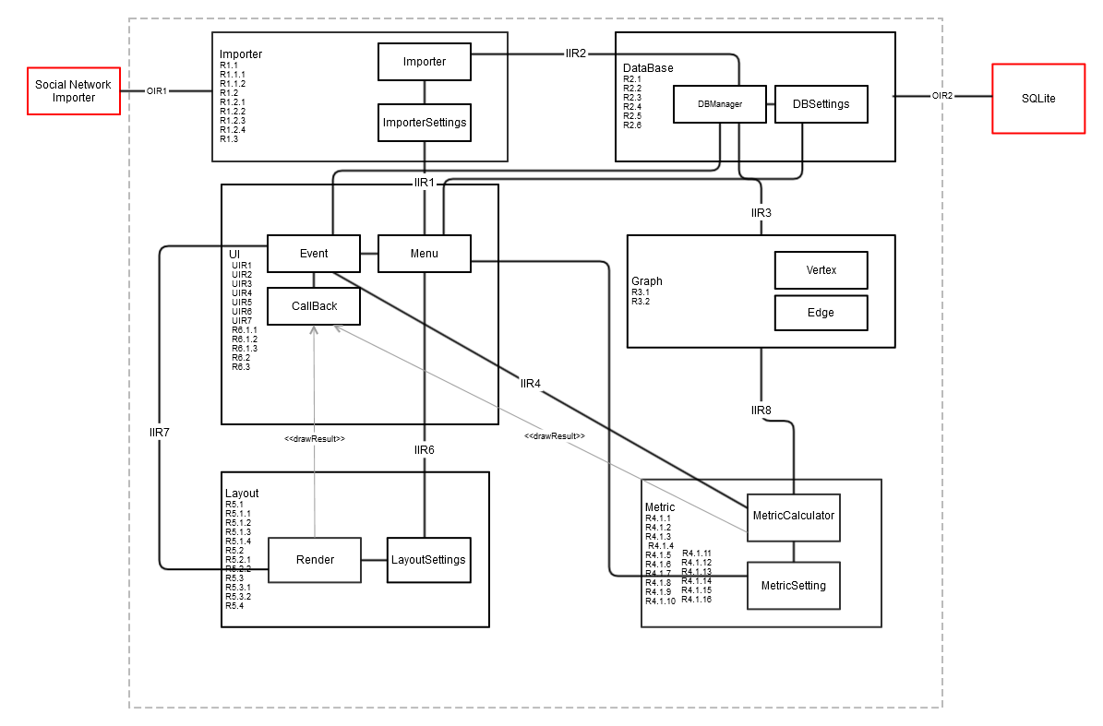
Architecture – Original

Slide 12
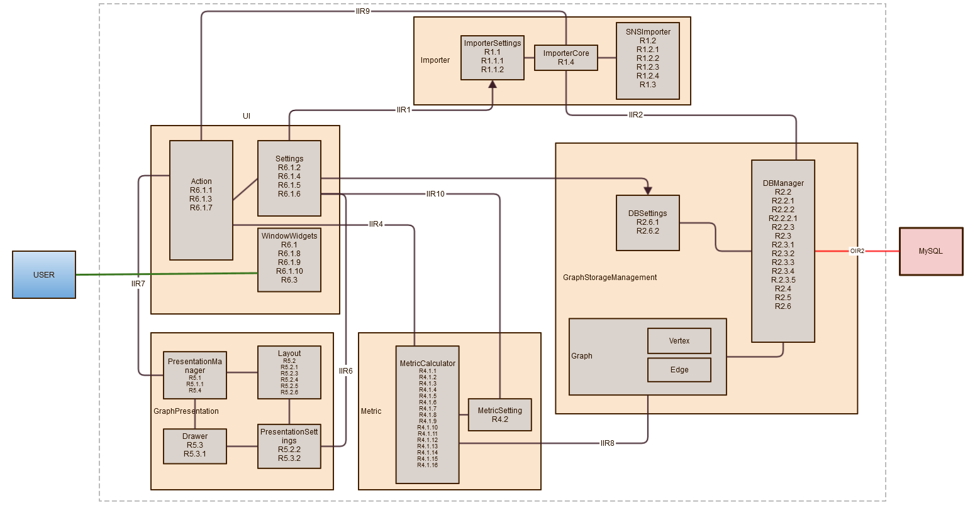
Architecture - Final

Slide 13
Class Diagram

Slide 14
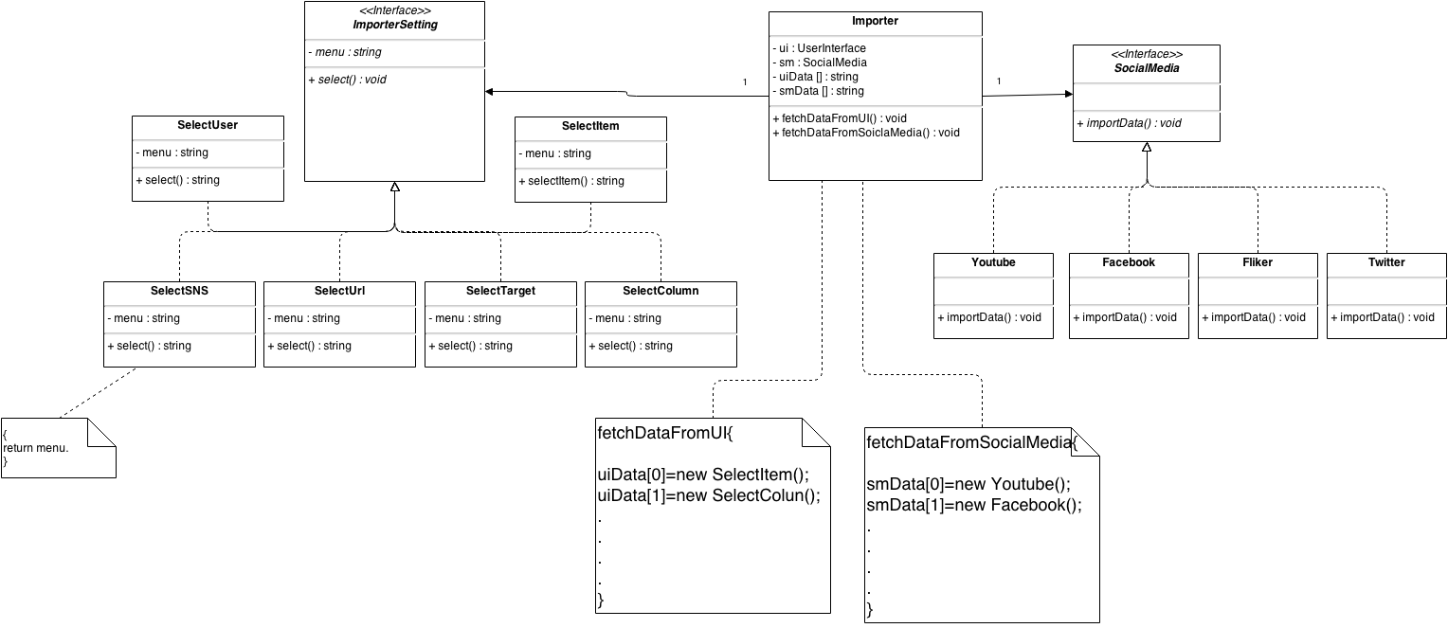
Importer – Initial Design

Slide 15
Importer – Design Issues

Slide 16
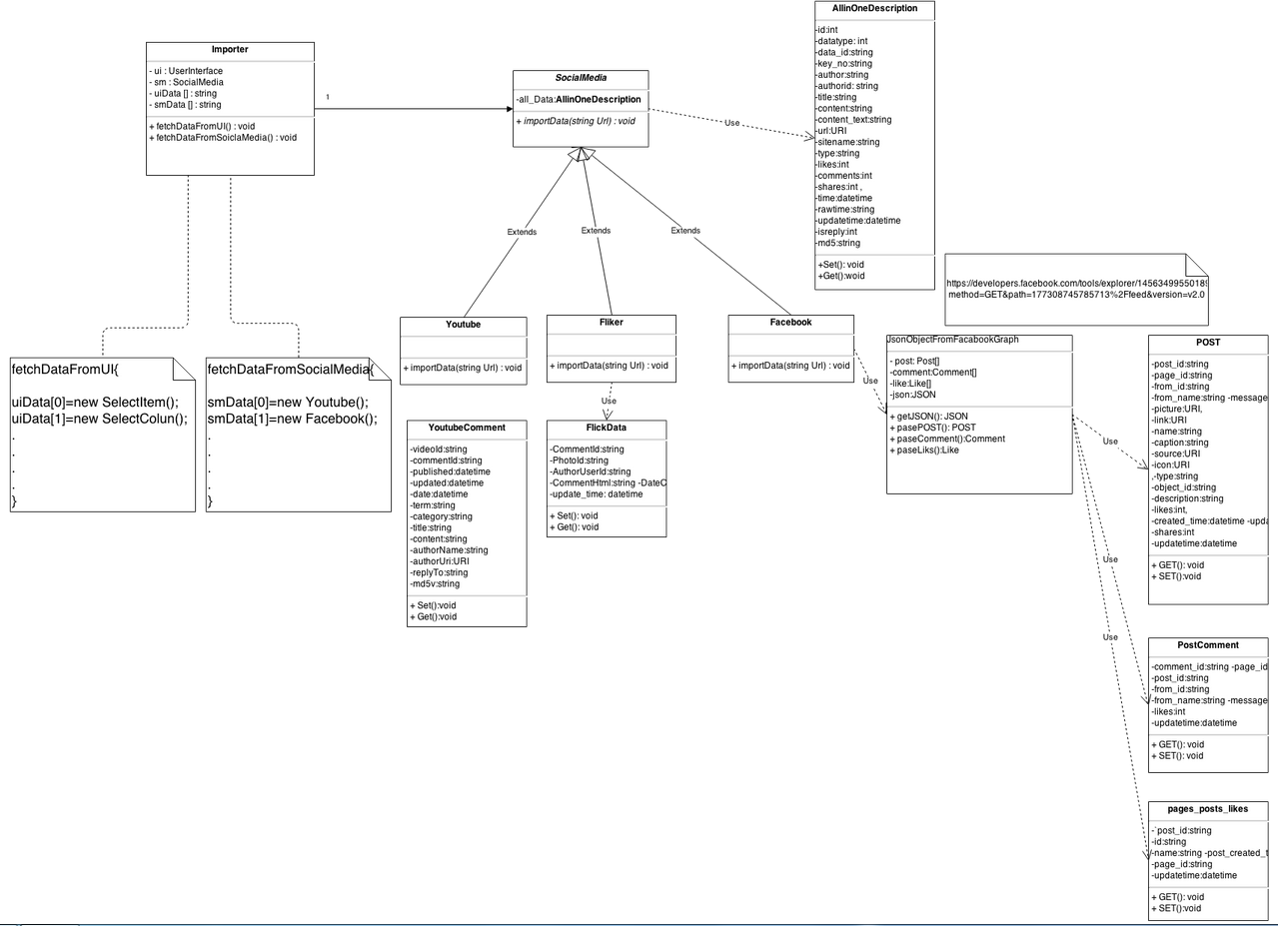
Importer - Redesigned

Slide 17
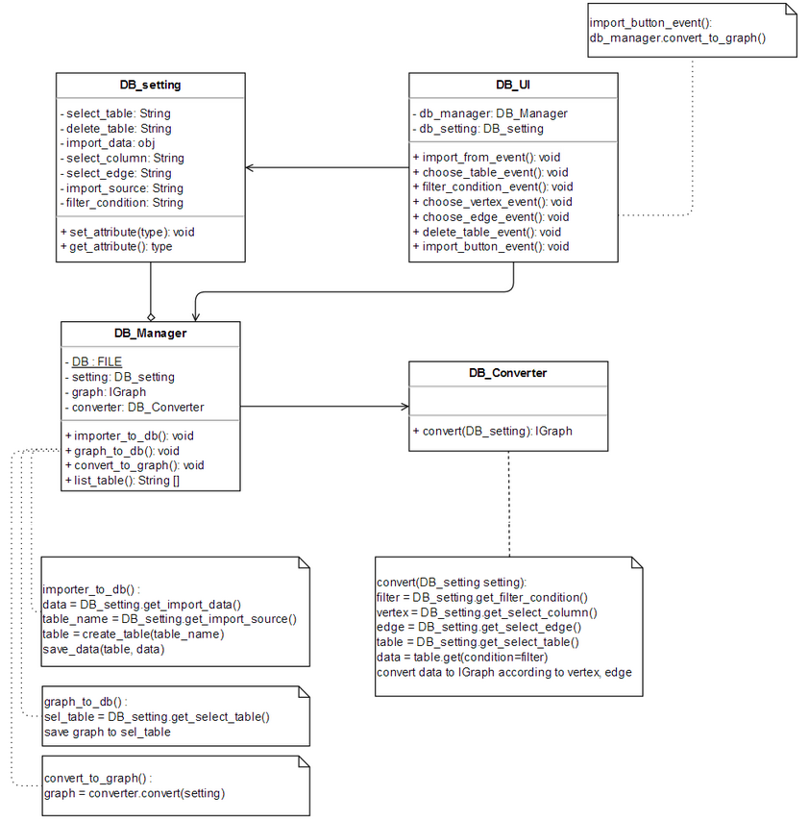
Graph Storage Management – Init.

Slide 18
Graph Storage Management - Issue

Slide 19
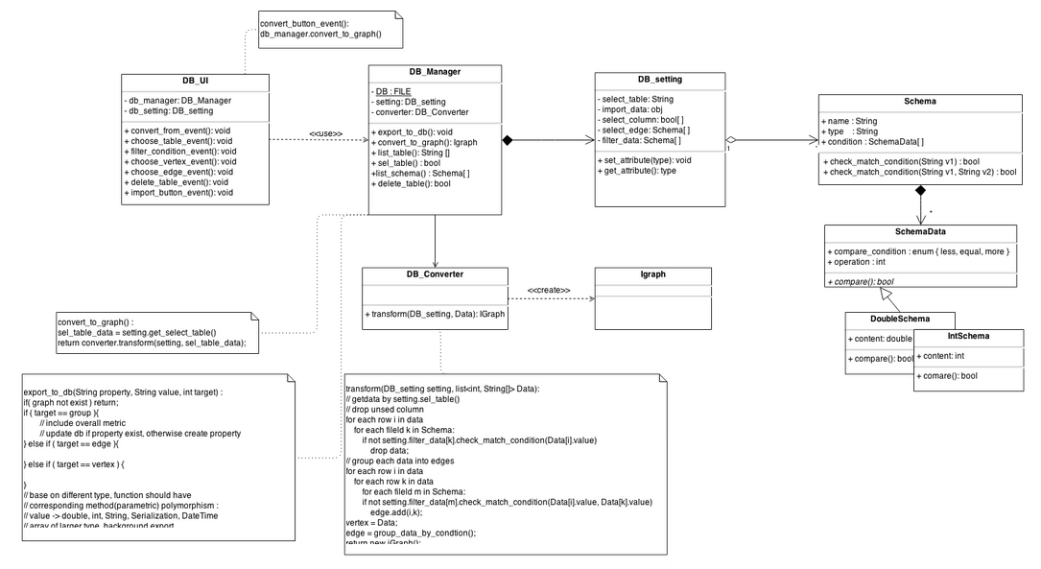
Graph Storage Management-Redesign

Slide 20
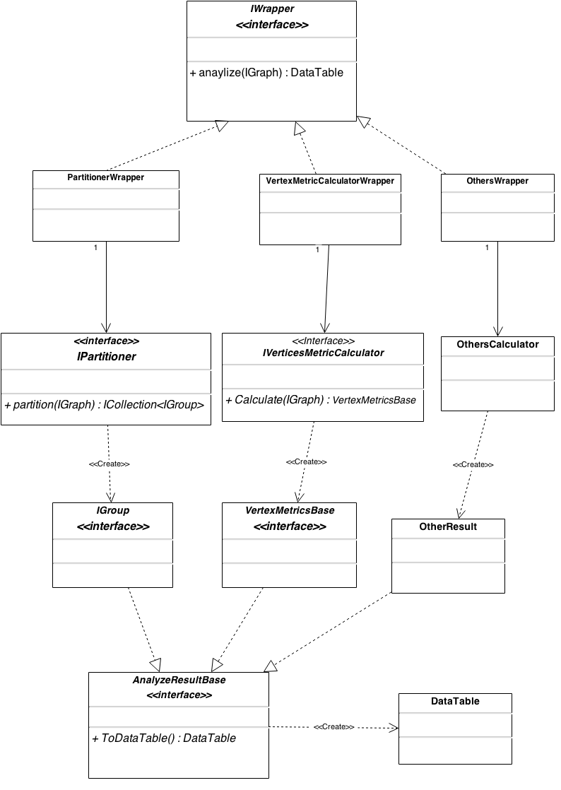
Metric – Initial Design

Slide 21
Metric – Design Issues

Slide 22
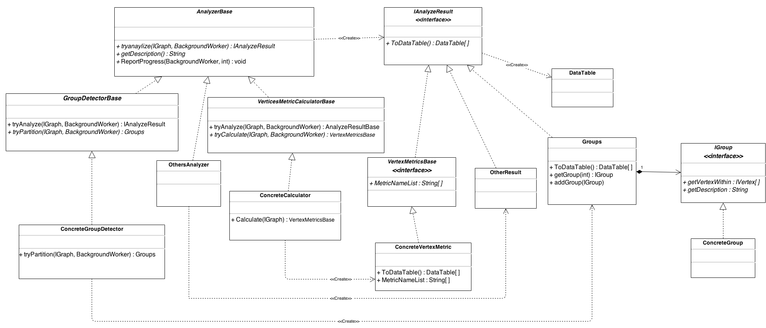
Metric – Redesign

Slide 23
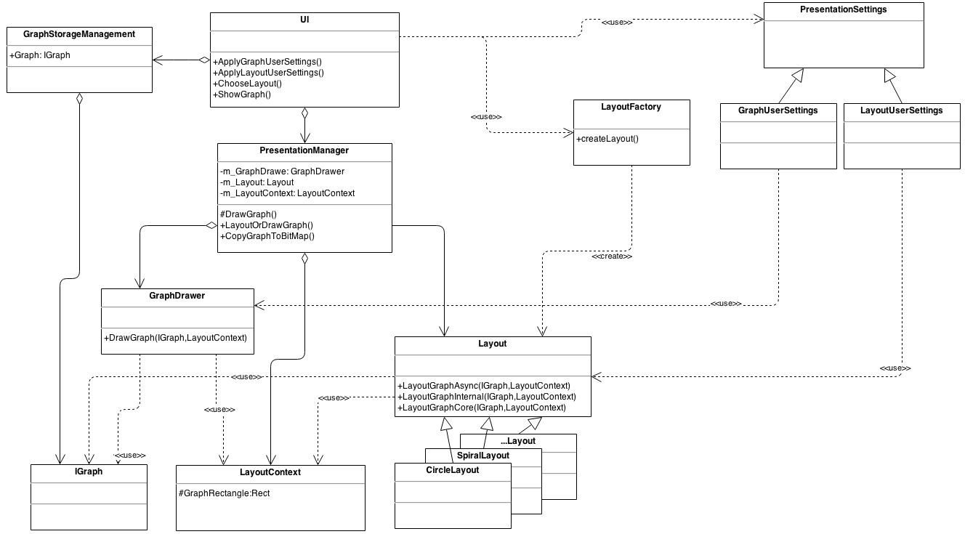
Graph Representation – Initial Design

Slide 24
Graph Representation – Design Issues

Slide 25
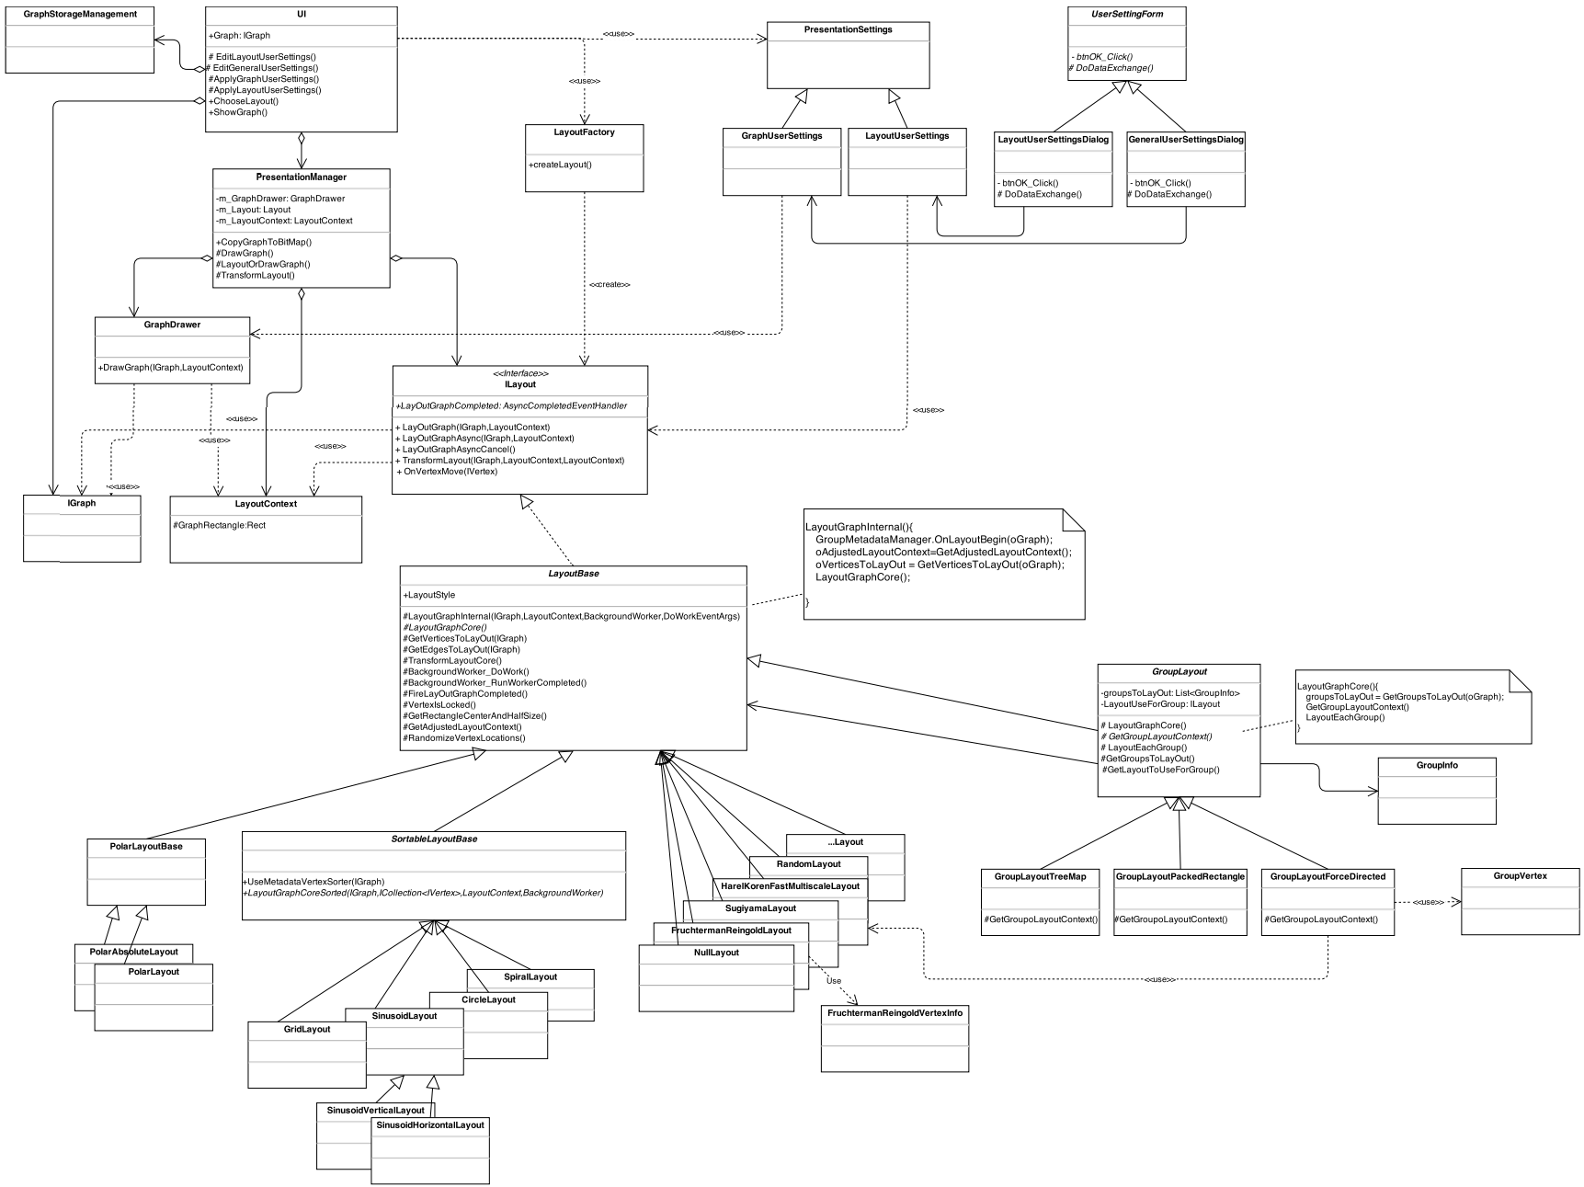
Graph Representation - Redesign

Slide 26
WBS

Slide 27
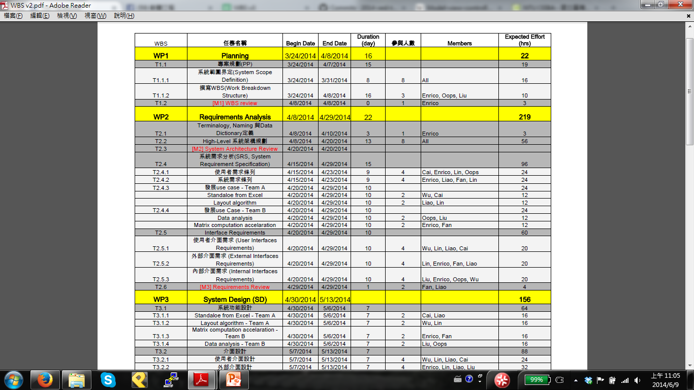
WBS - Original

Slide 28
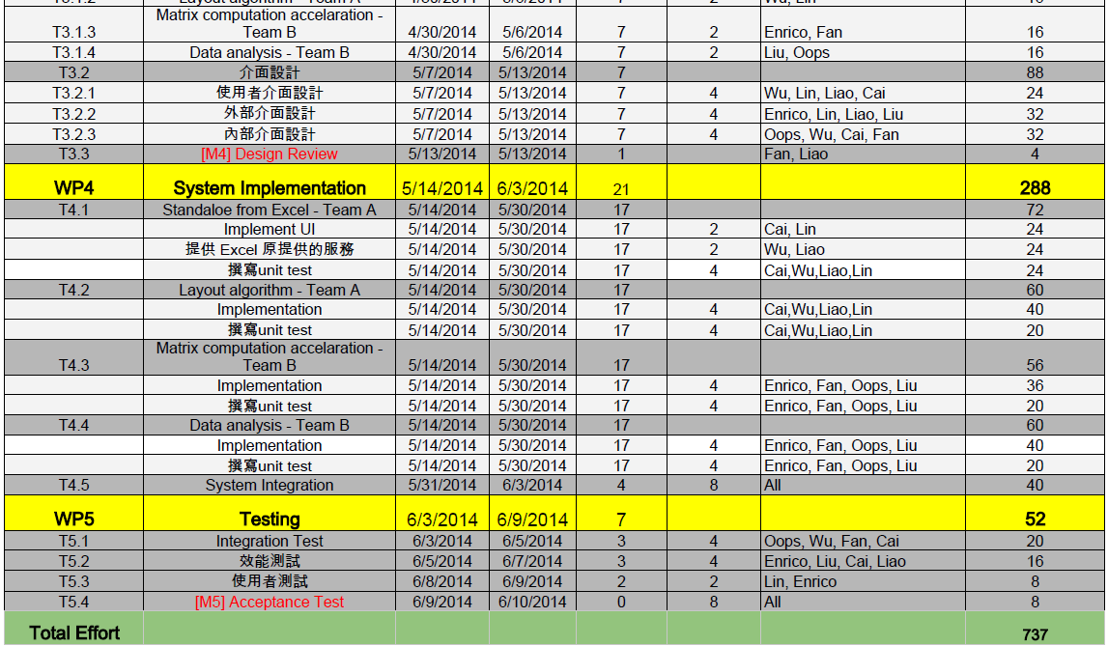

Slide 29
WBS-final
WBS | 任務名稱 | Begin Date | End Date | Duration (day) | 參與人數 | Members | Expected Effort (hrs) | Actual Effort (hrs)
WP1 | Planning | 3/24/2014 | 4/8/2014 | 16 |  |  | 22
T1.1 | 專案規劃(PP) | 3/24/2014 | 4/7/2014 | 15 |  |  | 19
T1.1.1 | 系統範圍界定(System Scope Definition) | 3/24/2014 | 3/31/2014 | 8 | 8 | All | 16
T1.1.2 | 撰寫WBS(Work Breakdown Structure) | 3/24/2014 | 4/8/2014 | 16 | 3 | Enrico, Oops, Liu | 10
T1.2 | [M1] WBS review | 4/8/2014 | 4/8/2014 | 0 | 1 | Enrico | 3
WP2 | Requirements Analysis | 4/8/2014 | 4/29/2014 | 22 |  |  | 219
T2.1 | Terminalogy, Naming 與Data Dictionary定義 | 4/8/2014 | 4/10/2014 | 3 | 1 | Enrico | 3
T2.2 | High-Level 系統架構規劃 | 4/8/2014 | 4/20/2014 | 13 | 8 | All | 56
T2.3 | [M2] System Architecture Review | 4/20/2014 | 4/20/2014
T2.4 | 系統需求分析(SRS, System Requirement Specification) | 4/15/2014 | 4/29/2014 | 15 |  |  | 96
T2.4.1 | 使用者需求條列 | 4/15/2014 | 4/23/2014 | 9 | 4 | Cai, Enrico, Lin, Oops | 24
T2.4.2 | 系統需求條列 | 4/15/2014 | 4/23/2014 | 9 | 4 | Enrico, Liao, Fan, Lin | 24
T2.4.3 | 發展use case - Team A | 4/20/2014 | 4/29/2014 | 10 |  |  | 24
 | Standaloe from Excel | 4/20/2014 | 4/29/2014 | 10 | 2 | Wu, Cai | 12
 | Layout algorithm | 4/20/2014 | 4/29/2014 | 10 | 2 | Liao, Lin | 12

Slide 30
WBS | 任務名稱 | Begin Date | End Date | Duration (day) | 參與人數 | Members | Expected Effort (hrs) | Actual Effort (hrs)
T2.4.4 | 發展use Case - Team B | 4/20/2014 | 4/29/2014 | 10 |  |  | 24
 | Data analysis | 4/20/2014 | 4/29/2014 | 10 | 2 | Oops, Liu | 12
 | Matrix computation accelaration | 4/20/2014 | 4/29/2014 | 10 | 2 | Enrico, Fan | 12
T2.5 | Interface Requirements | 4/20/2014 | 4/29/2014 | 10 |  |  | 60
T2.5.1 | 使用者介面需求 (User Interfaces Requirements) | 4/20/2014 | 4/29/2014 | 10 | 4 | Wu, Lin, Liao, Cai | 20
T2.5.2 | 外部介面需求 (External Interfaces Requirements) | 4/20/2014 | 4/29/2014 | 10 | 4 | Lin, Enrico, Fan, Liao | 20
T2.5.3 | 內部介面需求 (Internal Interfaces Requirements) | 4/20/2014 | 4/29/2014 | 10 | 4 | Liu, Enrico, Oops, Wu | 20
T2.6 | [M3] Requirements Review | 4/29/2014 | 4/29/2014 | 1 | 2 | Fan, Liao | 4
WP3 | System Design (SD) | 4/30/2014 | 5/13/2014 |  |  |  | 156
T3.1 | 系統功能設計 | 4/30/2014 | 5/6/2014 | 7 |  |  | 64
T3.1.1 | Standaloe from Excel - Team A | 4/30/2014 | 5/6/2014 | 7 | 2 | Cai, Liao | 16
T3.1.2 | Layout algorithm - Team A | 4/30/2014 | 5/6/2014 | 7 | 2 | Wu, Lin | 16
T3.1.3 | Matrix computation accelaration - Team B | 4/30/2014 | 5/6/2014 | 7 | 2 | Enrico, Fan | 16
T3.1.4 | Data analysis - Team B | 4/30/2014 | 5/6/2014 | 7 | 2 | Liu, Oops | 16
T3.2 | 介面設計 | 5/7/2014 | 5/13/2014 | 7 |  |  | 88
T3.2.1 | 使用者介面設計 | 5/7/2014 | 5/13/2014 | 7 | 4 | Wu, Lin, Liao, Cai | 24
T3.2.2 | 外部介面設計 | 5/7/2014 | 5/13/2014 | 7 | 4 | Enrico, Lin, Liao, Liu | 32
T3.2.3 | 內部介面設計 | 5/7/2014 | 5/13/2014 | 7 | 4 | Oops, Wu, Cai, Fan | 32
T3.3 | [M4] Design Review | 5/13/2014 | 5/13/2014 | 1 |  | Fan, Liao | 4

Slide 31
WBS | 任務名稱 | Begin Date | End Date | Duration (day) | 參與人數 | Members | Expected Effort (hrs) | Actual Effort (hrs)
WP4 | System Implementation | 5/29/2014 | 6/5/2014 |  |  |  | 240
T4.1 | Metric | 5/29/2014 | 6/5/2014 | 7 | 1 | Liu, Cai | 40
 | Dialog design | 5/29/2014 | 6/5/2014
 | coding | 5/29/2014 | 6/5/2014
 | unit testing | 6/3/2014 | 6/5/2014
T4.2 | Layout | 5/29/2014 | 6/5/2014 | 7 | 1 | Lin, Cai | 40
 | Dialog design | 5/29/2014 | 6/5/2014
 | coding | 5/29/2014 | 6/5/2014
 | unit testing | 6/3/2014 | 6/5/2014
T4.3 | GraphStorageManagement | 5/29/2014 | 6/5/2014 | 7 | 2 | Oops, Wu | 60
 | Dialog design | 5/29/2014 | 6/5/2014
 | coding | 5/29/2014 | 6/5/2014
 | unit testing | 6/3/2014 | 6/5/2014
T4.4 | Importer | 5/29/2014 | 6/5/2014 | 7 | 2 | Fan, Enrico | 60
 | Dialog design | 5/29/2014 | 6/5/2014
 | coding | 5/29/2014 | 6/5/2014
 | unit testing | 6/3/2014 | 6/5/2014
T4.5 | GUI scratch | 5/29/2014 | 6/5/2014 | 7 | 1 | Enrico, Cai | 40
 | main window design | 5/29/2014 | 6/5/2014
WP5 | Testing | 6/6/2014 | 6/9/2014 | 4 |  |  | 44
T5.1 | Integration Test | 6/6/2014 | 6/9/2014 | 4 | 7 | All | 20
T5.2 | 效能測試 | 6/6/2014 | 6/9/2014 | 4 | 7 | All | 16
T5.4 | [M5] Acceptance Test | 6/9/2014 | 6/10/2014 | 0 | 7 | All | 8
Total Effort |  |  |  |  |  |  | 681

Slide 32
Actual effort (Total.)

