Slide 1
Homework 9-2

Slide 2
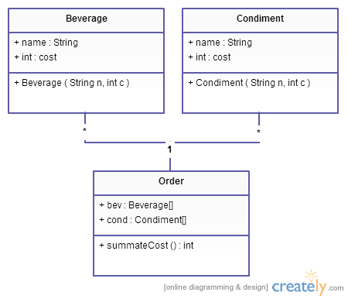
Code Directly
Problem: Arbitrary new Beverage every time someone makes an order?

Slide 3
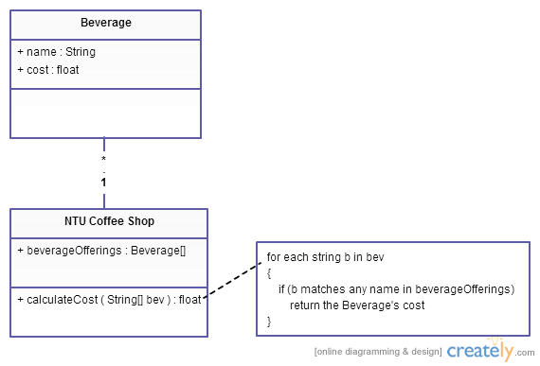
Initial Design - 1
NTU Coffee Shop is scrambling to update its ordering systems to match its beverage offerings (e.g. HouseBlend, DarkRoast, Decaf and Espresso) to calculate how they cost.

Slide 4
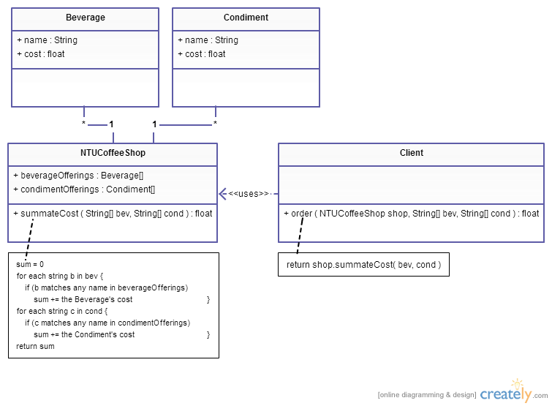
Initial Design - 2
In addition to your coffee, you can also ask for several condiments like steamed milk, soy, and mocha. Therefore, NTU Coffee Shop needs to have them built into its ordering system to summate the cost.

Slide 5
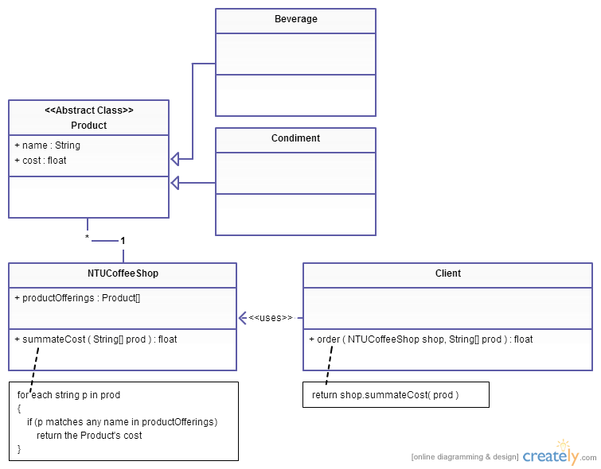
Re-design
Beverage and Condiment can be abstracted into an abstract class Product.

Slide 6
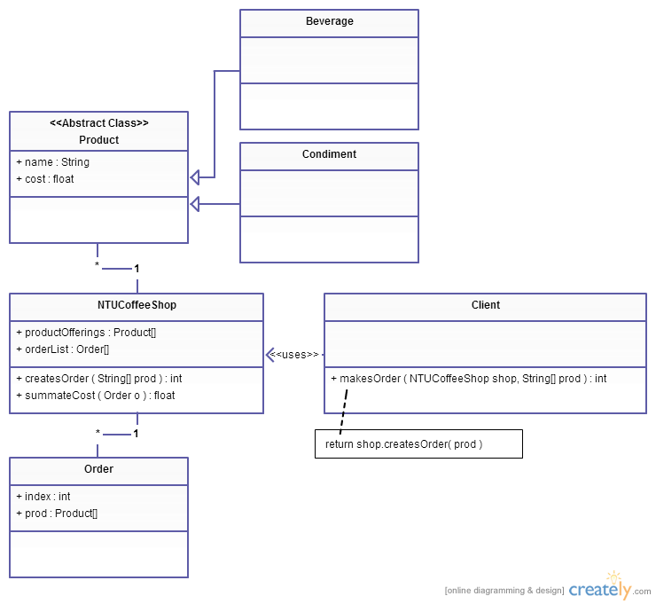
Alternate Design

