Slide 1
HW10
Group 3

Slide 2
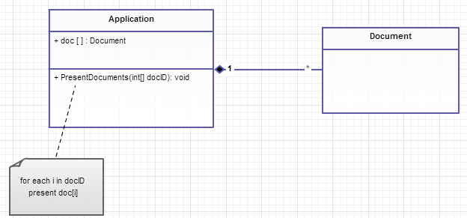
A powerful application can present multiple documents at the same time

Slide 3
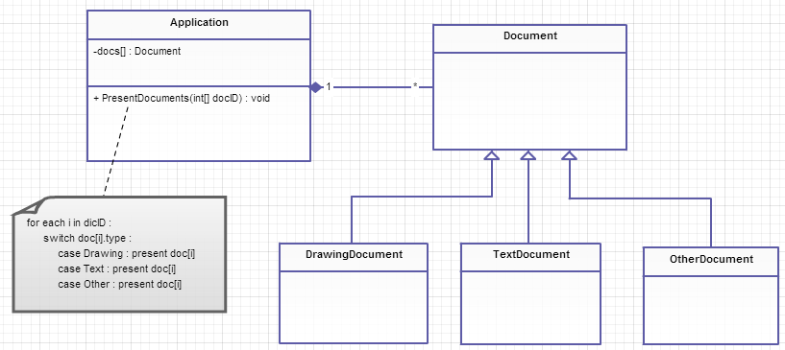
These documents include Drawing Document, TextDocument, and so on.

Slide 4
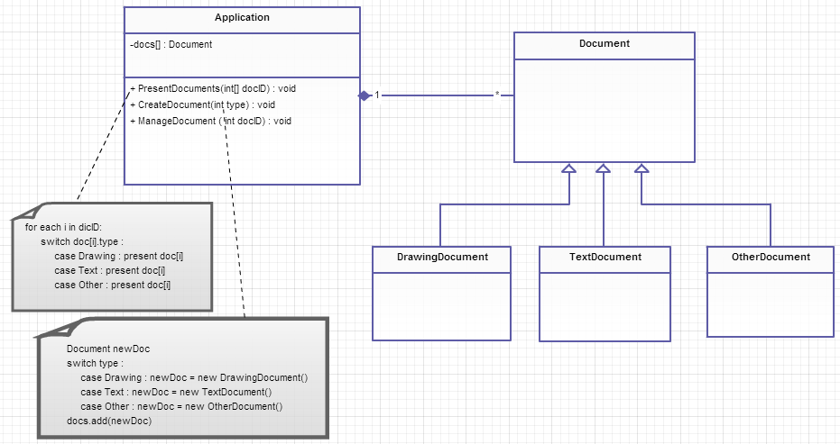
The application is responsible for managing documents and will create them as required

Slide 5
Re-Design

Slide 6
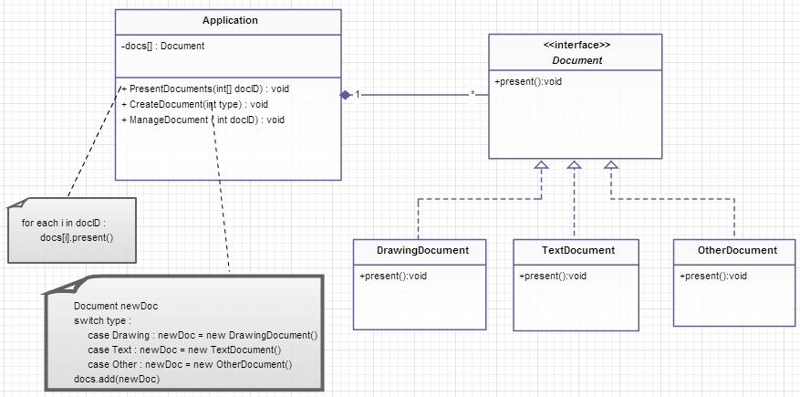

Slide 7
