Slide 1
HW1 – Initial Design
Team 3
B99902066 蔡宗翰 D98944002 林映孜
D02922030 范哲誠 D02944010 呂俊宏
B99902032 黃奕軻 B99902123 廖尉棠
B99902025 吳佳倫 B99902100 劉宗瑋

Slide 2
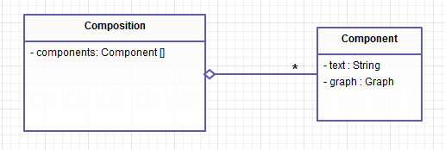

Slide 3
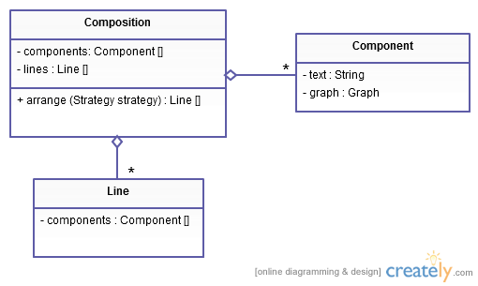

Slide 4
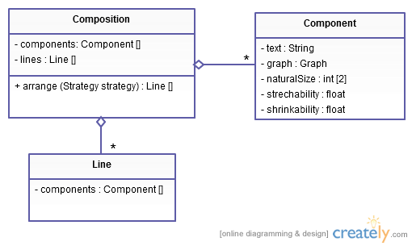

Slide 5
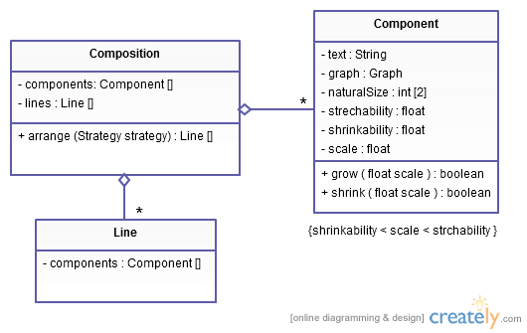

Slide 6
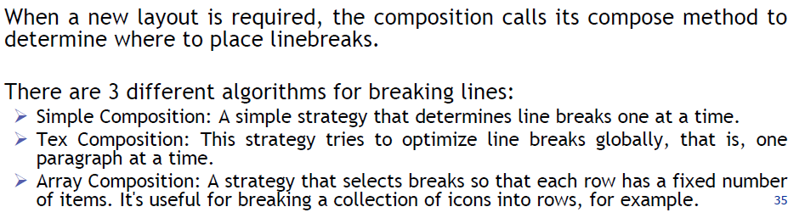
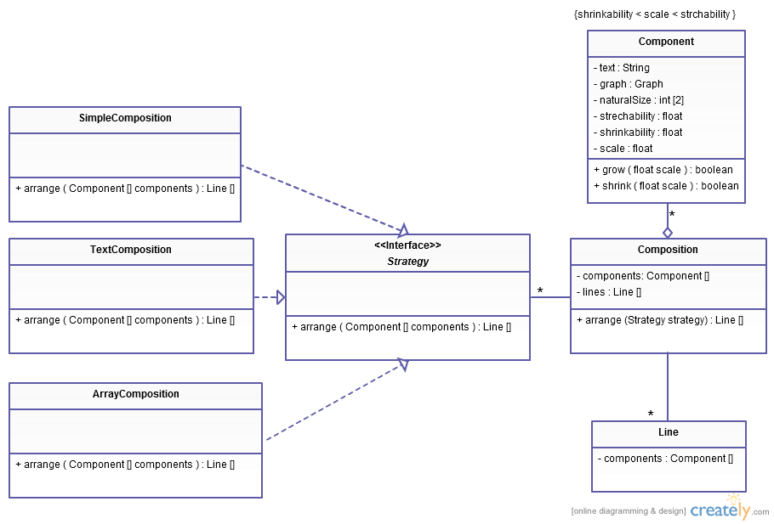

Slide 7
arrange(Component [] components){
lines = new Line[MaxLine];
foreach component{
if(addLineBreak())
lineHead ++;
else
lines[lineHead].add(component);
}
return lines;
}
arrange(Component [] components){
lines = new Line[MaxLine];
foreach paragraph{
foreach components in paragraph{
lines[lineHead].add(component);
}
}
return lines;
}
arrange(Component [] components){
lines = new Line[MaxLine];
count=0;
foreach component{
if(count++ <= numElementsInRow)
lines[lineHead].add(component);
count = 0;
else
lineHead ++;
}
return lines;
}
arrange(Strategy strategy){
return strategy.arrange(components);
}

