Slide 1
NetwrokVis
-NodeXL Improvement
TEAM3
組長:
B99902066 蔡宗翰
組員:
D98944002 林映孜 D02922030 范哲誠 D02944010 呂俊宏
B99902032 黃奕軻 B99902025 吳佳倫
B99902100 劉宗瑋

Slide 2
Outline
Goal
Requirements
System Architecture
Class Diagrams
Initial Design
Design Issues
Re-Design
Unit Testing
WBS
Actual Effort
Performance Evaluation
Test Coverage
Contribution
Demo

Slide 3
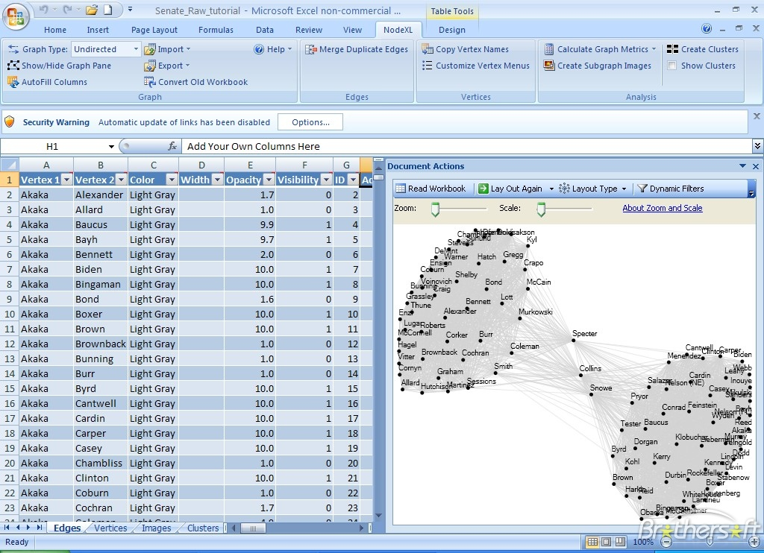
Goal
We have used NodeXL, a open source program which can fetch data from Social Network Service (SNS) and explore network graphs.

Slide 4
Goal
There are some improvements we want to work on NodeXL -
Make it stand alone from MS Excel, create a UI specifically designed for NodeXL.
Save fetched SNS data and calculated metrics in database to prevent redoing such time-consuming jobs.
Lower the memory usage, and expect faster computation.

Slide 5
Requirements

Slide 6
Requirements – DataImporter
Functional Requirement
R1.1 | UI can save settings in ImporterSettings
R1.1.1 | UI can select SNS (Social Network Site) which can be fetched in ImporterSettings
R1.1.2 | UI can select target/time/date which can be fetched in ImporterSettings
R1.1.3 | UI can select items/columns which can be fetched in ImporterSettings
R1.2 | Importer can import data from selected SNS (Social Network Site)
R1.2.1 | Importer can import data from Facebook
R1.2.2 | Importer can import data from Twitter
R1.2.3 | Importer can import data from Youtube
R1.2.4 | Importer can import data from Flickr
R1.3 | Importer can load data from file(graphML)
R1.4 | Core can load settings and execute with corresponding concrete importer.

Slide 7
Graph Storage Management
Non-Functional Requirement
R2.1 | Memory usage should be more efficient than original NodeXL
Functional Requirement
R2.2 | Table Design
R2.2.1 | Design Table Naming method
R2.2.2 | Design Different Social Media table schema & primary key
R2.2.2.1 | Facebook Schema
R2.2.3 | Design Index method
R2.3 | Table Function
R2.3.1 | List Tables
R2.3.2 | Add Table
R2.3.3 | Delete Table
R2.3.4 | Select Table
R.2.3.5 | UI Design
R2.4 | Filter rows by derived restriction
R2.5 | Save graph structure to DB(new table)
R2.6 | Convert selected data to "Graph" structure according to Settings
R2.6.1 | UI can select which column of the data to be used as vertices and save them in Settings
R2.6.2 | User can Match an (weighted) edge according to relationship between vertices (select edge) and save in Settings

Slide 8
Metric
Non-Functional Requirement
R4.6 | When multiple calculator are invoked, the action of writing data back to DB is not centralized
Functional Requirement
R4.1 | Calculate graph metrics according to Settings and generate result asynchronously.
R4.1.1 | Compute ClosenessCentrality of each vertex in a graph
R4.1.2 | Compute BetweennessCentrality of each vertex in a graph
R4.1.3 | Compute EigenvectorCentrality of each vertex in a graph
R4.1.4 | Compute PageRank of each vertex in a graph
R4.1.5 | Compute Max/Avg GeodesicDistances of a graph
R4.1.6 | Compute Modularity of a graph
R4.1.7 | Generate clusters of a graph by Girvan-Newman algorithm
R4.1.8 | Generate communities of a graph by Clauset Newman Moore algorithm
R4.1.9 | Identify all Cliques of a graph
R4.1.10 | Calculate clusters using the Wakita-Tsurumi algorithm

Slide 9
Metric
Functional Requirement
R4.1.11 | Calculate in/out degree of each vertex in a graph
R4.1.12 | Identify all strongly connected components of a graph
R4.1.13 | Calculate intergroup edges of any pair of group and within a group
R4.1.14 | Calculates the reciprocated vertex pair ratio for each of the graph's vertices
R4.1.15 | Generate a subgraph according to a specified vertex
R4.1.16 | Partition the graph into motifs
R4.2 | Calculator can report their work progress
R4.3 | UI can select some algorithm to calculate graph metrics and save in Settings.
R4.4 | The results of calculation are written back to DB immediately
R4.5 | The results of calculation should be visible to user after calculation

Slide 10
Graph Representation
Functional Requirement
R5.1 | LayoutControl hold a NodeXLControl Object
R5.2 | LayoutControl use NodeXLControl Object to show the graph
R5.2.1 | To showing the graph, we assign the graph and the chosen layout to NodeXLControl Object and then call NodeXLControl.drawgraph
R5.2.2 | The NodeXLControl will first layout the graph and then draw them on the window
R5.3 | When layouting, we specify the location of each vertex in the graph according to the layout context and layout type.
R5.3.1 | The types of layouts includes: CircleLayout, GridLayout, Random Layout, SinusoidLayout, etc.
R5.3.2 | Users can set the margins, and other layout settings.
R5.4 | The vertices in a graph can be clustered into several groups
R5.4.1 | The vertices can be layout globally or locally within groups, also can be choose by the users
R5.4.2 | Within each group, the vertices can be also layout with the chosen type, within the layout context of the group
R5.5 | The vertices and edge in the graph can be draw with different color, border
R5.5.1 | The used color and edge with are depend on user's selection
R5.5.2 | The users is able to click the button to show or hide vertex labels
R5.6 | The users is able to scale and zoom the graph with slide bars
R5.7 | The user is able to change the mouse mode while viewing the graph: selection, add selection, remove selection, zoom in/out, move graph

Slide 11
UI
Functional Requirement
R6.1 | Modification as 1. Menubar, 2. Model Control 3. Graph; Because that event Table show on the left, We still use data structure on memory
R6.1.1 | User can choose to load data from file, database or SNS importer.
R6.1.2 | After the data is loaded, user can choose which column of the data to be vertices and input restrictions to filter rows.
R6.1.3 | User can choose to export the data to image file or graphML file (need to specify the file path)
R6.1.4 | User can select multiple metric to be computed at once (check box)
R6.1.5 | Once the metrics are computed, user can use one of the metrics to autofill columns(color, width, style, opacity, visibility, label)
R6.1.6 | User can select a layout from dropdown list.
R6.1.7 | User can refresh the graph
R6.1.8 | User can Show/hide table
R6.1.9 | User can Show/hide graph label
R6.1.10 | There is a dropdown list widget, which includes the layout that user can choose.

Slide 12
Internal Interface Requirements(IIR)
Internal Interface Requirements
IIR1 | Importer read setting info from UI
IIR2 | Imorted data is stored to DataBase
IIR3 | Graph can ask data from DataBase
IIR4 | UI can ask Mertic to compute metrics
IIR5 | UI hold a LayoutControl object to handle layout and draw graph issues
IIR6 | When showing graph, UI assign graph to LayoutControl and show
IIR7 | UI can ask Importer to Import data and save in DB.
IIR8 | UI can select which Metric to be calculated and save in settings.

Slide 13
Outer Interface Requirement(OIR)
Outer Interface Requirement
OIR1 | Importer use "SocialNetworkImporter" to get data from SNS
OIR2 | DataBase use “MySQL" to save and fetch data.

Slide 14
User Interface Requirement (UIR)
User Interface Requirement
UIR1 | Import from SNS
UIR2 | Import from file
UIR3 | Calculate Metrics
UIR4 | Show graph
UIR5 | change layout
UIR6 | export graph
UIR7 | Show table(Metric, Edge, Vertice)

Slide 15
System Architecture

Slide 16
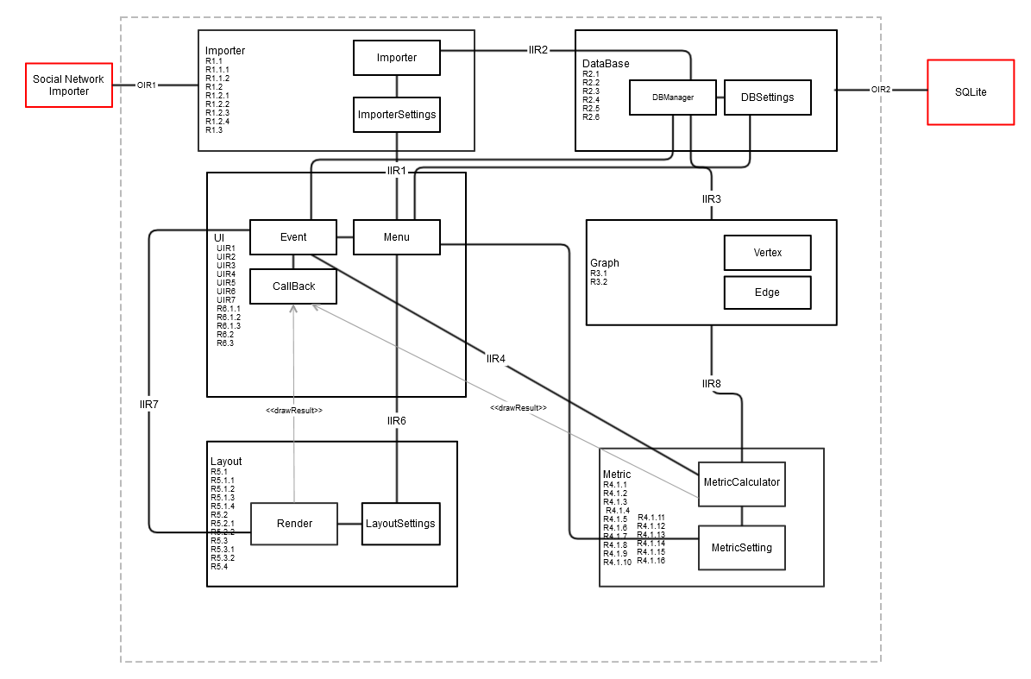
Architecture – Original

Slide 17
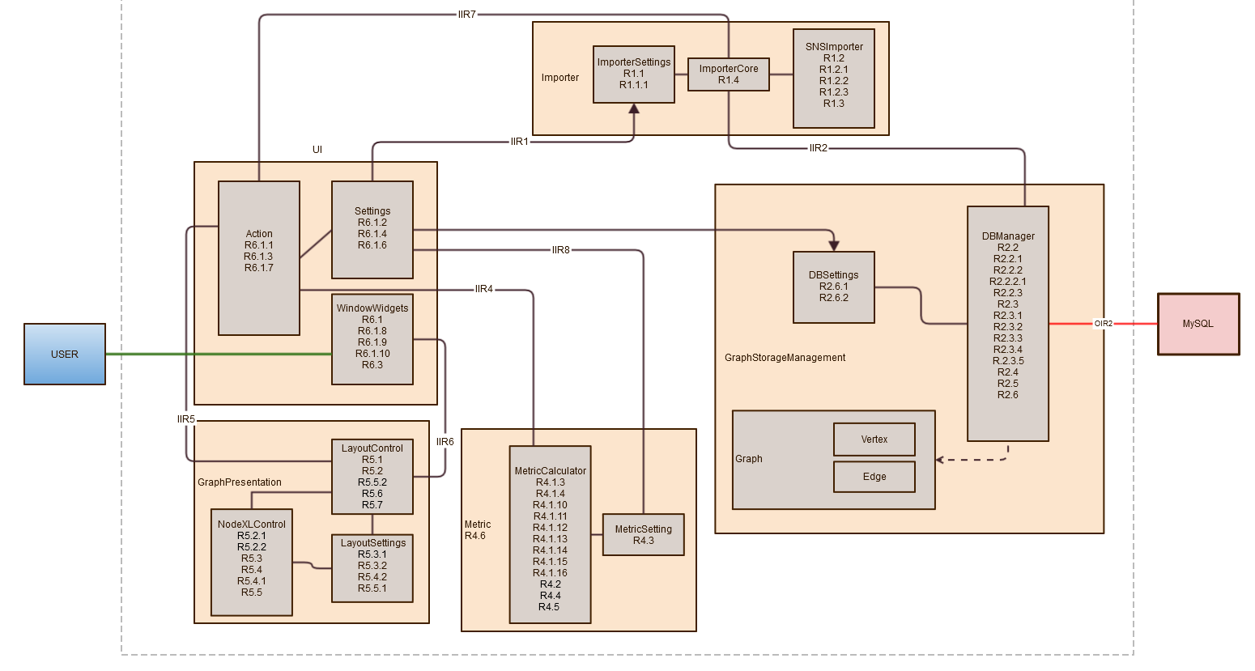
Architecture - Final

Slide 18
Class Diagram

Slide 19
Packages
UI
Importer
GraphStorageManagement
Metric
GraphRepresentation
Notes:
我們的系統共有5個package, 分別是UI, Importer, GraphStorageManagement, Metric, GraphRepresentation
以下分別對各個package說明 Initial design, design issues, 和 re-design

Slide 20
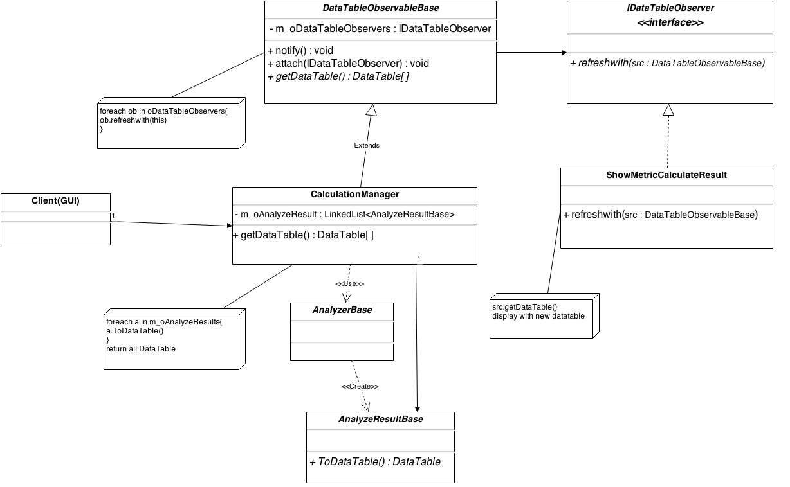
UI – Initial design
Observer pattern

Slide 21
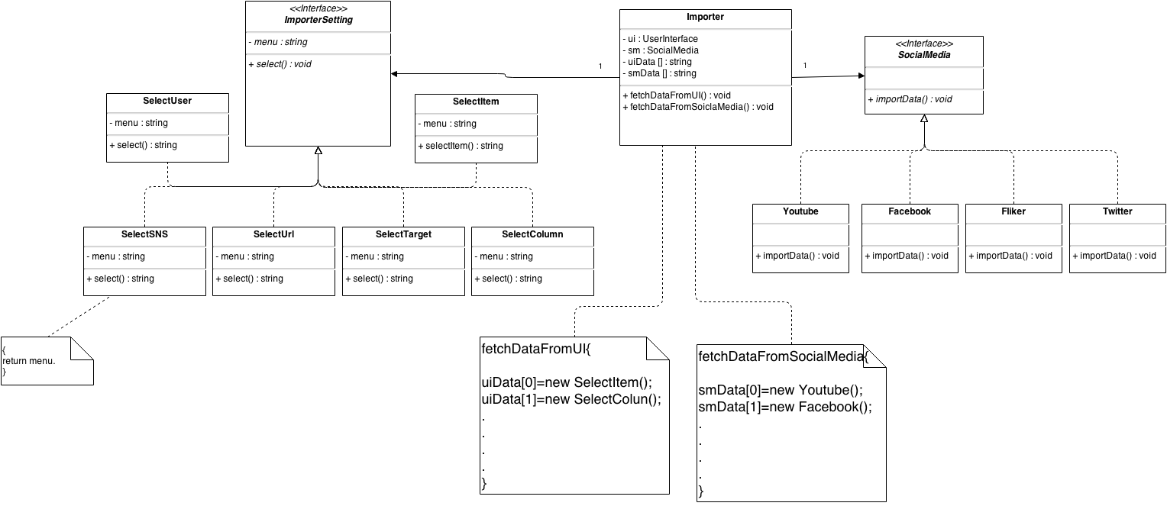
Importer – Initial design
Importer
Notes:
第二個是 Importer, initial design 中間的importer是核心, 左邊是importer的setting, 右邊是

Slide 22
Importer – Re-Design
Issues :
The imported data from the Social Media need to be saved in several tables. There will be difficulties while integrating data from different Social Media.
Solution:
Create a AllInOneTable class to integrate all the fields needed in one table.
ImporterSetting isn’t needed anymore, since we grab all the data from Social Media.

Slide 23
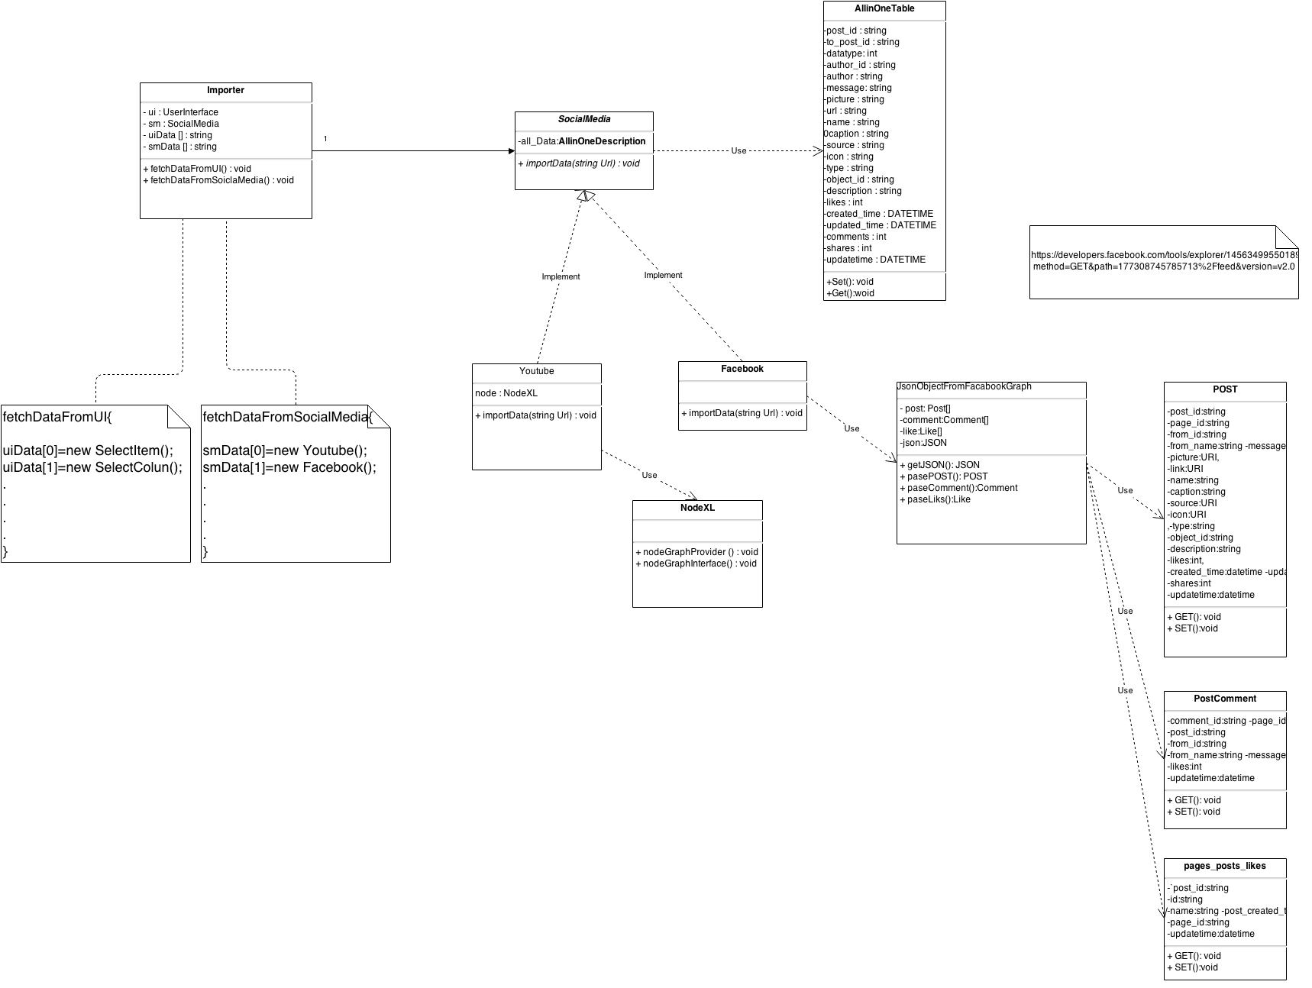
Importer – Re-Design
Importer

Slide 24
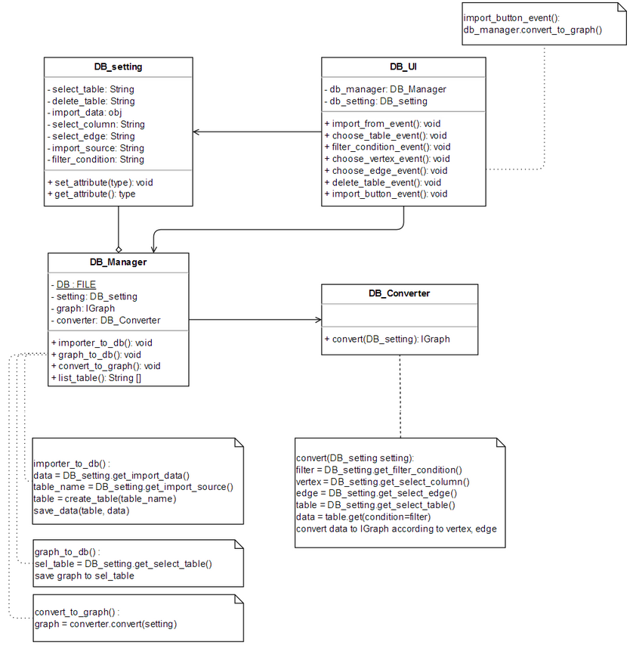
GraphStorageManagement – Initial design
GraphStorageManagement

Slide 25
GraphStorageManagement – Re-Design V.1
Issues :
The data filtering conditions varies based on the data, if a new data format is added, the convert() function will be open for modification.
Solution:
Create a abstract class SchemaData and several format of schema extend it.

Slide 26
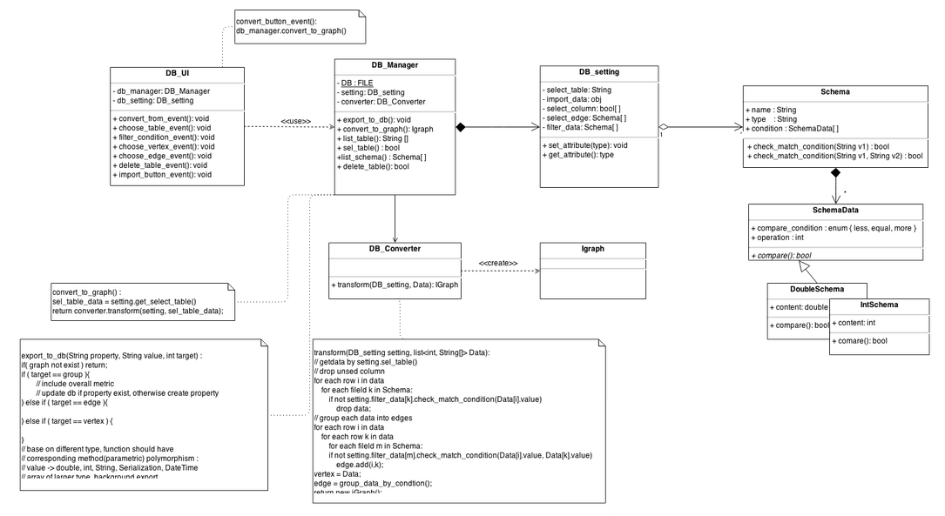
GraphStorageManagement – Re-Design V.1
GraphStorageManagement

Slide 27
GraphStorageManagement – Re-Design V.2
Issues :
There are many types of data field corresponding to the content, needs to be more flexible.
Solution:
builder pattern.

Slide 28
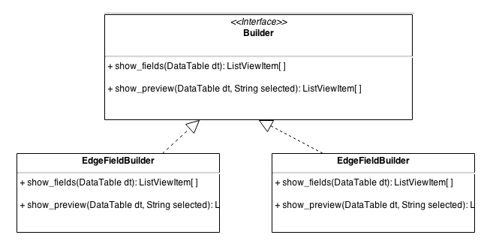
GraphStorageManagement – Re-Design V.2
GraphStorageManagement

Slide 29
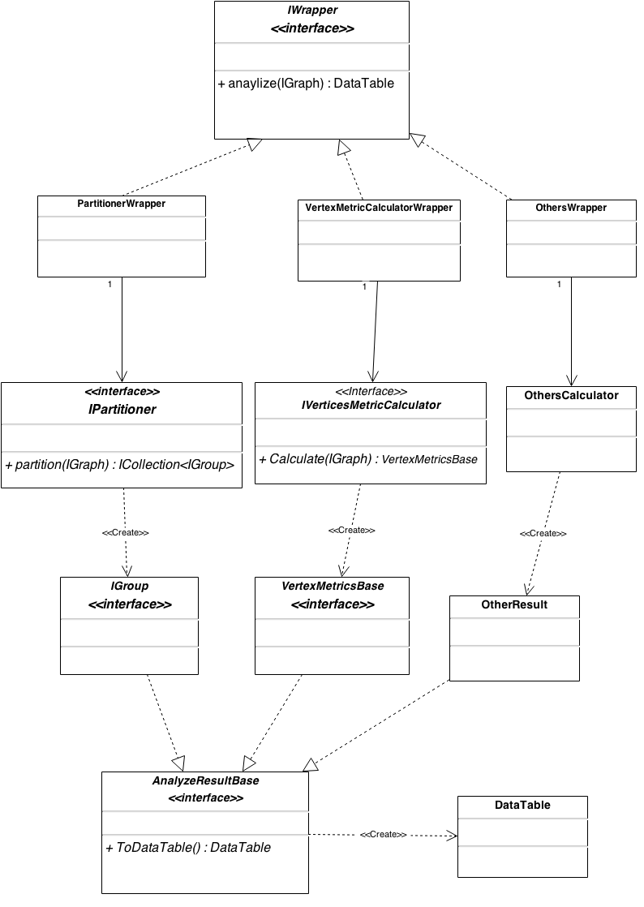
Metric – Initial design
Metric

Slide 30
Metric – Re-Design
Issues :
All analyzers need to have the ability to report its own progress.
Solution:
Let them extends an abstract class – AnalyzerBase.
-> Factory method pattern

Slide 31
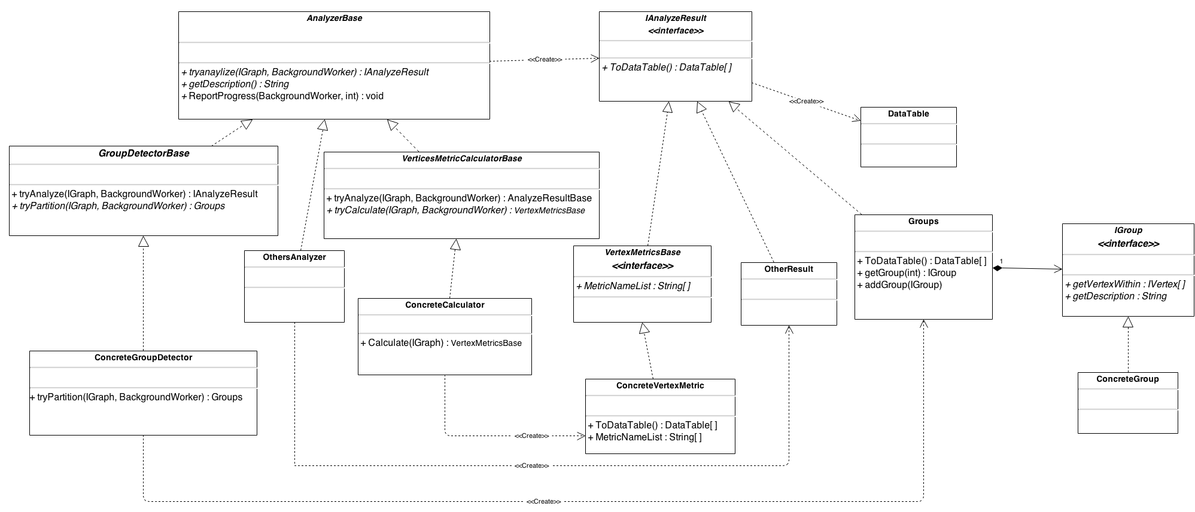
Metric – Re-Design
Metric

Slide 32
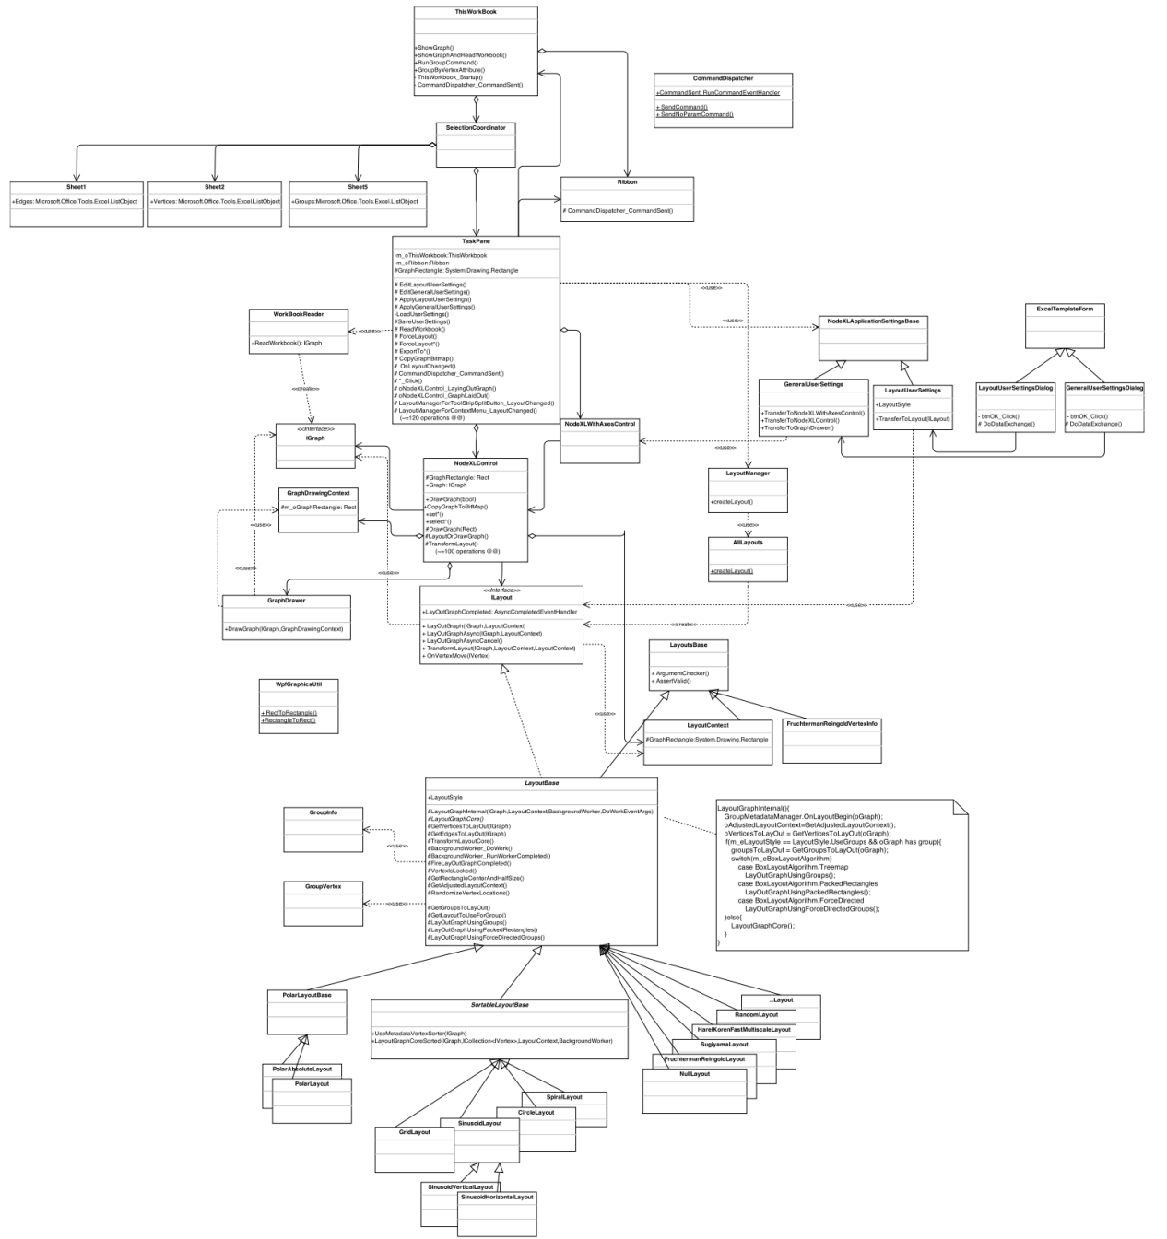
GraphRepresentation – NODEXL design
GraphRepresentation

Slide 33
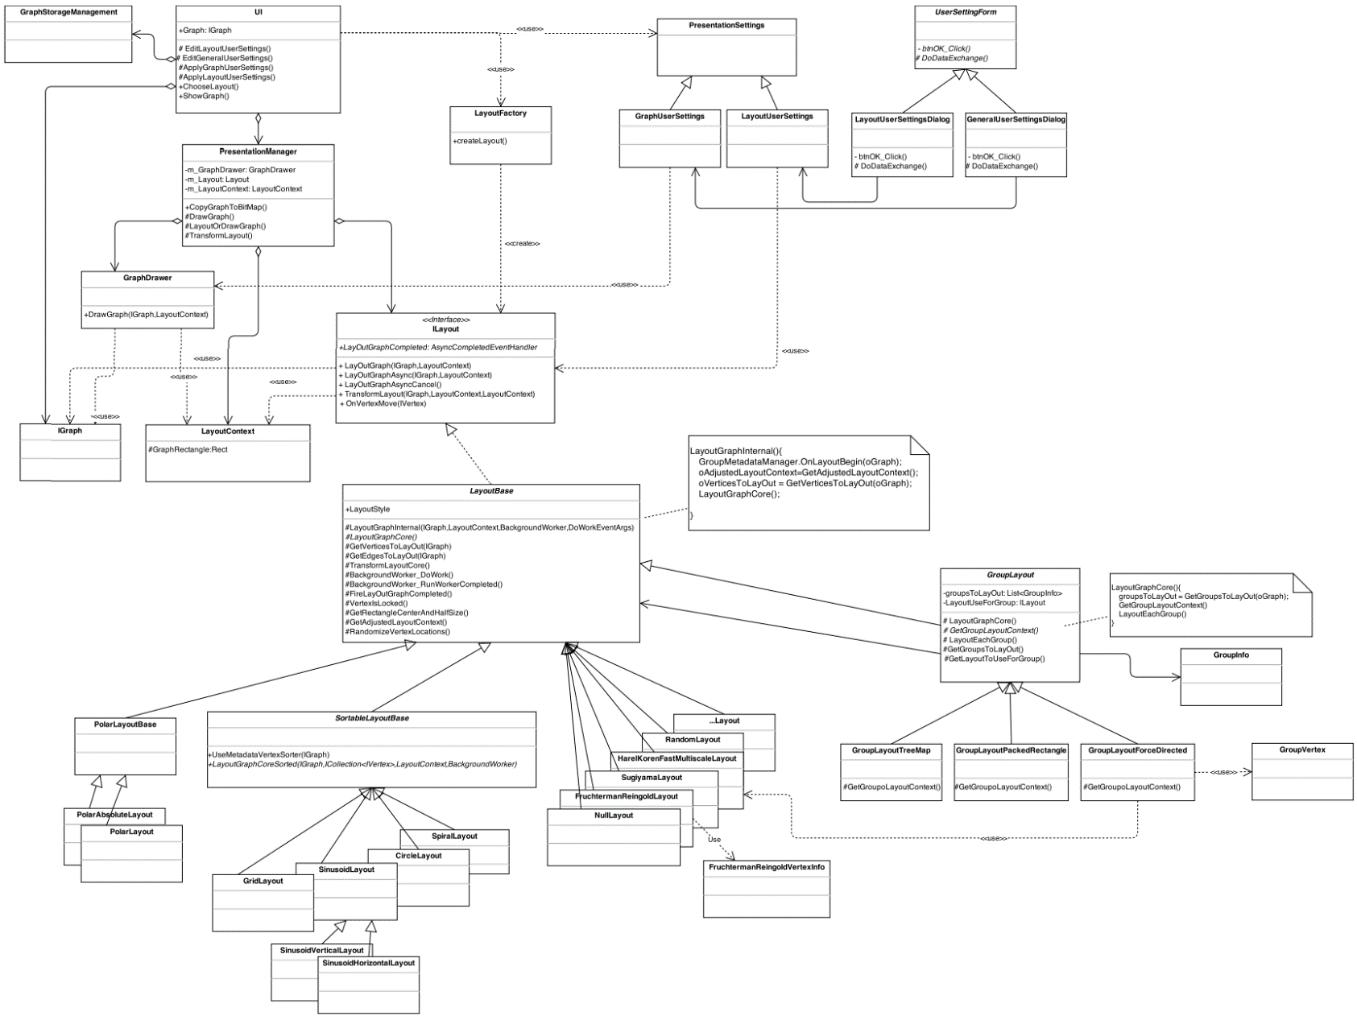
GraphRepresentation – Initial design
GraphRepresentation

Slide 34
GraphRepresentation – Re-Design
Issues :
The deployment of the revised NODEXL design may encounter several dependency problems while implementing.
Solution:
Exploit the layout functionality of NODEXL as plug-in without changing the original design of NODEXL.

Slide 35
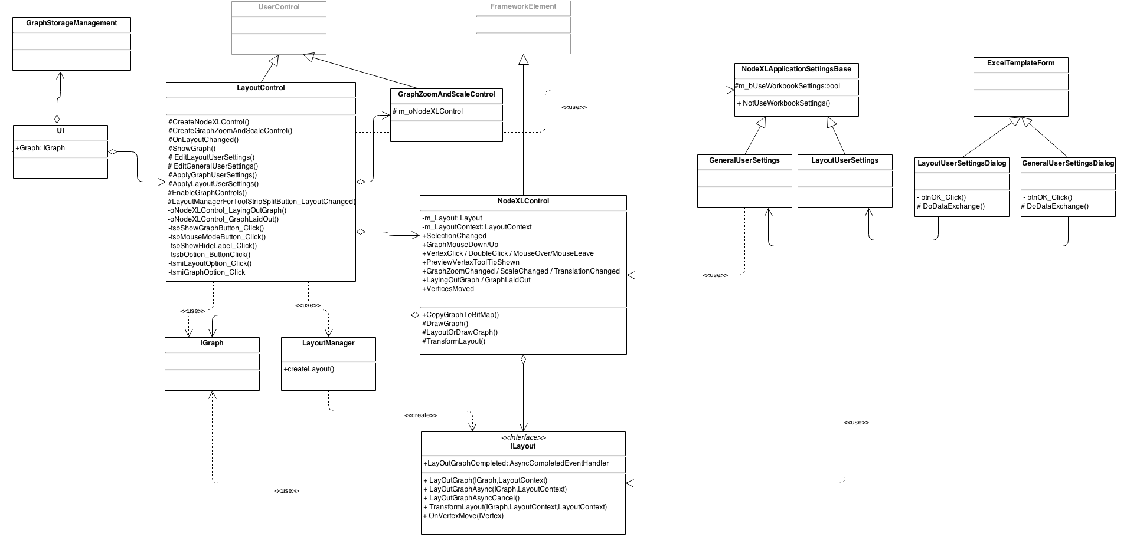
GraphRepresentation – Re-Design
GraphRepresentation

Slide 36
UNIT TESTING

Slide 37
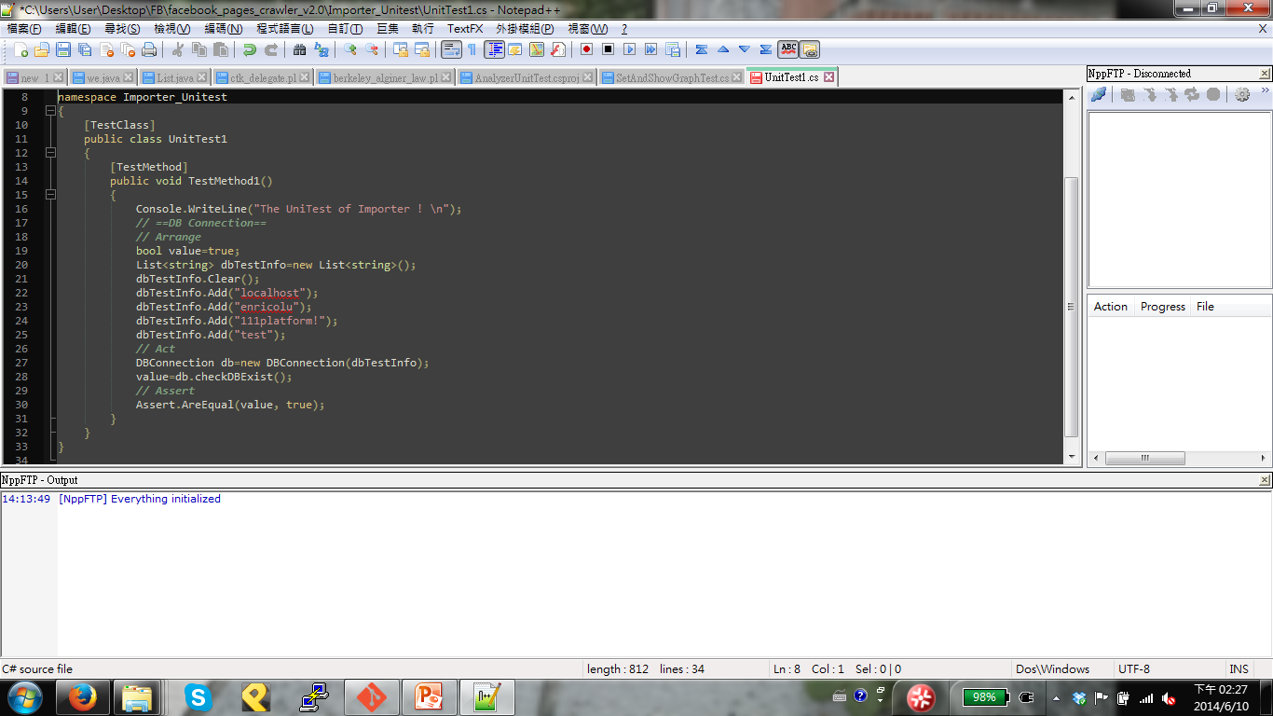
Unit Testing - Importer

Slide 38
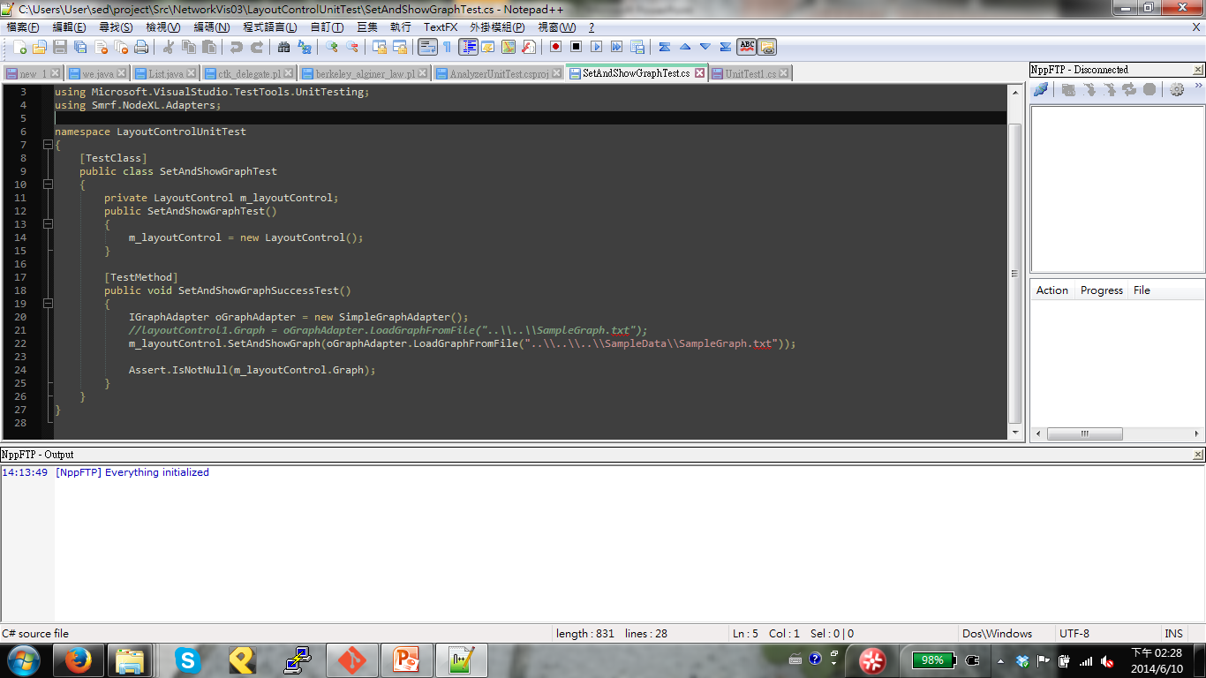
UNIT TESTING – Graph Representation

Slide 39
WBS

Slide 40
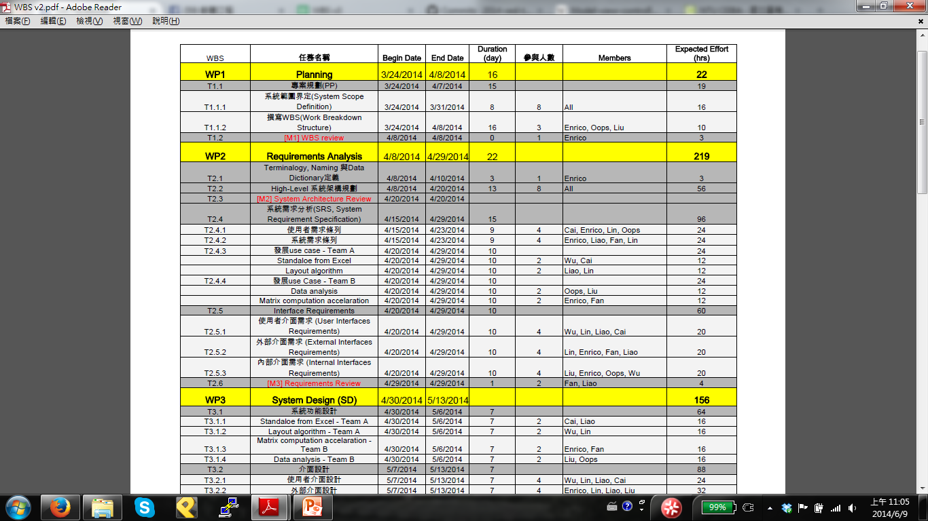
WBS - Original

Slide 41
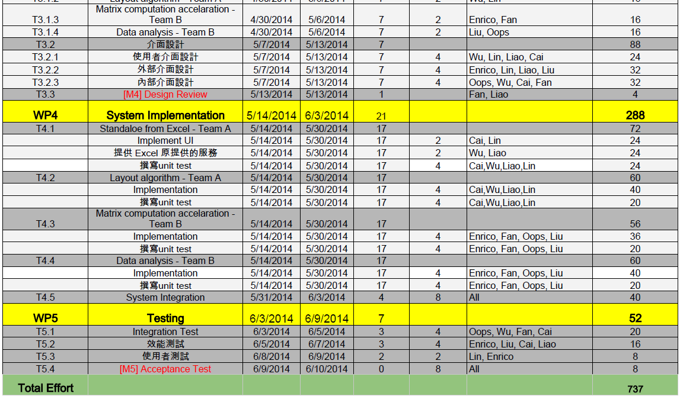

Slide 42
WBS-Final
 | 任務名稱 | Begin Date | End Date | Duration (day) | 參與人數 | Members | Expected Effort (hrs) | Actual Effort (hrs)
WP1 | Planning | 3/24/2014 | 4/8/2014 | 16 |  |  | 22 | 17
T1.1 | 專案規劃(PP) | 3/24/2014 | 4/7/2014 | 15 |  |  | 19 | 17
T1.1.1 | 系統範圍界定(System Scope Definition) | 3/24/2014 | 3/31/2014 | 8 | 8 | All | 16 | 7
T1.1.2 | 撰寫WBS(Work Breakdown Structure) | 3/24/2014 | 4/8/2014 | 16 | 3 | Enrico, Oops, Liu | 10 | 10
T1.2 | [M1] WBS review | 4/8/2014 | 4/8/2014 | 0 | 1 | Enrico | 3 | 1
WP2 | Requirements Analysis | 4/8/2014 | 4/29/2014 | 22 |  |  | 219 | 159
T2.1 | Terminalogy, Naming 與Data Dictionary定義 | 4/8/2014 | 4/10/2014 | 3 | 1 | Enrico | 3 | 2
T2.2 | High-Level 系統架構規劃 | 4/8/2014 | 4/20/2014 | 13 | 8 | All | 56 | 62
T2.3 | [M2] System Architecture Review | 4/20/2014 | 4/20/2014
T2.4 | 系統需求分析(SRS, System Requirement Specification) | 4/15/2014 | 4/29/2014 | 15 |  |  | 96 | 51
T2.4.1 | 使用者需求條列 | 4/15/2014 | 4/23/2014 | 9 | 4 | Cai, Enrico, Lin, Oops | 24 | 4
T2.4.2 | 系統需求條列 | 4/15/2014 | 4/23/2014 | 9 | 4 | Enrico, Liao, Fan, Lin | 24 | 30
T2.4.3 | 發展use case - Team A | 4/20/2014 | 4/29/2014 | 10 |  |  | 24
 | Standaloe from Excel | 4/20/2014 | 4/29/2014 | 10 | 2 | Wu, Cai | 12 | 2
 | Layout algorithm | 4/20/2014 | 4/29/2014 | 10 | 2 | Liao, Lin | 12 | 2

Slide 43
WBS | 任務名稱 | Begin Date | End Date | Duration (day) | 參與人數 | Members | Expected Effort (hrs) | Actual Effort (hrs)
T2.4.4 | 發展use Case - Team B | 4/20/2014 | 4/29/2014 | 10 |  |  | 24
 | Data analysis | 4/20/2014 | 4/29/2014 | 10 | 2 | Oops, Liu | 12 | 6
 | Matrix computation accelaration | 4/20/2014 | 4/29/2014 | 10 | 2 | Enrico, Fan | 12 | 7
T2.5 | Interface Requirements | 4/20/2014 | 4/29/2014 | 10 |  |  | 60 | 44
T2.5.1 | 使用者介面需求 (User Interfaces Requirements) | 4/20/2014 | 4/29/2014 | 10 | 4 | Wu, Lin, Liao, Cai | 20 | 15
T2.5.2 | 外部介面需求 (External Interfaces Requirements) | 4/20/2014 | 4/29/2014 | 10 | 4 | Lin, Enrico, Fan, Liao | 20 | 17
T2.5.3 | 內部介面需求 (Internal Interfaces Requirements) | 4/20/2014 | 4/29/2014 | 10 | 4 | Liu, Enrico, Oops, Wu | 20 | 12
T2.6 | [M3] Requirements Review | 4/29/2014 | 4/29/2014 | 1 | 2 | Fan, Liao | 4
WP3 | System Design (SD) | 4/30/2014 | 5/13/2014 |  |  |  | 156 | 122
T3.1 | 系統功能設計 | 4/30/2014 | 5/6/2014 | 7 |  |  | 64 | 80
T3.1.1 | Standaloe from Excel - Team A | 4/30/2014 | 5/6/2014 | 7 | 2 | Cai, Liao | 16
T3.1.2 | Layout algorithm - Team A | 4/30/2014 | 5/6/2014 | 7 | 2 | Wu, Lin | 16 | 40
T3.1.3 | Matrix computation accelaration - Team B | 4/30/2014 | 5/6/2014 | 7 | 2 | Enrico, Fan | 16 | 8
T3.1.4 | Data analysis - Team B | 4/30/2014 | 5/6/2014 | 7 | 2 | Liu, Oops | 16 | 32
T3.2 | 介面設計 | 5/7/2014 | 5/13/2014 | 7 |  |  | 88 | 42
T3.2.1 | 使用者介面設計 | 5/7/2014 | 5/13/2014 | 7 | 4 | Wu, Lin, Liao, Cai | 24 | 12
T3.2.2 | 外部介面設計 | 5/7/2014 | 5/13/2014 | 7 | 4 | Enrico, Lin, Liao, Liu | 32 | 6
T3.2.3 | 內部介面設計 | 5/7/2014 | 5/13/2014 | 7 | 4 | Oops, Wu, Cai, Fan | 32 | 24
T3.3 | [M4] Design Review | 5/13/2014 | 5/13/2014 | 1 |  | Fan, Liao | 4

Slide 44
WBS | 任務名稱 | Begin Date | End Date | Duration (day) | 參與人數 | Members | Expected Effort (hrs) | Actual Effort (hrs)
WP4 | System Implementation | 5/29/2014 | 6/5/2014 |  |  |  | 240 | 160
T4.1 | Metric | 5/29/2014 | 6/5/2014 | 7 | 1 | Liu, Cai | 40 | 44
 | Dialog design | 5/29/2014 | 6/5/2014 |  |  |  |  | 4
 | coding | 5/29/2014 | 6/5/2014 |  |  |  |  | 40
 | unit testing | 6/3/2014 | 6/5/2014
T4.2 | Layout | 5/29/2014 | 6/5/2014 | 7 | 1 | Lin, Cai | 40 | 24
 | Dialog design | 5/29/2014 | 6/5/2014
 | coding | 5/29/2014 | 6/5/2014
 | unit testing | 6/3/2014 | 6/5/2014
T4.3 | GraphStorageManagement | 5/29/2014 | 6/5/2014 | 7 | 2 | Oops, Wu | 60 | 25
 | Dialog design | 5/29/2014 | 6/5/2014
 | coding | 5/29/2014 | 6/5/2014
 | unit testing | 6/3/2014 | 6/5/2014
T4.4 | Importer | 5/29/2014 | 6/5/2014 | 7 | 2 | Fan, Enrico | 60 | 35
 | Dialog design | 5/29/2014 | 6/5/2014
 | coding | 5/29/2014 | 6/5/2014
 | unit testing | 6/3/2014 | 6/5/2014
T4.5 | GUI scratch | 5/29/2014 | 6/5/2014 | 7 | 1 | Enrico, Cai | 40 | 32
 | main window design | 5/29/2014 | 6/5/2014
WP5 | Testing | 6/6/2014 | 6/9/2014 | 4 |  |  | 44 | 14
T5.1 | Integration Test | 6/6/2014 | 6/9/2014 | 4 | 7 | All | 20 | 7
T5.2 | 效能測試 | 6/6/2014 | 6/9/2014 | 4 | 7 | All | 16 | 7
T5.4 | [M5] Acceptance Test | 6/9/2014 | 6/10/2014 | 0 | 7 | All | 8
Total Effort |  |  |  |  |  |  | 681 | 472

Slide 45
Actual Effort (Total.)
Planning and Analysis: 17+159 = 176 hrs
Design: 122 hrs
Implement and Testing: 160+14 = 174 hrs
Total: 472 hrs (Predicted effort: 681 hrs)
(Until 6/9 PM 5:00)

Slide 46
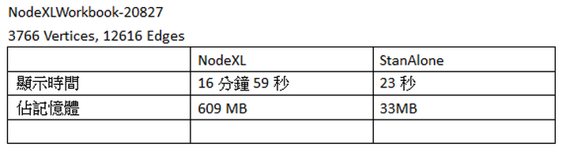
Performance Evaluation

Slide 47
Test Coverage

Slide 48
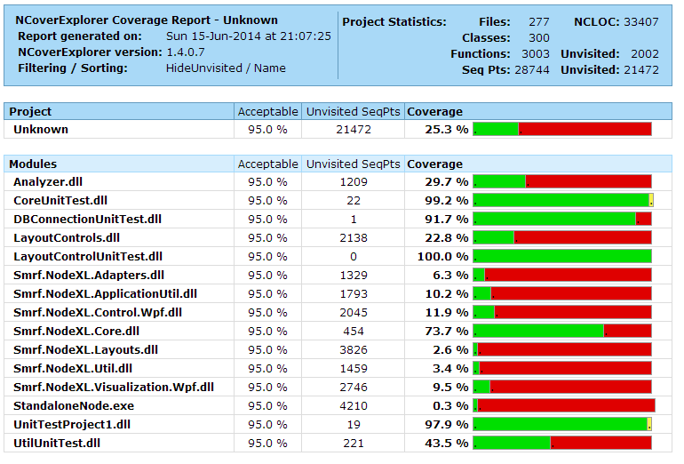
Test Coverage

Slide 49
Contribution

Slide 50
Contribution
組員 | 內容
蔡宗翰 | 條列需求、規劃設計架構、設計報告投影片
呂俊宏 | 條列需求、規劃設計架構、設計實作UI、整合整個Project
范哲誠 | 條列需求、規劃設計架構、設計實作Importer、整理投影片
林映孜 | 條列需求、規劃設計架構、設計實作GraphRepresentation
黃奕軻 | 條列需求、規劃設計架構、 設計實作GraphStorageManagement
劉宗瑋 | 條列需求、規劃設計架構、設計實作Metric
吳佳倫 | 條列需求、規劃設計架構、設計GraphStorageManagement、 設計報告投影片

Slide 51
DEMO

