Slide 1
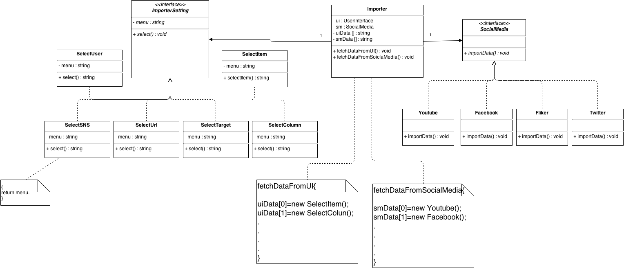
Importer – Initial design
Importer

Slide 2
Importer – Design Issues

Slide 3
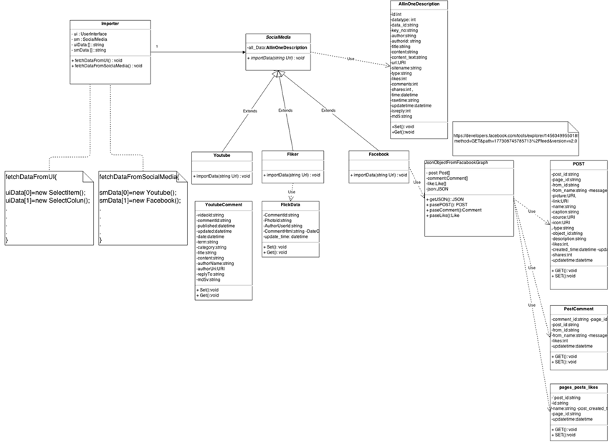
Importer – Re-Design V.1
Importer

Slide 4
Importer – Re-Design V.2

Slide 5
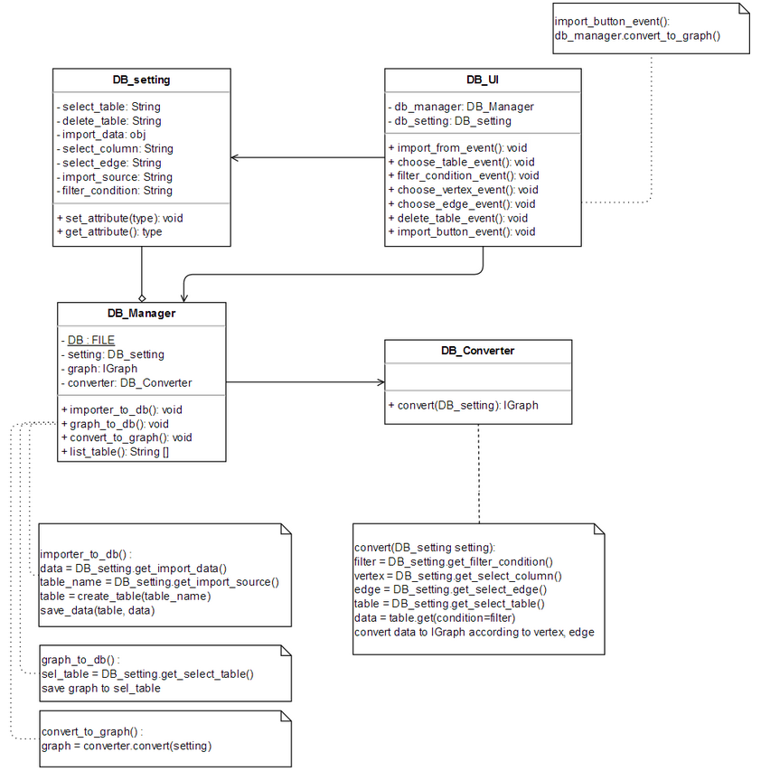
GraphStorageManagement – Initial design
GraphStorageManagement

Slide 6
GraphStorageManagement – Design Issues

Slide 7
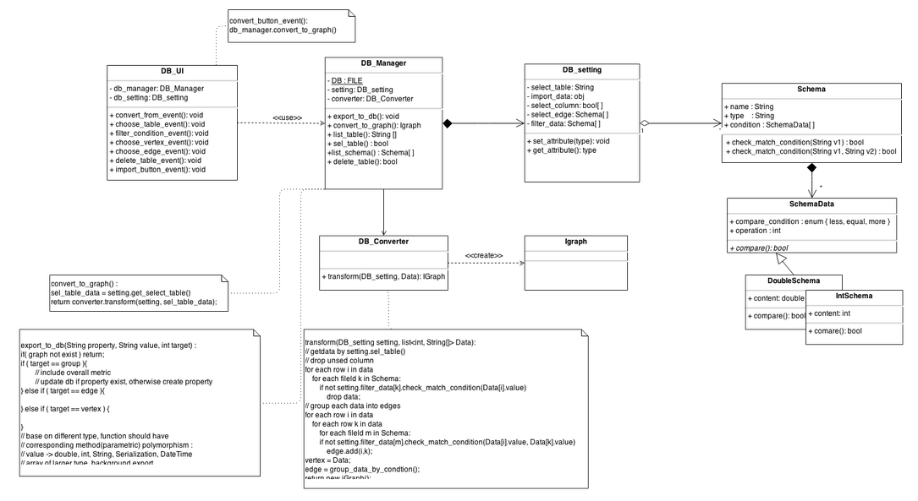
GraphStorageManagement – Re-Design V.1
GraphStorageManagement

Slide 8
GraphStorageManagement – Re-Design V.2

Slide 9
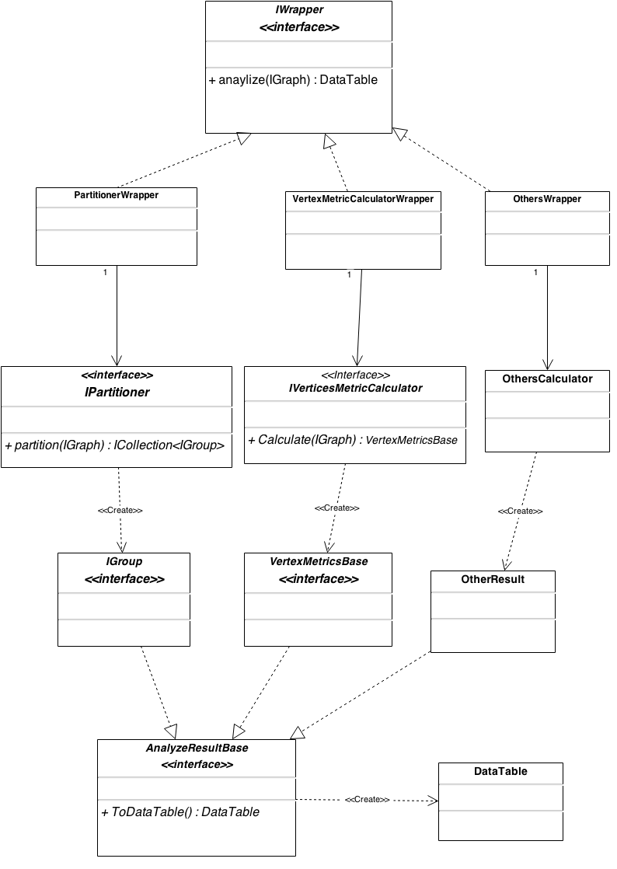
Metric – Initial design
Metric

Slide 10
Metric – Design Issues

Slide 11
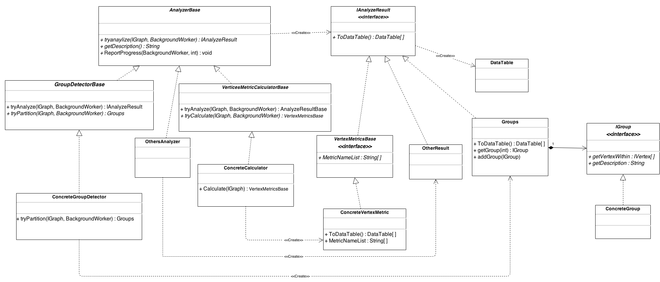
Metric – Re-Design V.1
Metric

Slide 12
Metric – Re-Design V.2

Slide 13
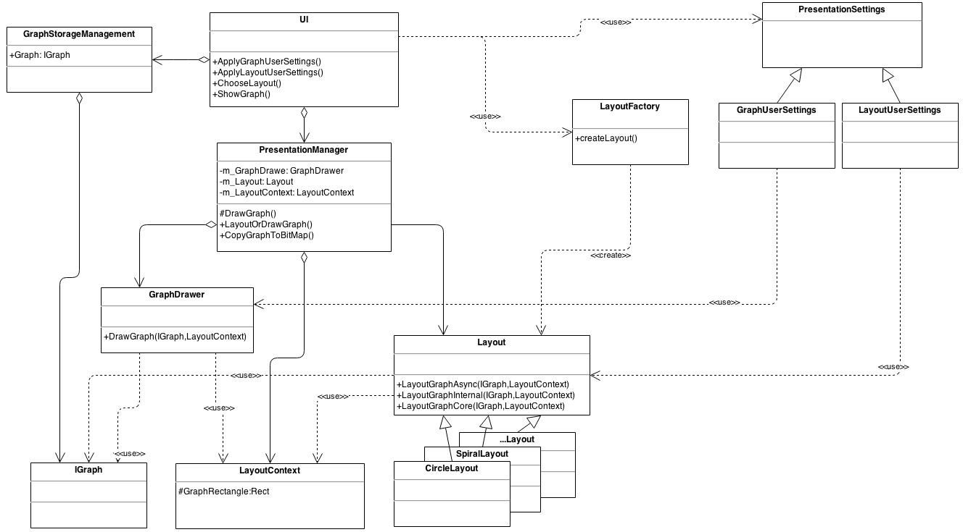
GraphRepresentation – Initial design
GraphRepresentation

Slide 14
GraphRepresentation – Design Issues

Slide 15
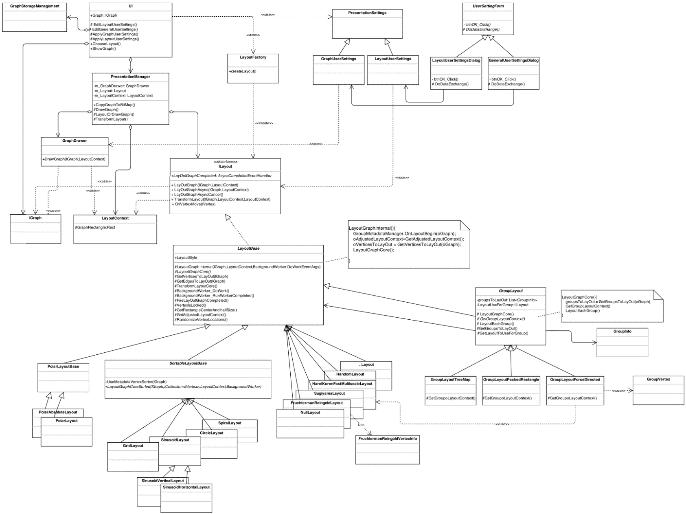
GraphRepresentation – Re-Design V.1
GraphRepresentation

Slide 16
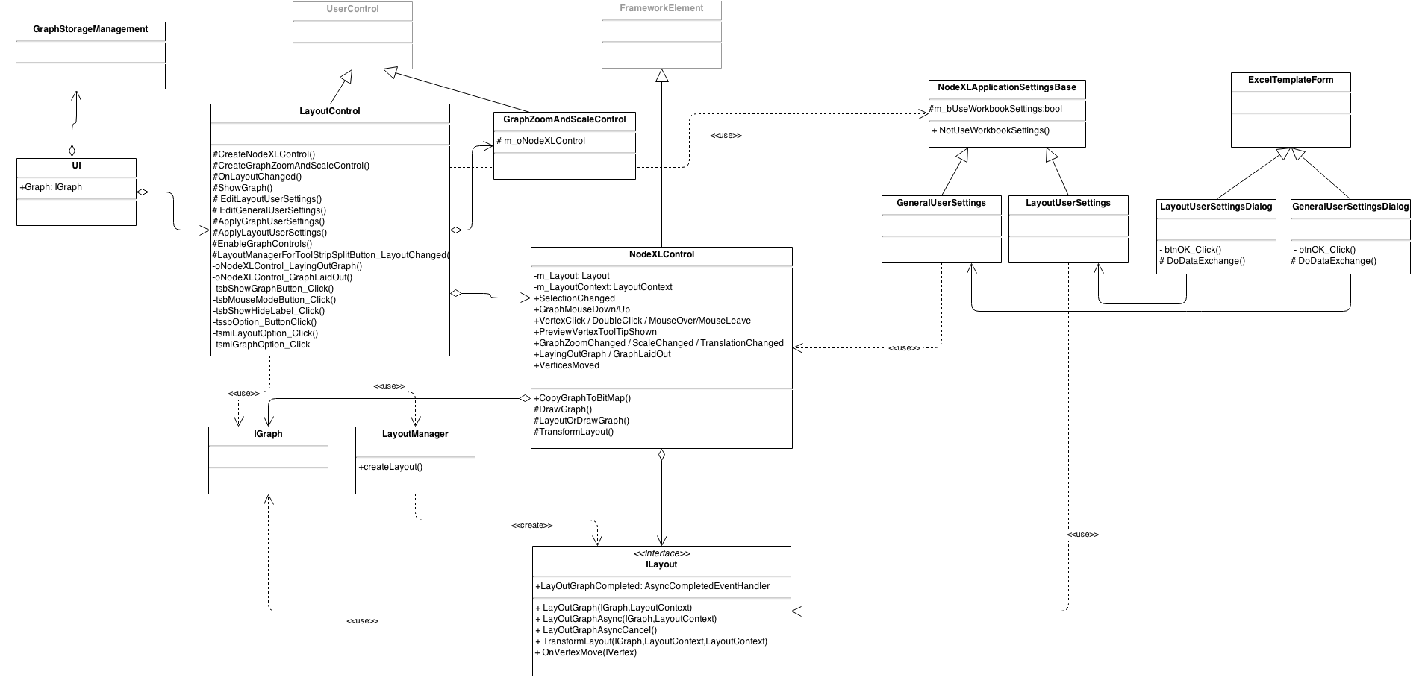
GraphRepresentation – Re-Design V.2
GraphRepresentation

