Slide 1
Hw14-2
Group 3

Slide 2
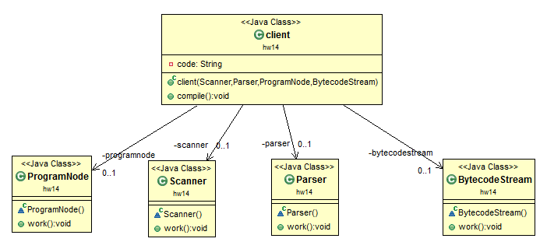
Direct coding

Slide 3
Initial Design

Slide 4
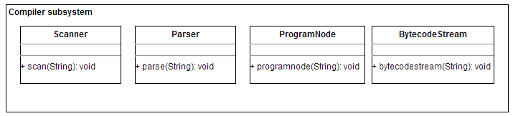
A compiler subsystem contains classes such as Scanner, Parser, ProgramNode, and BytecodeStream.

Slide 5
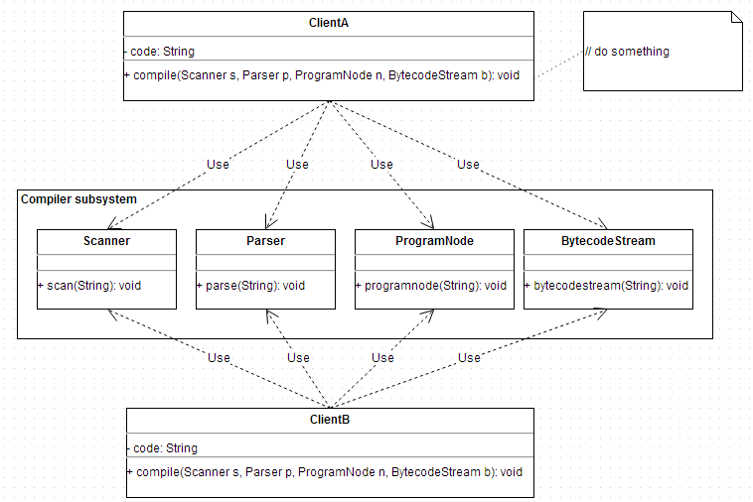
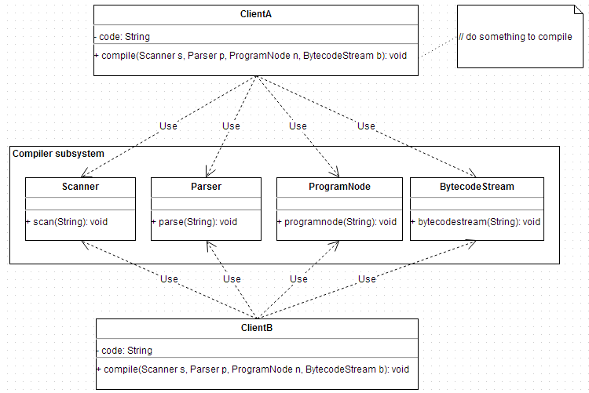
The client classes need to use Scanner, Parser, ProgramNode, and BytecodeStream to compile some code.

Slide 6
Re-Design

Slide 7
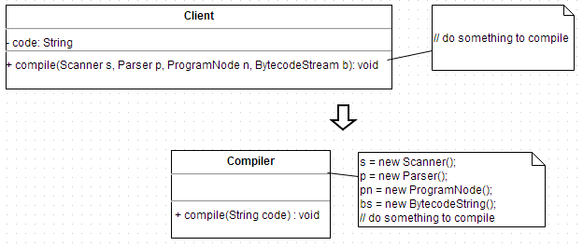

Slide 8
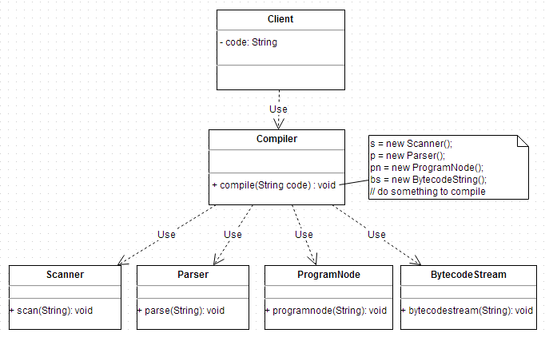

Slide 9
V2

Slide 10
