Slide 1
Homework 1 -- 4/8
team 3

Slide 2
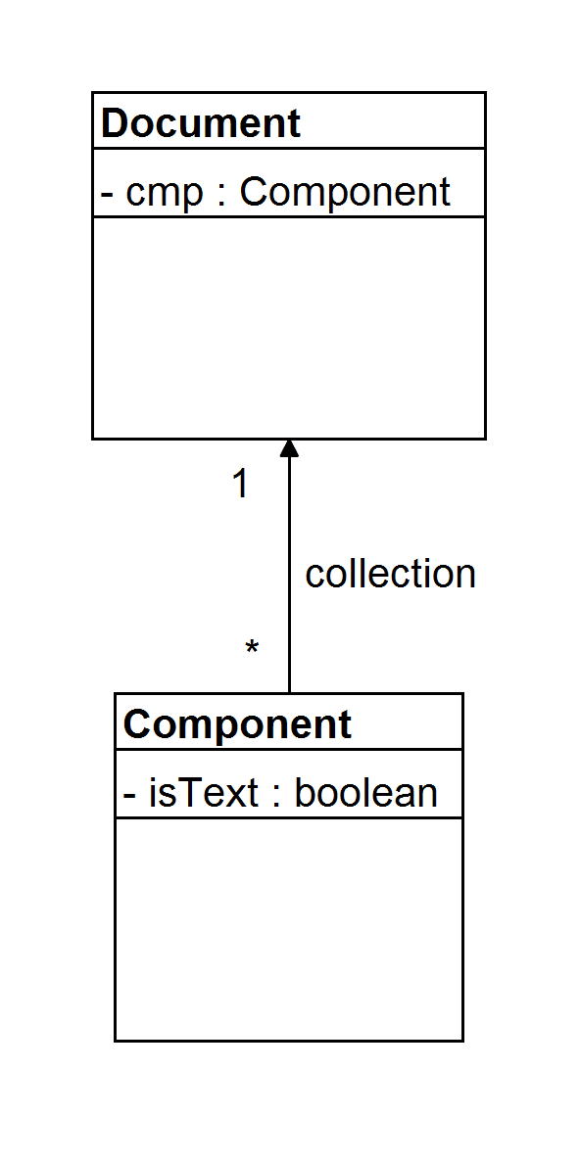
The Composition class maintains a collection of Component instances, which
represent text and graphical elements in a document.

Slide 3
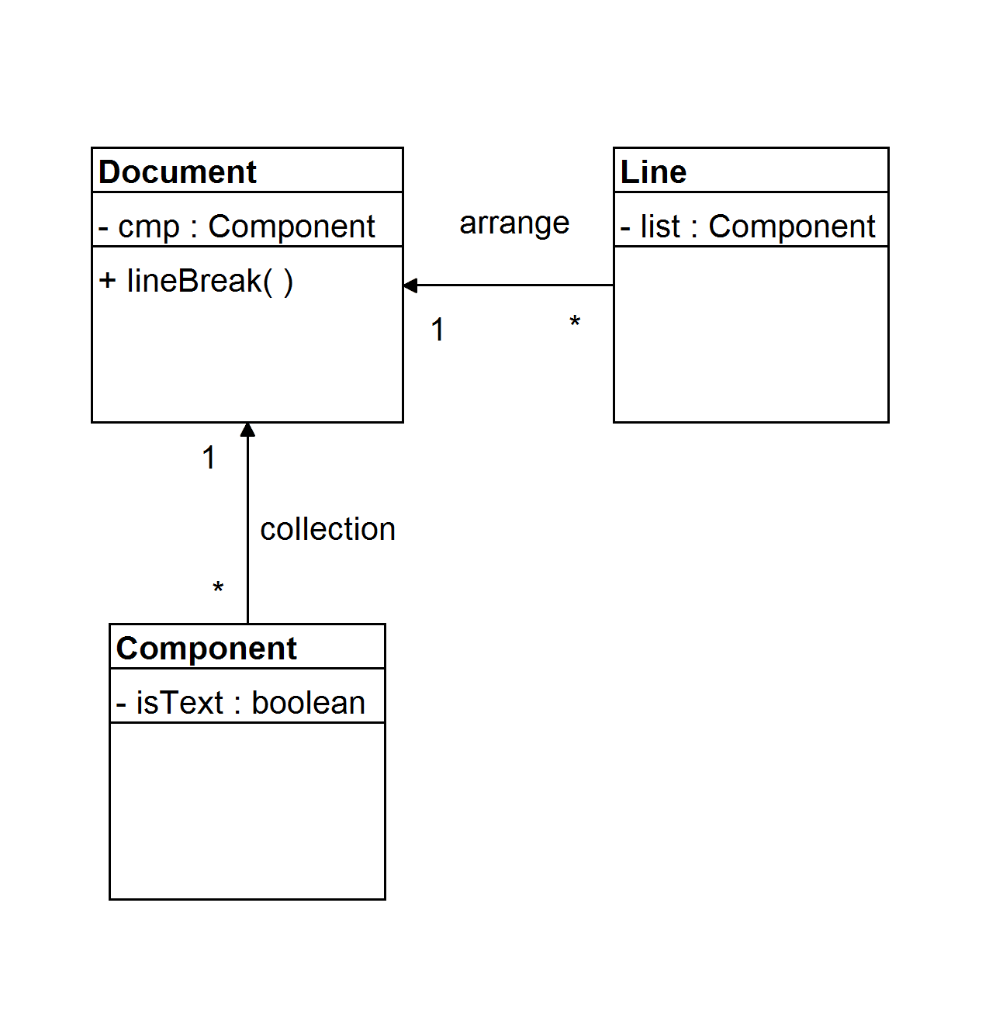
A composition arranges component objects into lines using a linebreaking
strategy.

Slide 4
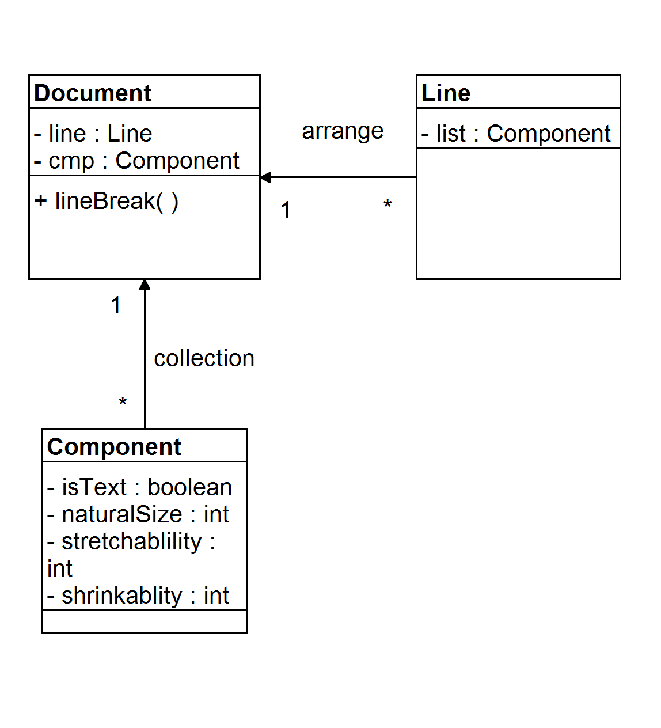
Each component has an associated natural size, stretchability, and
shrinkability.

Slide 5
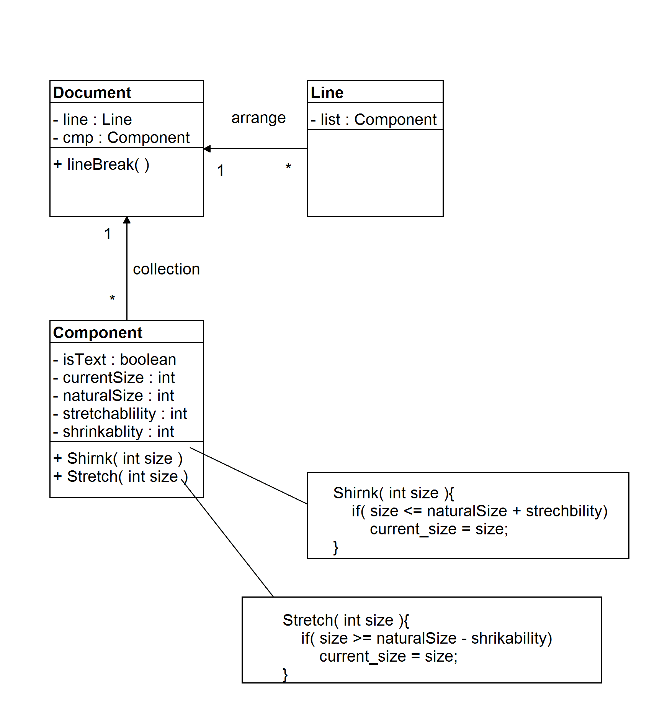
The stretchability defines how much the component can grow beyond its
natural size; shrinkability is how much it can shrink.

Slide 6
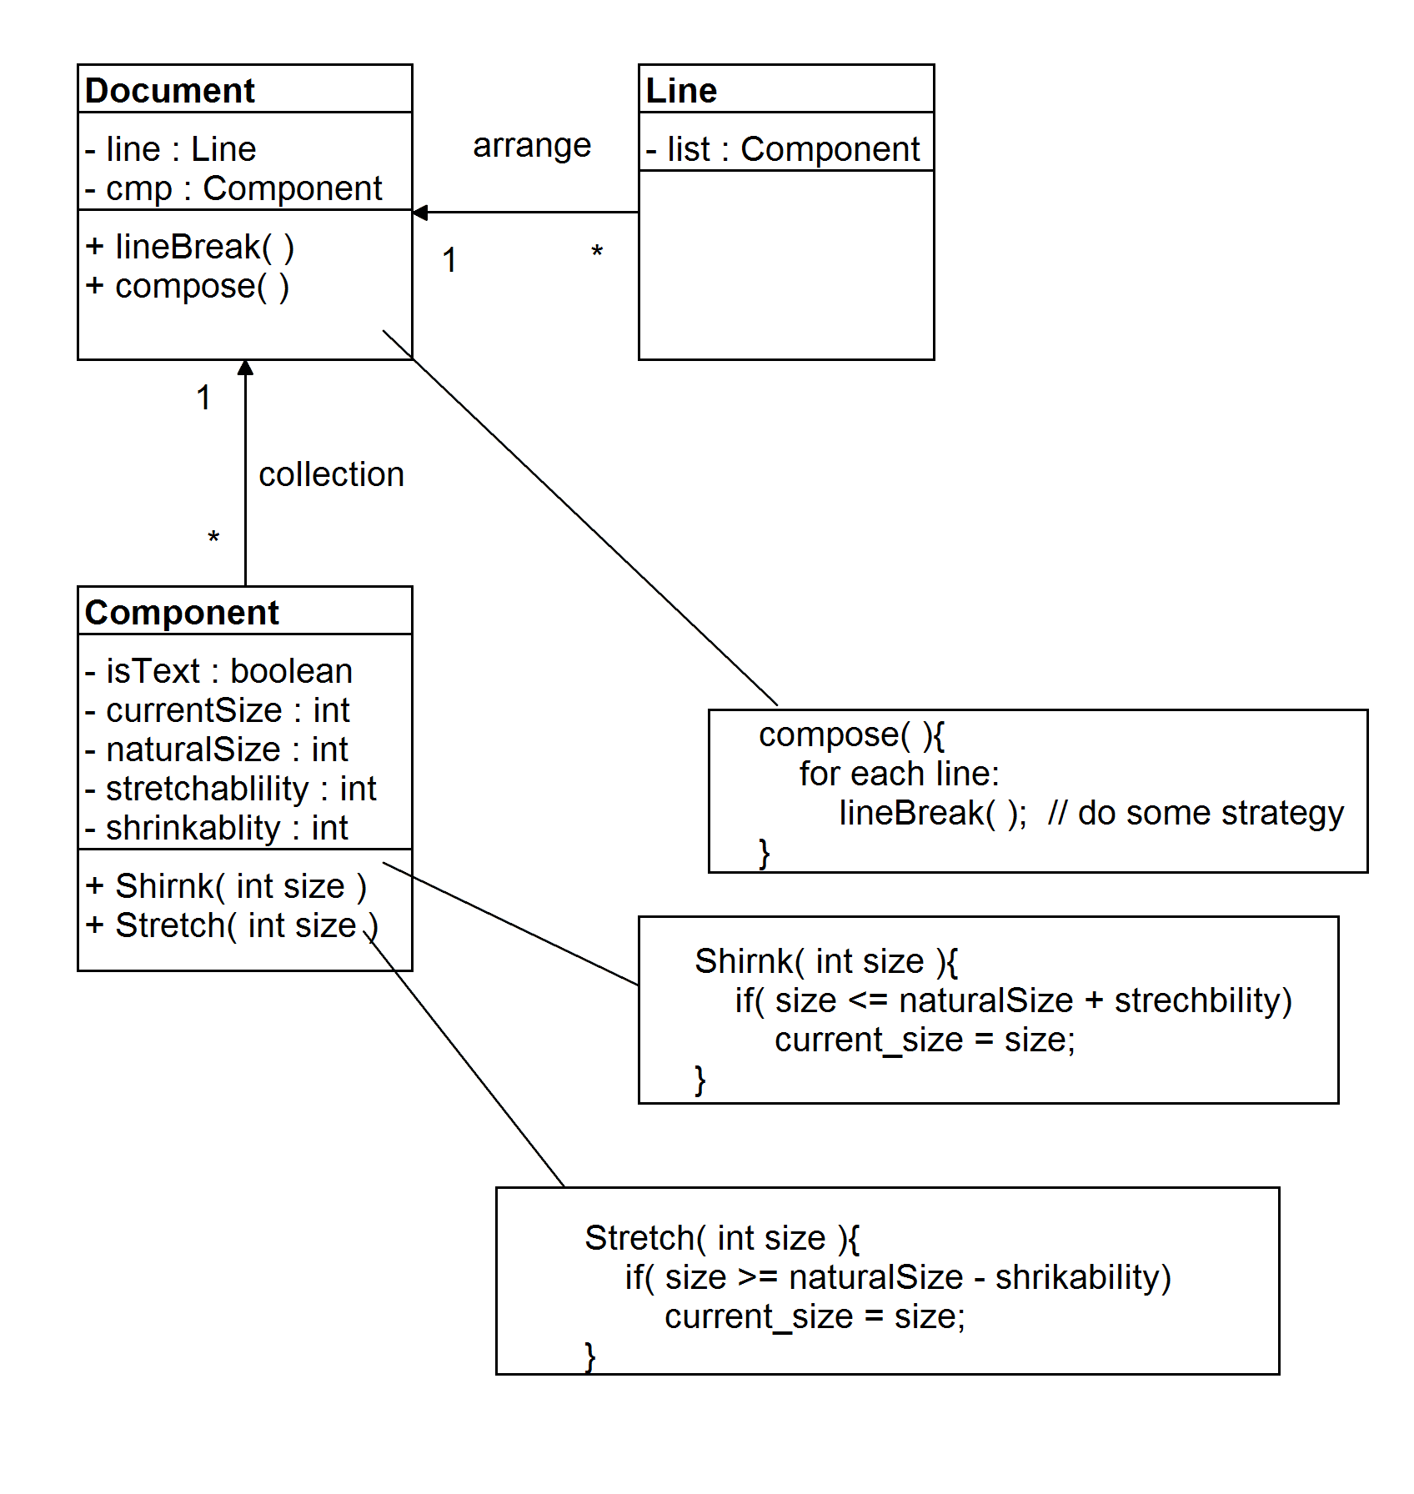
When a new layout is required, the composition calls its compose method to
determine where to place linebreaks.

Slide 7
There are 3 different algorithms for breaking lines:
Simple Composition: A simple strategy that determines line breaks one at a time.
Tex Composition: This strategy tries to optimize line breaks globally, that is, one paragraph at a time.
Array Composition: A strategy that selects breaks so that each row has a fixed number of items. It's useful for breaking a collection of icons into rows, for example.

Slide 8
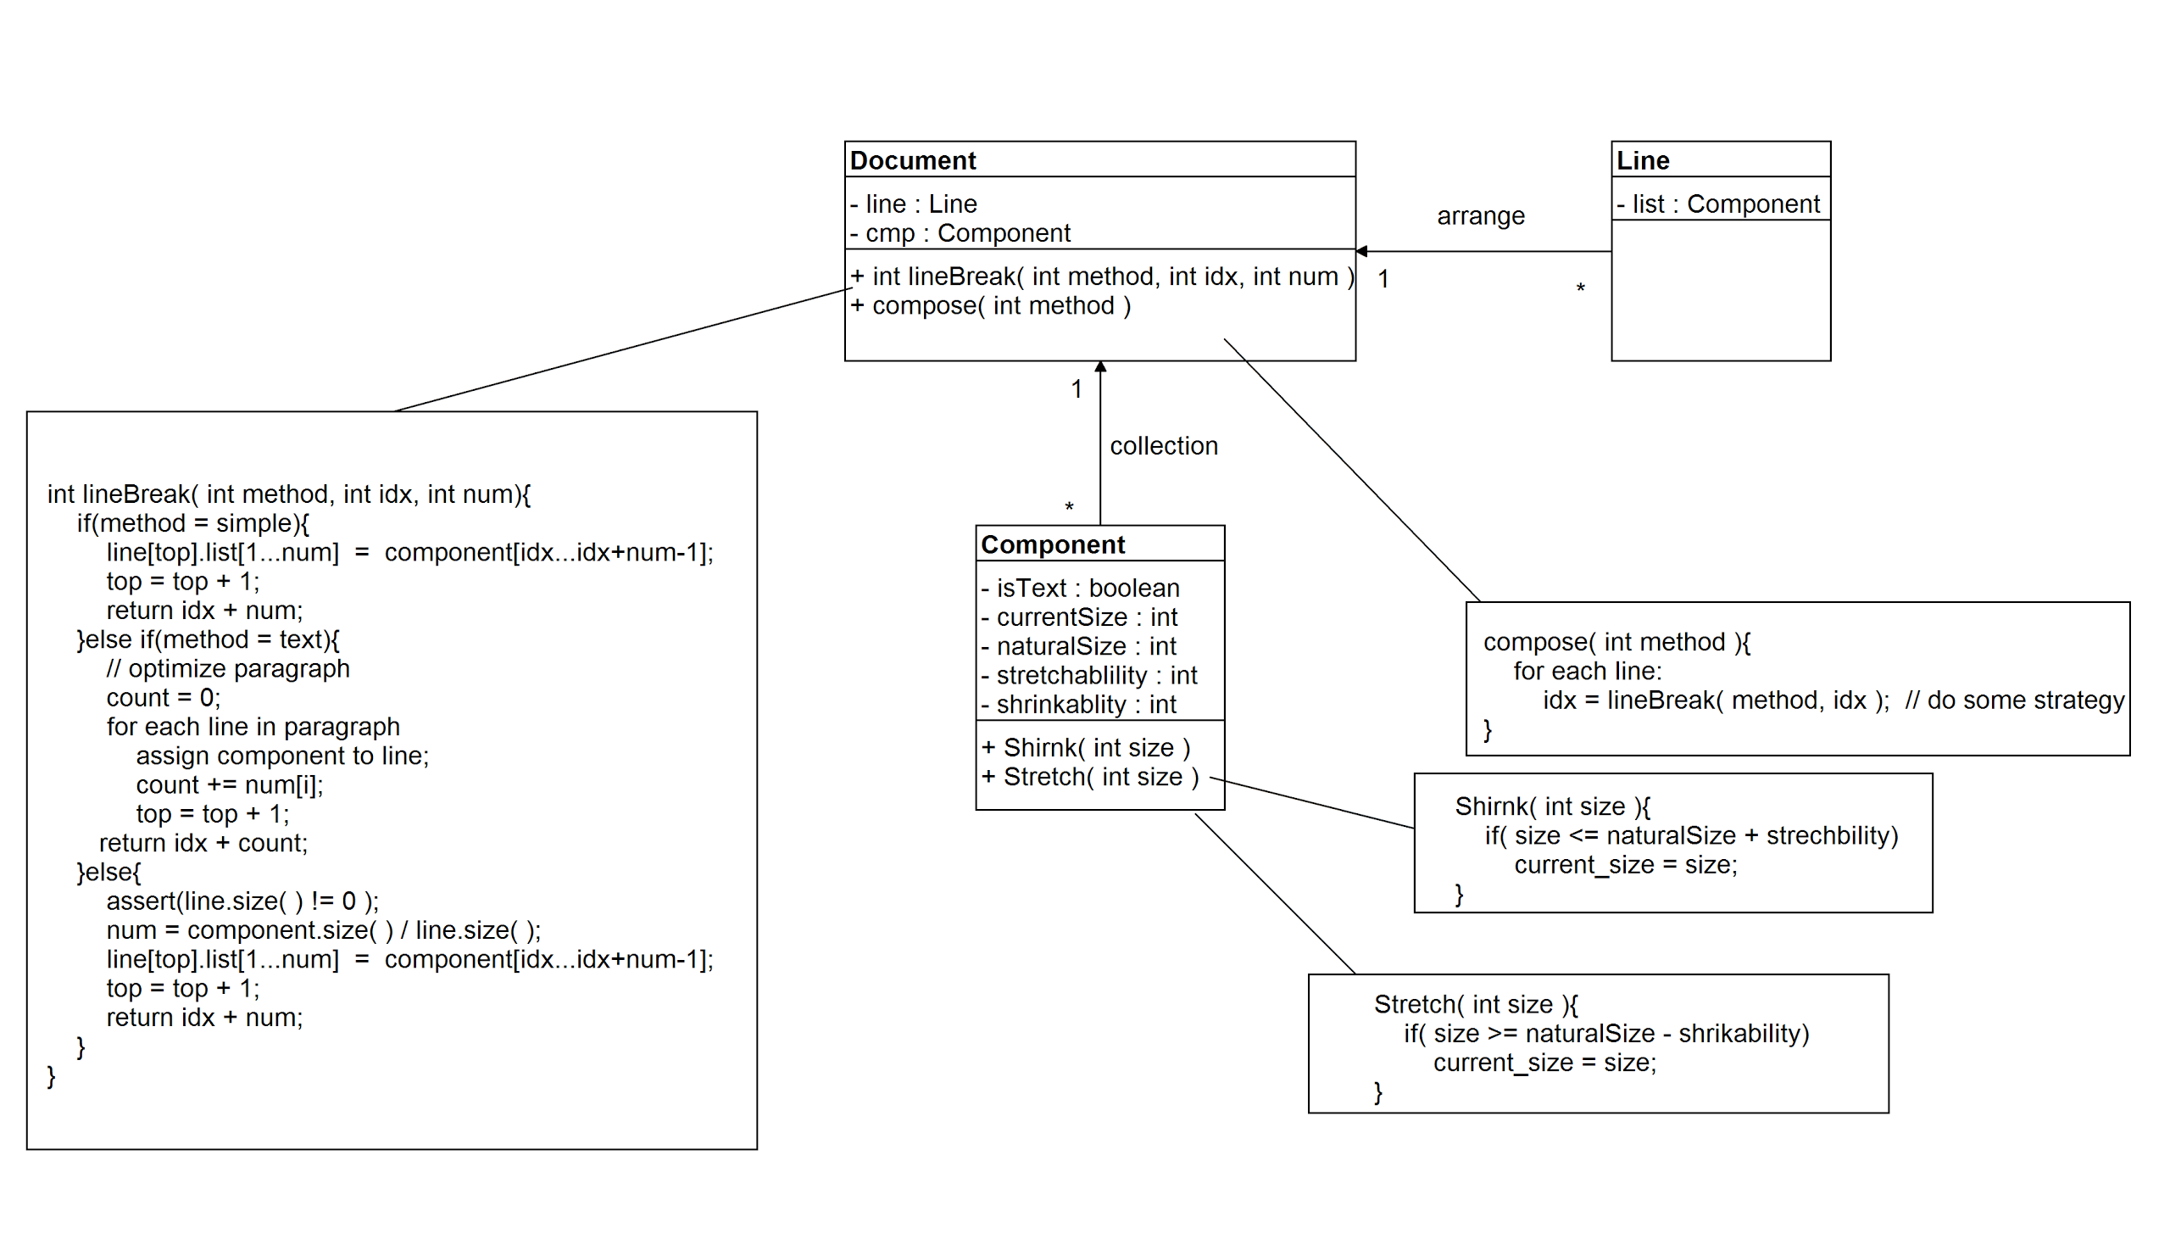

Slide 9
Homework 2 -- 4/8
team 3

Slide 10
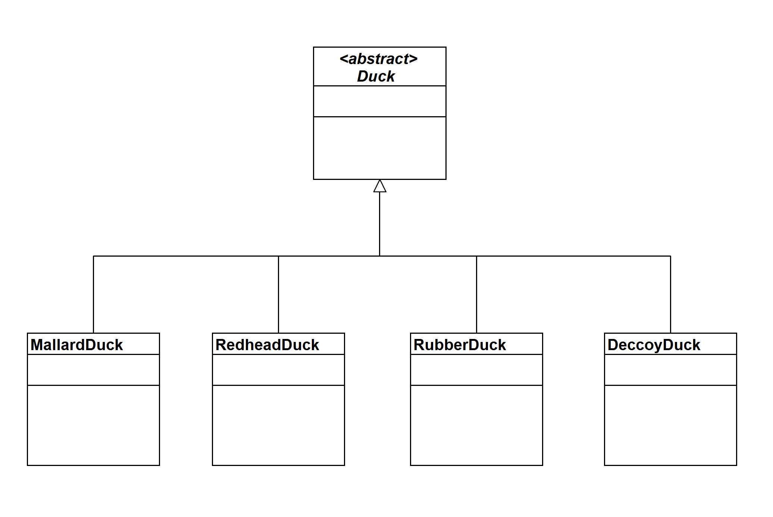
There are four types of ducks in the game:
(1) MallardDuck
(2) RedheadDuck
(3) RubberDuck
(4) DecoyDuck

Slide 11
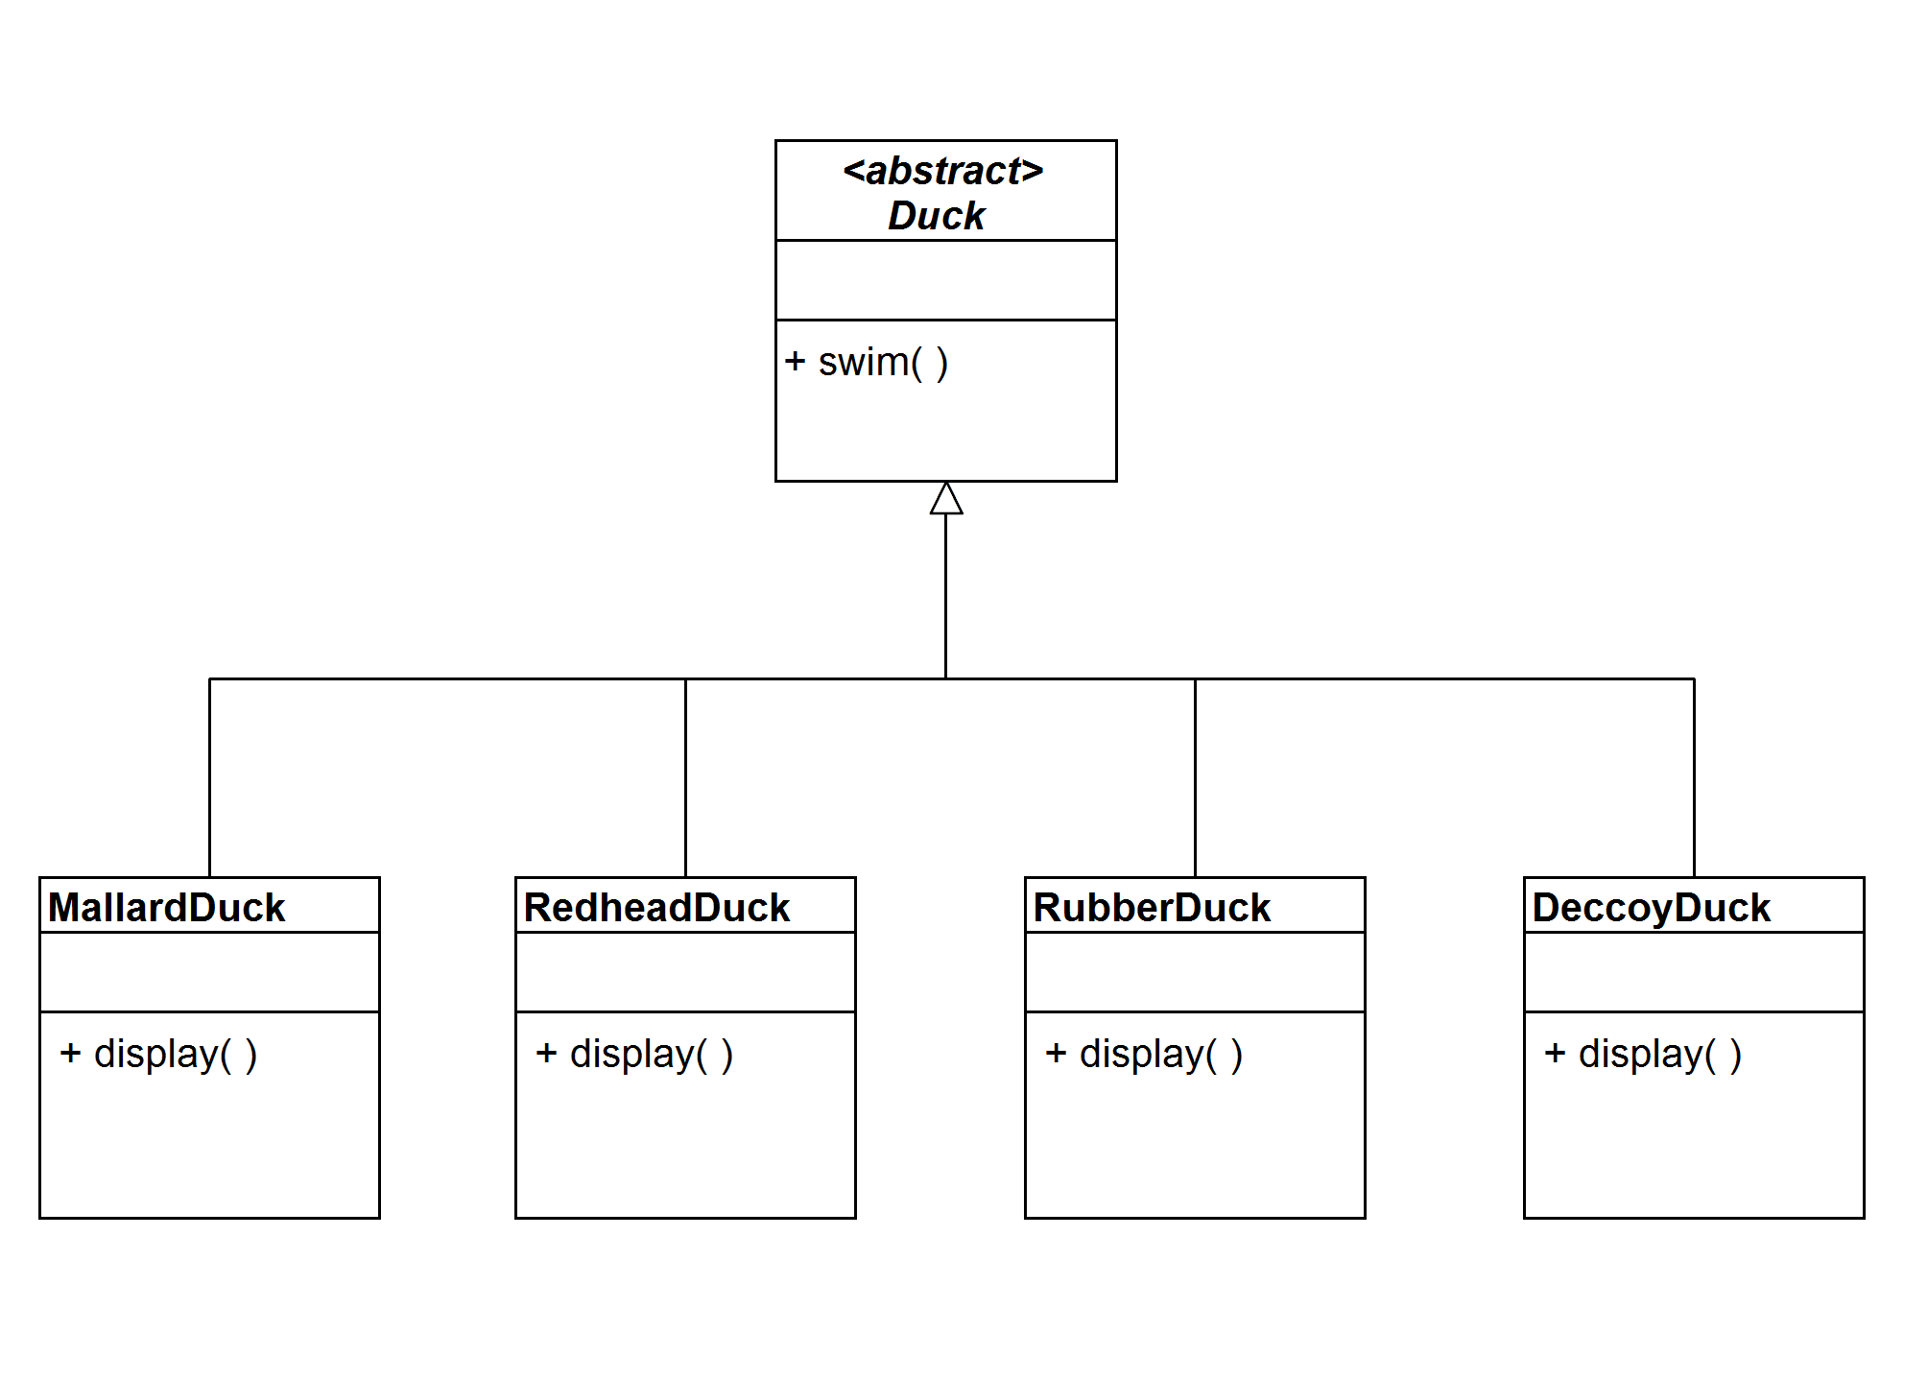
All types of the ducks have the same swim behavior but are with different displays.

Slide 12
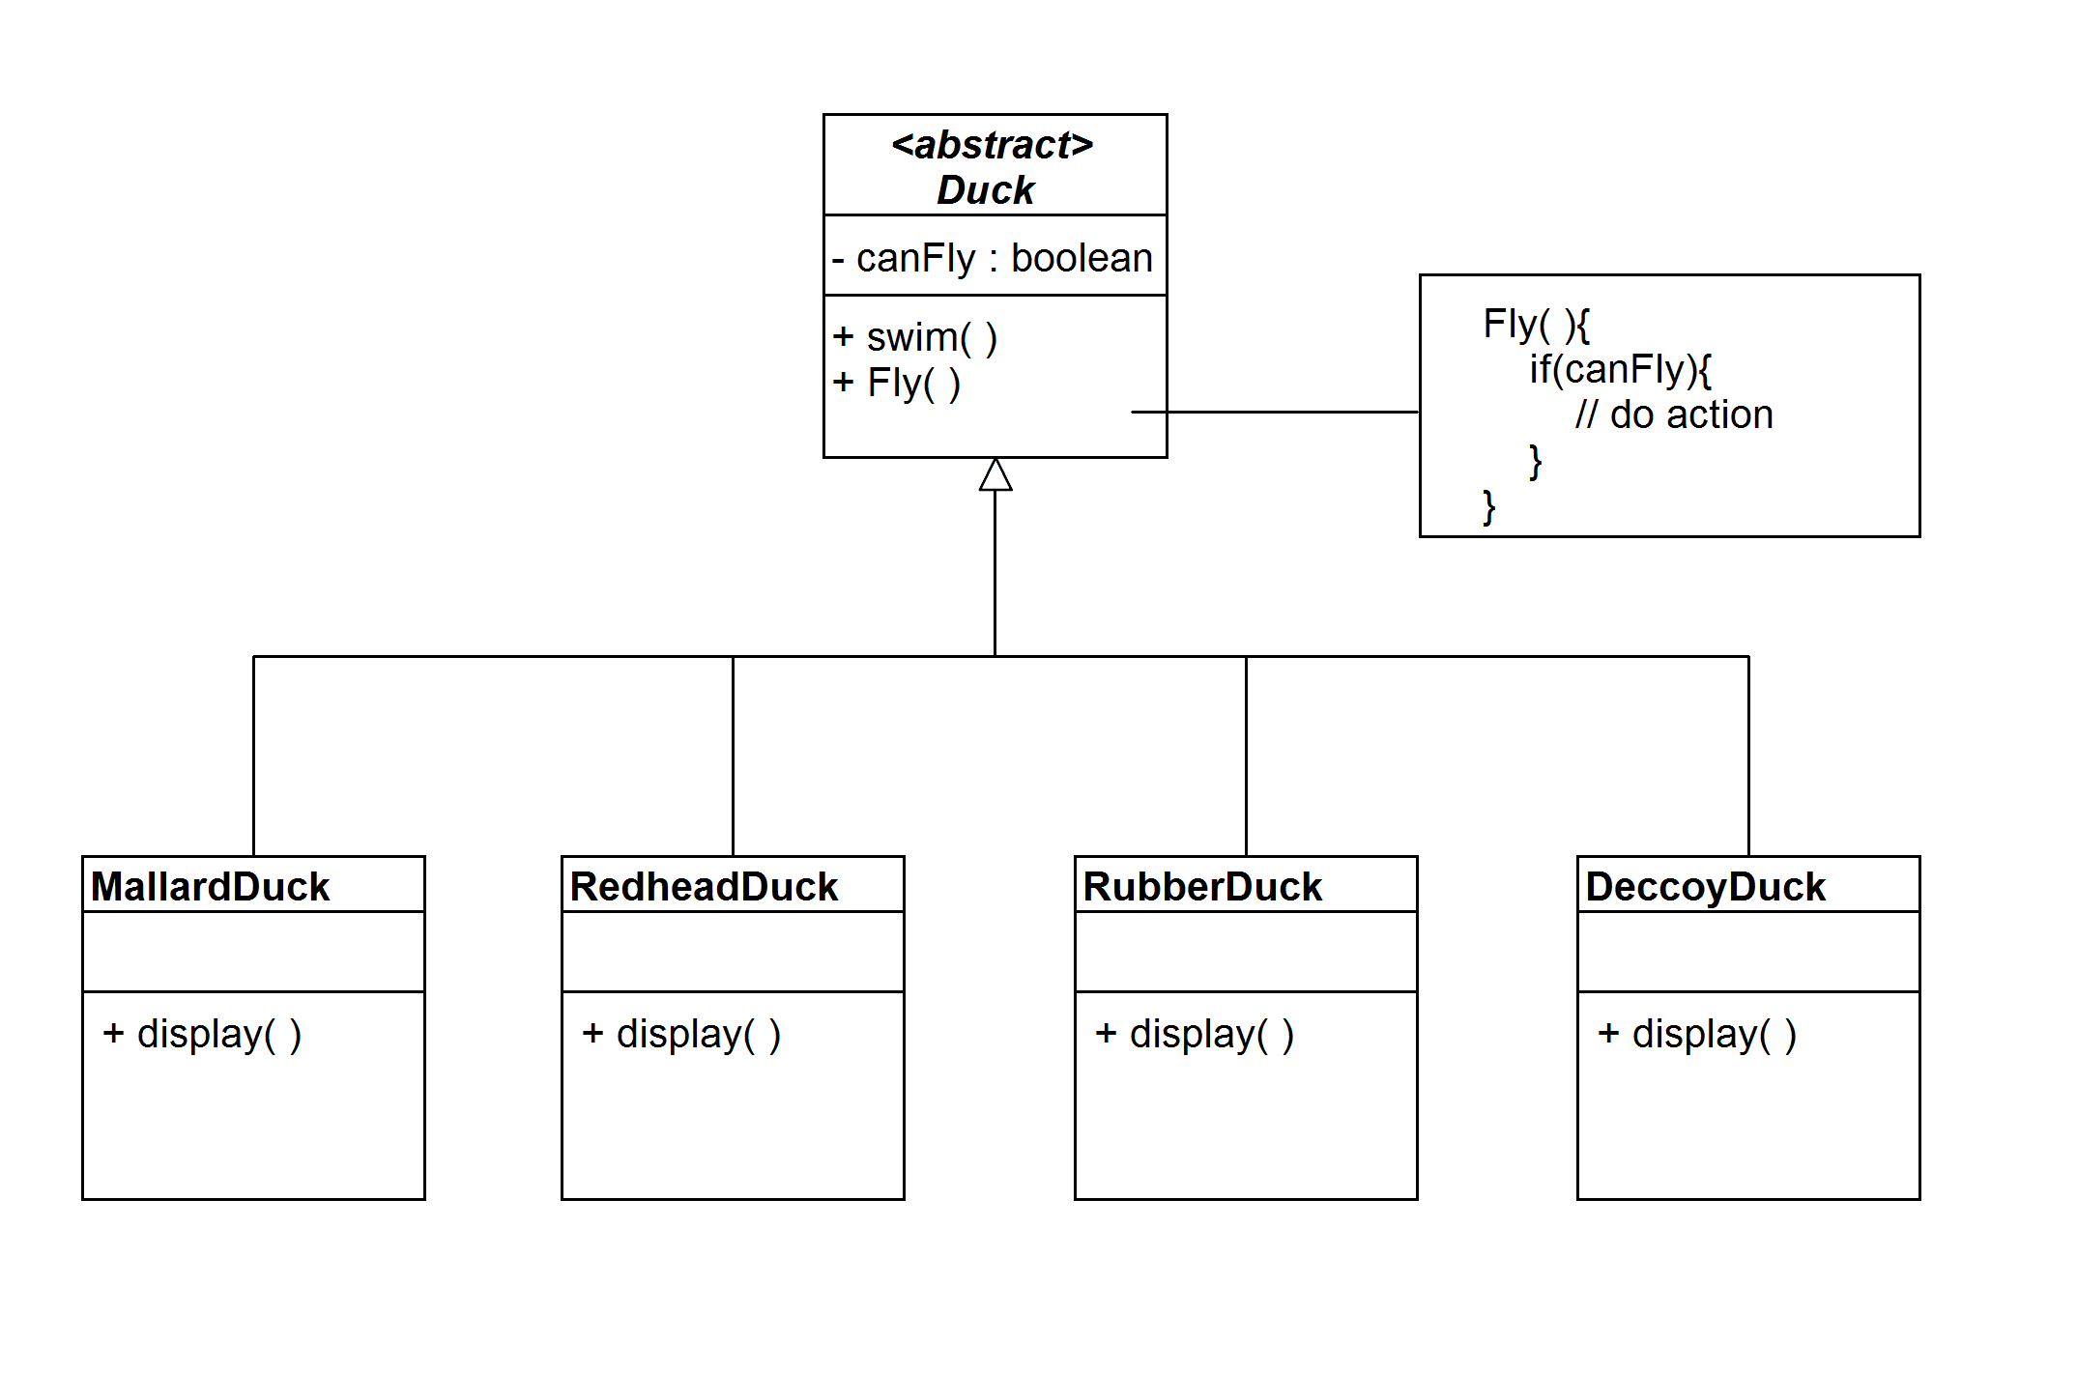
Some ducks can fly with wings, but some cannot fly.

Slide 13
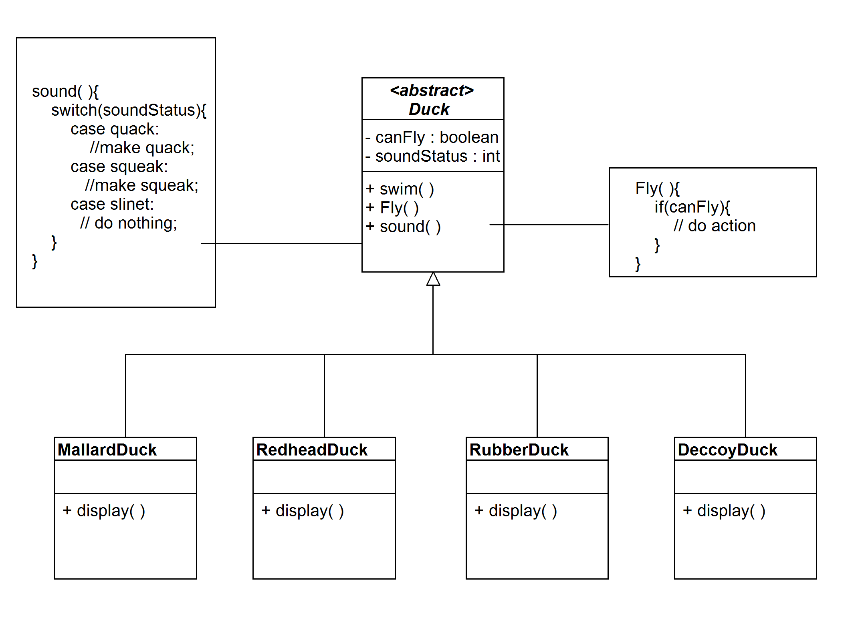
A duck can quack, squeak, or be silent.

Slide 14
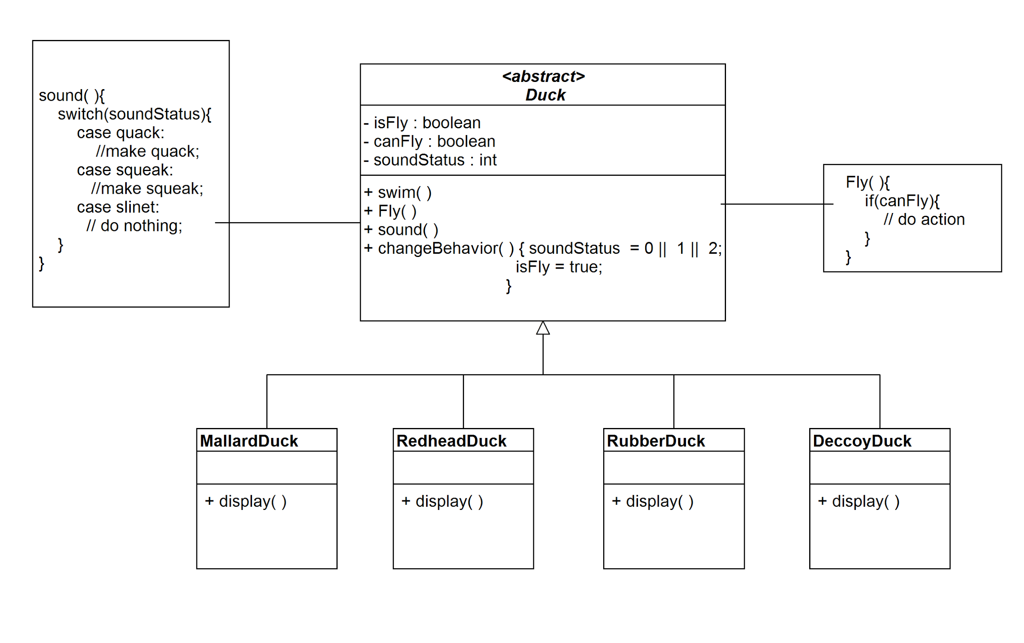
A duck can change its fly or quack behavior at run time.

Slide 15
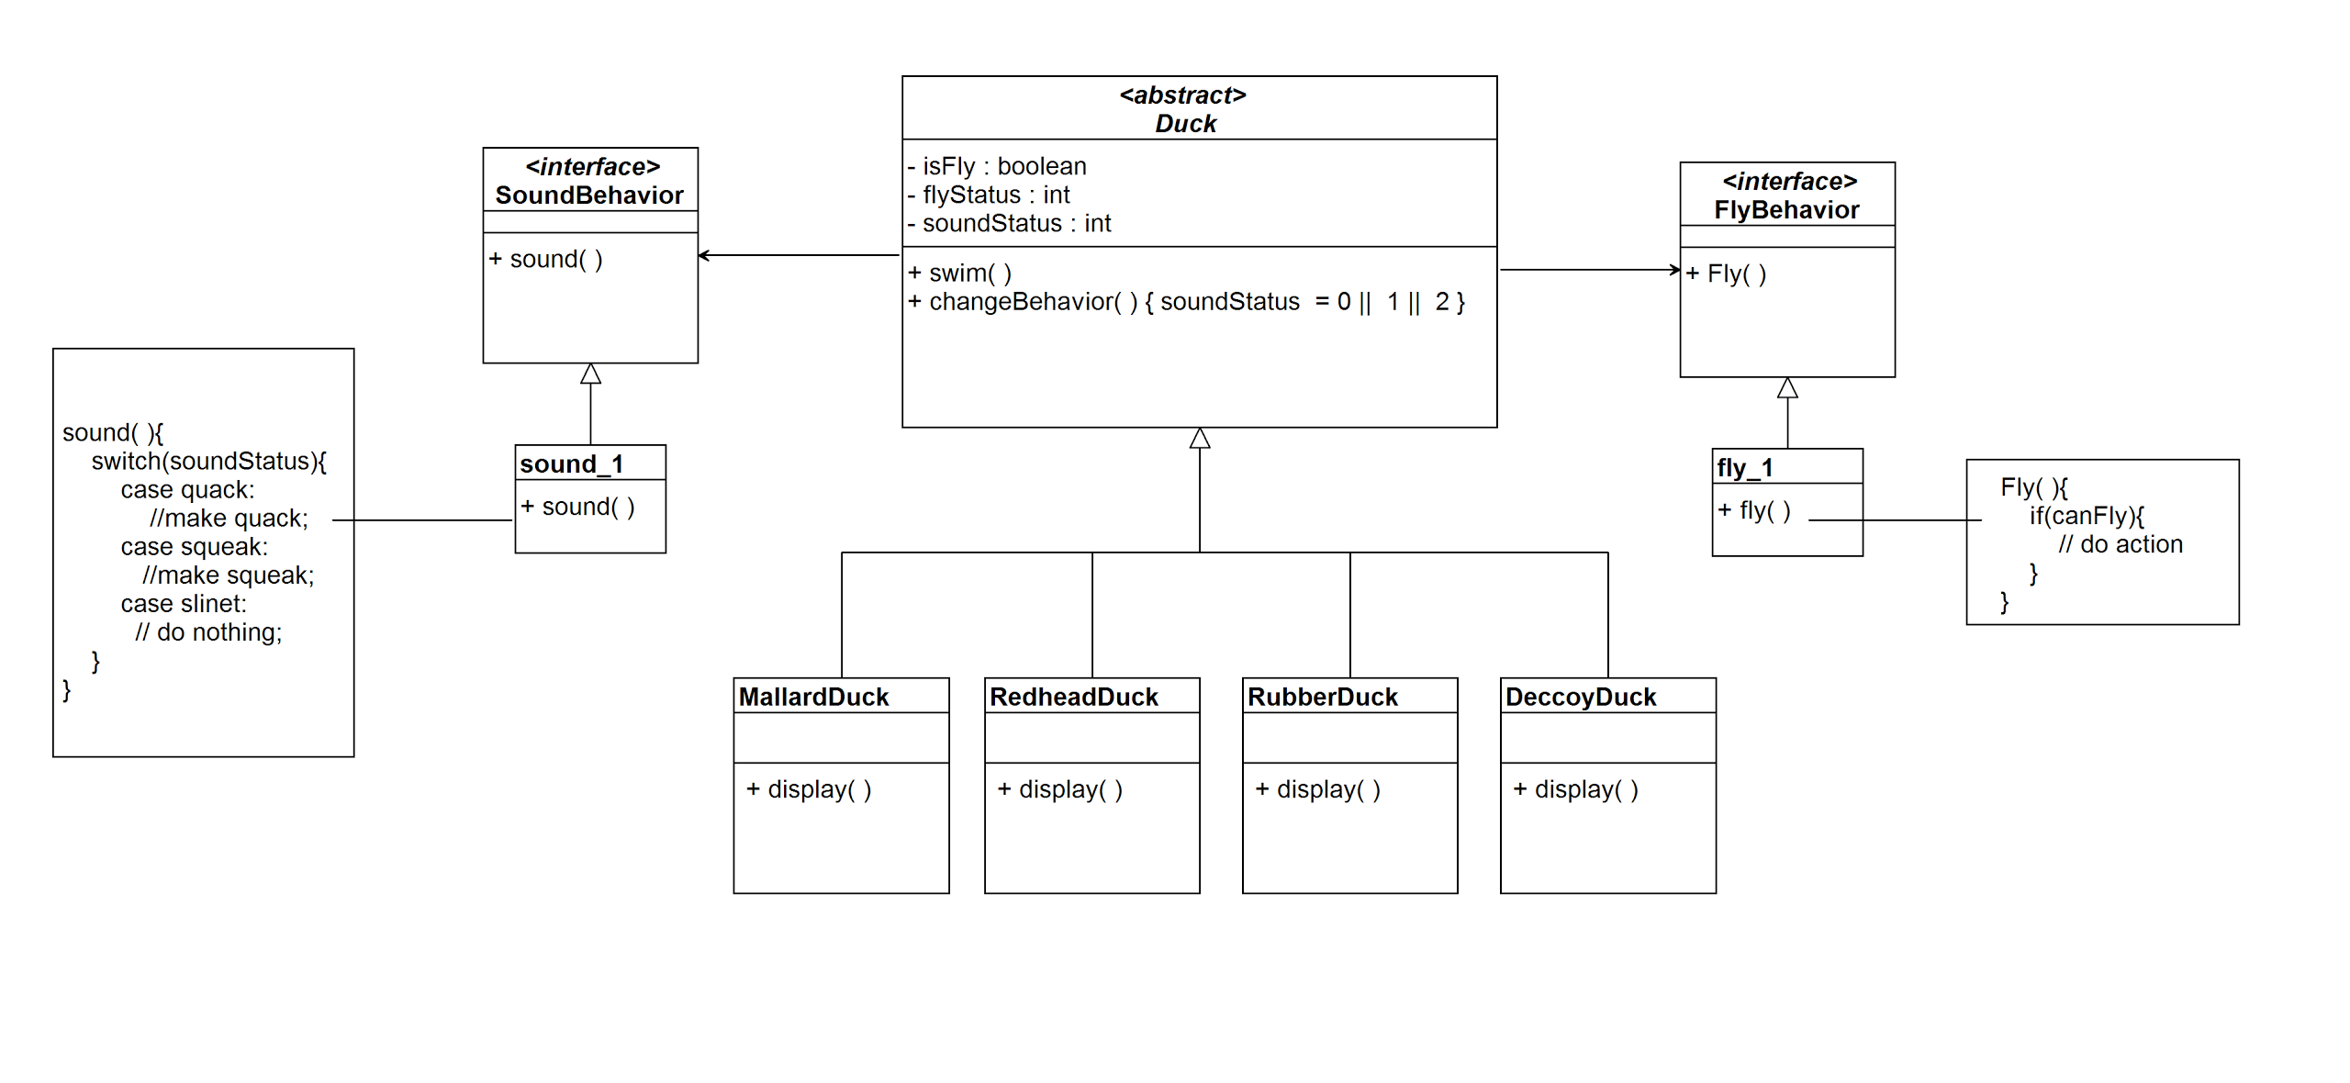
New fly or quack behaviors can be added, and the existing behaviors can be modified at compile time.

