Slide 1
NodeXL的改進與應用Project Review II
授課老師: 李允中老師
組長: B99902066 蔡宗翰
組員: d98944002 林映孜, d02922030 范哲誠, d02944010 呂俊宏
b99902032 黃奕軻, b99902123 廖尉棠, b99902025 吳佳倫
b99902100 劉宗瑋

Slide 2
Project 進度的檢討
透過Project Build Dependence 找出先後順序
22 project file, more than 476 class(including test & unit testing)
Design issue(20140304)
  Standalone program , 將NodeXL可以在Execl 外的程式獨立執行。
  New algorithm Design
New design issues(20140311)
  In Algorithms project, the project call external program “SnapGraphMetricCalculator.exe” to calculate GraphMetric. This maybe was the performance issues 1.
  Layouts maybe another the performance issues 2.

Slide 3
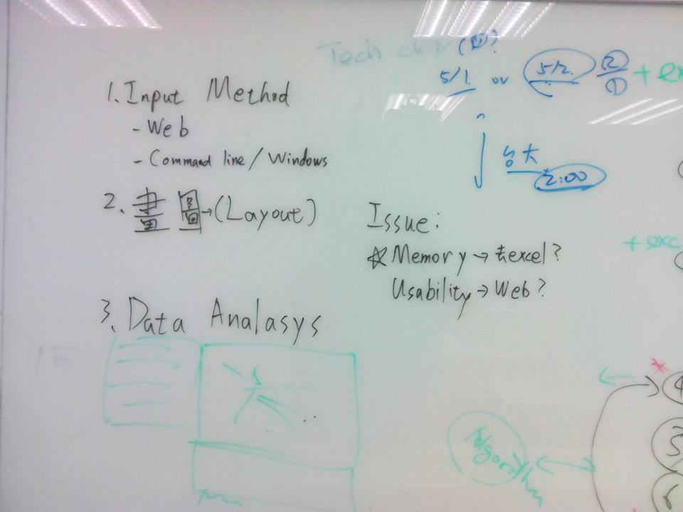
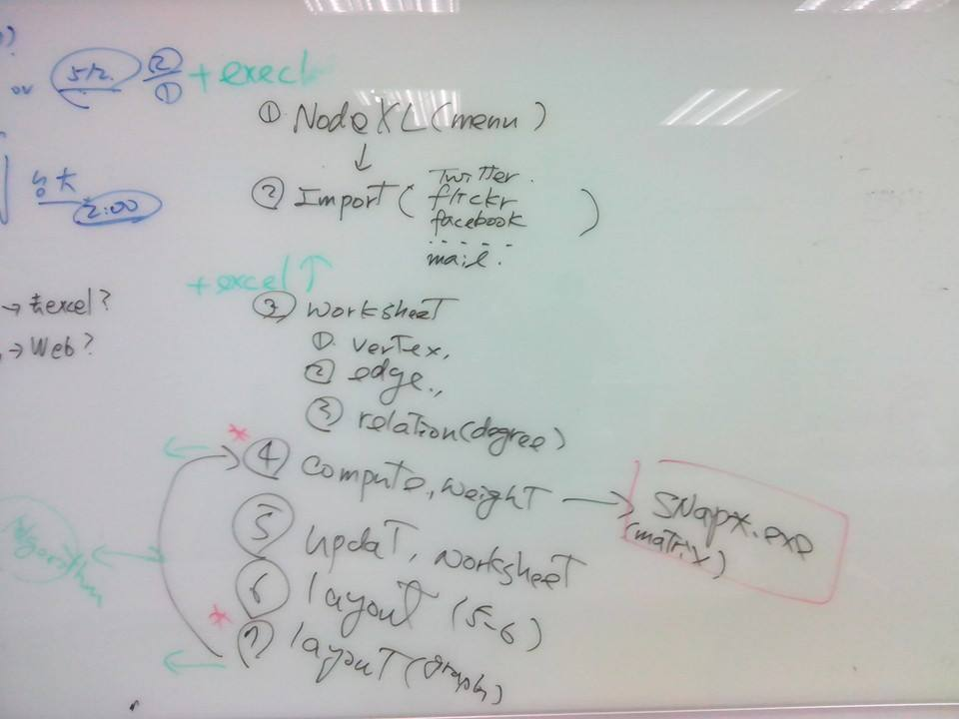
20140317 討論

Slide 4
Final Design Issues & Priority
解決執行過程的記憶體限制與運算緩慢問題
  Design issues 1: Let NodeXL is no longer excel plug-in and become a standalone application. And this standalone product can easily operate for people who do not study computer science
  Design issue 2: The application should accelerate matrix operations, rather than calling an external program (SnapGraphMetricCalculator.exe).
發展新的algorithm
  Design issue 3: Time series analysis for social network.
  Design issue 4: New Layout algorithm
易用性思考
  Developing web application(to be continue evaluation!)

Slide 5
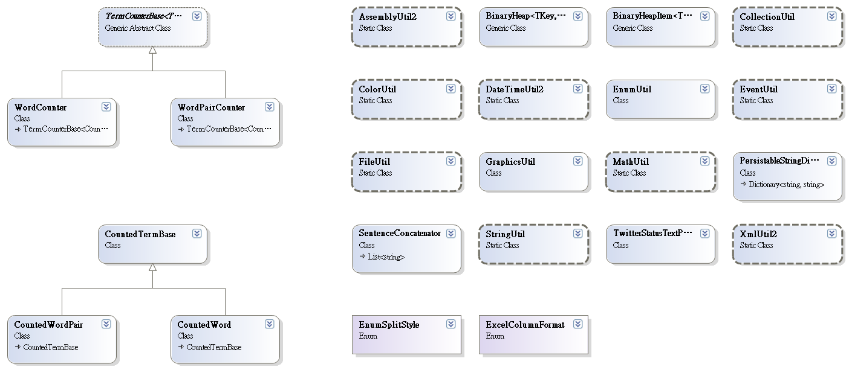
Util
Notes:
24

Slide 6
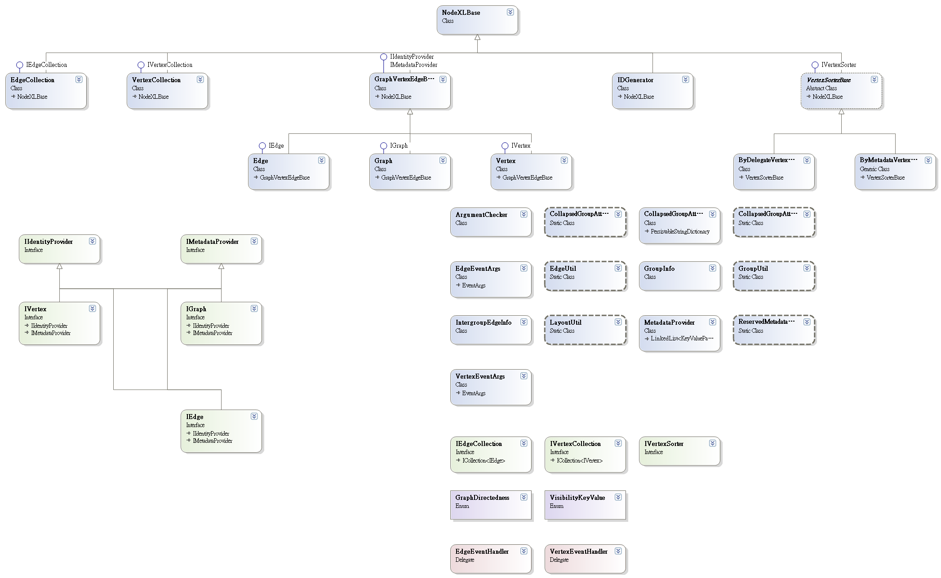
Core
Notes:
24+36 = 60

Slide 7
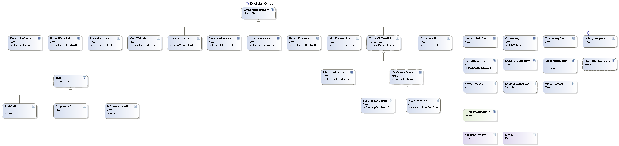
Algorithms
(Matrix computation)
Notes:
60+34= 94

Slide 8
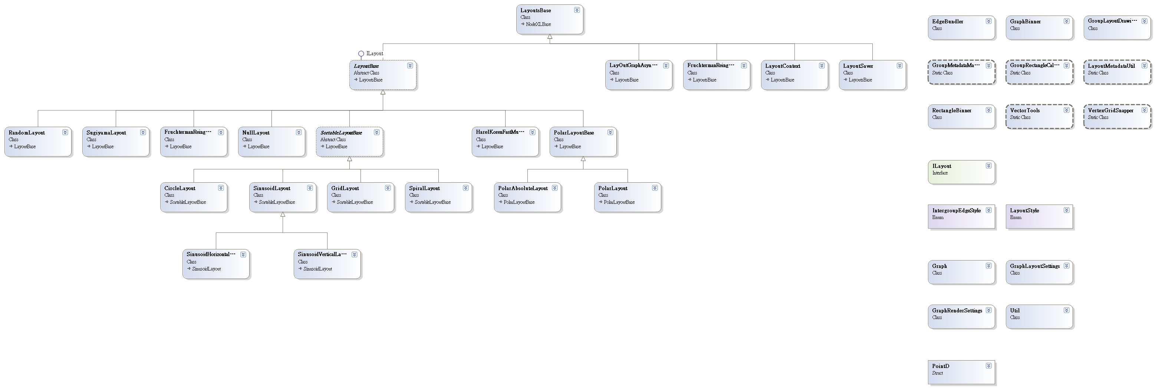
Layouts
Notes:
94+38 = 132

Slide 9
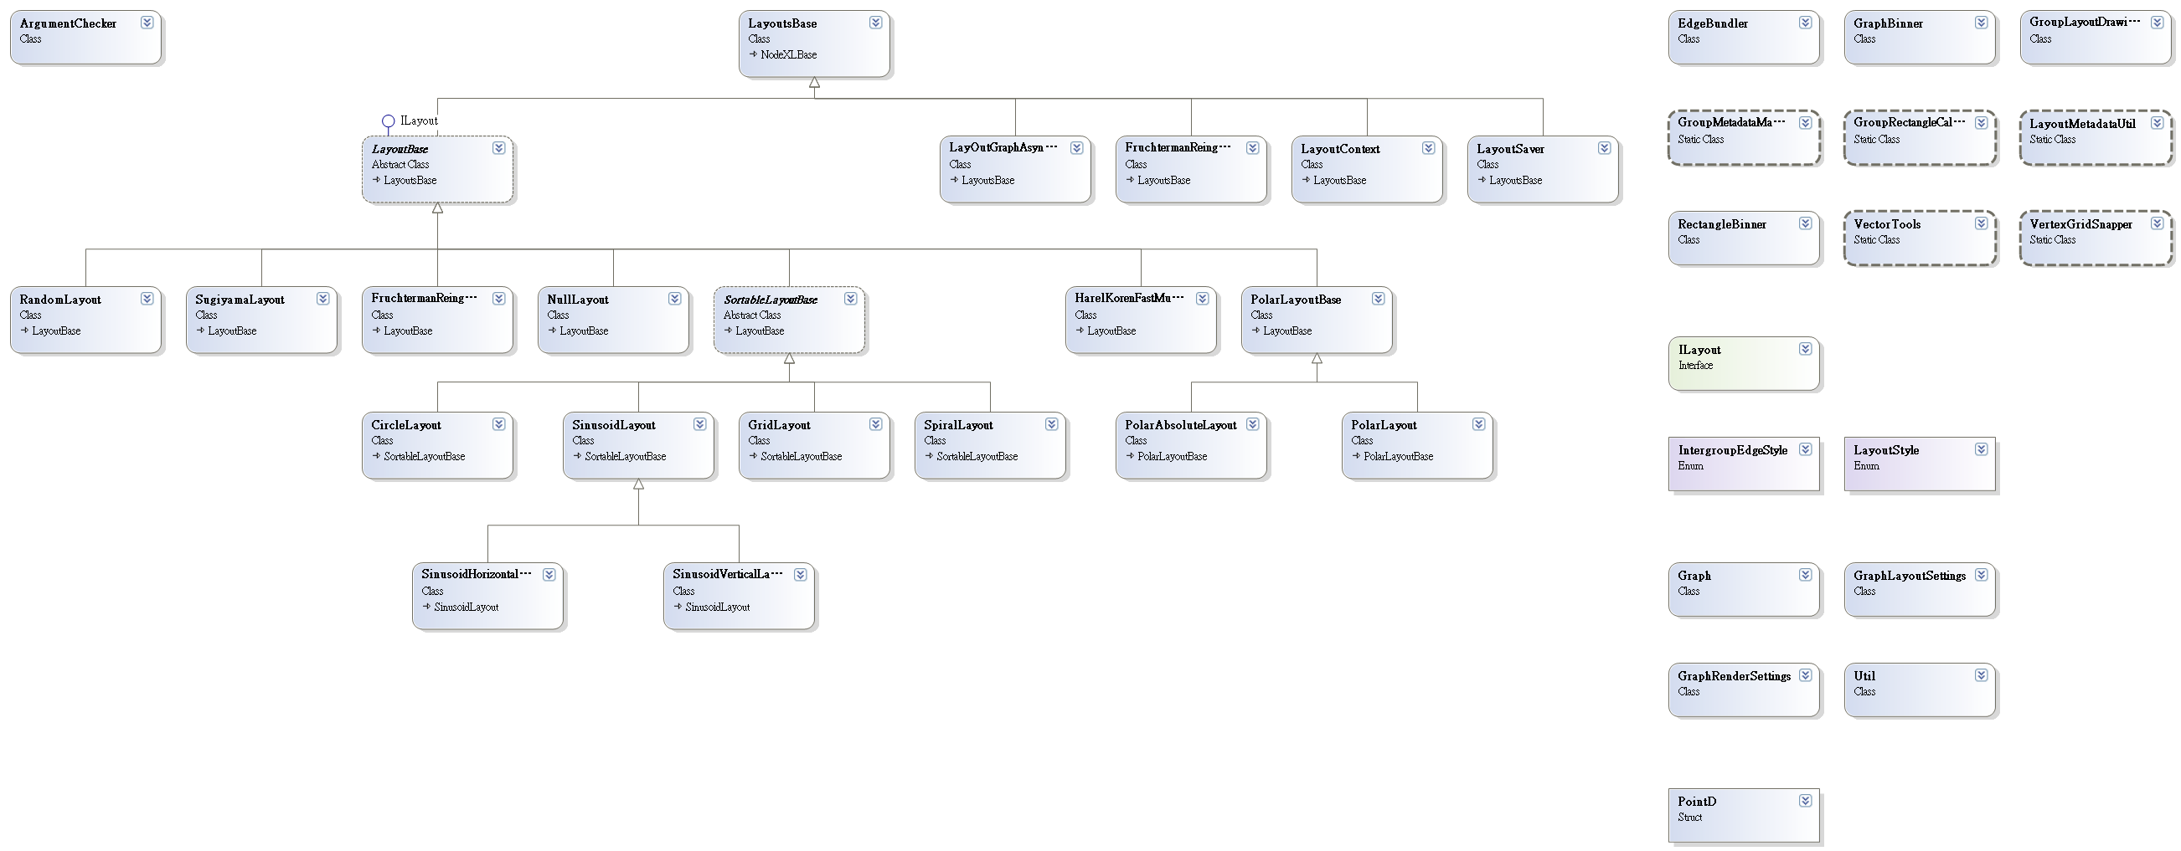
WpfVisualization
Notes:
132+39 = 171

Slide 10

ExcelTemplatePlugIns
Notes:
171+2 = 173

Slide 11
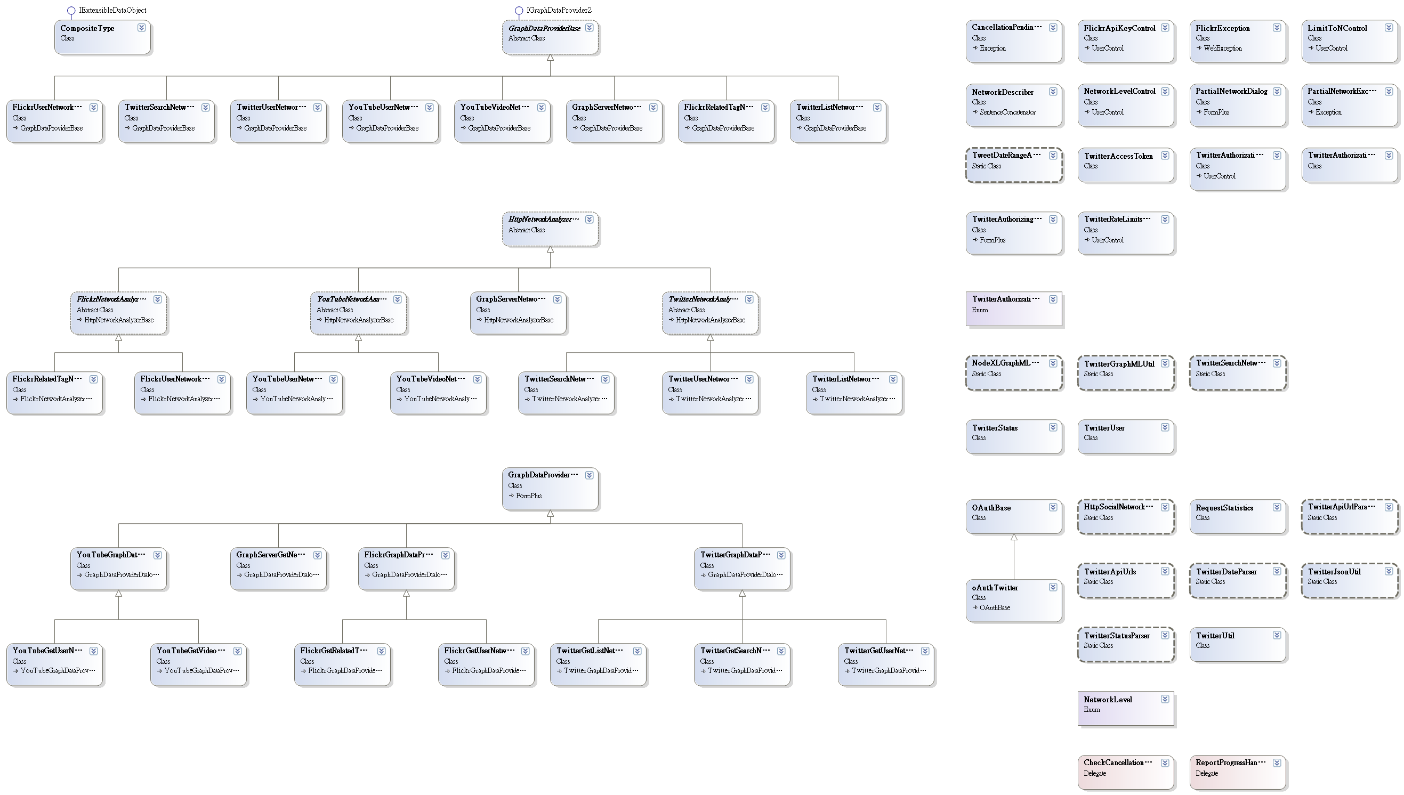
GraphDataProviders
(管理從不同social media 的資料)
Notes:
173 + 67 = 240

Slide 12
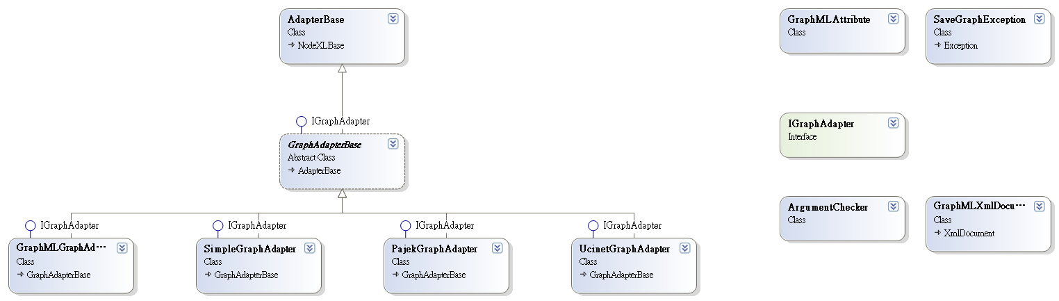
Adapters
(不同圖檔format 的資料)
Notes:
240+ 11 = 251

Slide 13
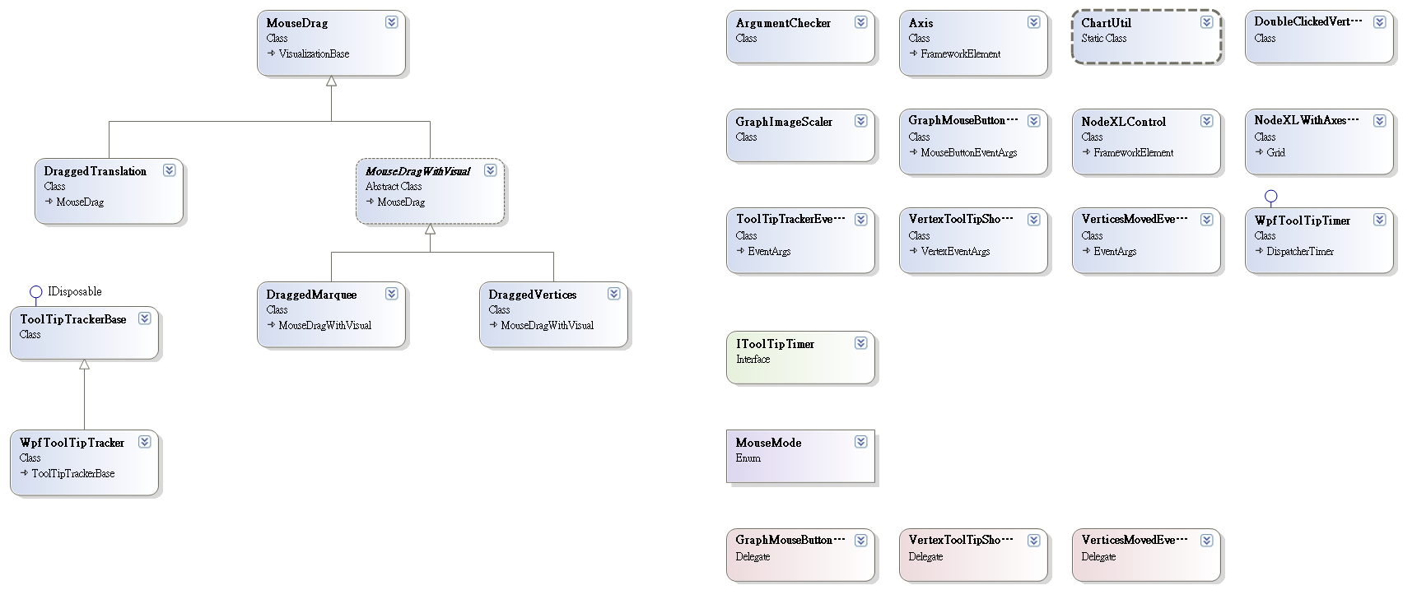
WpfControl
Notes:
251 + 24 = 275

Slide 14
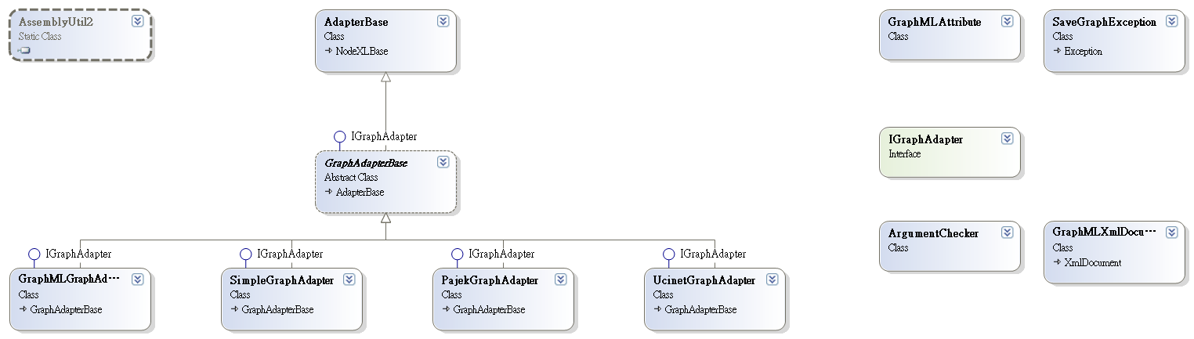
ExcelTemplateRegisterUser
Notes:
275 + 12 = 287

Slide 15
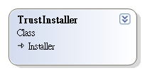
ExcelTemplateSetupTrustInstaller
Notes:
287 +1 = 288

Slide 16
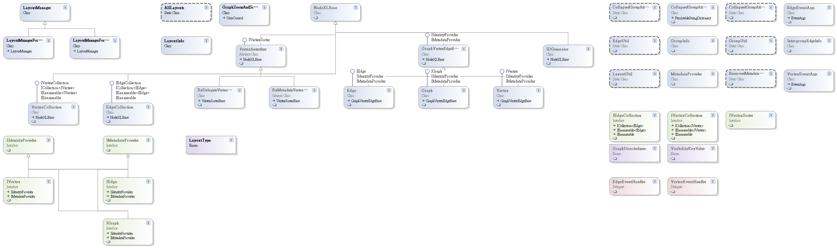
ApplicationUtil
Notes:
288+ 42 = 330

Slide 17
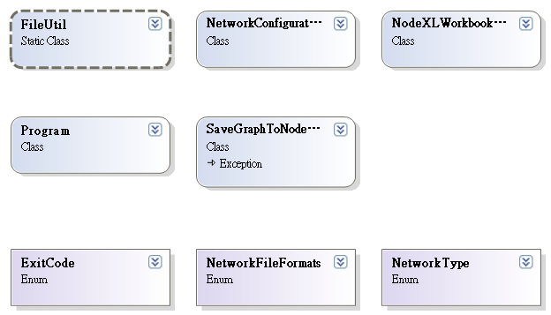
NetworkServer
Notes:
330 + 8 = 338

Slide 18
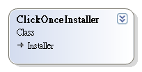
ExcelTemplateSetupClickOnceInstaller
Notes:
338 +1 = 339

Slide 19
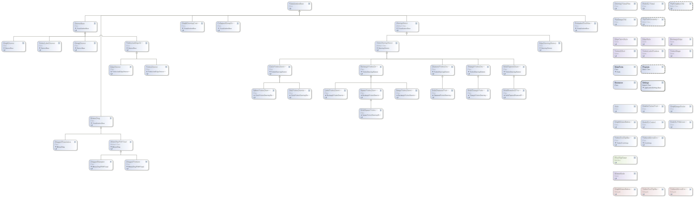
TestWpfNodeXLControl
Notes:
339 + 61 = 400

Slide 20
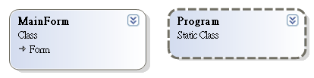
TestGraphDataProviders
Notes:
400 +2 = 402

Slide 21
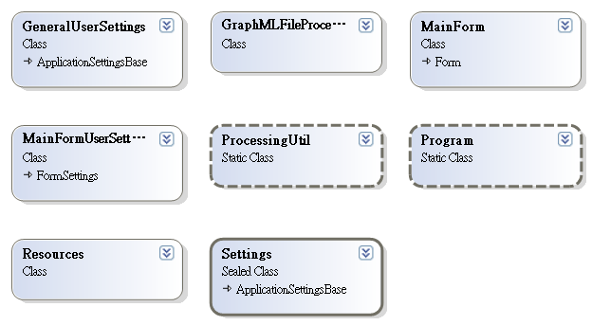
GraphMLFileProcessor
Notes:
402 + 8 = 410

Slide 22
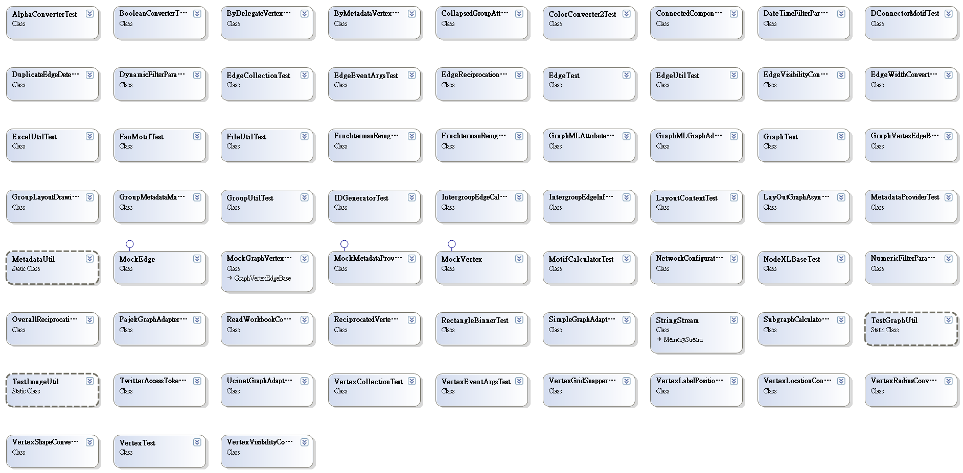
UnitTests
Notes:
410 + 66 = 476

