Slide 1
HW10
Group 3

Slide 2
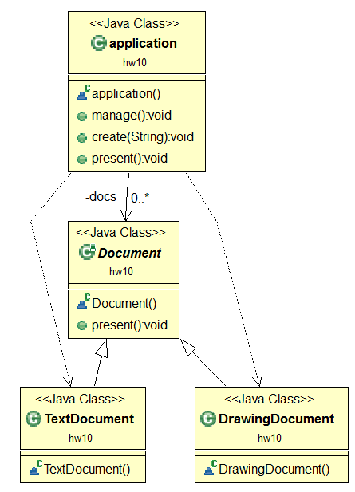
Code Directly

Slide 3
Initial Design

Slide 4
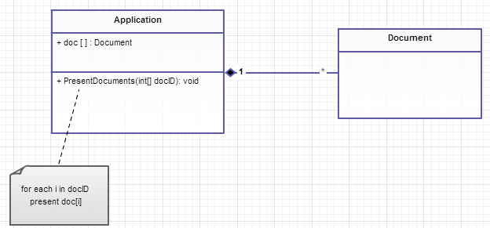
A powerful application can present multiple documents at the same time

Slide 5
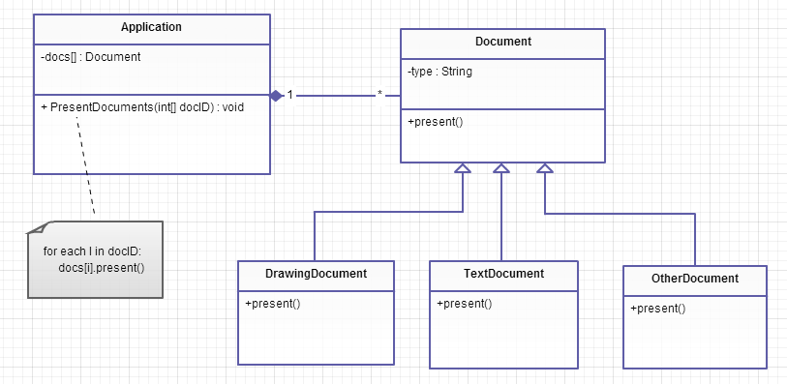
These documents include Drawing Document, TextDocument, and so on.

Slide 6
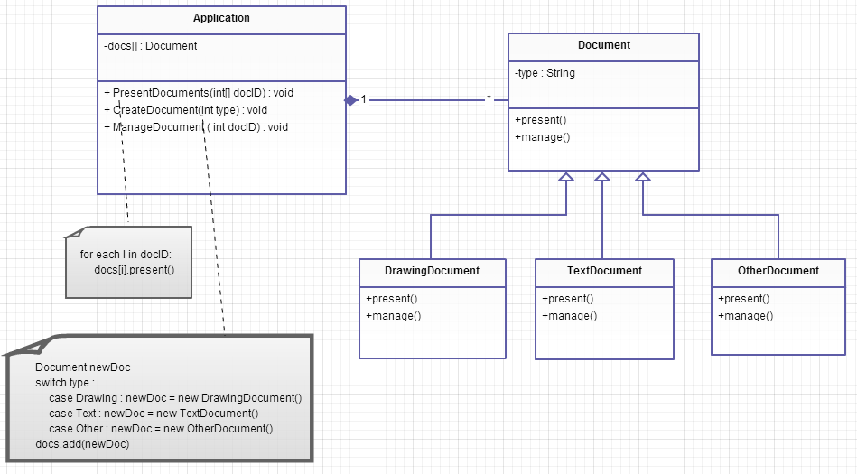
The application is responsible for managing documents and will create them as required

Slide 7
Re-Design

Slide 8
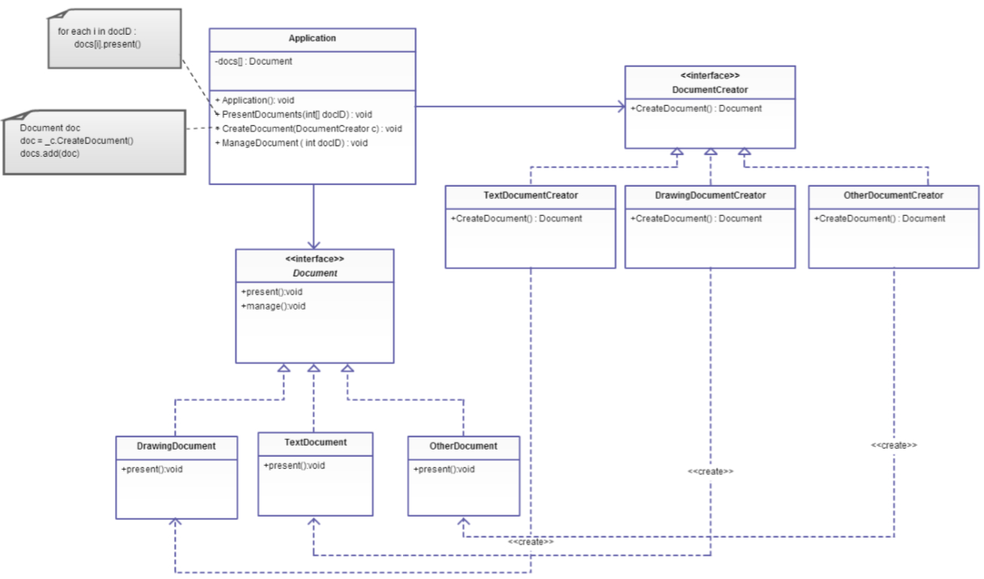

Slide 9
