Slide 1
SBO SDK 개발 커리쿨럼
ㆍ SBO 개발코스 오버뷰
- SBO 구성도 소개
- 개발 코스 소개
ㆍ DI API
- DI API 소개
- DI API 사용처
- DI API 설치 및 참조하기
- SDK 설치 및 사용해보기
- 자주 사용하는 DI API 소개
- 배치소스 배포 및 DI API 사용해서 SBO 접속하기
- DI API 사용해서 품목마스터 생성 및 갱신해보기
- DI API 사용해서 BP마스터 생성 및 갱신해보기
- DI API 사용해서 구매오더 생성 해보기
- DI API 사용해서 판매오더 생성 해보기
- DI API 사용해서 분개 생성 해보기

Slide 2
SBO SDK 개발 커리쿨럼
ㆍ UI API
- UI API 소개
- UI API 사용처
- UI API 컨트롤 소개
- UI API 개발툴 소개 및 설치
- UI API 참조하기
- UI API SDK 도움말 찾기
- UI 관련 정보 알아내기

Slide 3
SBO SDK 개발 커리쿨럼
ㆍ 애드온 프레임워크
- 애드온 프레임웍 소개 및 설치하기
- 개발 표준소스 배포 및 구동해보기
- 조회화면 개발하기
- 폼그리기
- 데이터 바인딩하기
- 폼기본값 셋팅
- 조회로직 추가하기
- 기타 이벤트 핸들링 해보기
- 저장화면 개발하기
- 테이블 생성하기
- 저장로직 추가하기
- UDO 개발하기
- UDO 등록하기
- UDO 코딩추가하기

Slide 4
SBO SDK 개발 커리쿨럼
ㆍ SBO 노티피케이션
- 노티피케이션 소개
- 노티피케이션 변수 설명
- 노티피케이션 등록해보기
ㆍ SBO 코어화면 수정
- 프레임웍 사용법 실습
- 구매오더에 폼컨트롤 추가해보기

Slide 5
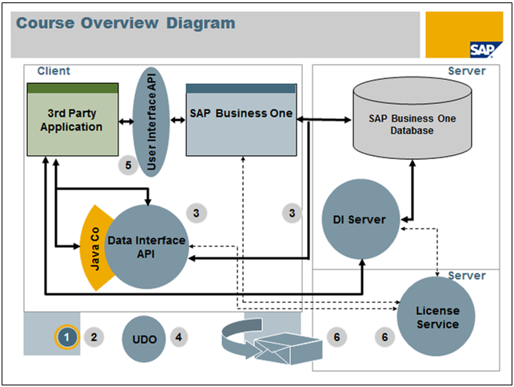
SBO 구성도 소개

Slide 6
SBO SDK 개발 커리쿨럼 오버뷰
ㆍ DI API
- 배치프로그램 개발 실습
ㆍ UI API
- 스크린페인터 실습
- B1 스튜디오 실습
- 표준 소스 구동및 개발
ㆍ DataBase
- SP생성
- 테이블, 컬럼생성 실습
- 노티피케이션 실습
ㆍ UDO
- UDO 생성
- 등록모듈 개발실습
ㆍ SBO 코어화면 컨트롤
- 구매오더화면에 컨트롤 붙히기 실습

Slide 7
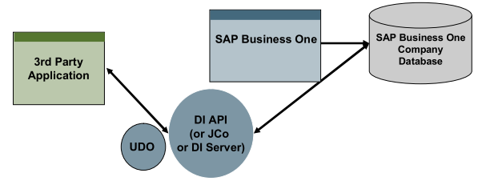
DI API 소개
ㆍSAP B1은 SBO DataBase를 직접 핸들링하는 것을 제한함.
- DataBase 에 직접 INSERT, UPDATE, DELETE 금지.
- SBO 클라이언트 내부기능 또는 DI API를 통해 생성해야 함.
ㆍ DI API는 위에서 설명한 문제를 해결하기위한 SBO에서 제공하는 Data InterFace

Slide 8
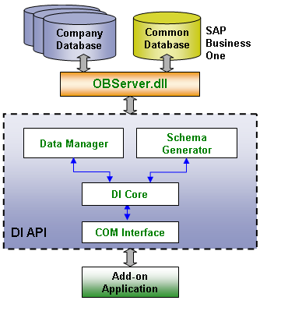
DI API 사용처
ㆍ SBO 애드온 개발
ㆍSBO 코어 문서 생성,수정 및 취소등
- 폼목,거래처마스터,오더,납품,송장등
ㆍSBO 코어테이블 추가필드 생성
- 품목테이블에 품목특성 유저컬럼 생성등
ㆍ SBO 유저 테이블 생성
- 불량항목 등록 테이블 생성등
ㆍ 배치프로그램
- 웹전표 생성 배치프로그램등
ㆍ 타시스템간 인터페이스

Slide 9
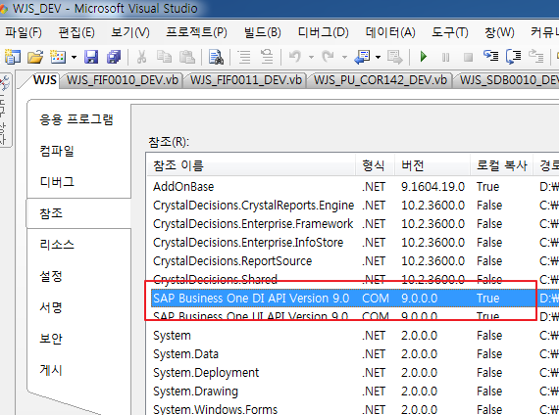
DI API 참조(실습하기)
ㆍ사용조건 : SBO DI/API가 설치되어있어야 함.
ㆍ개발툴(예시화면은 VB.NET) 에서 DI API를 참조(실습)

Slide 10
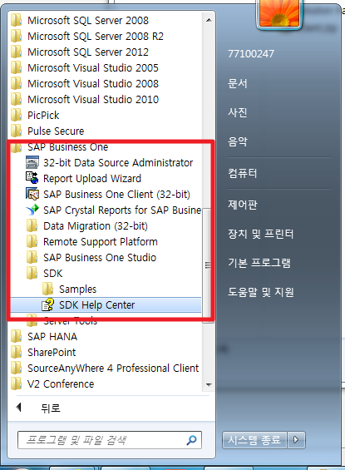
DI API 개발참조문서 설치및 실행하기 (실습하기)
개발문서 설치하기
SBO 설치파일 폴더\Packages\SDK\SETUP.exe 실행
개발문서 실행하기

Slide 11
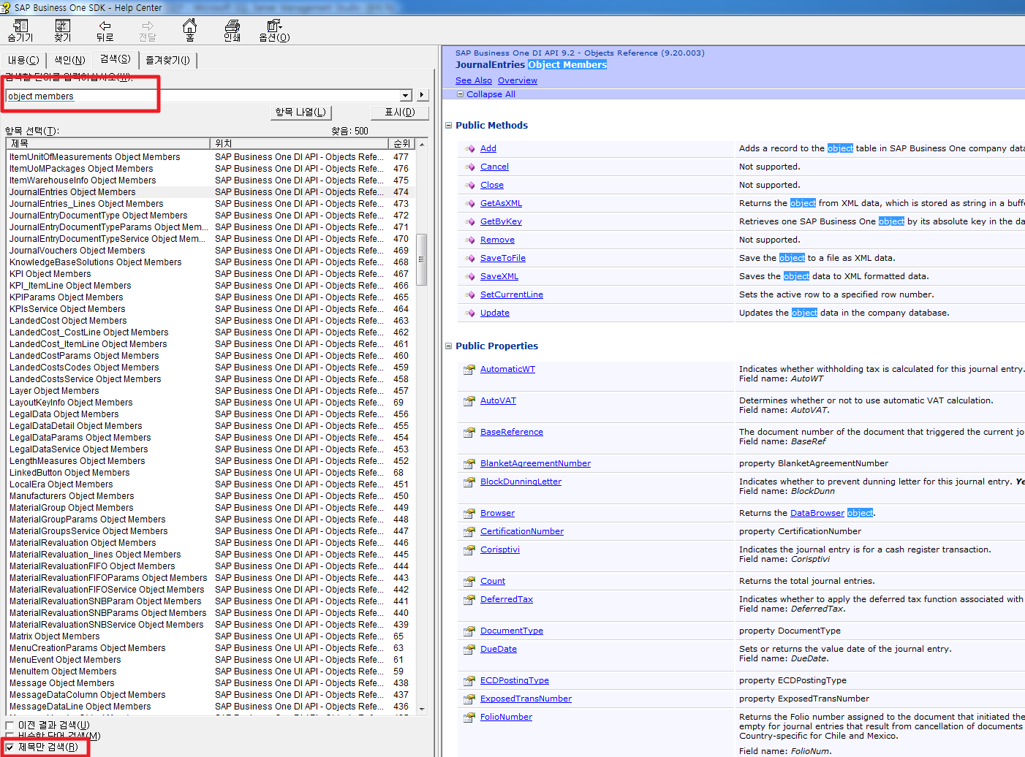
DI API 개발참조문서 보기

Slide 12
DI API 선언(사용빈도가 높은 DI API들)
컴퍼니 클래스
Private oCompany As SAPbobsCOM.Company ‘DI 의 기본구성은 SBO에 셋팅된 회사 기준
oCompany = New SAPbobsCOM.Company
레코드셋
Dim oRS As SAPbobsCOM.Recordset = nothing
oRS = oCompany.GetBusinessObject(SAPbobsCOM.BoObjectTypes.BoRecordset)
품목마스터
Dim oITEM As SAPbobsCOM.Items = nothing
oITEM = oCompany.GetBusinessObject(SAPbobsCOM.BoObjectTypes.oItems)
BP마스터
Dim oBP As SAPbobsCOM.BusinessPartners = nothing
oBP = oCompany.GetBusinessObject(SAPbobsCOM.BoObjectTypes.oBusinessPartners)
구매오더
Dim oOPOR As SAPbobsCOM.Documents = nothing
oOPOR = oCompany.GetBusinessObject(SAPbobsCOM.BoObjectTypes.oPurchaseOrders)
판매오더
Dim oORDR As SAPbobsCOM.Documents = nothing
oORDR = oCompany.GetBusinessObject(SAPbobsCOM.BoObjectTypes.oOrders)

Slide 13
DI API 선언(사용빈도가 높은 DI API들)
분개
Dim oJE As SAPbobsCOM.JournalEntries = nothing
oJE = oCompany.GetBusinessObject(SAPbobsCOM.BoObjectTypes.oJournalEntries)
DI API 처리중 발생오류
oCompany.GetLastErrorDescription
DI API 생성된 문서키
oCompany.GetNewObjectKey
글로벌 트랜잭션 처리
oCompany.StartTransaction()
If oCompany.InTransaction Then
End If
oCompany.EndTransaction(SAPbobsCOM.BoWfTransOpt.wf_Commit)
...

Slide 14
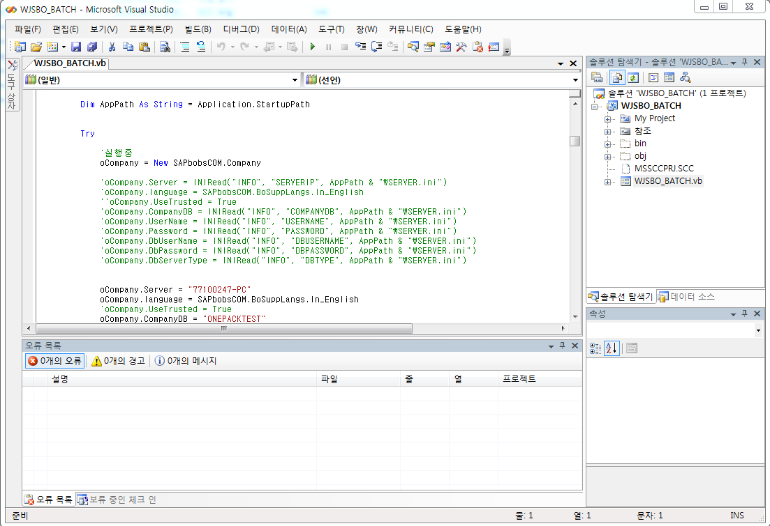
DI API 실습 (배치 소스 배포 및 구동) (실습하기)

Slide 15
DI API 실습 (SBO접속하기) (실습하기)
컴퍼니 클래스 선언후 SBO접속하기
Private oCompany As SAPbobsCOM.Company ‘DI 의 기본구성은 SBO에 셋팅된 회사 기준
SBO 접속하기 코딩 실습하기
oCompany = New SAPbobsCOM.Company
oCompany.Server = "77100247-PC"
oCompany.language = SAPbobsCOM.BoSuppLangs.ln_English
'oCompany.UseTrusted = True
oCompany.CompanyDB = "ONEPACKTEST"
oCompany.UserName = "manager"
oCompany.Password = "1234"
oCompany.DbUserName = "sa"
oCompany.DbPassword = "1"
oCompany.DbServerType = SAPbobsCOM.BoDataServerTypes.dst_MSSQL2012
If oCompany.Connect <> 0 Then
MsgBox(oCompany.GetLastErrorDescription)
If oCompany.Connected Then
oCompany.Disconnect()
End If
System.Runtime.InteropServices.Marshal.ReleaseComObject(oCompany)
oCompany = Nothing
Me.Dispose()
Me.Close()
Exit Sub
Else
MsgBox("접속성공")
End If

Slide 16
DI API 실습 (레코드셋 사용해보기) (실습하기)
레코드셋 선언
Dim oRS As SAPbobsCOM.Recordset = Nothing
oRS = oCompany.GetBusinessObject(SAPbobsCOM.BoObjectTypes.BoRecordset)
oRS.DoQurey("SELECT AcctCode, AcctName FROM OACT")
For i As Integer = 1 To oRS.RecordCount
If i = 1 Then
MsgBox(oRS.Fields.Item("AcctCode").Value & " : " & oRS.Fields.Item("AcctName").Value)
End If
Next
oRS.MoveFirst()
oRS.MoveNext()
oRS.MoveLast()
oRS.MovePrevious()

Slide 17
DI API 실습 (품목마스터 생성 및 갱신) (실습하기)
Sub Add_Item()
Dim RetVal As Long
Dim ErrCode As Long
Dim ErrMsg As String
Dim vItem As SAPbobsCOM.Items
Set vItem = vCmp.GetBusinessObject(oItems)
'Set value to mandatory fields:
vItem.ItemCode = "MyNewItem“
'Set Value to other fields
vItem.ItemName = "MyNewItem Name"
vItem.WhsInfo.WarehouseCode = "01"
'Adding the Item
RetVal = vItem.Add
'Checking the result
If RetVal <> 0 Then ‘RetVal = 0 if and only if Add() was successful
vCmp.GetLastError ErrCode, ErrMsg
MsgBox ErrCode & " " & ErrMsg
End If
End Sub

Slide 18
DI API 실습 (BP마스터 생성 및 갱신) (실습하기)
Dim oBP As SAPbobsCOM.BusinessPartners = nothing
oBP = oCompany.GetBusinessObject(SAPbobsCOM.BoObjectTypes.oBusinessPartners)
If oBP.GetByKey("TEST_BP_00001") Then
oBP.CardCode = "TEST_BP_00001"
If oBP.Update <> 0 Then
MsgBox(oCompany.GetLastErrorDescription)
Else
MsgBox("BP 갱신 완료")
End If
Else
oBP.CardCode = "TEST_BP_00001"
oBP.CardName = "TEST_BP_00001"
If oBP.Add <> 0 Then
MsgBox(oCompany.GetLastErrorDescription)
Else
MsgBox("BP 생성 완료")
End If
End If

Slide 19
DI API 실습 (구매오더 생성) (실습하기)
oOPOR.DocDate = Now.Date.ToString("yyyy-MM-dd")
oOPOR.CardCode = oRS.Fields.Item("CardCode").Value
oOPOR.Lines.SetCurrentLine(0)
oOPOR.BPL_IDAssignedToInvoice = "1"
For i = 1 To oRS.RecordCount
oOPOR.Lines.ItemCode = oRS.Fields.Item("ItemCode").Value.ToString.Trim
oOPOR.Lines.Quantity = oRS.Fields.Item("Quantity").Value.ToString.Trim
oOPOR.Lines.LineTotal = oRS.Fields.Item("LineTotal").Value.ToString.Trim
oOPOR.Lines.Add()
oRS.MoveNext()
Next
If oOPOR.Add <> 0 Then
MsgBox(oCompany.GetLastErrorDescription)
Else
MsgBox(oCompany.GetNewObjectKey & "로 구매오더 생성 완료")
End If

Slide 20
DI API 실습 (판매오더 생성) (실습하기)
oORDR.DocDate = Now.Date.ToString("yyyy-MM-dd")
oORDR.DocDueDate = Now.Date.ToString("yyyy-MM-dd")
oORDR.CardCode = oRS.Fields.Item("CardCode").Value
oORDR.Lines.SetCurrentLine(0)
oORDR.BPL_IDAssignedToInvoice = "1"
For i = 1 To oRS.RecordCount
oORDR.Lines.ItemCode = oRS.Fields.Item("ItemCode").Value.ToString.Trim
oORDR.Lines.Quantity = oRS.Fields.Item("Quantity").Value.ToString.Trim
oORDR.Lines.LineTotal = oRS.Fields.Item("LineTotal").Value.ToString.Trim
oORDR.Lines.Add()
oRS.MoveNext()
Next
If oORDR.Add <> 0 Then
MsgBox(oCompany.GetLastErrorDescription)
Else
MsgBox(oCompany.GetNewObjectKey & "로 판매오더 생성 완료")
End If

Slide 21
DI API 실습 (분개 생성) (실습하기)
Dim oJE As SAPbobsCOM.JournalEntries = oCompany.GetBusinessObject(SAPbobsCOM.BoObjectTypes.oJournalEntries)
oJE.ReferenceDate = Now.Date.ToString("yyyy-MM-dd")
oJE.Memo = oRS.Fields.Item("Memo").Value
oJE.Lines.SetCurrentLine(0)
For i = 1 To oRS.RecordCount
oJE.Lines.AccountCode = oRS.Fields.Item("Account").Value.ToString.Trim
If oRS.Fields.Item("Debit").Value <> 0 Then
oJE.Lines.Debit = oRS.Fields.Item("Debit").Value
End If
If oRS.Fields.Item("Credit").Value <> 0 Then
oJE.Lines.Credit = oRS.Fields.Item("Credit").Value
End If
oJE.Lines.ShortName = oRS.Fields.Item("ShortName").Value
oJE.Lines.Add()
oRS.MoveNext()
Next
If oJE.Add <> 0 Then
MsgBox(oCompany.GetLastErrorDescription)
Else
MsgBox(oCompany.GetNewObjectKey & "로 분개생성 완료")
End I

Slide 22
UI API 소개
UI(User InterFace) API란?
SBO 에서는 SAP 제공되는 독자적인 화면 컨트롤이 사용됨.
DI API와 마찬가지로 SBO SDK를 통해 독자적으로 구현해야 함.
SBO내에서 화면을 그려서 띠우거나 컨트롤 하기 위해 참조하는 SBO제공 API

Slide 23
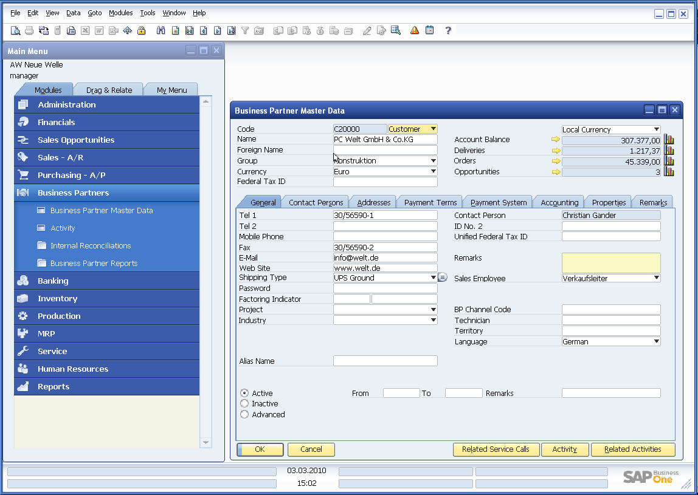
UI API 소개
Connection Objects
SboGuiAPI
Application
Desktop
Menu
Form
Items
ComboBox
EditText
Matrix
Grid
Folder
…
…
DataSources
DBDataSource
DataTable
UserDataSource
Menus
Forms
Controls (“Items”) on Forms
Notes:
The User Interface API (UI API) is a collection of COM objects that provide access to:
forms
controls within these forms
menus
Note: The “Main Menu” and the status bar are forms as well

Slide 24
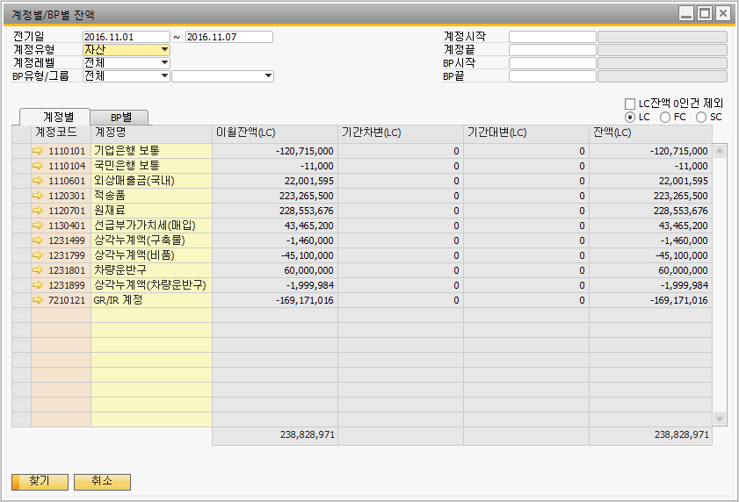
UI API 사용처
ㆍ SBO 애드온 개발 (유저폼)
ㆍ 코어폼 수정및 콘트롤추가등

Slide 25
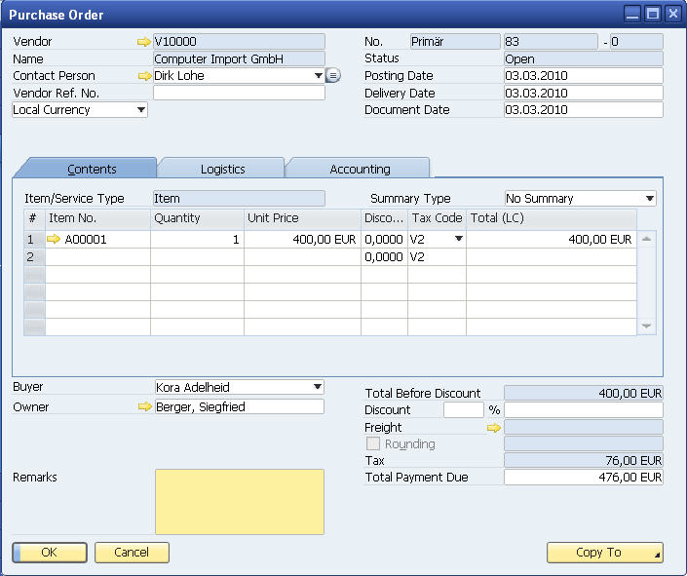
UI API - UI 컨트롤 소개
EditText
StaticText
Folder
Combobox
Matrix
Checkbox
LinkedButton
ButtonCombo
Button
Notes:
Form item types are the same as controls in Visual Basic forms from a user perspective - except the LinkedButton which is specific to SAP Business One
Technically, the SAP objects are unrelated to VB form controls
Examples of form item types are:
Button
CheckBox
ComboBox
EditText
LinkedButton
Grid
Matrix (most tables in system forms)
OptionBtn ("Radio Button")
PictureBox
StaticText

Slide 26
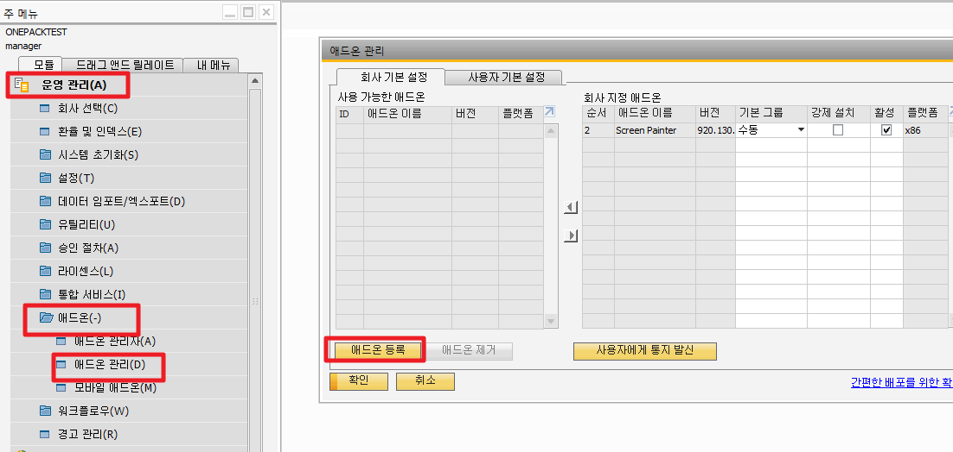
UI 개발툴 소개 – Screen Painter
ㆍ사용조건 : SBO Screen Painter 애드온이 설치되어있어야 함.
ㆍ스크린 페인터 설치 실습하기

Slide 27
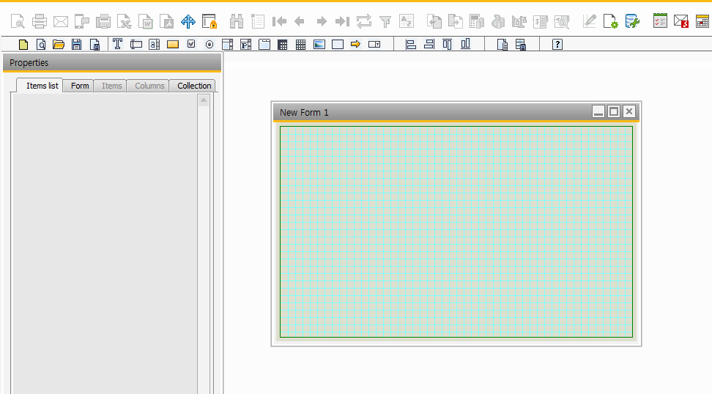
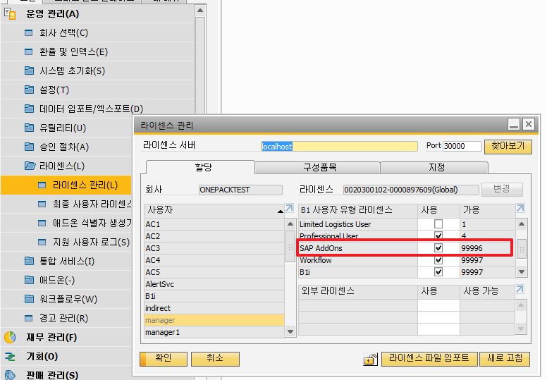
UI 개발툴 소개 – Screen Painter
ㆍ스크린 페인터 실행해보기
애드온 라이선스가 활성되어있는 유저여아함

Slide 28
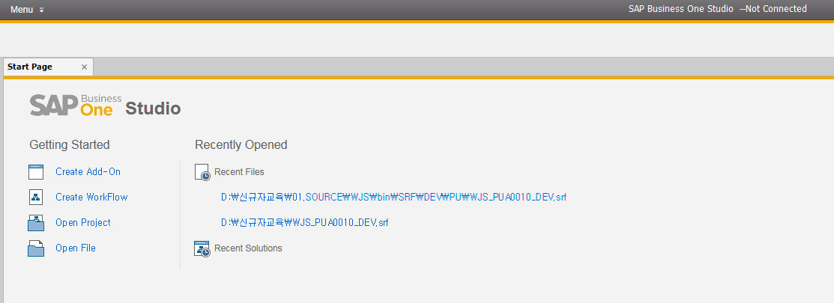
UI 개발툴 소개 – SAP Business One Studio (32-bit)
ㆍ사용조건 : SAP Business One Studio (32-bit) 이 설치되어있어야 함.
ㆍSAP Business One Studio (32-bit) 설치및 실행 실습하기

Slide 29
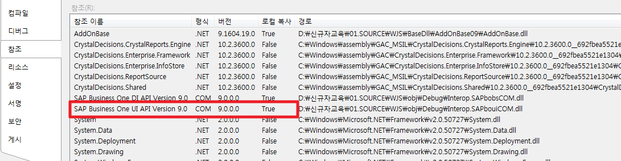
UI API 참조(실습)
ㆍ사용조건 : SBO DI/API가 설치되어있어야 함.
ㆍ개발툴(예시화면은 VB.NET) 에서 UI API를 참조(실습)

Slide 30
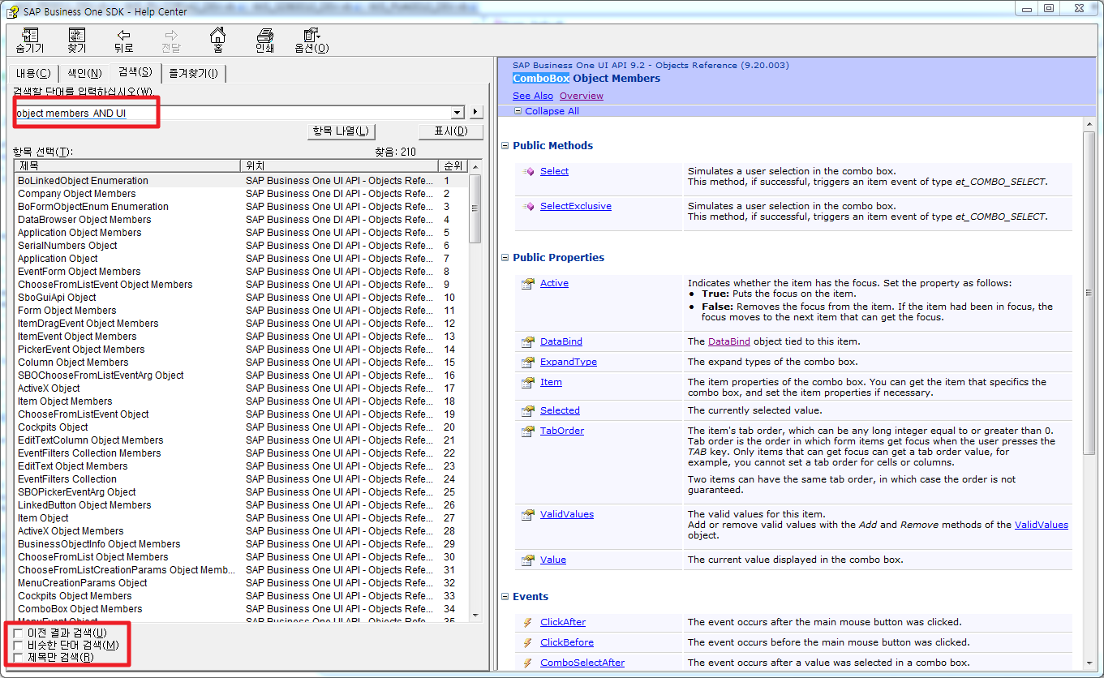
UI API 도움말 찾기(실습)

Slide 31
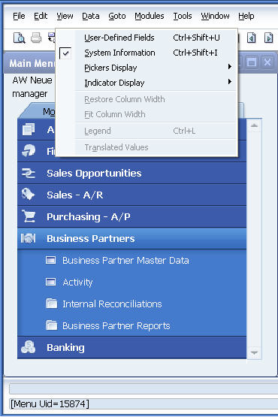
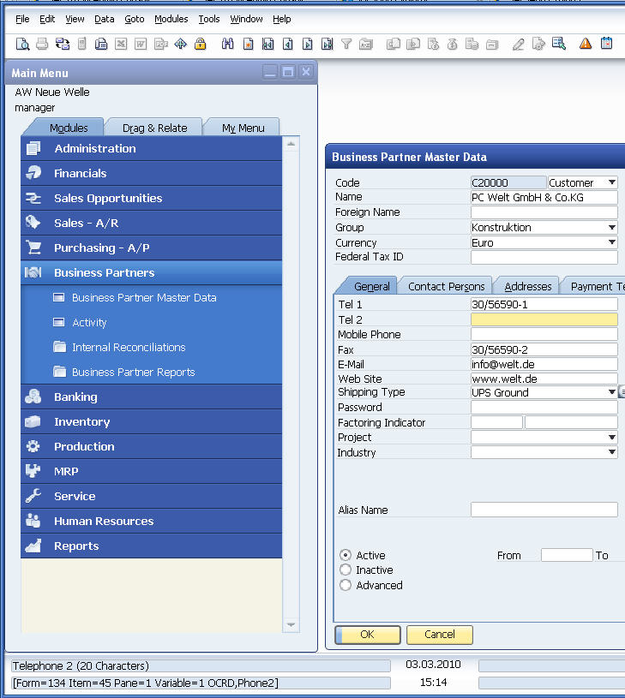
UI API - UI 정보 알아내기(실습)
Notes:
You can view technical information related to forms, items (controls), and corresponding database tables/fields by selecting View > System Information and mouse over the items(controls) in question.
The information is shown in the lower left corner of the screen:
Form Type (string, but appears as a number for system forms)
Item UID (string, but appears as a number for system items)
Pane - current layer linking items with folders (tabs) – see later in this unit
Database table name
Database field name
Menu item unique id
Note:
Database details are not available for items which display information that is:
Calculated within the user interface
Sourced from more than one database field – for example amounts combine the float value with the currency code, e.g. „EUR 7.59“. The information in the status bar will contain a „variable“ ID.
The information displayed relates to the position of the mouse pointer, not necessarily the item which currently has input focus

Slide 32
애드온 개발 – UI Event 소개
Member | Value | Description
et_ALL_EVENTS | 0 | All events, for use when filtering events
et_ITEM_PRESSED | 1 | The main mouse button was clicked on one of the following:
 |  | Tab
 |  | Button
 |  | Option button
 |  | Check box (standalone or within a cell)
 |  | This event occurs when a mouse is released within an item, that is, mouse up.
et_KEY_DOWN | 2 | A key was pressed.
et_GOT_FOCUS | 3 | An item received focus.
et_LOST_FOCUS | 4 | An item lost focus.
et_COMBO_SELECT | 5 | A value was selected in a combo box.
et_CLICK | 6 | The main mouse button was clicked on an item, that is, mouse down.
et_DOUBLE_CLICK | 7 | The main mouse button was double-clicked on an item.
et_MATRIX_LINK_PRESSED | 8 | A link arrow in a matrix was pressed.
et_MATRIX_COLLAPSE_PRESSED | 9 | A matrix list was collapsed or expanded.
et_VALIDATE | 10 | An item lost focus and validation is required.
et_MATRIX_LOAD | 11 | Data was loaded from the database into a matrix data source.
 |  | This event occurs for user-defined matrix objects only. If a form contains two matrix objects, the system generates two events.

Slide 33
애드온 개발 – UI Event 소개
Member | Value | Description
et_DATASOURCE_LOAD | 12 | Data was loaded from the GUI into a matrix data source.
 |  | This event occurs once per matrix. If a form has two matrix objects, the system generates two events.
et_FORM_LOAD | 16 | A form was opened (FormDataEvent).
et_FORM_UNLOAD | 17 | A form was closed.
et_FORM_ACTIVATE | 18 | A form received focus.
et_FORM_DEACTIVATE | 19 | A form lost focus.
et_FORM_CLOSE | 20 | A form is about to be closed.
et_FORM_RESIZE | 21 | A form has been resized.
et_FORM_KEY_DOWN | 22 | A key was pressed when no form had the focus.
et_FORM_MENU_HILIGHT | 23 | A form is modifying the status of toolbar items, that is, enabling and disabling icons.
 |  | By default, these events are not thrown. You can activate these events by setting an event filter.
et_PRINT | 24 | A print preview was requested for a report or document (PrintEvent).
 |  | This event lets you exit from the application print operation and use your own printing.
et_PRINT_DATA | 25 | A print preview was requested for a report (ReportDataEvent).
 |  | This event lets you get the report data in XML format.
et_CHOOSE_FROM_LIST | 27 | A ChooseFromList event occurred, as follows:
 |  | The Before event occurs before the ChooseFromList form is displayed. If the BubbleEvent parameter is set to False, the form is not displayed.
 |  | The After event occurs after the user makes a selection or chooses Cancel.
et_RIGHT_CLICK | 28 | The right mouse button was clicked on an item (RightClickEvent).
et_MENU_CLICK | 32 | The main mouse button was released on a menu item without submenus.
 |  | For future use.

Slide 34
애드온 개발 – UI Event 소개
Member | Value | Description
et_FORM_DATA_ADD | 33 | A record in a business object was added (FormDataEvent).
et_FORM_DATA_UPDATE | 34 | A record in a business object was updated (FormDataEvent).
et_FORM_DATA_DELETE | 35 | A record in a business object was deleted (FormDataEvent).
et_FORM_DATA_LOAD | 36 | A record in a business object was loaded -- via browse, link button, or find (FormDataEvent).
et_PICKER_CLICKED | 37 | A Picker event occurred, as follows:
 |  | The Before event occurs before the Picker form is displayed. If the BubbleEvent parameter is set to False, the picker is not displayed.
 |  | The After event occurs after the user makes a selection or chooses Cancel.
et_GRID_SORT | 38 | A grid column was sorted, either by a user clicking the column title or an add-on calling the Sort method of the Grid object.
et_Drag | 39 | The item was dragged and dropped at the position you want it to appear.
et_FORM_DRAW | 45 | A form was drawn (ItemEvent).
 |  | The before event would raise after the FormLoadAfter event and before the form was drawn.
 |  | And after the form was drawn, which means all form items location/size is determined (for system form), the after form draw event would be raised.
et_UDO_FORM_BUILD | 49 | A UDO form was built.
et_UDO_FORM_OPEN | 50 | A UDO form was opened.
et_B1I_SERVICE_COMPLETE | 51 | The B1i service has been completed.
et_FORMAT_SEARCH_COMPLETED | 59 | The format search has been completed.
et_PRINT_LAYOUT_KEY | 80 | A print or print preview was requested for an add-on form, and the layout needs the key of the add-on form (LayoutKeyEvent).
et_FORM_VISIBLE | 97 | A form was visible.

Slide 35
애드온 개발 – 조회화면 개발(실습)
① 화면그리기
② 개발 표준소스 구동하기
③개발 표준소스에 화면 붙히기
④데이터 바인딩및 기본 코딩 추가하기
⑤조회 쿼리 추가하기
⑥이벤트 추가하기
⑦ 결과값 조회

Slide 36
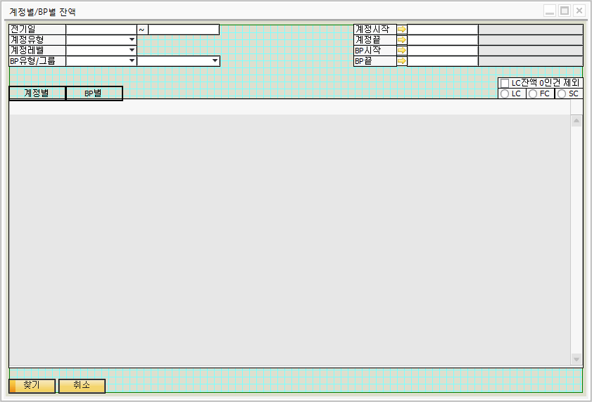
애드온 개발 - UI 그리기 (실습)

Slide 37
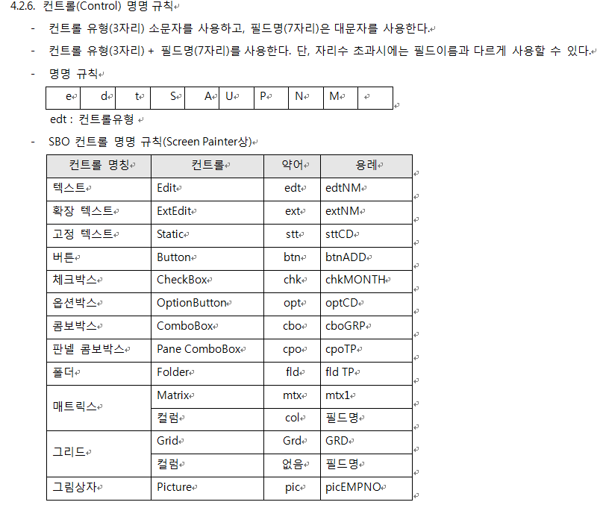
애드온 개발 – 웅진 개발 표준 명명규칙 소개

Slide 38
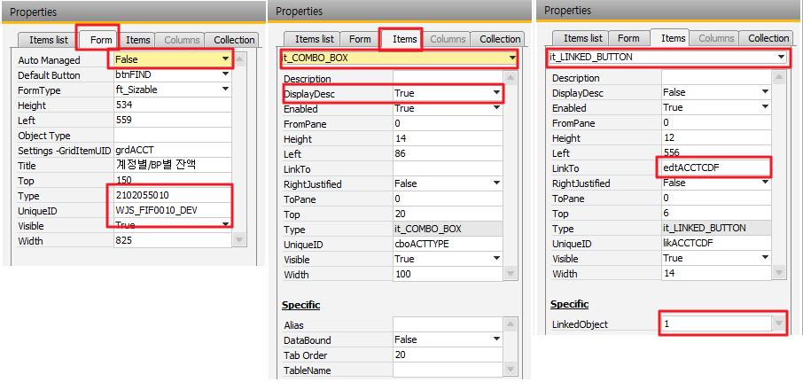
애드온 개발 - UI 그리기 (실습)

Slide 39
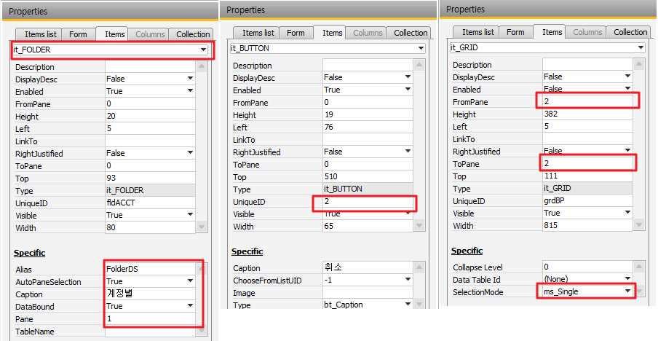
애드온 개발 - UI 그리기 (실습)

Slide 40
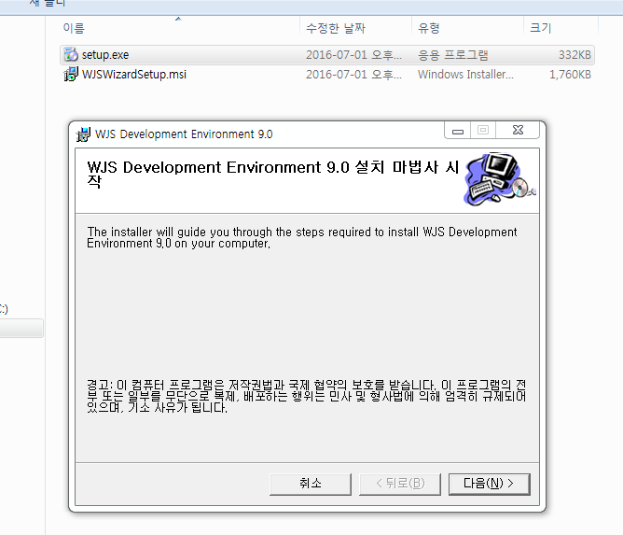
애드온 개발- 프레임웍 설치(실습)

Slide 41
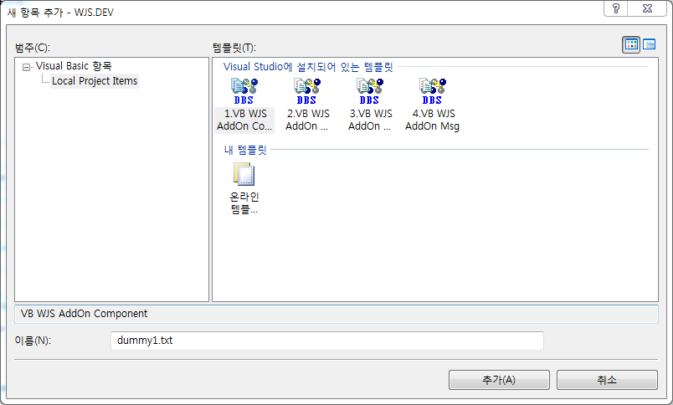
애드온 개발- 프레임웍 구성설명
1.VB WJS AddOn Component : 폼추가, 코어화면 갱신
2. VB WJS AddOn Listener : 이벤트 추가
3. VB WJS AddOn Caption : 캡션관리
4. VB WJS AddOn Msg : 메세지 관리

Slide 42
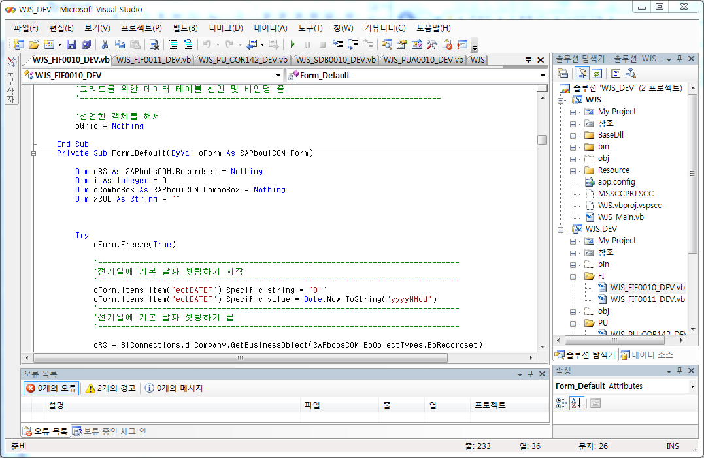
애드온 개발 – 표준소스 구동(실습)

Slide 43
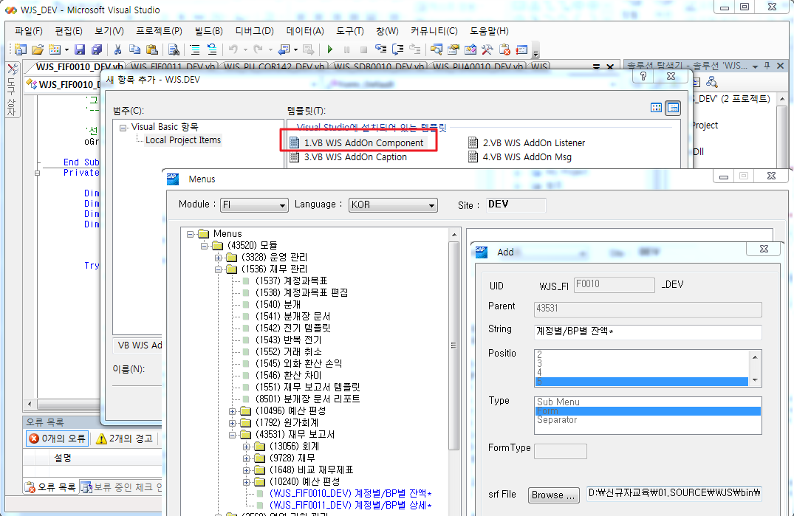
애드온 개발 – 화면붙히기(실습)
CTRL + SHIFT + A

Slide 44
애드온 개발 – 바인딩 & 폼디폴트 SUB 선언 코딩(실습)
Private Sub DataBinded(ByVal oForm As SAPbouiCOM.Form)
End Sub
Private Sub Form_Default(ByVal oForm As SAPbouiCOM.Form)
End Sub

Slide 45
애드온 개발 – 바인딩 코딩추가 (실습)
유저데이터소스 선언
Call oForm.DataSources.UserDataSources.Add("edtDATEF", BoDataType.dt_DATE)
Call oForm.DataSources.UserDataSources.Add("edtDATET", BoDataType.dt_DATE)
Call oForm.DataSources.UserDataSources.Add("cboACTTYPE", BoDataType.dt_SHORT_TEXT)
…
폼컨트롤과 데이터소스 바인딩
Call oForm.Items.Item("edtDATEF").Specific.DataBind.SetBound(True, "", "edtDATEF")
Call oForm.Items.Item("edtDATET").Specific.DataBind.SetBound(True, "", "edtDATET")
Call oForm.Items.Item("cboACTTYPE").Specific.DataBind.SetBound(True, "", "cboACTTYPE")
…
옵션버튼 바인딩
Dim oOptBtn As SAPbouiCOM.OptionBtn = Nothing
Call oForm.Items.Item("optLC").Specific.DataBind.SetBound(True, "", "optCURR")
oOptBtn = oForm.Items.Item("optFC").Specific
oOptBtn.GroupWith("optLC")
oOptBtn = oForm.Items.Item("optSC").Specific
oOptBtn.GroupWith("optLC")
oOptBtn = Nothing
그리드바인딩
Call oForm.DataSources.DataTables.Add("grdACCT")
Dim oGrid As SAPbouiCOM.Grid = oForm.Items.Item("grdACCT").Specific
oGrid.DataTable = oForm.DataSources.DataTables.Item("grdACCT")

Slide 46
애드온 개발 – 날짜셋팅&콤보박스&옵션버튼 코딩추가 (실습)
날짜값 넣어주기
oForm.Items.Item("edtDATEF").Specific.string = "01"
oForm.Items.Item("edtDATET").Specific.value = Date.Now.ToString("yyyyMMdd")
콤보박스 셋팅하기
Dim oRS As SAPbobsCOM.Recordset = Nothing
Dim i As Integer = 0
Dim oComboBox As SAPbouiCOM.ComboBox = Nothing
oComboBox = oForm.Items.Item("cboACTTYPE").Specific
oRS.DoQuery("SELECT GroupMask, AcctName FROM OACT WHERE Levels = '1'")
oComboBox.ValidValues.Add("", "전체")
For i = 0 To oRS.RecordCount - 1
oComboBox.ValidValues.Add(oRS.Fields.Item("GroupMask").Value, oRS.Fields.Item("AcctName").Value)
oRS.MoveNext()
Next
oComboBox.Select(0, BoSearchKey.psk_Index) '콤보리스트에 등록된 리스트의 첫번째(0번째 인덱스)값을 선택
옵션버튼 값셋팅하기
oForm.DataSources.UserDataSources.Item("optCURR").Value = "1"

Slide 47
애드온 개발 – 콤보 이벤트 추가 (실습)
<B1Listener(BoEventTypes.et_COMBO_SELECT, False, ActionType.Itm, "cboBPTYPE")> _
Public Overridable Sub ET_cboBPTYPE_AFComboSelect(ByVal pVal As ItemEvent)
oForm = B1Connections.theAppl.Forms.Item(pVal.FormUID)
oComboBox = CType(CType(oForm.Items.Item("cboBPTYPE"), SAPbouiCOM.Item).Specific, ComboBox)
'ADD YOUR ACTION CODE HERE ...
Dim oRS As SAPbobsCOM.Recordset = Nothing
Try
oForm.Freeze(True)
oComboBox = oForm.Items.Item("cboBPGRP").Specific
For i As Integer = 0 To oComboBox.ValidValues.Count - 1
oComboBox.ValidValues.Remove(0, BoSearchKey.psk_Index)
Next
oRS = B1Connections.diCompany.GetBusinessObject(SAPbobsCOM.BoObjectTypes.BoRecordset)
oRS.DoQuery("SELECT GroupCode, GroupName FROM OCRG WHERE GroupType = '" & oForm.DataSources.UserDataSources.Item("cboBPTYPE").Value.Trim & "'")
oComboBox.ValidValues.Add("", "전체")
For i As Integer = 0 To oRS.RecordCount - 1
oComboBox.ValidValues.Add(oRS.Fields.Item("GroupCode").Value, oRS.Fields.Item("GroupName").Value)
oRS.MoveNext()
Next
oComboBox.Select("", BoSearchKey.psk_ByValue)
'oForm.DataSources.UserDataSources.Item("cboBPGRP").Value = ""
Catch ex As Exception
Finally
oForm.Freeze(False)
oRS = Nothing
End Try
End Sub
ㆍ 콤보값이 변경되면 하위콤보값을 삭제후 재셋팅

Slide 48
애드온 개발 – ChooseFromList 추가하기(실습)
Private Sub AddChooseFromList(ByVal oForm As SAPbouiCOM.Form)
Dim oCFL As SAPbouiCOM.ChooseFromList
Dim oCFLCreationParams As SAPbouiCOM.ChooseFromListCreationParams
Dim oCons As SAPbouiCOM.Conditions
Dim oCon As SAPbouiCOM.Condition
'-------------------------------------------------------------------------------
'계정시작 ChooseFromList 셋팅 시작
'-------------------------------------------------------------------------------
oCFLCreationParams = B1Connections.theAppl.CreateObject(SAPbouiCOM.BoCreatableObjectType.cot_ChooseFromListCreationParams)
oCFLCreationParams.ObjectType = BoLinkedObject.lf_GLAccounts
oCFLCreationParams.UniqueID = "edtACCTCDF"
oCFL = oForm.ChooseFromLists.Add(oCFLCreationParams)
oCons = oCFL.GetConditions()
oCon = oCons.Add()
oCon.Alias = "Postable"
oCon.Operation = SAPbouiCOM.BoConditionOperation.co_EQUAL
oCon.CondVal = "Y"
oCFL.SetConditions(oCons)
oForm.Items.Item("edtACCTCDF").Specific.ChooseFromListUID = "edtACCTCDF"
oForm.Items.Item("edtACCTCDF").Specific.ChooseFromListAlias = "AcctCode"
'-------------------------------------------------------------------------------
'계정시작 ChooseFromList 셋팅 끝
'-------------------------------------------------------------------------------
oCFLCreationParams = Nothing
oCFL = Nothing
oCons = Nothing
oCon = Nothing
End Sub

Slide 49
애드온 개발 – ChooseFromList 이벤트 추가하기(실습)
<B1Listener(BoEventTypes.et_CHOOSE_FROM_LIST, False, ActionType.Itm, "edtACCTCDF")> _
Public Overridable Sub ET_edtACCTCDF_AFChooseFromList(ByVal pVal As ItemEvent)
oForm = B1Connections.theAppl.Forms.Item(pVal.FormUID)
oEditText = CType(CType(oForm.Items.Item("edtACCTCDF"), SAPbouiCOM.Item).Specific, EditText)
'ADD YOUR ACTION CODE HERE ...
Dim oDataTable As SAPbouiCOM.DataTable '데이터를 가져오기 위해 데이터테이블 추가
Try
'데이터 테이블을 ChooseFromList에 선택된 오브젝트에서 가져오도록 세팅
oDataTable = pVal.SelectedObjects
'사용자가 ChooseFromList의 취소 버튼을 눌렀을 경우 에러처리(데이터 테이블의 값으로 체크)
If Not oDataTable Is Nothing Then
oForm.DataSources.UserDataSources.Item("edtACCTCDF").ValueEx = oDataTable.GetValue("AcctCode", 0).ToString
oForm.DataSources.UserDataSources.Item("edtACCTNMF").ValueEx = oDataTable.GetValue("AcctName", 0).ToString
End If
Catch ex As Exception
B1Connections.theAppl.StatusBar.SetText("ET_edtSALEPCD_AFChooseFromList " & Err.Description, SAPbouiCOM.BoMessageTime.bmt_Short, SAPbouiCOM.BoStatusBarMessageType.smt_Error)
Finally
oDataTable = Nothing
End Try
End Sub
ㆍ ChooseFromList에서 선택한값과 디스크립션값을 셋팅

Slide 50
애드온 개발 – Find SUB 추가하기(실습)
ㆍ 쿼리 스트링을 실행
ㆍ 그리드의 컬럼 속성부여
- 컬럼타이틀
- Visible
- Editable
- 합계란
- 링크드오브젝트
- 오른정렬 등등
Dim oGrid As SAPbouiCOM.Grid = Nothing
oGrid = oForm.Items.Item("grdACCT").Specific
oGrid.DataTable.Clear()
oGrid.DataTable.ExecuteQuery(xSQL)
oGrid.Columns.Item("ACCTCODE").TitleObject.Caption = "계정코드“
…
oGrid.Columns.Item("ACCTCODE").LinkedObjectType = BoLinkedObject.lf_JournalPosting
…
For i = 2 To oGrid.Columns.Count - 1
G_Sum = oGrid.Columns.Item(i)
G_Sum.ColumnSetting.SumType = BoColumnSumType.bst_Auto
G_Sum = Nothing
Next").LinkedO
…
= BoLinkedObject.lf_JournalPosting

Slide 51
애드온 개발 – ITEM_PRESSED (조회버튼) 추가하기(실습)
<B1Listener(BoEventTypes.et_ITEM_PRESSED, false, ActionType.Itm, "btnFIND")> _
Public Overridable Sub ET_btnFIND_AFItemPressed(ByVal pVal As ItemEvent)
oForm = B1Connections.theAppl.Forms.Item(pVal.FormUID)
oButton = CType(CType(oForm.Items.Item("btnFIND"),SAPbouiCOM.Item).Specific,Button)
'ADD YOUR ACTION CODE HERE ...
Dim xSQL As String = ""
'-------------------------------------------------------------------------------
'계정별 그리드 조회 시작
'-------------------------------------------------------------------------------
xSQL = ""
xSQL = xSQL & "EXEC WJS_SP_FIF0010F '1',"
xSQL = xSQL & "'" & oForm.DataSources.UserDataSources.Item("edtDATEF").ValueEx.Trim & "',"
xSQL = xSQL & "'" & oForm.DataSources.UserDataSources.Item("edtDATET").ValueEx.Trim & "',"
xSQL = xSQL & "'" & oForm.DataSources.UserDataSources.Item("cboACTTYPE").ValueEx.Trim & "',"
xSQL = xSQL & "'" & oForm.DataSources.UserDataSources.Item("cboACTLVL").ValueEx.Trim & "',"
xSQL = xSQL & "'" & oForm.DataSources.UserDataSources.Item("cboBPTYPE").ValueEx.Trim & "',"
xSQL = xSQL & "'" & oForm.DataSources.UserDataSources.Item("cboBPGRP").ValueEx.Trim & "',"
xSQL = xSQL & "'" & oForm.DataSources.UserDataSources.Item("edtACCTCDF").ValueEx.Trim & "',"
xSQL = xSQL & "'" & oForm.DataSources.UserDataSources.Item("edtACCTCDT").ValueEx.Trim & "',"
xSQL = xSQL & "'" & oForm.DataSources.UserDataSources.Item("edtBPCDF").ValueEx.Trim & "',"
xSQL = xSQL & "'" & oForm.DataSources.UserDataSources.Item("edtBPCDT").ValueEx.Trim & "',"
xSQL = xSQL & "'" & oForm.DataSources.UserDataSources.Item("chkZEROYN").ValueEx.Trim & "'"
Find_grdACCT(oForm, xSQL)
End Sub

Slide 52
애드온 개발 – Column_Visible SUB 추가하기(실습)
Private Sub Column_Visible(ByVal oGrid As SAPbouiCOM.Grid, ByVal CURR_Value As String)
Select Case CURR_Value
Case "1"
oGrid.Columns.Item("OB_LC").Visible = True
oGrid.Columns.Item("DEB_LC").Visible = True
oGrid.Columns.Item("CRE_LC").Visible = True
oGrid.Columns.Item("BAL_LC").Visible = True
oGrid.Columns.Item("OB_FC").Visible = False
oGrid.Columns.Item("DEB_FC").Visible = False
oGrid.Columns.Item("CRE_FC").Visible = False
oGrid.Columns.Item("BAL_FC").Visible = False
oGrid.Columns.Item("OB_SC").Visible = False
oGrid.Columns.Item("DEB_SC").Visible = False
oGrid.Columns.Item("CRE_SC").Visible = False
oGrid.Columns.Item("BAL_SC").Visible = False
….
End Select
oGrid = Nothing
End Sub
ㆍ옵션버튼 값에 따라 컬럼을 보이기/감추기

Slide 53
애드온 개발 – ITEM_PRESSED (옵션버튼) 추가하기(실습)
<B1Listener(BoEventTypes.et_ITEM_PRESSED, False, ActionType.Itm, "optFC")> _
Public Overridable Sub ET_optFC_AFItemPressed(ByVal pVal As ItemEvent)
oForm = B1Connections.theAppl.Forms.Item(pVal.FormUID)
oOptionBtn = CType(CType(oForm.Items.Item("optFC"), SAPbouiCOM.Item).Specific, OptionBtn)
'ADD YOUR ACTION CODE HERE ...
oForm.Freeze(True)
Select Case oForm.PaneLevel
Case "1"
Column_Visible(oForm.Items.Item("grdACCT").Specific, oForm.DataSources.UserDataSources.Item("optCURR").Value.Trim)
oForm.Items.Item("grdACCT").Specific.AutoResizeColumns()
Case "2"
Dim oGrid As SAPbouiCOM.Grid = oForm.Items.Item("grdBP").Specific
Column_Visible(oGrid, oForm.DataSources.UserDataSources.Item("optCURR").Value.Trim)
oGrid.AutoResizeColumns()
oGrid = Nothing
End Select
oForm.Freeze(False)
End Sub
ㆍPane 레벨에 따라 이벤트 처리

Slide 54
애드온 개발 – VALIDATE 이벤트 추가하기(실습)
ㆍ계정코드를 지우면 계정명도 지워지도록 이벤트 추가
ㆍPval.ItemChanged > 이벤트 콘트롤값 변경유무 확인가능
<B1Listener(BoEventTypes.et_VALIDATE, False, ActionType.Itm, "edtACCTCDF")> _
Public Overridable Sub ET_edtACCTCDF_AFValidate(ByVal pVal As ItemEvent)
oForm = B1Connections.theAppl.Forms.Item(pVal.FormUID)
oEditText = CType(CType(oForm.Items.Item("edtACCTCDF"), SAPbouiCOM.Item).Specific, EditText)
'ADD YOUR ACTION CODE HERE ...
If pVal.ItemChanged Then
If oForm.DataSources.UserDataSources.Item("edtACCTCDF").Value = "" Then
oForm.DataSources.UserDataSources.Item("edtACCTNMF").Value = ""
End If
End If
End Sub

Slide 55
애드온 개발 – DOUBLE_CLICK 이벤트 추가하기(실습)
ㆍ그리드 더블클릭시 행 선택되로록…
<B1Listener(BoEventTypes.et_DOUBLE_CLICK, False, ActionType.Itm, "grdBP")> _
Public Overridable Sub ET_grdBP_AFDoubleClick(ByVal pVal As ItemEvent)
oForm = B1Connections.theAppl.Forms.Item(pVal.FormUID)
oGrid = CType(CType(oForm.Items.Item("grdBP"), SAPbouiCOM.Item).Specific, Grid)
'ADD YOUR ACTION CODE HERE ...
If pVal.Row < 0 Then Exit Sub
oGrid.SelectionMode = BoMatrixSelect.ms_Single
oGrid.Rows.SelectedRows.Add(pVal.Row)
End Sub

Slide 56
애드온 개발 – 저장화면 개발(실습)
① SBO 에서 테이블 생성하기
② 화면그리기
③ 개발 표준소스에 화면 붙히기
④ 데이터 바인딩및 기본 코딩 추가하기
⑤ 조회 쿼리 추가하기
⑥ 이벤트 추가하기
⑦ 저장로직 추가하기
⑧ 결과값 조회

Slide 57
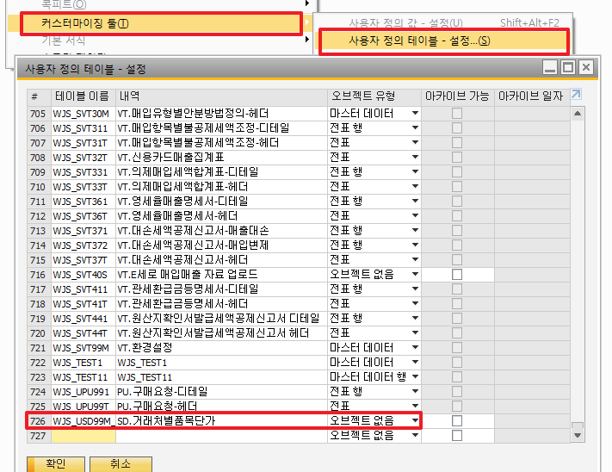
애드온 개발 – SBO에서 테이블 생성하기(실습)

Slide 58
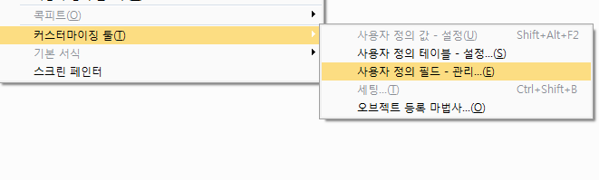
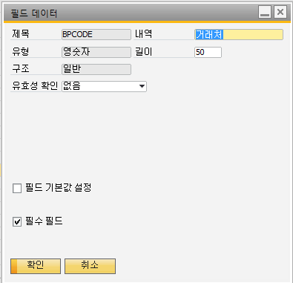
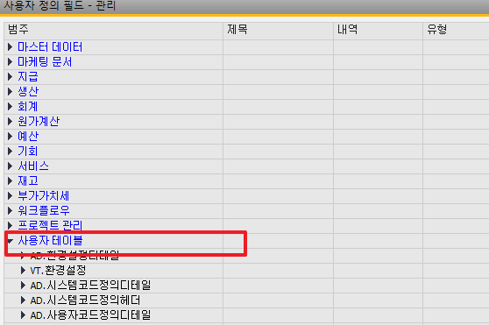
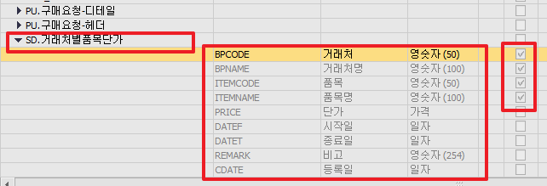
애드온 개발 – SBO에서 테이블 생성하기(실습)

Slide 59
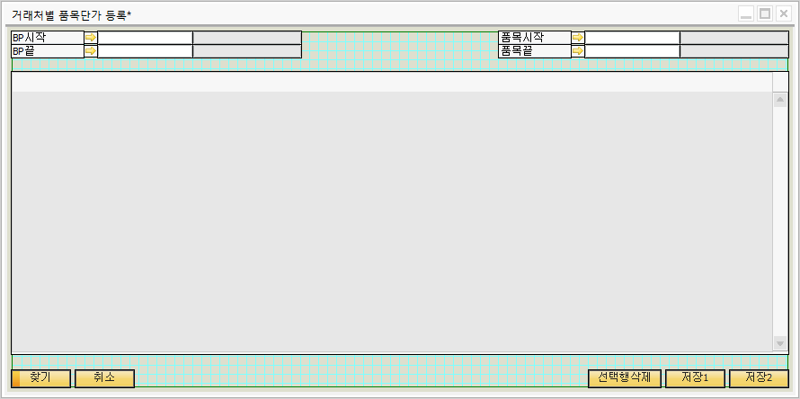
애드온 개발 – 화면 그리기 (실습)

Slide 60
애드온 개발 – 저장화면 기본코딩추가(실습)
③ 개발 표준소스에 화면 붙히기
④ 데이터 바인딩및 기본 코딩 추가하기
⑤ 조회 쿼리 추가하기
⑥ 이벤트 추가하기

Slide 61
애드온 개발 – 메뉴셋팅 (실습)
Private Sub MenuSetting(ByVal oForm As SAPbouiCOM.Form)
Call oForm.EnableMenu(1292, True) '행추가
Call oForm.EnableMenu(1293, False) '행삭제
Call oForm.EnableMenu(1299, False) '행닫기
Call oForm.EnableMenu(1287, False) '복제
Call oForm.EnableMenu(1283, False) '제거
Call oForm.EnableMenu(1284, False) '취소
Call oForm.EnableMenu(1288, False) '>>
Call oForm.EnableMenu(1289, False) '<<
Call oForm.EnableMenu(1290, False) '|<
Call oForm.EnableMenu(1291, False) '>|
Call oForm.EnableMenu(1282, False) '추가
Call oForm.EnableMenu(1281, False) '찾기
'Call oForm.EnableMenu(8961, False) '엑셀
'Call oForm.EnableMenu(1294, False) '행복제
End Sub
SBO 툴바의 버튼의 활성 비활성 셋팅

Slide 62
애드온 개발 – 저장 & 갱신 로직 추가 방식1(실습)
If oUserTable.GetByKey(oGrid.DataTable.GetValue("CODE", oGrid.GetDataTableRowIndex(i))) Then
oUserTable.UserFields.Fields.Item("U_BPCODE").Value = oGrid.DataTable.GetValue("U_BPCODE", oGrid.GetDataTableRowIndex(i))
oUserTable.UserFields.Fields.Item("U_BPNAME").Value = oGrid.DataTable.GetValue("U_BPNAME", oGrid.GetDataTableRowIndex(i))
...
If oUserTable.Update() <> 0 Then
oGrid.DataTable.SetValue("SYSMSG", oGrid.GetDataTableRowIndex(i), B1Connections.diCompany.GetLastErrorDescription)
End If
Else
oRS.DoQuery("SELECT ISNULL(MAX(CAST(CODE AS INT)),0) + 1 AS MAXCODE FROM [@WJS_USD99M_DEV]")
oUserTable.Code = oRS.Fields.Item("MAXCODE").Value
oUserTable.Name = oRS.Fields.Item("MAXCODE").Value
oUserTable.UserFields.Fields.Item("U_BPCODE").Value = oGrid.DataTable.GetValue("U_BPCODE", oGrid.GetDataTableRowIndex(i))
oUserTable.UserFields.Fields.Item("U_BPNAME").Value = oGrid.DataTable.GetValue("U_BPNAME", oGrid.GetDataTableRowIndex(i))
oUserTable.UserFields.Fields.Item("U_ITEMCODE").Value = oGrid.DataTable.GetValue("U_ITEMCODE", oGrid.GetDataTableRowIndex(i))
...
If oUserTable.Add() <> 0 Then
oGrid.DataTable.SetValue("SYSMSG", oGrid.GetDataTableRowIndex(i), B1Connections.diCompany.GetLastErrorDescription)
End If
End If
SBO DI API 객체 사용방식

Slide 63
애드온 개발 – 저장 & 갱신 로직 추가 방식2(실습)
If oRS.Fields.Item("CNT").Value = 0 Then
oRS.DoQuery("SELECT ISNULL(MAX(CAST(CODE AS INT)),0) + 1 AS MAXCODE FROM [@WJS_USD99M_DEV]")
xSQL = ""
xSQL = xSQL & "INSERT INTO [@WJS_USD99M_DEV] (Code, Name, U_BPCODE, U_BPNAME, U_ITEMCODE, U_ITEMNAME,U_PRICE, U_DATEF, U_DATET, U_REMARK, U_CDATE)" & vbCrLf
xSQL = xSQL & "VALUES("
xSQL = xSQL & "'" & oRS.Fields.Item("MAXCODE").Value.ToString.Trim & "',"
xSQL = xSQL & "'" & oRS.Fields.Item("MAXCODE").Value.ToString.Trim & "',"
xSQL = xSQL & "N'" & oGrid.DataTable.GetValue("U_BPCODE", oGrid.GetDataTableRowIndex(i)) & "',"
xSQL = xSQL & "N'" & oGrid.DataTable.GetValue("U_BPNAME", oGrid.GetDataTableRowIndex(i)) & "',"
xSQL = xSQL & "N'" & oGrid.DataTable.GetValue("U_ITEMCODE", oGrid.GetDataTableRowIndex(i)) & "',"
xSQL = xSQL & "N'" & Replace(oGrid.DataTable.GetValue("U_ITEMNAME", oGrid.GetDataTableRowIndex(i)), "'", "''") & "',"
xSQL = xSQL & oGrid.DataTable.GetValue("U_PRICE", oGrid.GetDataTableRowIndex(i)) & ","
xSQL = xSQL & "'" & oGrid.DataTable.GetValue("U_DATEF", oGrid.GetDataTableRowIndex(i)) & "',"
xSQL = xSQL & "'" & oGrid.DataTable.GetValue("U_DATET", oGrid.GetDataTableRowIndex(i)) & "',"
xSQL = xSQL & "N'" & oGrid.DataTable.GetValue("U_REMARK", oGrid.GetDataTableRowIndex(i)) & "',"
xSQL = xSQL & "'" & oGrid.DataTable.GetValue("U_CDATE", oGrid.GetDataTableRowIndex(i)) & "'"
xSQL = xSQL & ")"
oRS.DoQuery(xSQL)
Else
xSQL = ""
xSQL = xSQL & "UPDATE [@WJS_USD99M_DEV] SET U_BPCODE = N'" & oGrid.DataTable.GetValue("U_BPCODE", oGrid.GetDataTableRowIndex(i)) & "', " & vbCrLf
xSQL = xSQL & "U_BPNAME = '" & oGrid.DataTable.GetValue("U_BPNAME", oGrid.GetDataTableRowIndex(i)) & "', " & vbCrLf
xSQL = xSQL & "U_ITEMCODE = '" & oGrid.DataTable.GetValue("U_ITEMCODE", oGrid.GetDataTableRowIndex(i)) & "', " & vbCrLf
xSQL = xSQL & "U_ITEMNAME = '" & oGrid.DataTable.GetValue("U_ITEMNAME", oGrid.GetDataTableRowIndex(i)) & "', " & vbCrLf
xSQL = xSQL & "U_PRICE = " & oGrid.DataTable.GetValue("U_PRICE", oGrid.GetDataTableRowIndex(i)) & ", " & vbCrLf
xSQL = xSQL & "U_DATEF = '" & oGrid.DataTable.GetValue("U_DATEF", oGrid.GetDataTableRowIndex(i)) & "', " & vbCrLf
xSQL = xSQL & "U_DATET = '" & oGrid.DataTable.GetValue("U_DATET", oGrid.GetDataTableRowIndex(i)) & "', " & vbCrLf
xSQL = xSQL & "U_REMARK = '" & oGrid.DataTable.GetValue("U_REMARK", oGrid.GetDataTableRowIndex(i)) & "', " & vbCrLf
xSQL = xSQL & "U_CDATE = '" & oGrid.DataTable.GetValue("U_CDATE", oGrid.GetDataTableRowIndex(i)) & "' " & vbCrLf
xSQL = xSQL & "WHERE Code = '" & oGrid.DataTable.GetValue("CODE", oGrid.GetDataTableRowIndex(i)) & "'"
oRS.DoQuery(xSQL)
End If
SBO 레코드셋을 이용한 쿼리스트링방식

Slide 64
애드온 개발 – 삭제 로직 추가 (실습)
Dim oGrid As SAPbouiCOM.Grid = oForm.Items.Item("grdPRC").Specific
Dim oUserTable As SAPbobsCOM.UserTable
oUserTable = B1Connections.diCompany.UserTables.Item("WJS_USD99M_DEV")
For i As Integer = 0 To oGrid.DataTable.Rows.Count - 1
If oGrid.DataTable.GetValue("CHK", oGrid.GetDataTableRowIndex(i)) = "Y" Then
If oGrid.DataTable.GetValue("CODE", oGrid.GetDataTableRowIndex(i)) <> "" Then
If oUserTable.GetByKey(oGrid.DataTable.GetValue("CODE", oGrid.GetDataTableRowIndex(i))) Then
If oUserTable.Remove() <> 0 Then
oGrid.DataTable.SetValue("SYSMSG", oGrid.GetDataTableRowIndex(i), B1Connections.diCompany.GetLastErrorDescription)
End If
End If
End If
End If
Next
XSQL = “DELETE FROM [XXX] WHERE KEY = ‘XXX’” 방식도 가능

Slide 65
애드온 개발 – UDO 개발(실습)
① SBO 에서 테이블 생성하기
② SBO 에서 UDO 등록하기
③ 화면그리기
④ B1 스튜디오에서 DB데이터 소스 반영하기
⑤ 개발 표준소스에 화면 붙히기
⑥ 폼기본값 코딩 추가하기
⑦ 이벤트 추가하기
⑧ 저장, 조회, 갱신 테스트

Slide 66
애드온 개발 – UDO 개발(실습)
ㆍUDO 란?
- User Define Object 라 하여 SBO에서 제공하는 개발용 객체
- SBO의 판매오더, 구매오더 등의 화면 구성을 가짐
- 별도의 코딩없이 조회, 갱신, 저장 로직이 지원됨
- SBO에서 제공하는 네이게이션기능, 복제, 로그기록 등을 사용할수 있음
- 애드온에서는 주로 저장화면 개발시 사용(인사마스터, 고정자산마스터등)

Slide 67
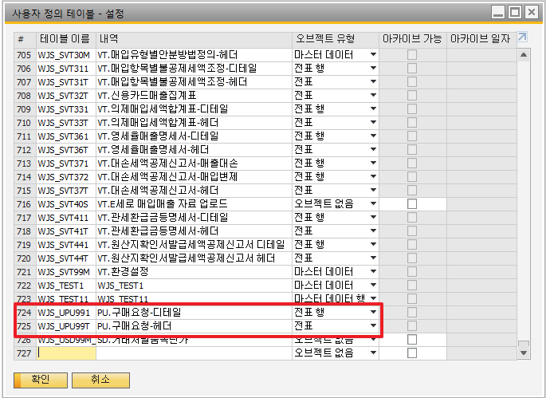
애드온 개발 – UDO 테이블 만들기 (실습)

Slide 68
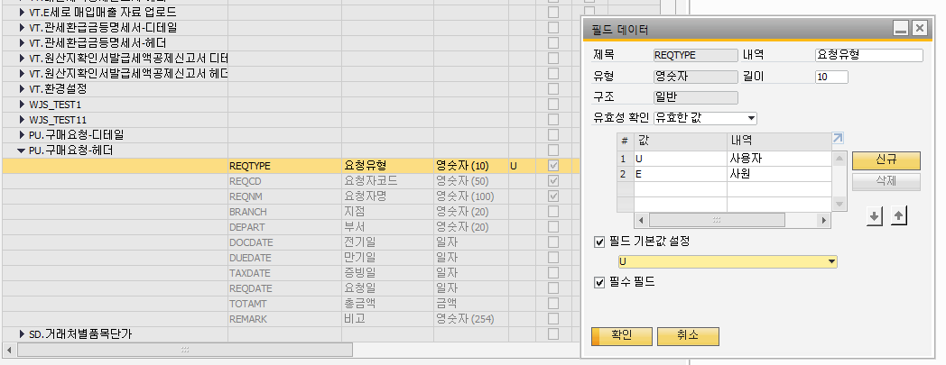
애드온 개발 – UDO 테이블 만들기 (실습)

Slide 69
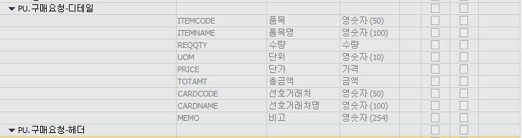
애드온 개발 – UDO 테이블 만들기 (실습)

Slide 70
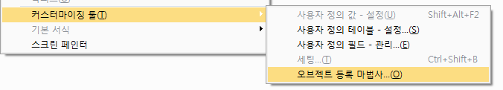
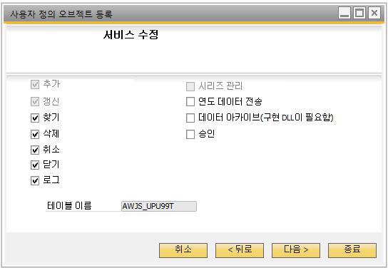
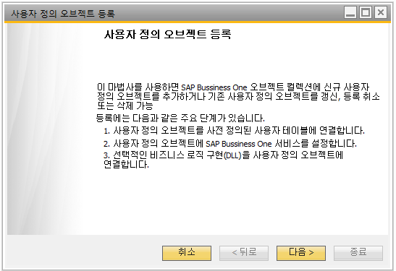
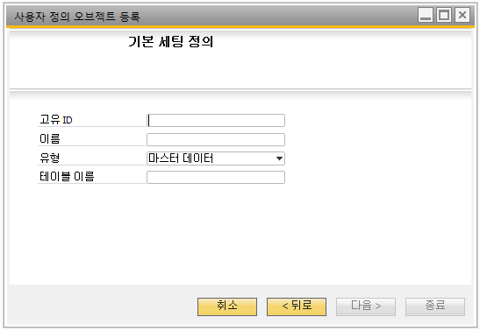

애드온 개발 – UDO 등록하기 (실습)

Slide 71
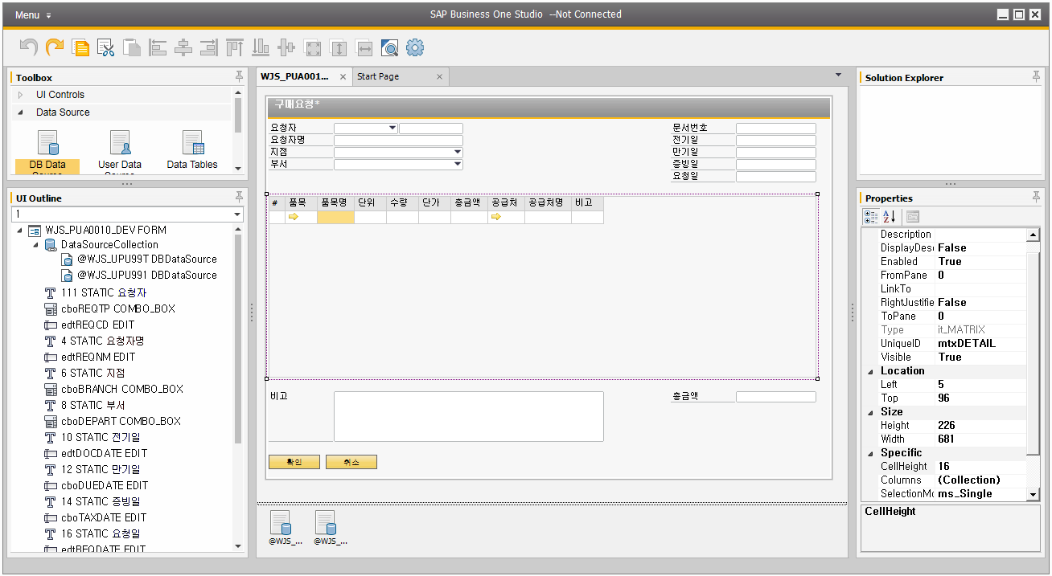
애드온 개발 – 화면 그리기 (실습)

Slide 72
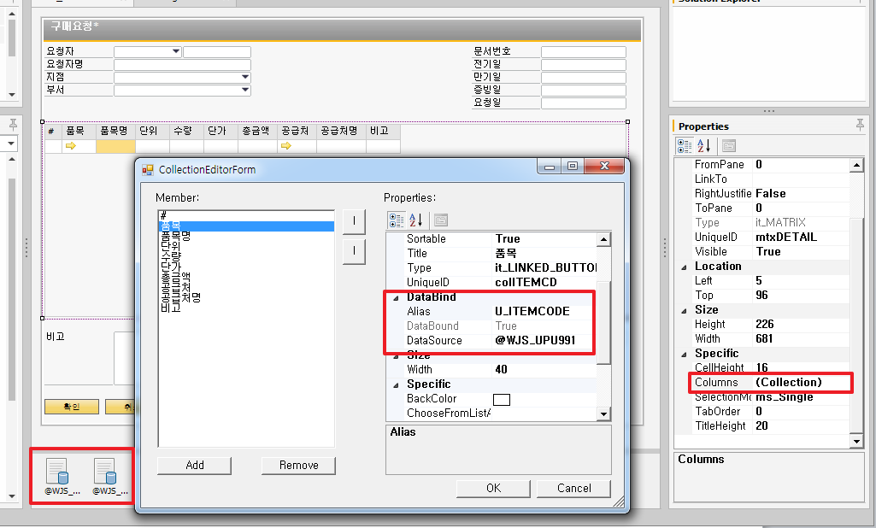
애드온 개발 – DB DataSource 바인딩 (실습)

Slide 73
애드온 개발 – UDO 폼기본값 셋팅 (실습)
Dim oMatrix As SAPbouiCOM.Matrix = oForm.Items.Item("mtxDETAIL").Specific
Dim oRS As SAPbobsCOM.Recordset = B1Connections.diCompany.GetBusinessObject(SAPbobsCOM.BoObjectTypes.BoRecordset)
Dim oComboBox As SAPbouiCOM.ComboBox = Nothing
Dim i As Integer = 0
oForm.Mode = BoFormMode.fm_ADD_MODE
oComboBox = oForm.Items.Item("cboBRANCH").Specific
oRS.DoQuery("SELECT Code, Name FROM OUBR")
For i = 1 To oRS.RecordCount
oComboBox.ValidValues.Add(oRS.Fields.Item("Code").Value, oRS.Fields.Item("Name").Value)
oRS.MoveNext()
Next
oForm.DataSources.DBDataSources.Item("@WJS_UPU99T").SetValue("U_DOCDATE", 0, Now.Date.ToString("yyyyMMdd"))
oForm.ActiveItem = "edtREQCD"
oForm.DataBrowser.BrowseBy = "edtDOCENT"
oForm.Items.Item("cboREQTP").SetAutoManagedAttribute(BoAutoManagedAttr.ama_Editable, BoAutoFormMode.afm_Add, BoModeVisualBehavior.mvb_True)
oForm.Items.Item("cboREQTP").SetAutoManagedAttribute(BoAutoManagedAttr.ama_Editable, BoAutoFormMode.afm_Ok, BoModeVisualBehavior.mvb_False)
oForm.Items.Item("cboREQTP").SetAutoManagedAttribute(BoAutoManagedAttr.ama_Editable, BoAutoFormMode.afm_Find, BoModeVisualBehavior.mvb_False)
oForm.Items.Item("cboREQTP").SetAutoManagedAttribute(BoAutoManagedAttr.ama_Editable, BoAutoFormMode.afm_View, BoModeVisualBehavior.mvb_False)
oForm.Items.Item("edtREQCD").Specific.ChooseFromListUID = "cfl_USER"
oForm.Items.Item("edtREQCD").Specific.ChooseFromListAlias = "USER_CODE"
oMatrix.AutoResizeColumns()
기본 폼모드 설정
콤보셋팅
일자 셋팅
기본 브라우저값 설정
컨트롤 자동속정관리 설정
기본 ChooseFromList 설정
매트릭스 컬럼 자동조정 하기

Slide 74
애드온 개발 – UDO 메뉴 셋팅 (실습)
Private Sub MenuSetting(ByVal oForm As SAPbouiCOM.Form)
Call oForm.EnableMenu(1292, True) '행추가
Call oForm.EnableMenu(1293, True) '행삭제
Call oForm.EnableMenu(1299, False) '행닫기
Call oForm.EnableMenu(1287, True) '복제
Call oForm.EnableMenu(1283, True) '제거
Call oForm.EnableMenu(1284, True) '취소
Call oForm.EnableMenu(1288, True) '>>
Call oForm.EnableMenu(1289, True) '<<
Call oForm.EnableMenu(1290, True) '|<
Call oForm.EnableMenu(1291, True) '>|
Call oForm.EnableMenu(1282, True) '추가
Call oForm.EnableMenu(1281, True) '찾기
Call oForm.EnableMenu(8961, True) '엑셀
Call oForm.EnableMenu(1294, False) '행복제
End Sub
SBO 툴바의 UDO관련 버튼의 활성 비활성 셋팅

Slide 75
애드온 개발 – UDO 이벤트 추가 (실습)
oCFLCreationParams = B1Connections.theAppl.CreateObject(SAPbouiCOM.BoCreatableObjectType.cot_ChooseFromListCreationParams)
oCFLCreationParams.ObjectType = BoLinkedObject.lf_Items
oCFLCreationParams.UniqueID = "colITEMCD"
oCFL = oForm.ChooseFromLists.Add(oCFLCreationParams)
oCons = oCFL.GetConditions()
oCon = oCons.Add()
oCon.Alias = "Canceled"
oCon.Operation = SAPbouiCOM.BoConditionOperation.co_EQUAL
oCon.CondVal = "N"
oCon.Relationship = BoConditionRelationship.cr_AND
oCon = oCons.Add()
oCon.Alias = "SellItem"
oCon.Operation = SAPbouiCOM.BoConditionOperation.co_EQUAL
oCon.CondVal = "Y"
oCFL.SetConditions(oCons)
oMatrix.Columns.Item("colITEMCD").ChooseFromListUID = "colITEMCD"
oMatrix.Columns.Item("colITEMCD").ChooseFromListAlias = "ItemCode"
ㆍ ChooseFromList 추가하기
- 사용자, 사원, 매트릭스 BP, 매트릭스 ITEM

Slide 76
애드온 개발 – UDO 이벤트 추가 (실습)
ㆍ 요청자 콤보값에 의해 요청자 ChooseFromList 변경하기
- 콤보값이 유저면 유저ChooseFromList POPUP
- 콤보값이 사원이면 사원ChooseFromList POPUP
If oComboBox.Selected.Value = "U" Then
oForm.Items.Item("edtREQCD").Specific.ChooseFromListUID = "cfl_USER"
oForm.Items.Item("edtREQCD").Specific.ChooseFromListAlias = "USER_CODE"
Else
oForm.Items.Item("edtREQCD").Specific.ChooseFromListUID = "cfl_EMP"
oForm.Items.Item("edtREQCD").Specific.ChooseFromListAlias = "empID"
End If
oForm.DataSources.DBDataSources.Item("@WJS_UPU99T").SetValue("U_REQCD", 0, "")
oForm.DataSources.DBDataSources.Item("@WJS_UPU99T").SetValue("U_REQNM", 0, "")
oForm.DataSources.DBDataSources.Item("@WJS_UPU99T").SetValue("U_BRANCH", 0, "")
oForm.DataSources.DBDataSources.Item("@WJS_UPU99T").SetValue("U_DEPART", 0, "")

Slide 77
애드온 개발 – UDO 이벤트 추가 (실습)
ㆍ Matrix 행추가시 로직추가
- 행을추가한후 라인을 초기화
- 미초기화시 상위행이 복제됨
- 행추가후 행번호를 재설정
Dim oMatrix As SAPbouiCOM.Matrix = Nothing
Dim oDbSrc As SAPbouiCOM.DBDataSource = Nothing
oForm.Freeze(True)
oMatrix = oForm.Items.Item("mtxDETAIL").Specific
oDbSrc = oForm.DataSources.DBDataSources.Item("@WJS_UPU991")
oMatrix.AddRow(1)
oMatrix.FlushToDataSource()
oDbSrc.SetValue("U_ITEMCODE", oMatrix.VisualRowCount - 1, "")
oDbSrc.SetValue("U_ITEMNAME", oMatrix.VisualRowCount - 1, "")
oDbSrc.SetValue("U_REQQTY", oMatrix.VisualRowCount - 1, 0)
oDbSrc.SetValue("U_UOM", oMatrix.VisualRowCount - 1, "")
oDbSrc.SetValue("U_PRICE", oMatrix.VisualRowCount - 1, 0)
oDbSrc.SetValue("U_TOTAMT", oMatrix.VisualRowCount - 1, 0)
oDbSrc.SetValue("U_CARDCODE", oMatrix.VisualRowCount - 1, "")
oDbSrc.SetValue("U_CARDNAME", oMatrix.VisualRowCount - 1, "")
oDbSrc.SetValue("U_MEMO", oMatrix.VisualRowCount - 1, "")
oMatrix.LoadFromDataSource()
Call Auto_Line(oForm)

Slide 78
애드온 개발 – UDO 이벤트 추가 (실습)
Dim oMatrix As SAPbouiCOM.Matrix = oForm.Items.Item("mtxDETAIL").Specific
oForm.Freeze(True)
oMatrix.AddRow()
Call oMatrix.DeleteRow(oMatrix.VisualRowCount)
oMatrix.FlushToDataSource()
Call Auto_Line(oForm)
oForm.Freeze(False)
ㆍ Matrix 행삭제시 로직추가
- 행삭제후 행의 번호를 재설정

Slide 79
애드온 개발 – UDO 이벤트 추가 (실습)
Private Sub Auto_Line(ByVal oForm As SAPbouiCOM.Form) Dim oMatrix As SAPbouiCOM.Matrix Dim i As Integer Try
oMatrix = oForm.Items.Item("mtxDETAIL").Specific
oMatrix.FlushToDataSource()
For i = 1 To oMatrix.VisualRowCount
oMatrix.GetLineData(i)
oForm.DataSources.DBDataSources.Item("@WJS_UPU991").SetValue("LineId", i - 1, i)
oMatrix.SetLineData(i)
Next
oMatrix.LoadFromDataSource()
Catch ex As Exception
B1Connections.theAppl.StatusBar.SetText("Auto_LineNo " & Err.Description, SAPbouiCOM.BoMessageTime.bmt_Short, SAPbouiCOM.BoStatusBarMessageType.smt_Error)
Finally
oMatrix = Nothing
End Try
End Sub
ㆍ Matrix 행번호 설정하기
-Matrix 루프돌며 번호셋팅

Slide 80
애드온 개발 – UDO 이벤트 추가 (실습)
ㆍ Matrix 행의 수량, 단가 변동시 총액 계산로직 추가
If pVal.ItemChanged = True Then
Select Case pVal.ColUID
Case "colQTY", "colPRICE"
Dim v_TOTAMT_d As Double = 0
oForm.DataSources.DBDataSources.Item("@WJS_UPU991").Offset = pVal.Row - 1
oMatrix.GetLineData(pVal.Row)
oMatrix.SetLineData(pVal.Row)
v_TOTAMT_d = oForm.DataSources.DBDataSources.Item("@WJS_UPU991").GetValue("U_REQQTY", pVal.Row - 1) * oForm.DataSources.DBDataSources.Item("@WJS_UPU991").GetValue("U_PRICE", pVal.Row - 1)
Call oForm.DataSources.DBDataSources.Item("@WJS_UPU991").SetValue("U_TOTAMT", pVal.Row - 1, v_TOTAMT_d)
oMatrix.SetLineData(pVal.Row)
Dim TOTAMT As Double = 0
Dim i As Integer = 0
For i = 0 To oMatrix.VisualRowCount - 1
TOTAMT = TOTAMT + oForm.DataSources.DBDataSources.Item("@WJS_UPU991").GetValue("U_TOTAMT", i)
Next
oForm.DataSources.DBDataSources.Item("@WJS_UPU99T").SetValue("U_TOTAMT", 0, TOTAMT)
End Select
End If

Slide 81
애드온 개발 – UDO Form Data 이벤트 소개
ㆍ et_FORM_DATA_ADD
- UDO폼 또는 UDO스타일 코어폼이 추가 되는순간
- 추가모드에서 추가버튼 클릭시
ㆍ et_FORM_DATA_DELETE
- UDO폼 또는 UDO스타일 코어폼이 삭제 되는순간
- 확인모드에서 수정후 갱신버튼을 클릭시
ㆍ et_FORM_DATA_UPDATE
- UDO폼 또는 UDO스타일 코어폼이 갱신 되는순간
- 마우스 우클릭후 제거메뉴 클릭시
ㆍ et_FORM_DATA_LOAD
- UDO폼 또는 UDO스타일 코어폼이 로드 되는순간
- 찾기모드에서 문서번호등을 입력후 찾기버튼을 누를시
- 네이게이션 버튼으로 문서를 조회할시

Slide 82
애드온 개발 – UDO 이벤트 소개
ㆍ 제거시 제거의사 반영로직 추가하기
ㆍ Before Action EVENT 사용
<B1Listener(BoEventTypes.et_MENU_CLICK, True, ActionType.Mnu, "1283")> _
Public Overridable Function ET_BFDataMenu_Remove(ByVal pVal As MenuEvent) As Boolean
oForm = B1Connections.theAppl.Forms.ActiveForm
'ADD YOUR ACTION CODE HERE ...
If B1Connections.theAppl.MessageBox("제거하시겠습니까?", 1, "예", "아니오") <> 1 Then
Return False
End If
Return True
End Function

Slide 83
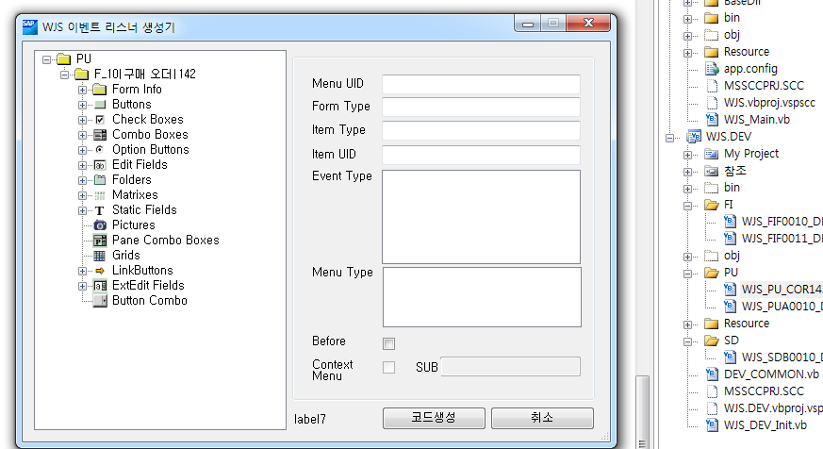
애드온 개발 – 코어화면 수정하기
ㆍ 구매오더를 띄운 상태에서 애드온 컴포넌트 호출

Slide 84
애드온 개발 – 코어화면 수정하기
ㆍ폼로드 이벤트에 컨트롤 추가 로직 추가하기
Dim oItem As SAPbouiCOM.Item
'Dim oButton As SAPbouiCOM.Button
Dim oBtnCombo As SAPbouiCOM.ButtonCombo = Nothing
oItem = oForm.Items.Add("edtTEST1", BoFormItemTypes.it_EDIT)
oItem.Height = oForm.Items.Item("222").Height
oItem.Top = oForm.Items.Item("222").Top + oForm.Items.Item("222").Height + 1
oItem.Left = oForm.Items.Item("222").Left
oItem.Width = oForm.Items.Item("222").Width
oItem.RightJustified = True
oForm.Items.Item("edtTEST1").Specific.DataBind.SetBound(True, "OPOR", "U_TEST")
oItem = oForm.Items.Add("sttTEST1", BoFormItemTypes.it_STATIC)
oItem.Specific.caption = "TEST"
oItem.Height = oForm.Items.Item("230").Height
oItem.Top = oForm.Items.Item("edtTEST1").Top
oItem.Left = oForm.Items.Item("230").Left
oItem.Width = oForm.Items.Item("230").Width
oItem.LinkTo = "edtTEST1"

Slide 85
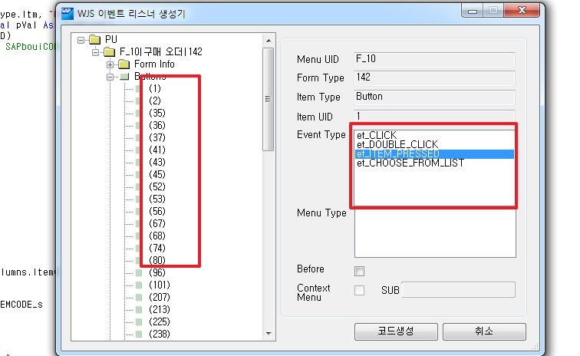
애드온 개발 – 코어화면 수정하기
ㆍ새로 추가한 컨트롤 이벤트 추가하기
<B1Listener(BoEventTypes.et_ITEM_PRESSED, False, ActionType.Itm, "btnPRINT")> _
Public Overridable Sub ET_btnPRINT_AFItemPressed(ByVal pVal As ItemEvent)
oForm = B1Connections.theAppl.Forms.Item(pVal.FormUID)
'oButton = CType(CType(oForm.Items.Item("btnPRINT"), SAPbouiCOM.Item).Specific, Button)
'ADD YOUR ACTION CODE HERE ...

Slide 86
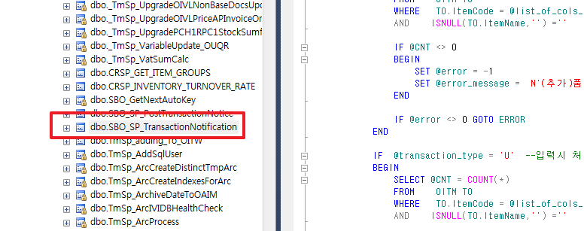
애드온 개발 – SBO 노티피케이션 소개
ㆍ SBO 객체형 데이터 트랜잭션 컨트룰 SP
(예제) BP마스터 등록시 외국어 이름이 공란인경우 오류발생
품목마스터 등록시 품목명 공란인경우 오류발생 등
FormData 이벤트 보다 나중에 체크됨(최종체크수단)

Slide 87
애드온 개발 – 노티 변수 소개
@object_type nvarchar(25) : 객체 번호 예)BP: 2 ITEM:4
@transaction_type nchar(1) : [A]dd, [U]pdate, [D]elete, [C]ancel, C[L]ose
@num_of_cols_in_key int : 키컬럼의 갯수
@list_of_key_cols_tab_del nvarchar(255) : 키컬럼명
@list_of_cols_val_tab_del nvarchar(255) : 키값
@error INT : 에러번호
@error_messageNVARCHAR (200) : 에러메세지

Slide 88
애드온 개발 – 노티 추가해보기 (실습)
ㆍ @object_type = 4 : --품목마스터
ㆍ @transaction_type = 'A' --입력시 처리
ㆍ 품목마스터가 등록시 품목명값이 없으면 오류메세지후 롤백
IF @object_type = '4'
BEGIN
DECLARE @CNT AS INT
SET @CNT = 0
IF @transaction_type = 'A' --입력시 처리
BEGIN
SELECT @CNT = COUNT(*)
FROM OITM T0
WHERE T0.ItemCode = @list_of_cols_val_tab_del
AND ISNULL(T0.ItemName,'') =''
IF @CNT <> 0
BEGIN
SET @error = -1
SET @error_message = N'(추가)품목명을 넣어주십시요.'
END
IF @error <> 0 GOTO ERROR
END
END

Slide 89
고생하셨습니다.

