Slide 1

WoongJin INTERNSHIP PRESENTATION
SMB 사업본부
B1D 이강호

Slide 2
INDEX
PILOT PROJECT
INTERNSHIP
PROGRAMMER ATTITUDE
GROWTH STRATEGY
ROAD MAP

Slide 3
PILOT PROJECT
Process
Point
Employee Cost Handling
Payment Request
Apply / Reject
Journal Entry
UDO CRUD
UI, DI API
MATRIX GRID
EVENT
SQL
SDK

Slide 4
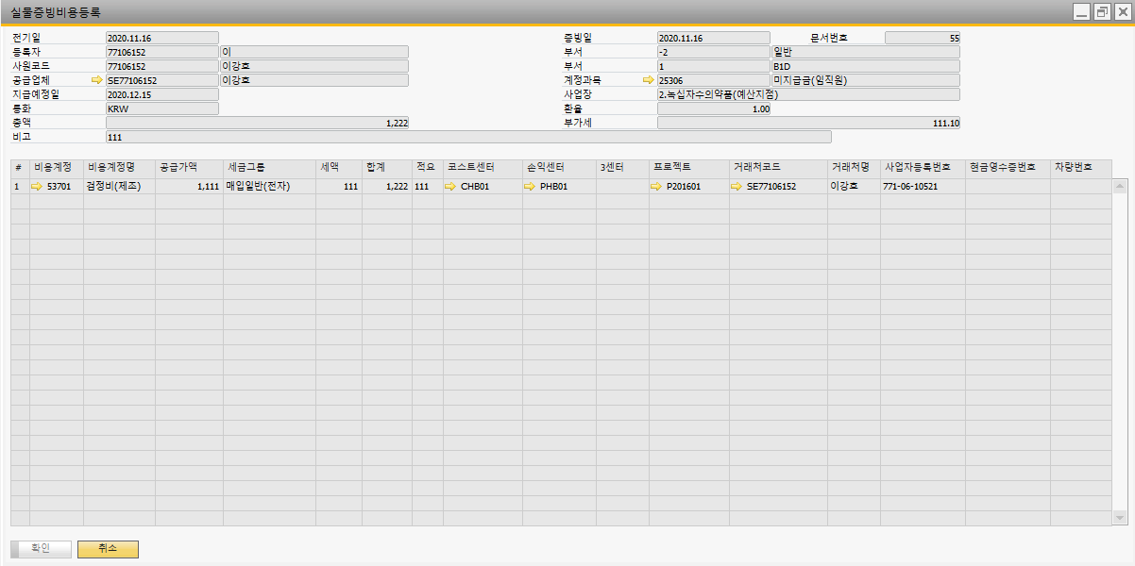
PILOT PROJECT
ComboboxColumn Control
Matrix Item Event
UDO Control – UDO FORM

Slide 5
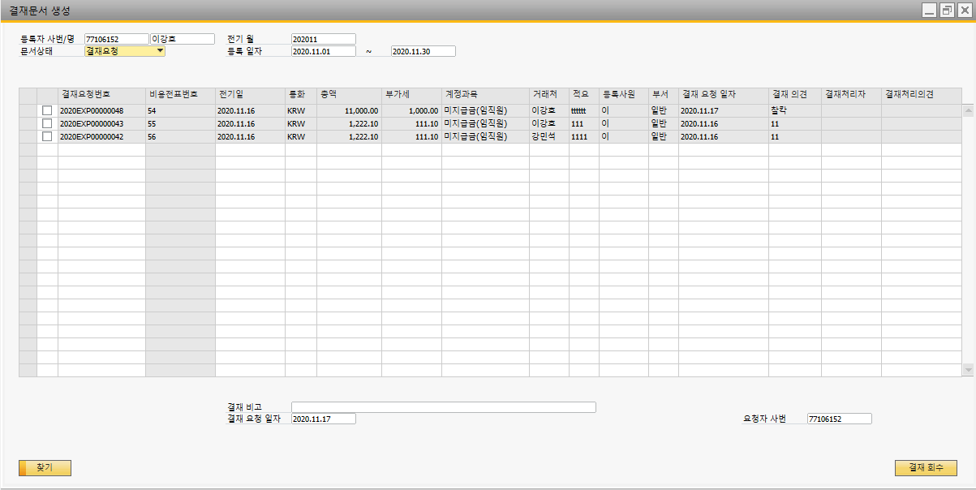
PILOT PROJECT
MSSQL Sequence
GRID Item Event
UDO Update – DI API

Slide 6
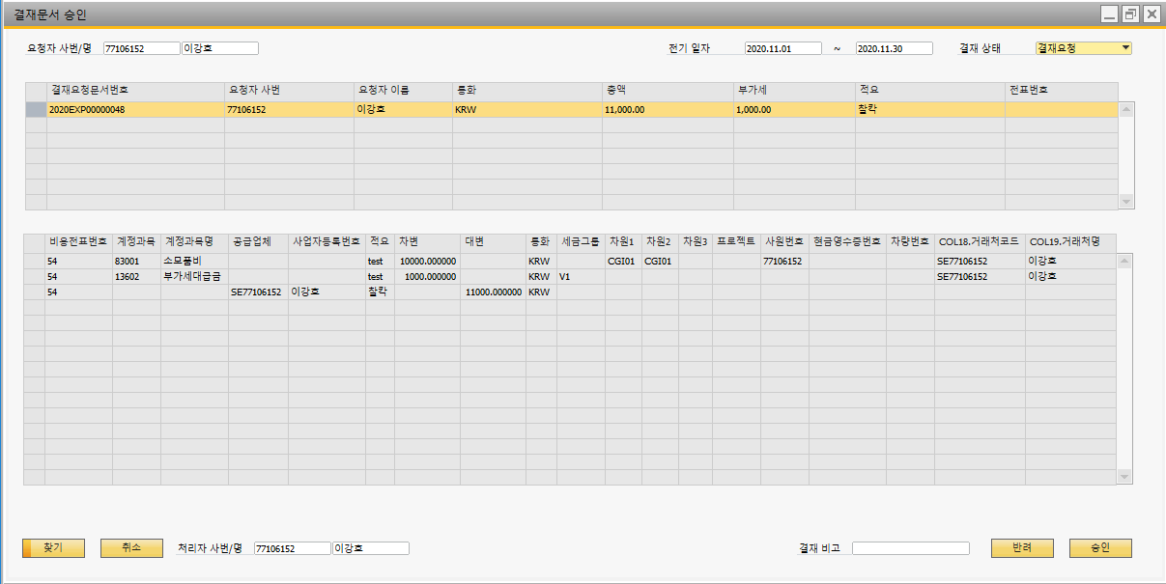
PILOT PROJECT
@Table in SP
GRID Selected Row

Slide 7



PILOT PROJECT
After Project
Test Case
Debug
Logic

Slide 8



INTERNSHIP - 3 Month
After Internship
People Synergy
Code Review

Slide 9




PROGRAMMER ATTITUDE
Programmer’s Virtue
Tenacity
Communication
Self-Improvement

Slide 10




GROWTH STRATEGY
TO BE
B1D
“
B1D
”
10.0
Add on
Project
Framework
Mobile

Slide 11
ROAD MAP - 3 YEARS
2021
2022
2023
Train SBO SDK | Global Project | High Level Global SBO Programmer Contribute to make Platinum Partnership with SAP
Local Project
 | Improve own skill
Framework Develop
 | Be a Clean Coder, Make a Good Reference
Find my own skill

Slide 12

Q & A

Slide 13
Thank you
Speaker 이강호

