Slide 1
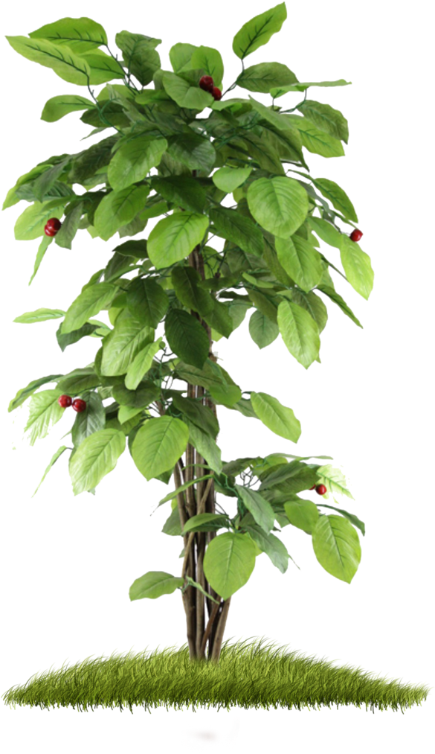
Discovering Plants
An Interactive Multimedia Journey Through South African Life Sciences

Slide 2
Welcome to this interactive learning module!
Plants are essential for life on Earth. In this module, you will explore South Africa's rich plant diversity, discover how plants adapt to different environments, learn about indigenous medicinal plants, and examine the important relationship between Indigenous Knowledge and scientific knowledge.
Learning Objectives
🌱 Explain why plants are important to ecosystems and human life.
🌍 Identify major South African biomes and their plant diversity.
🍃 Describe how plants adapt to different environments.
🌿 Recognize the role of indigenous medicinal plants in traditional and modern society.
🔬 Compare Indigenous Knowledge with scientific knowledge in understanding plants.
🌳 Explain the importance of conserving South Africa's plant biodiversity.
📝 Complete a knowledge check to assess your understanding.

Slide 3
Main Menu
🌿 Biodiversity
🌱 Plant Adaptations
🌼 Indigenous Medicinal Plants
🍃 Plants and Nutrition
🌍 Conservation
🧠 Quiz Challenge
Choose a topic!

Slide 4
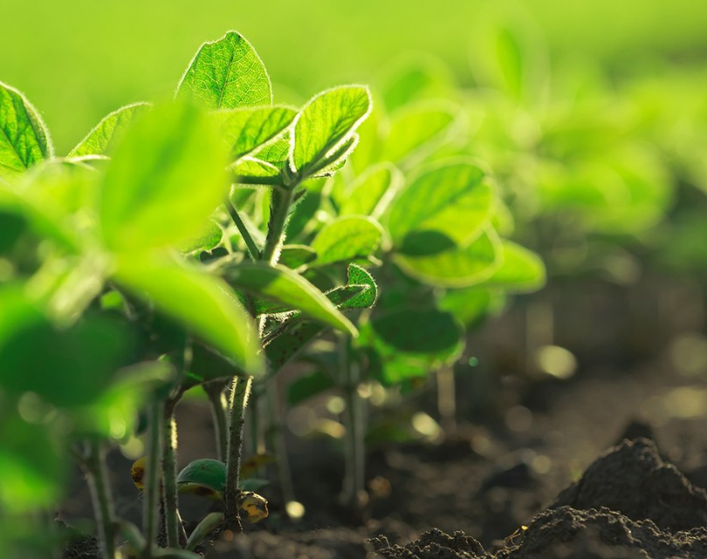
Why Plants Matter?
Plants are essential for life on Earth. They produce oxygen, provide food, regulate ecosystems, and support biodiversity. Many communities also rely on plants for medicine, cultural practices, and livelihoods. In this module, you will explore how scientific knowledge and Indigenous Knowledge help us understand the importance of plants.
🌿 Did You Know?
About 80% of the world's population uses traditional plant-based medicines as part of primary healthcare.
https://www.jove.com/schools/v/19130/importance-of-plants

Slide 5
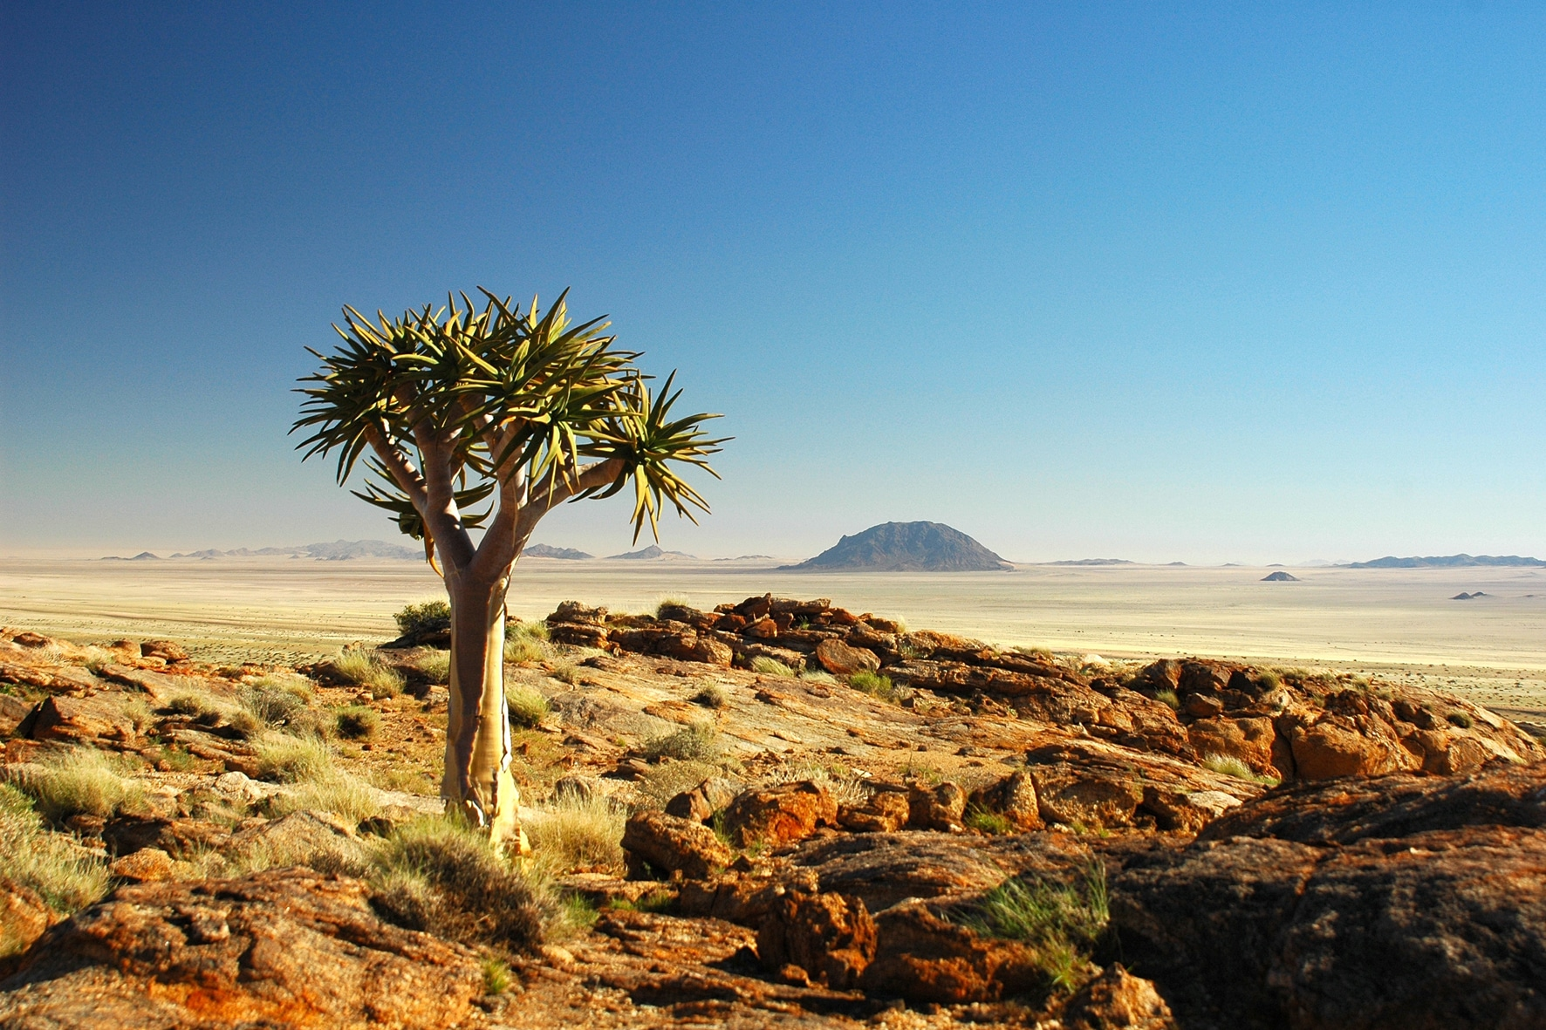
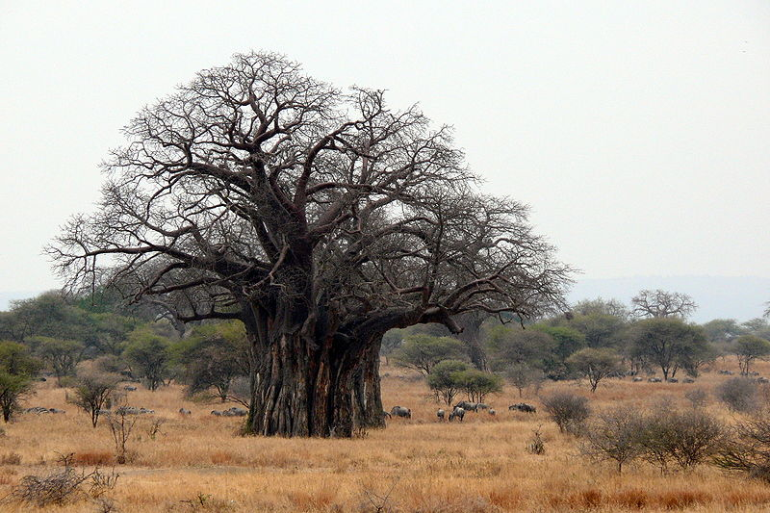
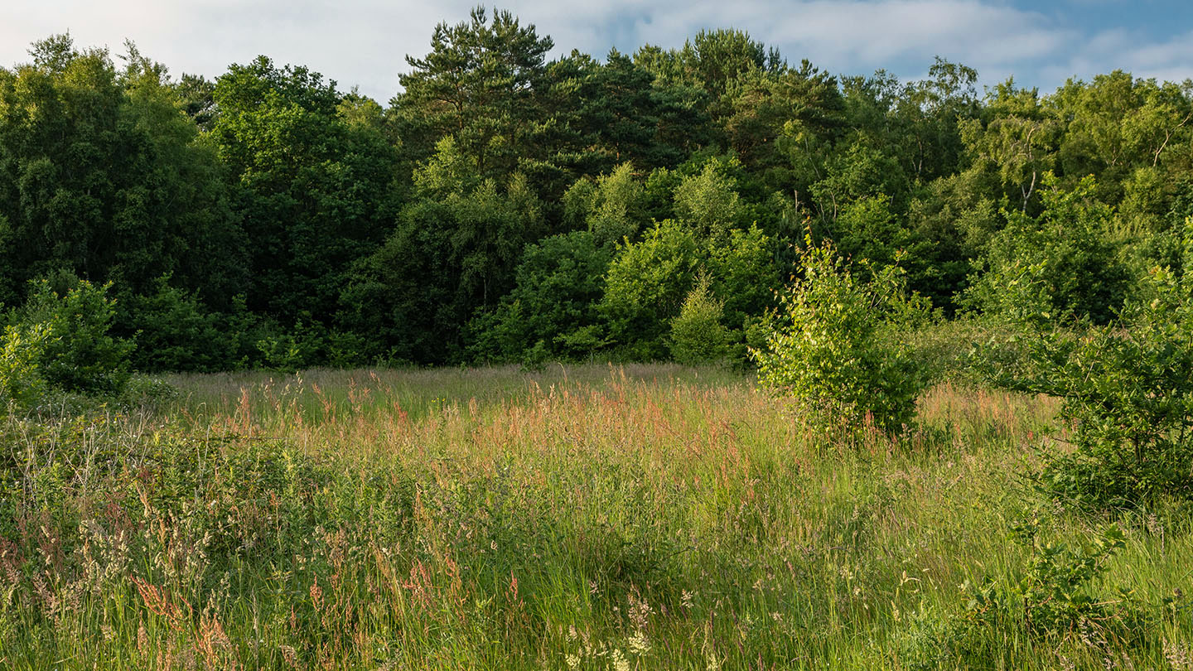
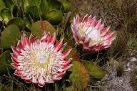
Biodiversity
South Africa: A Biodiversity Hotspot
South Africa is one of the world's richest countries for plant diversity,
with thousands of plant species found nowhere else on Earth.
Click a biome to learn more.
🌾 Grassland
🌳 Forest
🌵 Succulent Karoo
🌿 Fynbos

Slide 6
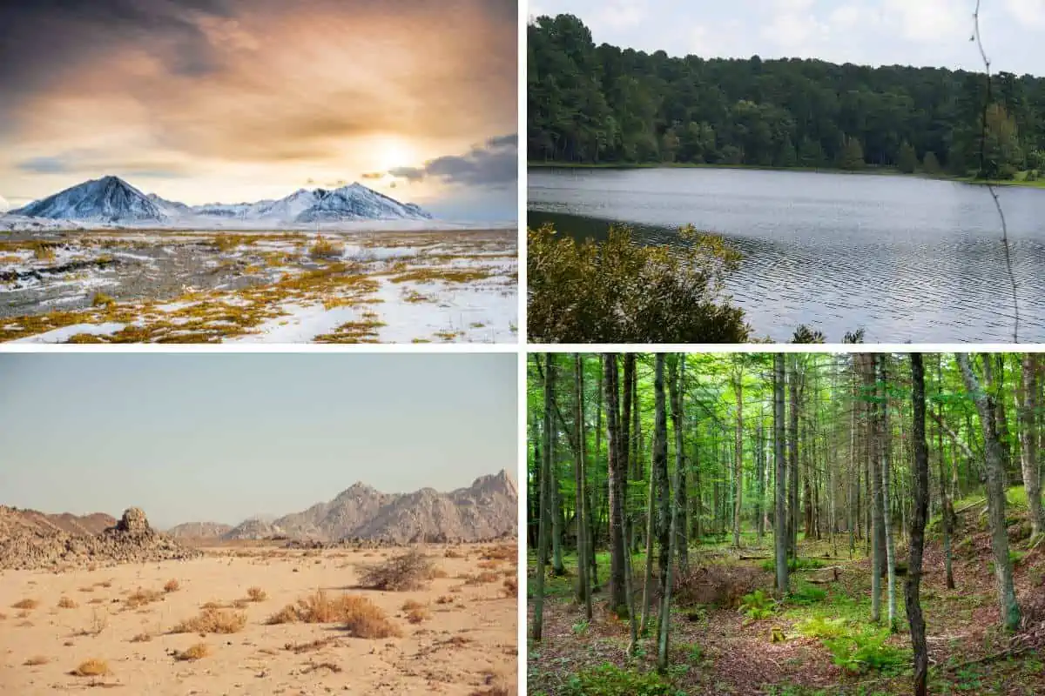
Plant Adaptations
Plants have special features called adaptations that help them survive in different environments.
🌵 Desert
Thick stems store water.
Small leaves reduce water loss.
🌳 Forest
Broad leaves capture sunlight.
Tall stems compete for light.
🌾 Grassland
Deep roots survive fires.
Flexible stems withstand wind.
💧 Wetlands
Air spaces in roots help plants survive flooded soils.
How Do Plants Survive?

Slide 7
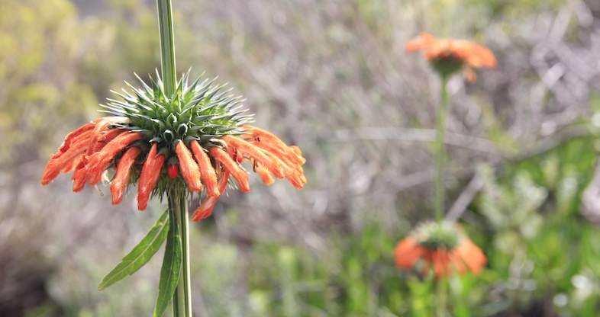
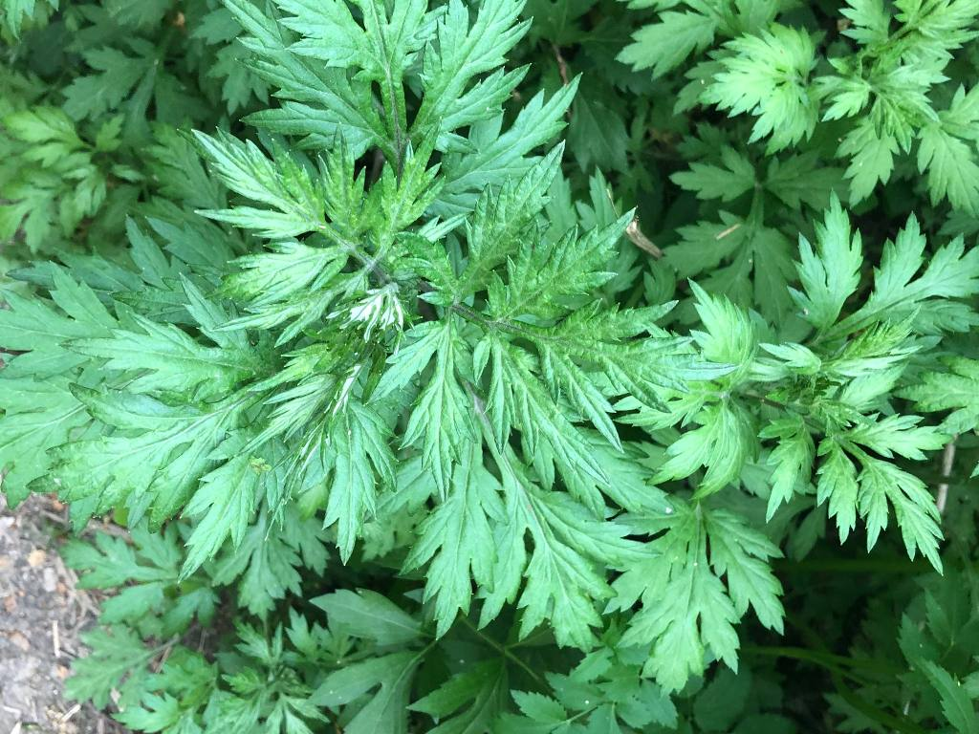
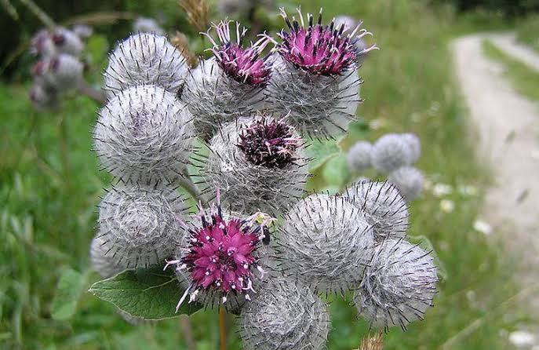
Indigenous Medicinal Plants

Slide 8
Indigenous Medicinal Plants
🌿 Aloe ferox
Traditional use:
Treats burns and skin conditions.
Scientific note:
Contains compounds with anti-inflammatory properties.
🌿 African Potato
Traditional use:
Supports immune health.
Scientific note:
Contains phytochemicals currently being researched.
🌿 Wild Garlic
Traditional use:
Used for coughs and colds.
Scientific note:
Contains sulfur compounds like garlic.

Slide 9
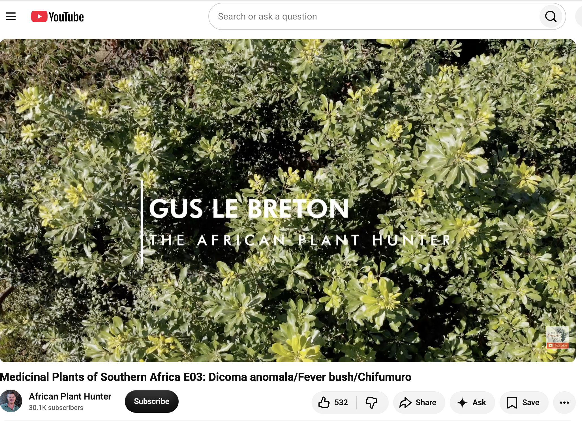
Indigenous Knowledge Spotlight
Click the imahge to watch the video!
Reflection question
Why is it important to preserve Indigenous Knowledge?

Slide 10
Scientific Connections
Both systems help us understand and care for the environment
1. Indigenous Knowledge
Passed from generation to generation.
Based on observation and experience.
Often shared through storytelling and practice.
2. Scientific Knowledge
Based on observation, investigation, and experimentation.
Tested using evidence.
Shared through research and publications.

Slide 11
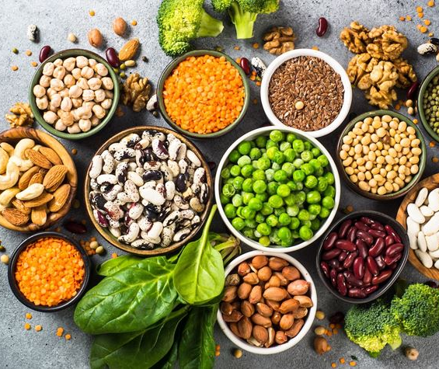
Plants and Nutrition
Plants Keep Us Healthy
  Plants provide nutrients our bodies need to grow and function.
🥬 Leafy vegetables
  Rich in iron and vitamins.
🍊 Fruits
  Provide vitamins, fibre, and antioxidants.
🌽 Grains
  Supply carbohydrates for energy.
🫘 Legumes
  Excellent source of plant protein.
Healthy eating includes a variety of plant foods every day.

Slide 12
Conservation: Why Should We Protect Plants?
2. How can we help?
✅ Protect natural habitats
✅ Plant indigenous species
✅ Harvest sustainably
✅ Reduce pollution
❌ Habitat destruction
❌ Climate change
❌ Pollution
❌ Overharvesting

Slide 13
Quiz Yourself
Question 1
Plants make their own food through:
A. Respiration
B. Photosynthesis
C. Digestion
D. Fermentation
Question 3
Which plant is commonly used to treat burns?
A. Aloe ferox
B. Pine
C. Oak
D. Maize
Question 5
Which statement about Indigenous Knowledge is TRUE?
A. It is only written in books.
B. It is developed through generations of observation and experience.
C. It replaces scientific knowledge.
D. It is not used in South Africa.
Question 2
Which biome is famous for proteas?
A. Desert
B. Fynbos
C. Wetlands
D. Forest
Question 4
Which plant part carries out photosynthesis?
A. Root
B. Stem
C. Leaf
D. Flower

Slide 14
Plants Fun Facts
Amazing Plant Facts
🍃 South Africa has one of the richest floral kingdoms in the world.
🍃 The baobab tree can store thousands of liters of water.
🍃 Some seeds remain dormant for years before germinating.
🍃 Plants communicate using chemical signals.

Slide 15
Congratulations!
🌿 You have completed the Plant Discovery Journey. What you learned:
✅ Importance of plants
✅ South African biodiversity
✅ Plant adaptations
✅ Indigenous medicinal plants
✅ Conservation
✅ Plant nutrition
Thank you for exploring!

Slide 16

Resources
South African Plant Resources
PlantZAfrica (SANBI)
SANBI Biodiversity Information System
South African National Plant Checklist
Biology & Multimedia Resources
HHMI BioInteractive
PhET Interactive Simulations
Khan Academy Biology
Amoeba Sisters
Bozeman Science
Images & Media
Unsplash – https://unsplash.com
Pixabay – https://pixabay.com
Pexels – https://www.pexels.com
Wikimedia Commons – https://commons.wikimedia.org
Conservation & Biodiversity
IUCN Red List – https://www.iucnredlist.org
GBIF – https://www.gbif.org
iNaturalist – https://www.inaturalist.org
National Geographic Education – https://education.nationalgeographic.org

