Slide 1

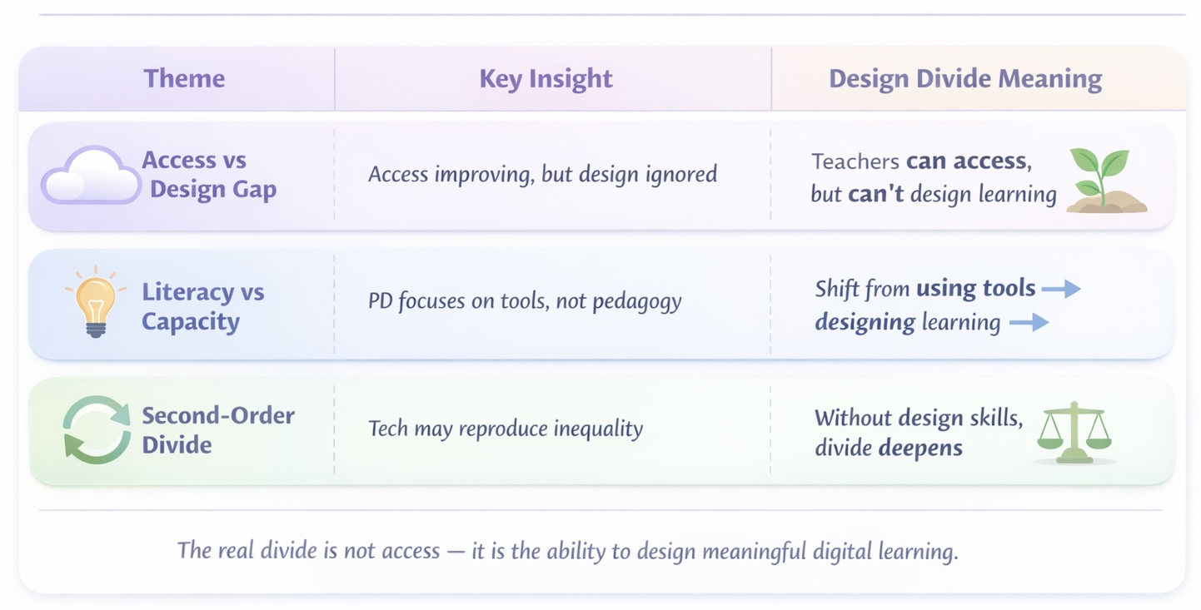
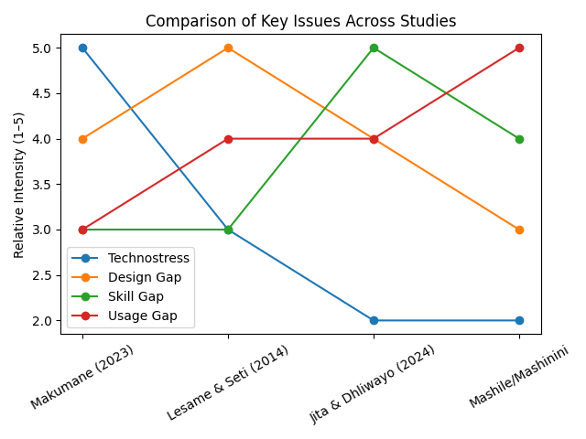
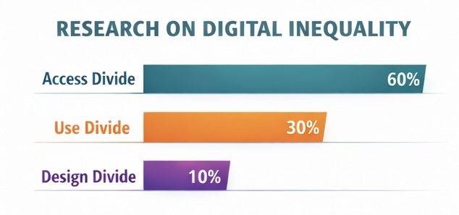

What is the Digital Design Divide? Investigating Implications for Teacher Professional Development in South Africa
Thembisile Buthelezi, Educational Technology
Abstract
Literature Review
Findings
Recommendations
Despite progress in improving digital access in South Africa, an important dimension of inequality remains underexplored, the Digital Design Divide, which refers to teachers’ ability to design meaningful technology-enhanced learning. Existing research is heavily concentrated on the Digital Access and Use Divides, with a strong focus on what learners can and cannot access. As a result, limited attention has been given to teachers’ pedagogical design capacity and their role in shaping meaningful technology integration. This review highlights this gap and argues for a stronger focus on teacher professional development to support the design of equitable, engaging, and cognitively rich learning experiences.
Ahiaku et al. (2025): Explores "digital disconnection" in rural schools, where geographical isolation and infrastructure deficits force educators back to traditional teaching methods despite physical access to hardware.
Ajani and Govender (2025): Argues that digital tools must be firmly embedded in pedagogical practice rather than treated as an "occasional extra," emphasizing curriculum innovation for pre-service teachers using the TPACK framework.
Chisango and Marongwe (2021): Reveals a deepening digital divide in disadvantaged schools driven by theft, vandalism, and psychological barriers like technophobia among experienced educators who prefer traditional chalkboards.
Mashile (2016): Highlights that even in well-resourced private schools, training remains the greatest barrier, as most educators are self-taught and lack the advanced skills required for "higher-order" digital lesson planning.
Muyambi and Ramorola (2025): Identifies a significant gap in digital subject-specific knowledge among educators, underscoring that successful technology integration is directly dependent on targeted professional development and policy awareness.
Jita and Dhliwayo (2024): Demonstrates that combining Communities of Practice (CoP) with Design-Based Research (DBR) creates a "safe space" for teacher educators to build confidence and model interactive tablet use in the classroom.
Promote UDL: Use Universal Design for Learning to balance educational equity with technological progress (NEPT, 2024; Chase, 2024)
Mastery-Oriented PD: Offer continuous, multi-pathway training linked to student outcomes rather than "one-size-fits-all" sessions (Carlson & Isaacs, 2018)
Leverage Leadership: School leaders should model innovative technology use in daily practice to foster a reflective culture (Novak, K. 2024)
"Flip" Meetings: Use video/email for announcements to free up staff meeting time for hands-on professional development
Introduction
Directions for Future Research
Digital inequality in South Africa is deeply rooted in historical and socio-economic disparities shaped by apartheid-era inequalities.
Despite ongoing efforts to integrate digital technologies into schools, significant gaps remain between well-resourced and under-resourced contexts.
As digital technologies become increasingly central to teaching and learning, addressing these inequalities requires moving beyond access to consider how technology is meaningfully used and integrated within classrooms.
Investigate the barriers and enablers for digital design skills specifically in rural vs. urban South African contexts (Buthelezi et al., 2025)
Evaluate the long-term impact of context-sensitive PD on inclusive lesson design (Voogt et al., 2015; Molokomme, 2025; Ajani & Luthuli, 2025)
Study how school leadership influences the adoption of innovative digital pedagogies in underserved schools (Chardin & Novak, 2020; Thibodeau, 2024)
Implications
Purpose & Research Question
For Teachers: Limited design skill results in digital substitution rather than transformational learning experiences (Aruleba & Jere, 2022)
For Students: Strengthening teacher capacity is essential to prepare students for digital participation in the workforce and higher education (Chomunorwa et al., 2023)
For Policy Makers: National strategies must prioritize teacher capacity to design technology-enhanced lessons rather than just infrastructure (Giebel, 2013)
Purpose
To examine systemic barriers in South African education and propose a shift from "access-only" policies to teacher-as-designer models
Research Question
How can targeted professional development and institutional support help educators design inclusive and equitable technology-enhanced learning?
References

