Slide 1
OpenDaylight: Service Function Chaining

Slide 2
Topics
What is Service Chaining?
Service Chaining “Components”
ODL and Service Chaining
Complementary Projects

Slide 3
Network Service Insertion Today
Network services are ubiquitous
Firewall and load balancer are in almost every data center
Current state of the art is topology dependent
Very complex: VLAN-stitching, Policy Based Routing (PBR), etc.
Static: no dynamic, horizontal or vertical scaling, requires network changes
Service chaining is accomplished via hop-by-hop switching/routing changes
No way to share valuable information between the network and services, or between service functions

Slide 4
Service Chaining
Service chaining is the broad term that describes delivering multiple service functions in a specific order
Decouples network topology and service functions
Supports dynamic insertion of service functions
Common model for all types of services
Enables the sharing of information between service functions
Composed of data plane and control/policy planes
Overlay data plane Control and policy planes
IETF WG: Service Function Chaining (SFC)
https://datatracker.ietf.org/wg/sfc/

Slide 5
Service Chaining: Service Graphs
Sub-graphs define service chains from the overall service graph
Service functions can be in more than one chain
A service path is the specific instantiation of a service chain
Chain¹: S¹→S²→S⁶→S⁸
Path^{n}: instance(S¹) → instance(S²) → instance(S⁶) → instance (S⁸)

Slide 6
Service Chaining Components
Classifier: determines what traffic needs to be chained based on policy.
Service Chain: the intended set of service that must be traversed.
Service Path: the actual instances of services traversed.
Service Overlay: topology created to realize a service path.
Metadata: information passed between participating nodes.

Slide 7
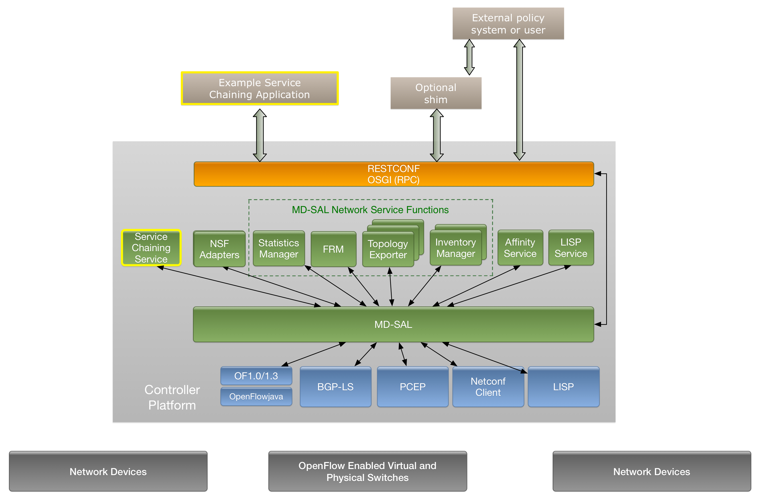
ODL and Service Chaining

Slide 8
Service Chaining Service
Receives information about chain and/or path to be constructed via northbound API
Information about available service nodes are contained in the node datastore
Constructs service path:
Simple: just a list
Complex: constrained list (e.g. bandwidth, capabilities, etc.)

Slide 9
Example SC Application
Presents list of available services (types and other instances) to the end user
Southbound RESTCONF to ODL
List of service type → chain
List of service function → path
Can evolve to pass constraints as well (not in current scope)

Slide 10
Plugins
Support several south-bound protocols
NC/YANG
LISP
Openflow
Register service function and present them to the node datastore
Pass metadata to participating nodes
Create the needed topology
Evolve from simple static end-points to dynamic mapping (see LISP service)

Slide 11
Complementary Projects
LISP Service
LISP can provide the needed overlay to create a service path
Use LISP API to “map” service locators
Group Based Policy
Service chains are instantiations of policy
Service chains are part of a contract
Policy metadata passed along service chain

