Slide 1
Healthawadika
By Roshambo Technology
- Anna Baker, Cameron Lloyd, Lihe Zhang, Xuanlin Yang

Slide 2
Agenda
The idea
Tech specs
Demo
Next step
Q & A
Notes:
we envision it as a palace….
in order to help user better focus on the function, on the interaction with others, on the debate, on the clash of great ideas
looked up a lot of pictures of early stage websites..

Slide 3
The Idea
A place for discussing health-related issues with an old fashioned web style design
Extra features - Toolkit (BMI Calculator) - Auto-locate and search for nearby doctors - Hot Deals
Notes:
we envision it as a palace….
in order to help user better focus on the function, on the interaction with others, on the debate, on the clash of great ideas
looked up a lot of pictures of early stage websites..

Slide 4
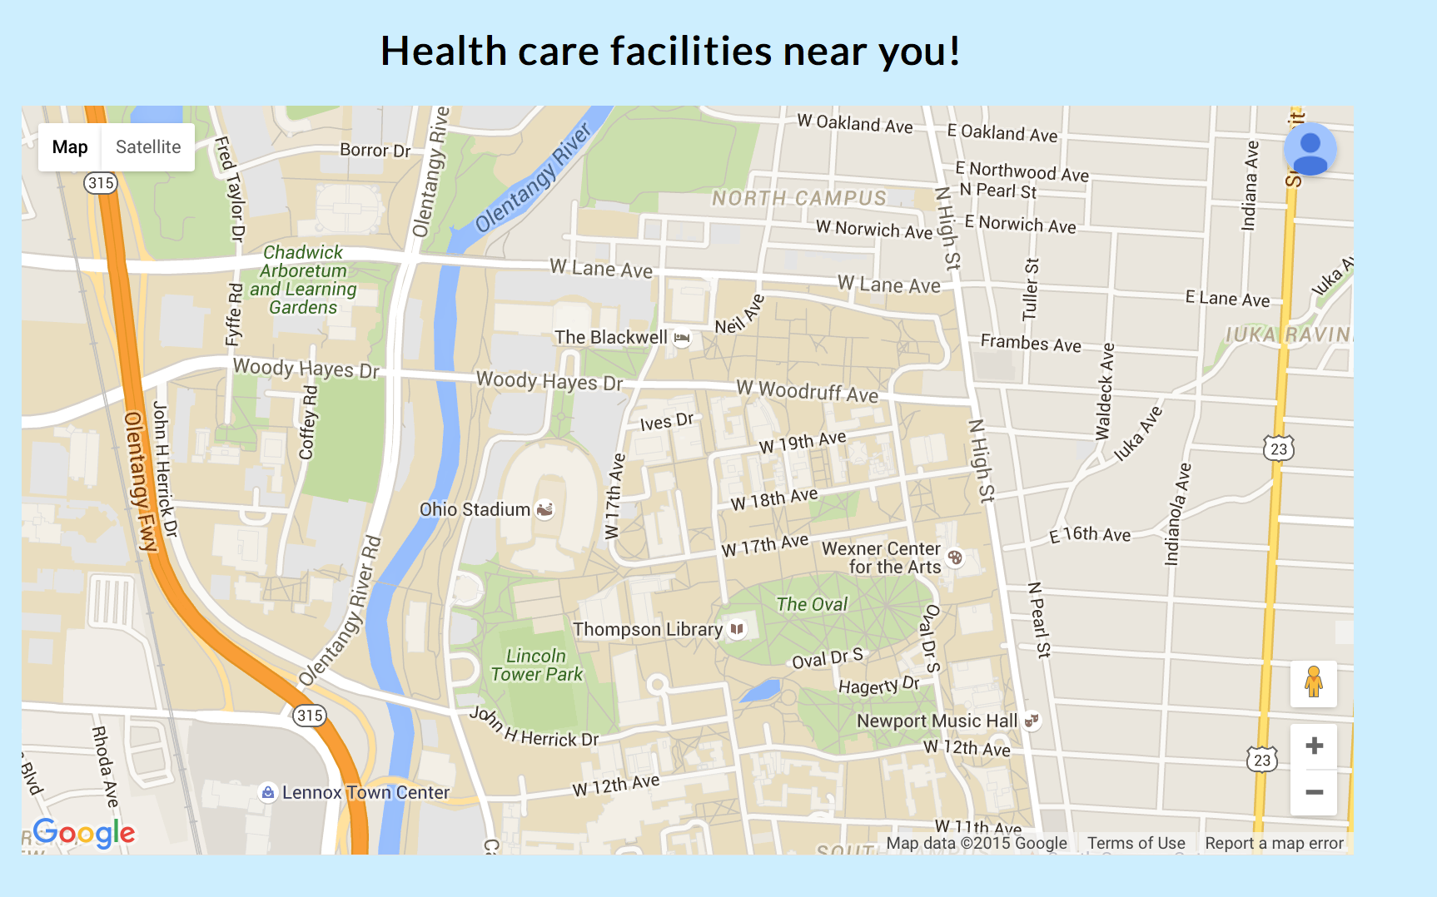
Provider Locator
Will auto-locate you to find the nearest providers:

Slide 5
Hot Deals
To demonstrate knowledge of rails db
Redirect to an external marketplace, where patients can filter health-related products or procedures based on the area of the body, illness, injury, etc.
Allows users who are paying out-of-pocket to shop around

Slide 6
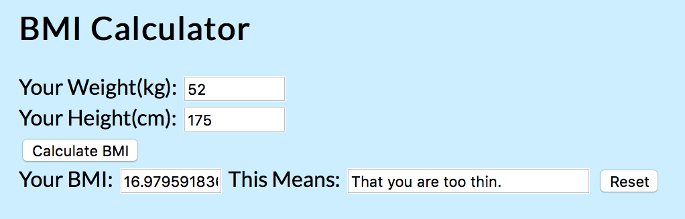
Toolkit (BMI Calculator)
To integrate previous knowledge learned in the course

Slide 7
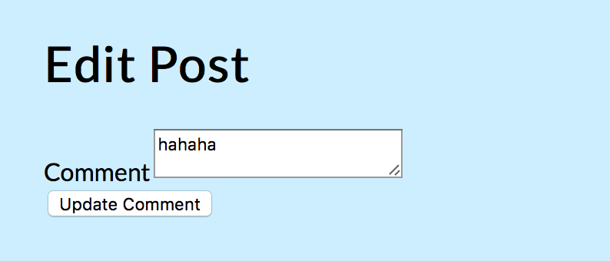
Q & A Forum
Ask health-related questions:

Slide 8
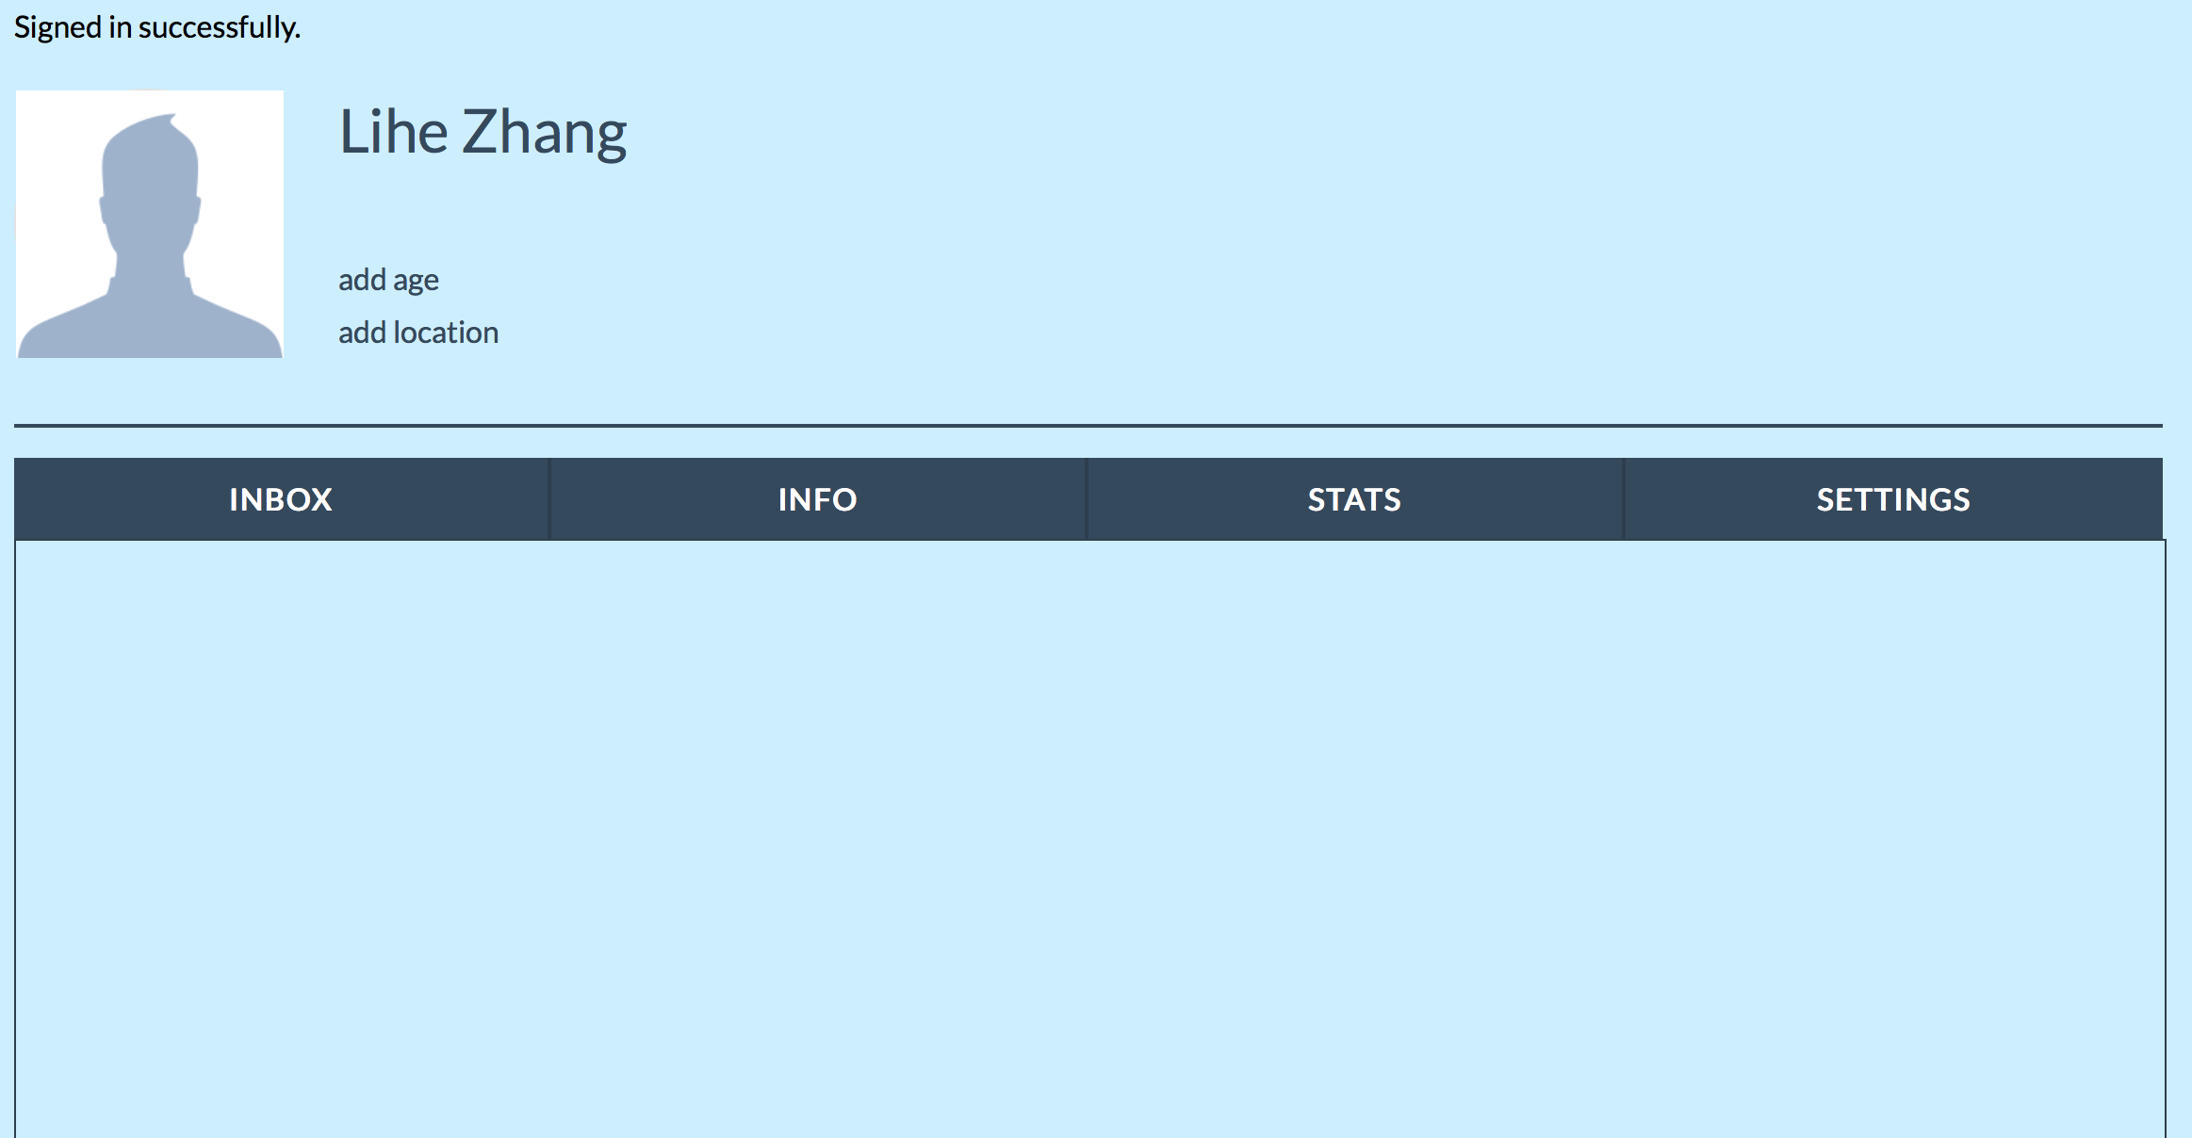
Dashboard
-To show user profile, stats, settings:

Slide 9
Tech specs
Notes:
we fully leveraged all knowledge learned this semester, and successfully integrate the topics from tech group as well.

Slide 10
devise
A gem for flexible authentication.
Rack based (can run on numerous servers)
MVC solution
Multiple models can be signed in at once
Modularity -- use only what you need
10 modules: Database Authenticatable, Omniauthable, Confirmable, Recoverable, Registerable, Rememberable, Trackable, Timeoutable, Validatable, Lockable
To use:
gem ‘devise’ rails generate devise:install rails generate devise MODEL
Notes:
we envision it as a palace….
in order to help user better focus on the function, on the interaction with others, on the debate, on the clash of great ideas
looked up a lot of pictures of early stage websites..

Slide 11
haml
HTML Abstraction Markup Language
Sits on top of HTML or XML
Expresses document structures easily
Utilizes indentation vs. closing tags
Allows Ruby to be embedded
Can be used as a plugin for RoR or as a stand-alone template engine
To use:
gem ‘haml’ haml YOURHAMLDOC.haml
Notes:
we envision it as a palace….
in order to help user better focus on the function, on the interaction with others, on the debate, on the clash of great ideas
looked up a lot of pictures of early stage websites..

Slide 12
Demo

Slide 13
Looking forward...

Slide 14
Future Plans
Search bar
Better password security
Add more tools to ‘Tool Kit’:
e.g. Blood alcohol and Basal Metabolic Rate (BMR) calculator
Complete ‘Dashboard’:
Inbox - Display messages and replies from forum posts
Info - Display user profile information:
e.g. preferred health care facilities, interests, etc.
Stats - List and display different biometrics such as BMI
Can be set to private
Settings - Update user account information such as privacy
‘User Interests’ feed
Narrow options of what is displayed from user home page

Slide 15
Questions?

