Slide 1
Quora for Health
By Team Roshambo

Slide 2
The Idea
A Quora for health-related issues
A Q & A Forum
Extra features - Toolkit (BMI Calculator) - Auto-locate and search for nearby doctors - Hot Deals

Slide 3
Dashboard
Provides a view to access application features:

Slide 4
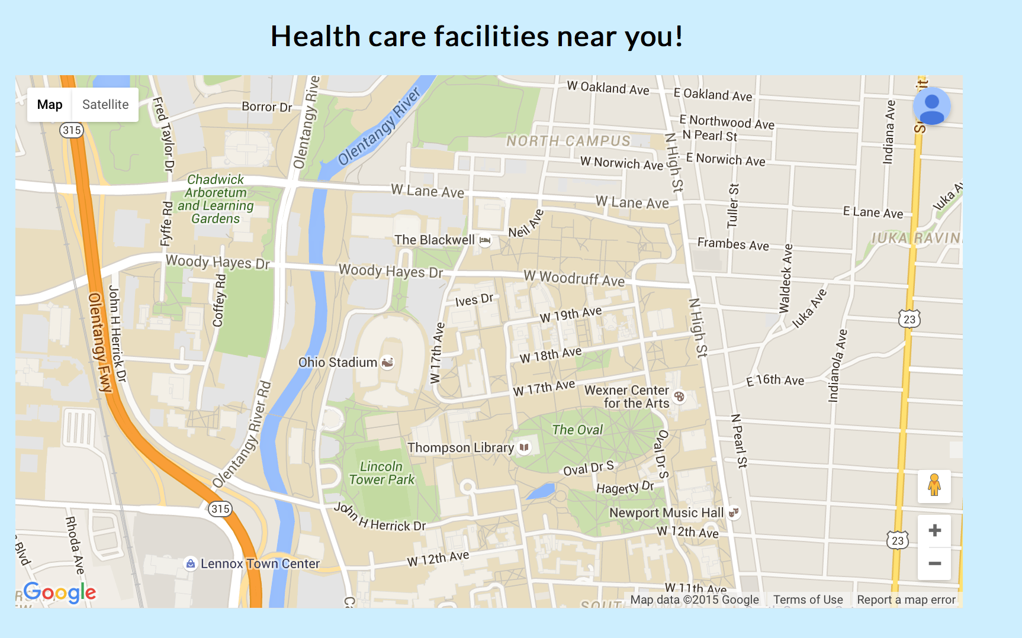
Provider Locator
Will auto-locate you to find the nearest providers:

Slide 5
Provider Locator
Provider Locator (Google Map Services)
function initMap() {
navigator.geolocation.getCurrentPosition(function(position) { pos = {lat: position.coords.latitude, lng: position.coords.longitude};
map = new google.maps.Map(document.getElementById('map'), { center: pos, zoom: 15
});
infowindow = new google.maps.InfoWindow(); var service = new google.maps.places.PlacesService(map);
service.nearbySearch({location: pos, radius: 500, types: ['store']}, callback);});}

Slide 6
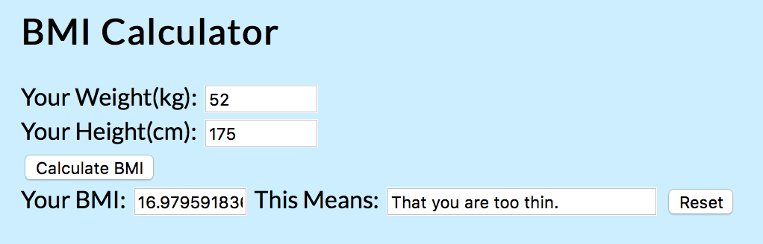
Toolkit (BMI Calculator)
To integrate previous knowledge learned in the course

Slide 7
Toolkit (BMI Javascript)
function calculateBmi() { var weight = document.bmiForm.weight.value var height = document.bmiForm.height.value if(weight > 0 && height > 0){ var finalBmi = weight/(height/100*height/100) document.bmiForm.bmi.value = finalBmi if(finalBmi < 18.5){ document.bmiForm.meaning.value = "That you are too thin." } if(finalBmi > 18.5 && finalBmi < 25){ document.bmiForm.meaning.value = "That you are healthy." } if(finalBmi > 25){ document.bmiForm.meaning.value = "That you are overweight." } } else{ alert("ERROR: Please Fill in everything correctly.") } }

Slide 8
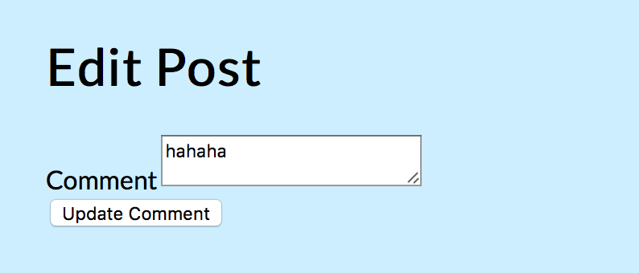
Q & A Forum
Ask health-related questions:

Slide 9
Hot Deals
To demonstrate knowledge of rails db
Redirect to an external marketplace, where patients can filter health-related products or procedures based on the area of the body, illness, injury, etc.
Allows users who are paying out-of-pocket to shop around

Slide 10
DEMO

