Slide 1
Two-Commodity Flow (2CF) is equivalent to Linear Programming (LP)
Ming Ding (ETH Zurich)
May 24, 2024
Joint work with Rasmus Kyng (ETH Zurich), Peng Zhang (Rutgers)
DATA Lab @ Northeastern

Slide 2

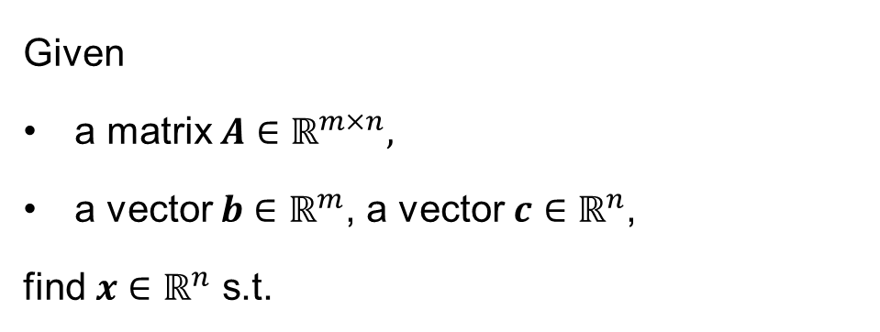
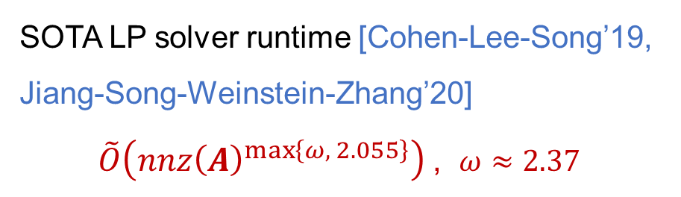
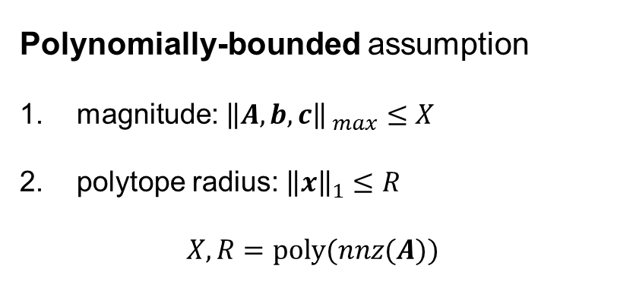
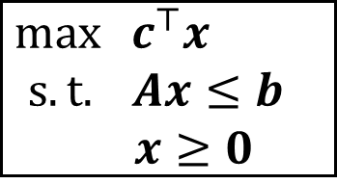
Problem definition -- Linear Programs (LP)
Optimization problem with linear objective and linear constraints
Given
a matrix $A∈ℝ^{m×n},$
a vector $b∈ℝ^{m}$, a vector $c∈ℝ^{n}$,
find $x∈ℝ^{n}$ s.t.
Polynomially-bounded assumption
magnitude: ${\left\|A,b,c\right\|}_{ max}≤X$
polytope radius: ${\left\|x\right\|}_{1}≤R$
$$X,R=poly(nnz(A))$$
$\max{ c^{⊤}x}$ $s.t.$ $Ax≤b$
$x≥0$
SOTA LP solver runtime [Cohen-Lee-Song’19, Jiang-Song-Weinstein-Zhang’20]
$\tilde{O}\left(nnz{\left(A\right)}^{\max\left\{ω, 2.055\right\}}\right)$ , $ω≈2.37$
$\tilde{O}$ hides polylog dependences.

Slide 3
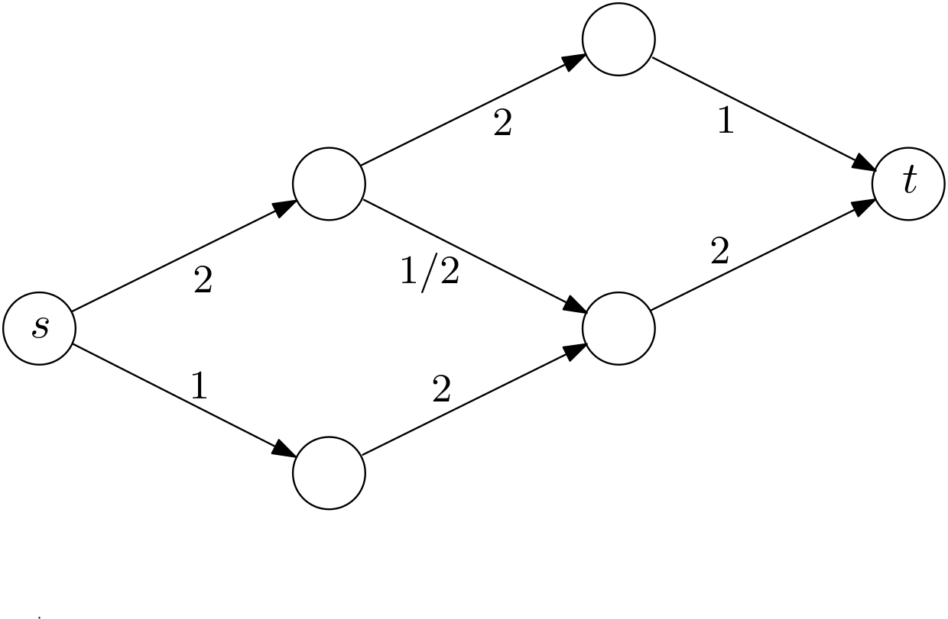
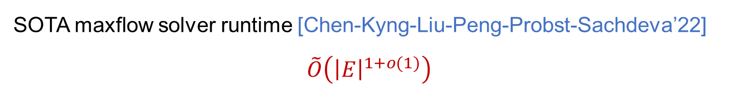

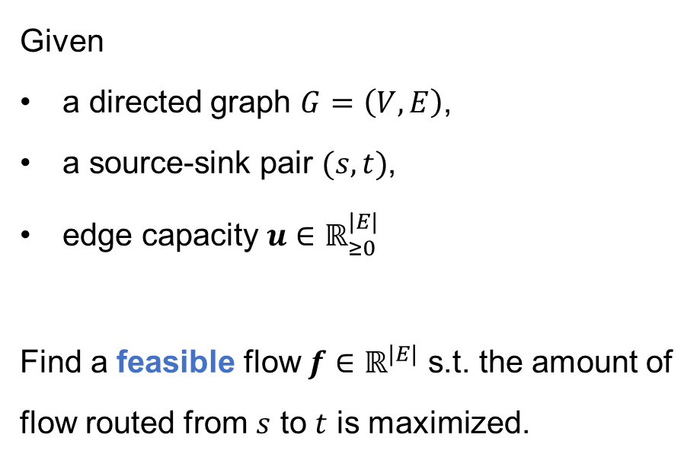
(Single-commodity) maxflow problem (1CF)
Given
a directed graph $G=\left(V, E\right)$,
a source-sink pair $(s,t)$,
edge capacity $u∈ℝ_{≥0}^{|E|}$
Find a feasible flow $f∈ℝ^{|E|}$ s.t. the amount of flow routed from $s$ to $t$ is maximized.
1
1
1
1
1
1
$$maxFlow=2$$
SOTA maxflow solver runtime [Chen-Kyng-Liu-Peng-Probst-Sachdeva’22]
$$\tilde{O}\left({\left|E\right|}^{1+o(1)}\right)$$

Slide 4
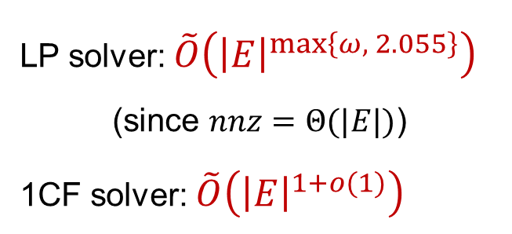


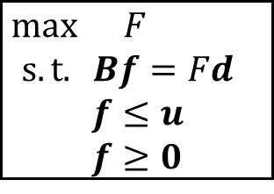

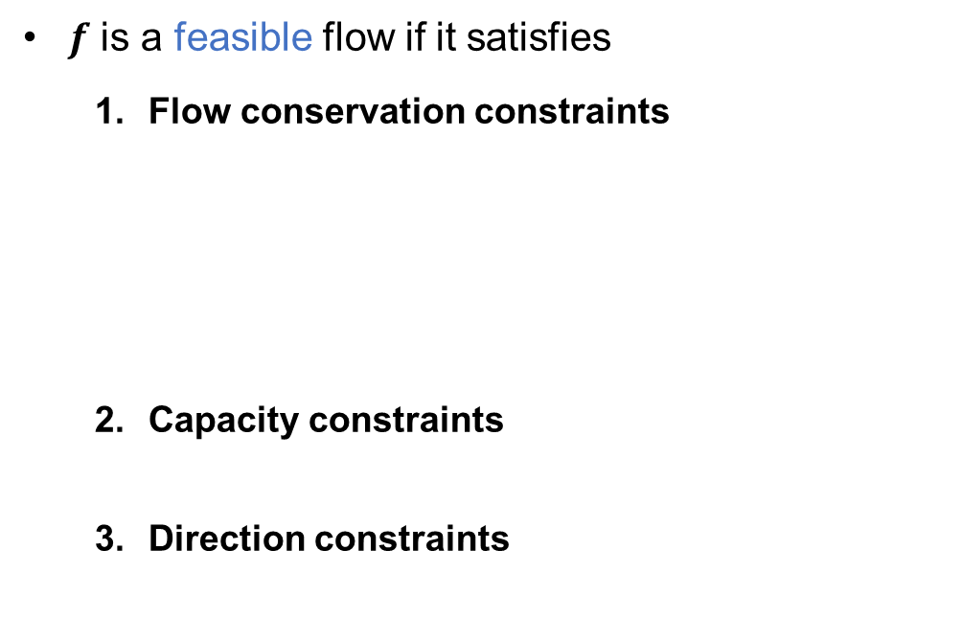
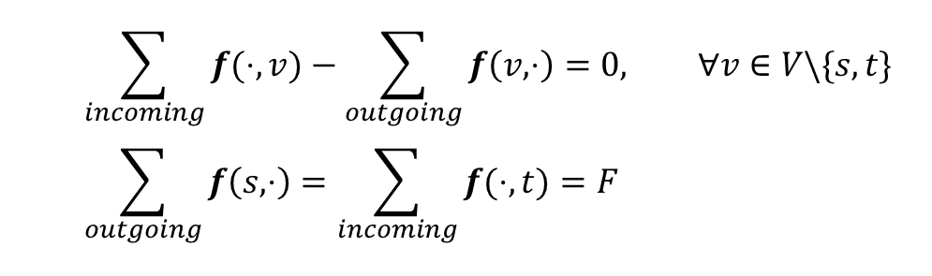
1CF as LP
$f$ is a feasible flow if it satisfies
Flow conservation constraints
Capacity constraints
Direction constraints
$$\sum_{incoming}{f(⋅,v)}−\sum_{outgoing}{f\left(v, ⋅\right)}=0, ∀v∈V\backslash \{s,t\} \\ \sum_{outgoing}{f\left(s, ⋅\right)}=\sum_{incoming}{f(⋅,t)}=F$$
$\max{ F}$ $s.t. Bf=Fd$
$f≤u$
$f≥0$
$$f\left(e\right)≤u\left(e\right), ∀ e∈E$$
LP solver: $\tilde{O}\left({\left|E\right|}^{\max\left\{ω, 2.055\right\}}\right)$
(since $nnz=Θ(|E|)$)
1CF solver: $\tilde{O}\left({\left|E\right|}^{1+o(1)}\right)$
$$f\left(e\right)≥0, ∀ e∈E$$
1
1
1
1
1
1
$$F=2$$

Slide 5
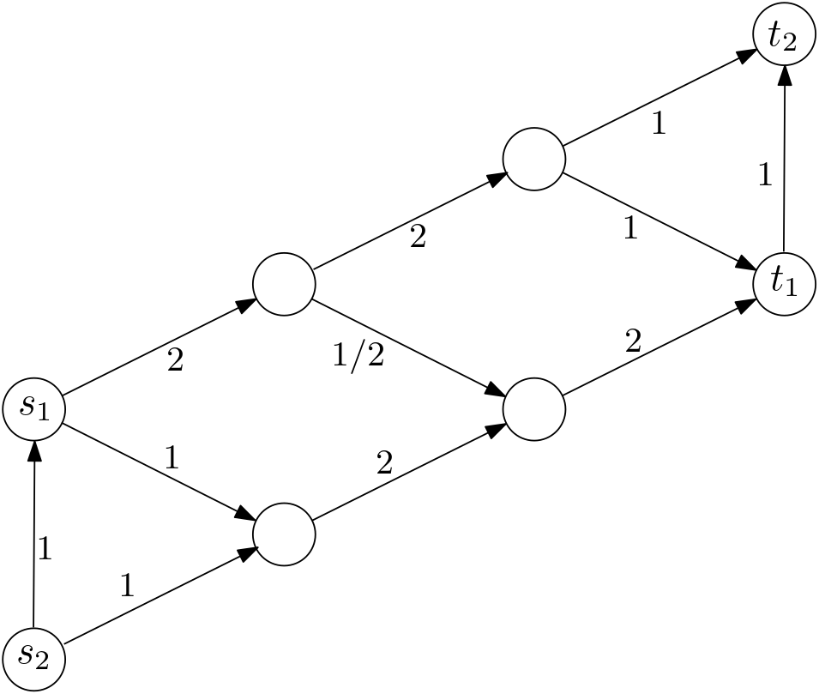
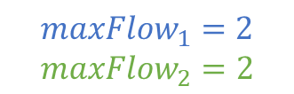


Two-commodity maxflow problem (2CF)
Given
a directed graph $G=\left(V, E\right)$,
a source-sink pair $(s,t)$,
edge capacity $u∈ℝ_{≥0}^{|E|}$
Find a feasible flow $f∈ℝ^{|E|}$ s.t. the amount of flow routed from $s$ to $t$ is maximized.
Given
a directed graph $G=\left(V, E\right)$,
two source-sink pairs $(s_{1},t_{1}, s_{2},t_{2})$,
edge capacity $u∈ℝ_{≥0}^{|E|}$
Find a pair of feasible flow $f_{1},f_{2}∈ℝ^{|E|}$ s.t. the sum of the amount of flow routed from $s_{1}$ to $t_{1}$ and from $s_{2}$ to $t_{2}$ is maximized.
1
1
1
1
1
1
1
1
1
1
1
1
1
1
$${maxFlow}_{1}=2$$
$${maxFlow}_{2}=2$$

Slide 6


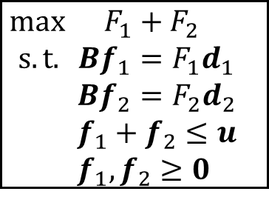

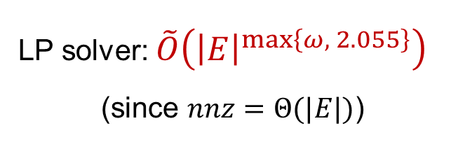

2CF as LP
$f$ is a feasible flow if it satisfies
Flow conservation constraints $\sum_{incoming}{f(⋅,v)}−\sum_{outgoing}{f\left(v, ⋅\right)}=0, ∀v∈V\backslash \{s,t\}$ $\sum_{outgoing}{f\left(s, ⋅\right)}=\sum_{incoming}{f(⋅,t)}=F$
Capacity constraints $f\left(e\right)≤u\left(e\right), ∀ e∈E$
Direction constraints $f\left(e\right)≥0, ∀ e∈E$
$(f_{1}, f_{2})$ is a pair of feasible flow if it satisfies
Flow conservation constraints: for $i∈\{1,2\}$ $\sum_{incoming}{f_{i}(⋅,v)}−\sum_{outgoing}{f_{i}\left(v, ⋅\right)}=0, ∀v∈V\backslash \{s_{i},t_{i}\}$ $\sum_{outgoing}{f_{i}\left(s, ⋅\right)}=\sum_{incoming}{f_{i}(⋅,t)}=F_{i}$
Capacity constraints $f_{1}\left(e\right)+f_{2}(e)≤u\left(e\right), ∀ e∈E$
Direction constraints $f_{1}\left(e\right), f_{2}(e)≥0, ∀ e∈E$
$\max{ F_{1}+F_{2}}$ $s.t. Bf_{1}=F_{1}d_{1}$
$Bf_{2}=F_{2}d_{2}$
${f_{1}+f}_{2}≤u$
$f_{1},f_{2}≥0$
$\max{ F}$ $s.t. Bf=Fd$
$f≤u$
$f≥0$
LP solver: $\tilde{O}\left({\left|E\right|}^{\max\left\{ω, 2.055\right\}}\right)$
(since $nnz=Θ(|E|)$)
1CF solver: $\tilde{O}\left({\left|E\right|}^{1+o(1)}\right)$
2CF solver: No faster algorithms known for 2CF beyond general LPs!
[D.-Kyng-Zhang’22] LP can be reduced to 2CF!

Slide 7

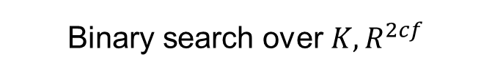

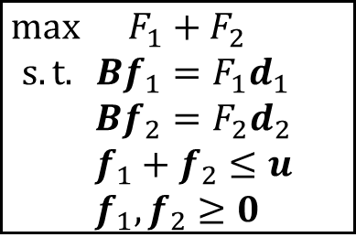





Optimization version → Feasibility version
LP
2CF
$\max{ F_{1}+F_{2}}$ $s.t. Bf_{1}=F_{1}d_{1}$
$Bf_{2}=F_{2}d_{2}$
${f_{1}+f}_{2}≤u$
$f_{1},f_{2}≥0$
$\max{ c^{⊤}x}$ $s.t.$ $Ax≤b$
$x≥0$
Optimization version
Equivalent hardness
Binary search over $K, R^{2cf}$
$$F_{1}+F_{2}≥R^{2cf}−ε^{2cf} \\ {\left\|Bf_{1}−F_{1}d_{1}\right\|}_{∞}≤ε^{2cf} \\ {\left\|Bf_{2}−F_{2}d_{2}\right\|}_{∞}≤ε^{2cf} \\ f_{1}+f_{2}≤u+ε^{2cf}1 \\ f_{1}, f_{2}≥0$$
$$F_{1}+F_{2}≥R^{2cf} \\ Bf_{1}=F_{1}d_{1}$$
$Bf_{2}=F_{2}d_{2}$
${f_{1}+f}_{2}≤u$
$f_{1},f_{2}≥0$
$$c^{⊤}x≥K−ε^{lp} \\ Ax≤b +ε^{lp}1 \\ x≥0$$
$$c^{⊤}x≥K \\ Ax≤b \\ x≥0$$
Feasibility version
$$(A, b,c,K,ε^{lp})$$
$$(G=\left(V,E\right),u,R^{2cf},ε^{2cf})$$

Slide 8
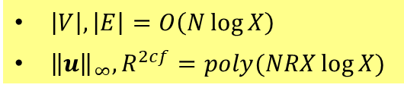

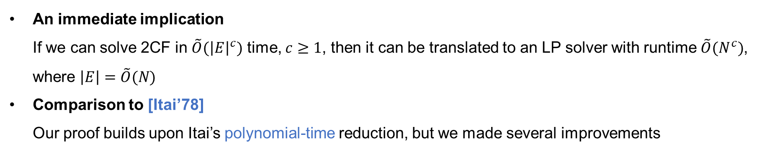

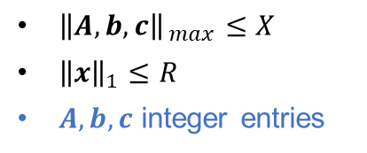


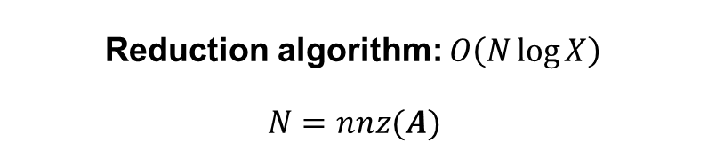


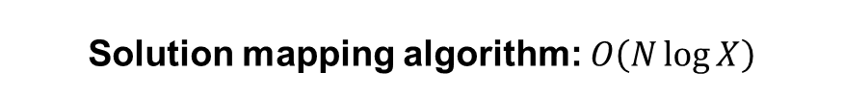
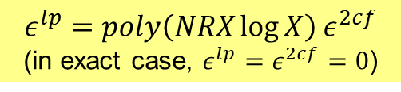

Main results
LP
2CF
$$\tilde{O}(N^{2})$$
Reduction algorithm: $O\left(N\log{X}\right)$
$$N=nnz(A)$$
$$(A, b,c,K)$$
$$(G=\left(V,E\right),u,R^{2cf})$$
${\left\|A,b,c\right\|}_{ max}≤X$
${\left\|x\right\|}_{1}≤R$
$A,b,c$ integer entries
$$\tilde{O}(N^{2})$$
$\left|V\right|, \left|E\right|=O\left(N\log{X}\right)$
${\left\|u\right\|}_{∞},R^{2cf}=poly(NRX\log{X})$
Solution mapping algorithm: $O\left(N\log{X}\right)$
$$exp(NRX)$$
$x^{lp} (ε^{lp})$
$f^{2cf} (ε^{2cf})$
$$ε^{lp}=poly\left(NRX\log{X}\right) ε^{2cf}$$
(in exact case, $ε^{lp}=ε^{2cf}=0$)
Exact case only
An immediate implication If we can solve 2CF in $\tilde{O}({\left|E\right|}^{c})$ time, $c≥1$, then it can be translated to an LP solver with runtime $\tilde{O}(N^{c})$, where $\left|E\right|=\tilde{O}(N)$
Comparison to [Itai’78] Our proof builds upon Itai’s polynomial-time reduction, but we made several improvements

Slide 9
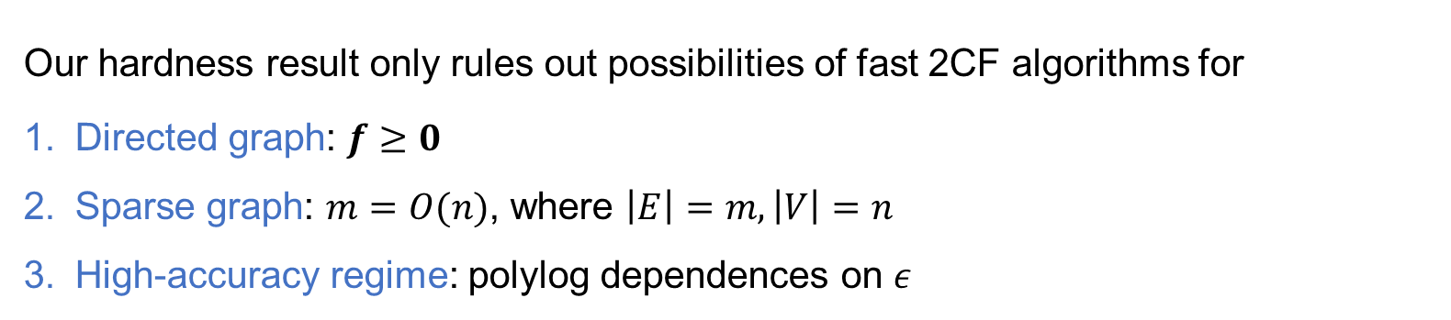
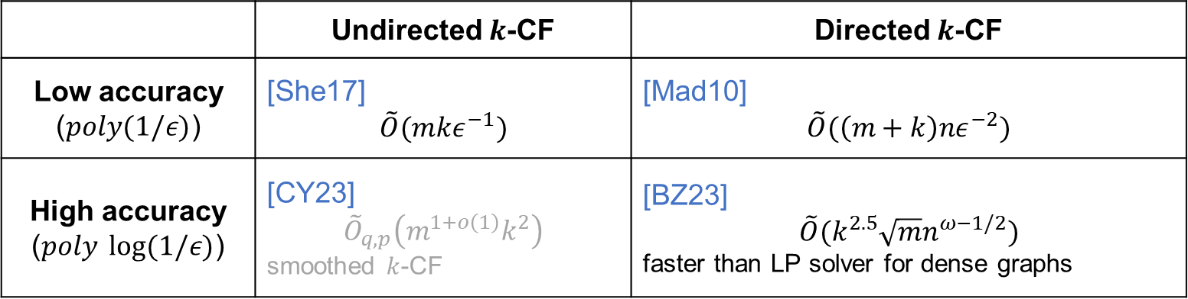
Remark
Our hardness result only rules out possibilities of fast 2CF algorithms for
Directed graph: $f≥0$
Sparse graph: $m=O(n)$, where $\left|E\right|=m, \left|V\right|=n$
High-accuracy regime: polylog dependences on $ε$
Outside of the settings, there indeed exists some fast multi-commodity flow solvers:
 | Undirected $k$-CF | Directed $k$-CF
Low accuracy ($poly(1/ε)$) | [She17] $$\tilde{O}(mkε^{−1})$$ | [Mad10] $$\tilde{O}(\left(m+k\right)nε^{−2})$$
High accuracy ($poly \log{(1/ε)}$) | [CY23] $${\tilde{O}}_{q,p}\left(m^{1+o\left(1\right)}k^{2}\right)$$ smoothed $k$-CF | [BZ23] $$\tilde{O}(k^{2.5}\sqrt{m}n^{ω−1/2})$$ faster than LP solver for dense graphs
LP solver for $k$-CF [CLS19]: $\tilde{O}({\left(mk\right)}^{ω+o(1)})$

Slide 10
Reduction Algorithm

Slide 11
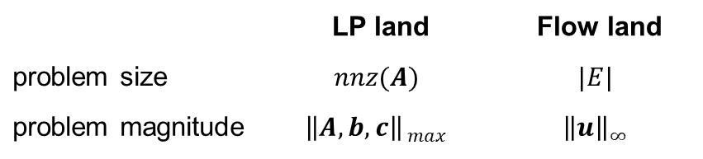


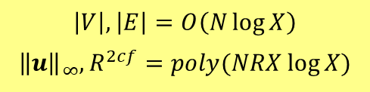


Overview of reduction algorithm
LP
2CF
Reduction algorithm: $O\left(N\log{X}\right)$
$$(G=\left(V,E\right),u,R^{2cf})$$
$$(A, b,c,K)$$
$${\left\|A,b,c\right\|}_{ max}≤X$$
$${\left\|x\right\|}_{1}≤R$$
$$\left|V\right|, \left|E\right|=O\left(N\log{X}\right)$$
$${\left\|u\right\|}_{∞},R^{2cf}=poly(NRX\log{X})$$
LEN
Keep track of:
2CFF
 | LP land | Flow land
problem size | $$nnz(A)$$ | $$|E|$$
problem magnitude | $${\left\|A,b,c\right\|}_{ max}$$ | $${\left\|u\right\|}_{∞}$$
2-LEN
SFF
1-LEN
FHF
Algebra
Continuous
Graph
Combinatorics
Flow land
LP land

Slide 12

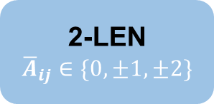

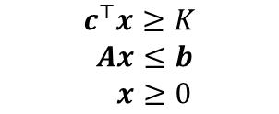
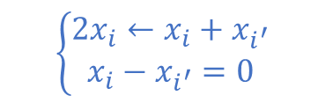

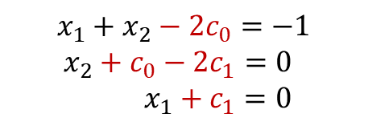






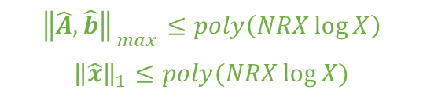

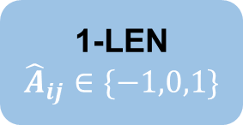

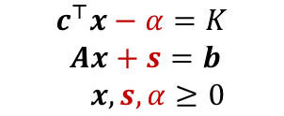

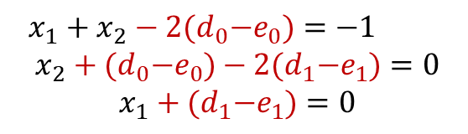
LP land
LP
$$c^{⊤}x≥K \\ Ax≤b \\ x≥0$$
$$5x_{1}+3x_{2}=−1$$
$$2^{0}+2^{2}$$
$$2^{0}+2^{1}$$
$$−2^{0}$$
$$O(N)$$
Add slack variables $α, s$
LEN
(Linear Equations with Nonnegative variables)
$$2^{0}⋅\left(x_{1}+x_{2}\right)+2^{1}⋅x_{2}+2^{2}⋅x_{1}=−2^{0}⋅1$$
$$c^{⊤}x−α=K \\ Ax+s=b \\ x,s,α≥0$$
$$x_{1}+x_{2}=−1 \\ x_{2}=0 \\ x_{1}=0$$
Add carry terms
$$O(N \log{X})$$
Bitwise decomposition
$$x_{1}+x_{2}−2c_{0}=−1 \\ x_{2}+c_{0}−2c_{1}=0 \\ x_{1}+c_{1}=0$$
2-LEN
$${\overline{A}}_{ij}∈\{0,±1,±2\}$$
$$\overline{A}\overline{x}=\overline{b}$$
$$\overline{x}≥0$$
$$\left\{\begin{aligned}2x_{i}←x_{i}+x_{i^{′}} \\ x_{i}−x_{i^{′}}=0\end{aligned}\right.$$
$$c_{i}←d_{i}−e_{i},$$
$$d_{i},e_{i}≥0$$
$$O(N \log{X})$$
Add auxiliary variables
1-LEN
$${\hat{A}}_{ij}∈\{−1,0,1\}$$
$$x_{1}+x_{2}−2{(d}_{0}−e_{0})=−1 \\ x_{2}+{(d}_{0}−e_{0})−2{(d}_{1}−e_{1})=0 \\ x_{1}+{(d}_{1}−e_{1})=0$$
$$\hat{A}\hat{x}=\hat{b}$$
$$\hat{x}≥0$$
$${\left\|\hat{A},\hat{b}\right\|}_{ max}≤poly\left(NRX\log{X}\right)$$
$${\left\|\hat{x}\right\|}_{1}≤poly(NRX\log{X})$$
$$d_{i}, e_{i}≤2XR$$

Slide 13



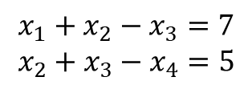



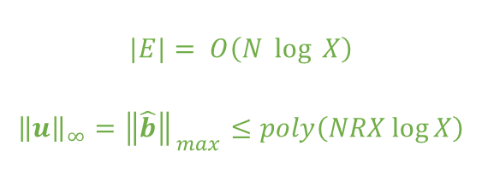








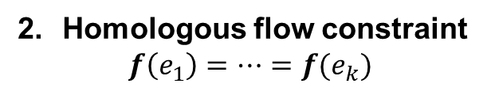



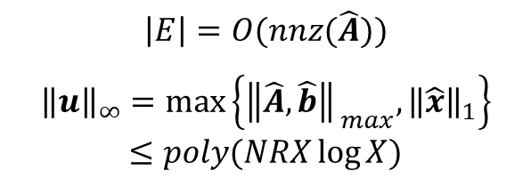












LP land → Flow land
$$|E|= O\left(N \log{X}\right)$$
$${\left\|u\right\|}_{∞}={\left\|\hat{b}\right\|}_{ max}≤poly\left(NRX\log{X}\right)$$
1-LEN
$${\hat{A}}_{ij}∈\{−1,0,1\}$$
FHF
(Fixed Homologous Flow problem)
$$x_{1}+x_{2}−x_{3}=7$$
$$x_{2}+x_{3}−x_{4}=5$$
$$x_{1}+x_{2}−x_{3}=7$$
$$\hat{A}x=\hat{b}$$
$${ J}_{1}$$
Encode flow conservation constraint
$$x_{1}$$
$${ J}_{1}$$
$$x_{3}$$
$$⋯$$
$$J_{2}$$
$$x_{1}$$
$$x_{3}$$
$$x_{2}$$
$$7$$
$$s$$
$$t$$
$$s$$
$$x_{2}$$
$$x_{4}$$
$$t$$
$$s$$
$$⋯$$
$$t$$
$$x_{2}$$
$$7$$
$$⋯$$
$$x_{3}$$
$${ J}_{2}$$
$$5$$
$$⋯$$
$$J_{m}$$
$$\left|E\right|=O(nnz(\hat{A}))$$
$${\left\|u\right\|}_{∞}=\max\left\{{\left\|\hat{A},\hat{b}\right\|}_{ max},{\left\|\hat{x}\right\|}_{1}\right\}$$
$$≤poly(NRX\log{X})$$
Fixed flow constraint
$$f\left(e\right)=u\left(e\right)=RHS$$
Homologous flow constraint
$$f\left(e_{1}\right)=…=f(e_{k})$$

Slide 14



Flow land
Target constraints (2CF):
Flow conservation constraints $Bf_{i}=F_{i}d_{i}, i∈\{1,2\}$
Capacity constraints $f_{1}+f_{2}≤u$
Direction constraints: $f_{1},f_{2}≥0$
2CF
Drop fixed
2CFF
fixed
drop extra constraints step by step
Drop selective
SFF
fixed + selective
FHF constrains:
Target constraints 1, 2, 3
Fixed flow constraints $f\left(e\right)=u\left(e\right)$
Homologous flow constraints
$f\left(e_{1}\right)=…=f(e_{k})$
Introduce
2nd commodity
Selective flow constraints
$$f_{\overline{i}}\left(e\right)=0, \overline{i}≠i$$
Drop homologous
FHF
fixed + homologous
Simplified reduction chain. More steps needed in the complete version.

Slide 15





















Drop homologous
FHF
fixed + homologous
$$(0, u)$$
$$(0, u)$$
$$v$$
$$w$$
$$y$$
$$z$$
fixed flow: $f_{1}\left(e\right)+f_{2}\left(e\right)=u$
$$\{1\}$$
$$(u,u)$$
$$\{1\}$$
$$\{1\}$$
$$(u,u)$$
$$\{1\}$$
$$v$$
$$w$$
$$y$$
$$z$$
SFF
fixed + selective
$$\{2\}$$
$$\{2\}$$
$$\{2\}$$
$$s_{2}$$
$$t_{2}$$
selective for commodity $1$: $f_{2}\left(e\right)=0$
selective for commodity $2$: $f_{1}\left(e\right)=0$

Slide 16


















Drop selective
SFF
fixed + selective
$$\{i\}$$
$$v$$
$$w$$
Only outgoing edge is $e_{4}$
$e_{4}$ only allow $f_{i}$
$e_{1}$ only routes $f_{i}$
Only incoming edge is $e_{5}$
$e_{5}$ only allow $f_{i}$
$e_{3}$ only routes $f_{i}$
$$e_{1}$$
$$e_{2}$$
$$e_{3}$$
$$v$$
$$w$$
2CFF
fixed
$$e_{4}$$
$$u$$
$$u$$
$$e_{5}$$
Fixed edge
$e_{4}, e_{5}$ route the same
$e_{1}, e_{3}$ route the same
$$t_{i}$$
$$s_{i}$$
Only fixed flow constraint remains
High-level idea of dropping fixed flow constraint (needs several steps)
Fixed flow edge = saturated edge
In feasibility 2CF, with a carefully chosen $R^{2cf}$, use $F_{1}+F_{2}≥R^{2cf}$ to force fixed flow edges to get saturated automatically

Slide 17








Flow Land
1-LEN
$${\hat{A}}_{ij}∈\{−1,0,1\}$$
$$|E|= O\left(N \log{X}\right)$$
$${\left\|u\right\|}_{∞}={\left\|\hat{b}\right\|}_{ max}≤poly\left(NRX\log{X}\right)$$
FHF
(Fixed Homologous Flow problem)
Homologous edge
Selective edge
Fixed edge
$$v$$
$$w$$
$$|E|= O\left(N \log{X}\right)$$
$${\left\|u\right\|}_{∞}≤poly\left(NRX\log{X}\right)$$
$$⋯$$
A constant-sized gadget
$$v$$
$$w$$
2CF

Slide 18
Solution Mapping & Error Analysis

Slide 19






Overview of solution mapping
LP
2CF
$$(A, b,c,K)$$
Solution mapping algorithm: $O\left(N\log{X}\right)$
$$(G=\left(V,E\right),u,R^{2cf})$$
$x^{lp} (ε^{lp})$
$f^{2cf}(ε^{2cf})$
$$ε^{lp}=poly\left(NRX\log{X}\right) ε^{2cf}$$
(in exact case, $ε^{lp}=ε^{2cf}=0$)
LEN
2CFF
Track solution error
2-LEN
SFF
1-LEN
FHF
LP land
Algebra
Continuous
Graph
Combinatorial
Flow land

Slide 20










Flow land
A constant-sized gadget
$$e_{1}$$
$$e_{2}$$
$$e$$
$$v$$
$$w$$
$$v$$
$$w$$
Instance $Q:{(f}^{Q},ε^{Q})$
Instance $P:{(f}^{P},ε^{P})$
Mapping rule: $f^{P}\left(e\right)←f^{Q}(e_{1})$
Error analysis
$$ε^{P}=O\left(\left|E^{P}\right|\right) ε^{Q}$$
Intuition: we map the flow of a gadget to a single edge
error accumulates in an additive manner → per gadget error blows up by a constant
At most $|E^{P}|$ gadgets → the total error blows up by $O(\left|E^{P}\right|)$

Slide 21

















Solution Mapping
Flow land
LP land
A constant-sized gadget
$$e_{2}$$
$$x^{Q}=\left(\begin{aligned}x^{P} \\ x^{new}\end{aligned}\right)$$
$$e_{1}$$
$$e$$
$$x^{P}$$
$$v$$
$$w$$
$$v$$
$$w$$
Instance $Q:{(f}^{Q},ε^{Q})$
Instance $P:{(f}^{P},ε^{P})$
Instance $Q:{(x}^{Q},ε^{Q})$
Instance $P:{(x}^{P},ε^{P})$
Mapping rule: $f^{P}\left(e\right)←f^{Q}(e_{1})$
Direct mapping
Error analysis
Error analysis
$$ε^{P}=O\left(\left|E^{P}\right|\right) ε^{Q}$$
$$ε^{P}=poly \left(N^{P},X^{P}\right)⋅ε^{Q}$$
Intuition: we map the flow of a gadget to a single edge
error accumulates in an additive manner → error blows up by a constant per gadget
At most $|E^{P}|$ gadgets → the total error blows up by $O(\left|E^{P}\right|)$
Simple algebra

Slide 22








Summary
$\max{ F_{1}+F_{2}}$ $s.t. Bf_{1}=F_{1}d_{1}$
$Bf_{2}=F_{2}d_{2}$
${f_{1}+f}_{2}≤u$
$f_{1},f_{2}≥0$
$$(A, b,c,K)$$
$$(G=\left(V,E\right),u,R^{2cf})$$
${\left\|A,b,c\right\|}_{ max}≤X$
${\left\|x\right\|}_{1}≤R$
$A,b,c$ integer entries
$\left|V\right|, \left|E\right|=O\left(N\log{X}\right)$
${\left\|u\right\|}_{∞},R^{2cf}=poly(NRX\log{X})$
$ε^{2cf}=\frac{ε^{lp}}{poly\left(NRX\log{X}\right)}$
2CF $≤$ LP
LP $≤$ 2CF
2CF $=$ LP

Slide 23


















Summary & open problems
LP
2CF
Reduction: $O\left(N\log{X}\right)$
$(A, b,c,K)$, $x^{lp}(ε^{lp})$
$(G=\left(V,E\right),u,R^{2cf})$, $f^{2cf}(ε^{2cf})$
Q3. We have dense LP -> sparse 2CF,
what about dense LP -> dense 2CF?
${\left\|A,b,c\right\|}_{ max}≤X$
${\left\|x\right\|}_{1}≤R$
$A,b,c$ integer entries
Solution mapping: $O\left(N\log{X}\right)$
$\left|V\right|, \left|E\right|=O\left(N\log{X}\right)$
${\left\|u\right\|}_{∞},R^{2cf}=poly(NRX\log{X})$
$ε^{2cf}=\frac{ε^{lp}}{poly\left(NRX\log{X}\right)}$
Q1. Exist an efficient reduction for non poly-bounded LP?
LEN
2CFF
$$Ω\left(\frac{ε^{lp}}{(N\log{X)5}NRX^{3}}\right)$$
$$ε^{lp}$$
$$O(N)$$
$$O(N\log{X})$$
Q2. Exist a strongly polynomial reduction?
Thank you !
$$Ω\left(\frac{ε^{lp}}{(N\log{X)4}NRX^{3}}\right)$$
$$Ω\left(\frac{ε^{lp}}{X}\right)$$
2-LEN
$$O(N\log{X})$$
SFF
$$O(N\log{X})$$
$$Ω\left(\frac{ε^{lp}}{(N\log{X) X}}\right)$$
1-LEN
FHF
$$Ω\left(\frac{ε^{lp}}{(N\log{X)2}NRX^{3}}\right)$$
$$O(N\log{X})$$
$$O(N\log{X})$$

Slide 24
Backup slides

Slide 25
Hardness of two-commodity Laplacians
State-of-the-art faster algorithms (LPs, maxflow) are Interior-Point-Method-based algorithms
Interior Point Methods (IPM): ways of solving convex optimization problems via a sequence of linear systems
Laplacians linear system: the linear equations that arise in IPM for maxflow
2-commodity Laplacians linear system: the linear equations that arise in IPM for 2CF
Theorem [Kyng-Zhang’17]
If we can quickly solve linear systems in 2-commodity Laplacians, then we can quickly solve linear systems in any matrix.
Implications:
Faster 2CF algorithms were unlikely to be IPM-based
However, it remains open that if other families of algorithms could succeed

Slide 26





Integral entry assumption is mild
$\max{ c^{⊤}x}$ $s.t.$ $Ax≤b$
$x≥0$
We round by at most $\frac{ε}{3R}$
entries of $A$ down to $\tilde{A}$
entries of $b,c$ up to $\tilde{b}, \tilde{c}$
$(A,b,c)$ is polynomially-bounded
Magnitude ${\left\|A,b,c\right\|}_{ max}≤X$
Polytope radius ${\left\|x\right\|}_{1}≤R$
If $(A,b,c)$ is feasible, then $(\tilde{A},\tilde{b},\tilde{c})$ is feasible
Since entries of $(\tilde{A},\tilde{b},\tilde{c})$ has a logarithmic number of bits, we can scale all of them to polynomially-bounded integers
If $\tilde{x}$ is a solution to $(\tilde{A},\tilde{b},\tilde{c})$ with $ε/3$ additive error.
Then $\tilde{x}$ is also a solution to $(A,b,c)$ with $ε$ additive error.
$$A \tilde{x}=\tilde{A}\tilde{x}+\left(A−\tilde{A}\right)\tilde{x}≤\left(\tilde{b}+\frac{ε}{3}1\right)+\frac{ε}{3R}⋅R=b+ε1$$
$$c^{⊤} \tilde{x}={\tilde{c}}^{⊤} \tilde{x}+{\left(c−\tilde{c}\right)}^{⊤}\tilde{x}≥\left({\tilde{c}}^{⊤}{\tilde{x}}^{∗}−\frac{ε}{3}\right)−\frac{ε}{3R}⋅R={\tilde{c}}^{⊤}{\tilde{x}}^{∗}−\frac{2}{3}ε≥c^{⊤}x^{∗}−\frac{2}{3}ε$$

Slide 27





































SFF → FHF
FHF
$$(f^{h}, ε^{h})$$
Error in congestion: $≤ε^{s}$
Error in demand: $≤{O(|E^{h}|)ε}^{s}$
Error in homology: $\left|f^{h}\left(e\right)−f^{h}(\hat{e})\right|≤Θ(ε^{s})$
$${f^{h}(e)=f}_{1}^{s}\left(e_{1}\right)$$
$$f^{h}\left(\hat{e}\right)=f_{1}^{s}\left({\hat{e}}_{1}\right)$$
$$v$$
$$e$$
$$w$$
$$y$$
$$z$$
$$\hat{e}$$
Goal: after mapping $f^{s}$ with error $ε^{s}$, how to bound $ε^{h}$ of $f^{h}$?
Error in congestion (fixed):
$$u−ε^{s}≤f_{1}^{s}\left({\hat{e}}_{4}\right)+f_{2}^{s}\left({\hat{e}}_{4}\right)≤u+ε^{s}$$
Error in demand: for $i∈\{1,2\}$
$$\left|f_{i}^{s}\left(e_{1}\right)+f_{i}^{s}\left(e_{3}\right)−f_{i}^{s}\left(e_{4}\right)\right|≤ε^{s}$$
fixed flow: $f_{1}\left(e\right)+f_{2}\left(e\right)=u\left(e\right)$
fixed flow: $f_{1}\left(e\right)+f_{2}\left(e\right)=u\left(e\right)$
$$\{1\}$$
$$u$$
$$\{1\}$$
$$\{1\}$$
$$u$$
$$\{1\}$$
$$v$$
$$e_{1}$$
$$e_{4}$$
$$w$$
$$y$$
$${\hat{e}}_{1}$$
$$z$$
$${\hat{e}}_{4}$$
SFF
$$(f^{s}, ε^{s})$$
$$\{2\}$$
$$e_{3}$$
$$\{2\}$$
$$\{2\}$$
$$s_{2}$$
$$t_{2}$$
selective for commodity $2$: $f_{1}\left(e\right)=0$
selective for commodity $1$: $f_{2}\left(e\right)=0$
selective for commodity $2$: $f_{1}\left(e\right)=0$
selective for commodity $1$: $f_{2}\left(e\right)=0$
Error in type for $\{1\}$: $f_{2}^{s}\left(e_{1}\right)≤ε^{s}$
Error in type for $\{2\}$: $f_{1}^{s}\left(e_{3}\right)≤ε^{s}$

Slide 28

























Error in homology (SFF → FHF)
Error in demand: for $i∈\{1,2\}$
$$\left|f_{i}^{s}\left(e_{1}\right)+f_{i}^{s}\left(e_{3}\right)−f_{i}^{s}\left(e_{4}\right)\right|≤ε^{s}$$
Error in congestion (fixed):
$$u−ε^{s}≤f_{1}^{s}\left({\hat{e}}_{4}\right)+f_{2}^{s}\left({\hat{e}}_{4}\right)≤u+ε^{s}$$
$$\{1\}$$
$$u$$
$$\{1\}$$
$$u$$
$$v$$
$$e_{1}$$
$$e_{4}$$
$$e_{2}$$
$$w$$
$$y$$
$${\hat{e}}_{1}$$
$$z$$
$${\hat{e}}_{3}$$
$${\hat{e}}_{4}$$
$$\{2\}$$
$$e_{3}$$
$$\{2\}$$
Error in type for $\{1\}$: $f_{2}^{s}\left(e_{1}\right)≤ε^{s}$
Error in type for $\{2\}$: $f_{1}^{s}\left(e_{3}\right)≤ε^{s}$
$$s_{2}$$
$$t_{2}$$
$\left|f^{h}\left(e\right)−f^{h}(\hat{e})\right|=\left|{f_{1}^{s}\left(e_{1}\right)−f}_{1}^{s}\left({\hat{e}}_{1}\right)\right|$
$≤\left|\left(f_{1}^{s}\left(e_{1}\right)+f_{1}^{s}\left(e_{3}\right)\right)−\left(f_{1}^{s}\left({\hat{e}}_{1}\right)+f_{1}^{s}\left({\hat{e}}_{3}\right)\right)\right|+\left|f_{1}^{s}\left(e_{3}\right)−f_{1}^{s}\left({\hat{e}}_{3}\right)\right|$
By solution mapping
$$≤Θ(ε^{s})$$
Error in demand of red vertices:
$$\left|f^{s}\left(e_{1}\right)+f^{s}\left(e_{3}\right)−f^{s}\left(e_{4}\right)\right|≤2ε^{s}$$
$$\left|f^{s}\left({\hat{e}}_{1}\right)+f^{s}\left({\hat{e}}_{3}\right)−f^{s}\left({\hat{e}}_{4}\right)\right|≤{2ε}^{s}$$
Error in type for $e_{3}$and ${\hat{e}}_{3}$:
$$\left|f_{1}^{s}\left(e_{3}\right)−f_{1}^{s}\left({\hat{e}}_{3}\right)\right|≤ε^{s}$$
Constant sized gadget
$$f^{s}\left(e\right)=f_{1}^{s}\left(e\right)+f_{2}^{s}(e)$$
Error in type for $e_{1}$and ${\hat{e}}_{1}$:
$$\left|f_{2}^{s}\left(e_{1}\right)−f_{2}^{s}\left({\hat{e}}_{1}\right)\right|≤ε^{s}$$
Error in congestion of $e_{4}$and ${\hat{e}}_{4}$:
$$\left|f^{s}\left({\hat{e}}_{4}\right)−f^{s}\left(e_{4}\right)\right|≤2ε^{s}$$
Error in type for $e_{3}$and ${\hat{e}}_{3}$:
$$\left|f_{1}^{s}\left(e_{3}\right)−f_{1}^{s}\left({\hat{e}}_{3}\right)\right|≤ε^{s}$$

Slide 29



























Error in demand (SFF → FHF)
$$\max_{w∈V^{h}\backslash \{s,t\}}\left|\sum_{incoming}{f^{h}\left(⋅,w\right)}−\sum_{outgoing}{f^{h}(w,⋅)}\right|$$
Solution mapping
$$\sum_{in∈H}{f_{1}^{s}(e_{1})}+\sum_{in∉H}{f_{1}^{s}(⋅,w)}$$
$$\sum_{out∈H}{f_{1}^{s}({\hat{e}}_{1})}+\sum_{out∉H}{f_{1}^{s}(w,⋅)}$$
$$e_{1}$$
SFF
$${\hat{e}}_{2}$$
$$e_{2}$$
$${\hat{e}}_{1}$$
$$ε^{s}+\left(\sum_{in∈H}{f_{1}^{s}(e_{2})}+\sum_{in∉H}{f_{1}^{s}}(⋅,w)\right)$$
Error in demand of $w$ in SFF
$$w$$
$$=\max_{w∈V^{h}\backslash \{s,t\}}{ε^{s}+\left|\sum_{in∈H}{f_{1}^{s}\left(e_{1}\right)}−\sum_{in∈H}{f_{1}^{s}\left(e_{2}\right)}\right|}$$
FHF
$$≤\max_{w∈V^{h}\backslash \{s,t\}}{ε^{s}+\sum_{in∈H}{\left|f_{1}^{s}\left(e_{1}\right)−f_{1}^{s}\left(e_{2}\right)\right|}}$$
$≤Θ(ε^{s})$ by constant sized gadget
$H$: set of homologous edges
$≤Θ\left(\left|E^{h}\right|\right)⋅ε^{s}$ by at most $\left|E^{h}\right|$ gadgets
$$u$$
$$u$$
$$z$$
$$v$$
$$e_{1}$$
$$e_{2}$$
$${\hat{e}}_{1}$$
$${\hat{e}}_{2}$$
$$s_{2}$$
$$t_{2}$$

