Slide 1
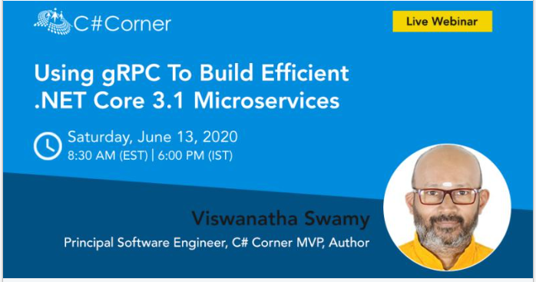
Viswanatha Swamy
LinkedIn: https://www.linkedin.com/in/viswanatha-swamy-b57326128/
Twitter: https://twitter.com/vishipayyallore
C# Corner

Slide 2
Information
All the sessions will be hands on.
Sessions will be weekly.
Will have parking lots for queries and other topics.
Some of the concepts we will introduced and revisited in next sessions.
There are multiple ways to do, we will use one of the way.
The focus was more on concepts and demos are kept simple.
I am still a learner. What!!! … wait … Yes, I am still a learner.
C# Corner

Slide 3
Tools we use
Visual Studio 2019 Professional
Azure Data Studio
SQL Server
C# Corner

Slide 4

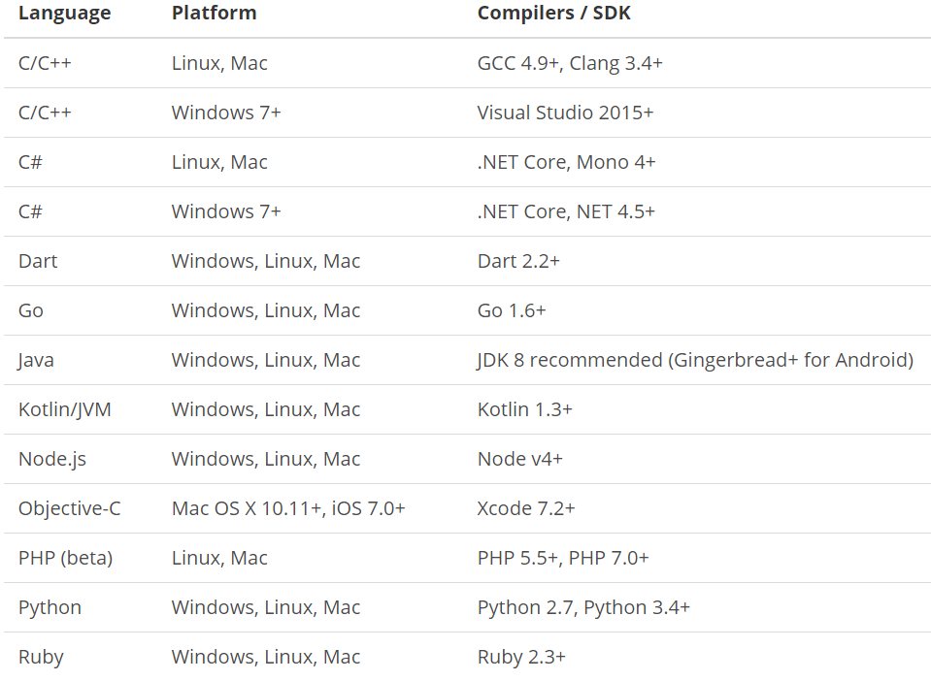
What is gRPC ?
is a modern open source high performance RPC framework that can run in any environment. It can efficiently connect services in and across data centers with pluggable support for load balancing, tracing, health checking and authentication. It is also applicable in last mile of distributed computing to connect devices, mobile applications and browsers to backend services.
https://docs.microsoft.com/en-us/aspnet/core/tutorials/grpc/grpc-start?view=aspnetcore-3.1&tabs=visual-studio
https://grpc.io/docs/guides/
https://grpc.io/docs/guides/concepts/
Motivation:
High Performance
IDL / Contract Based
Streaming (Unary, Client, Server, Bi-directional)
Security (https://developers.google.com/web/fundamentals/performance/http2)
Available across ecosystems
Supported Languages:
URL: https://grpc.io/about/#officially-supported-languages-and-platforms
C# Corner

Slide 5
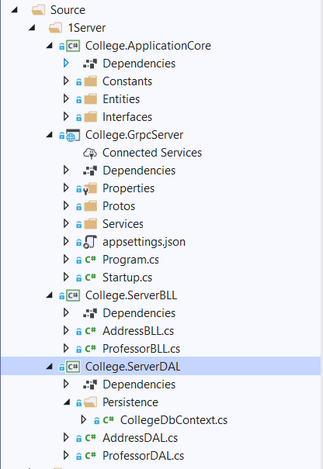
Creating gRPC Service with Layers
College.ApplicationCore:
Constants
Entities
Interfaces
College.GrpcServer:
.Proto files
gRPC Server implementations
Application Configuration
Start up and DI
College.ServerBLL:
Any Business Logic
College.ServerDAL:
Db Context
Data Access Layer which consumes Db Context
C# Corner

Slide 6
Creating gRPC Service with Layers
Demo
Creating gRPC Service
with Layers
C# Corner

Slide 7
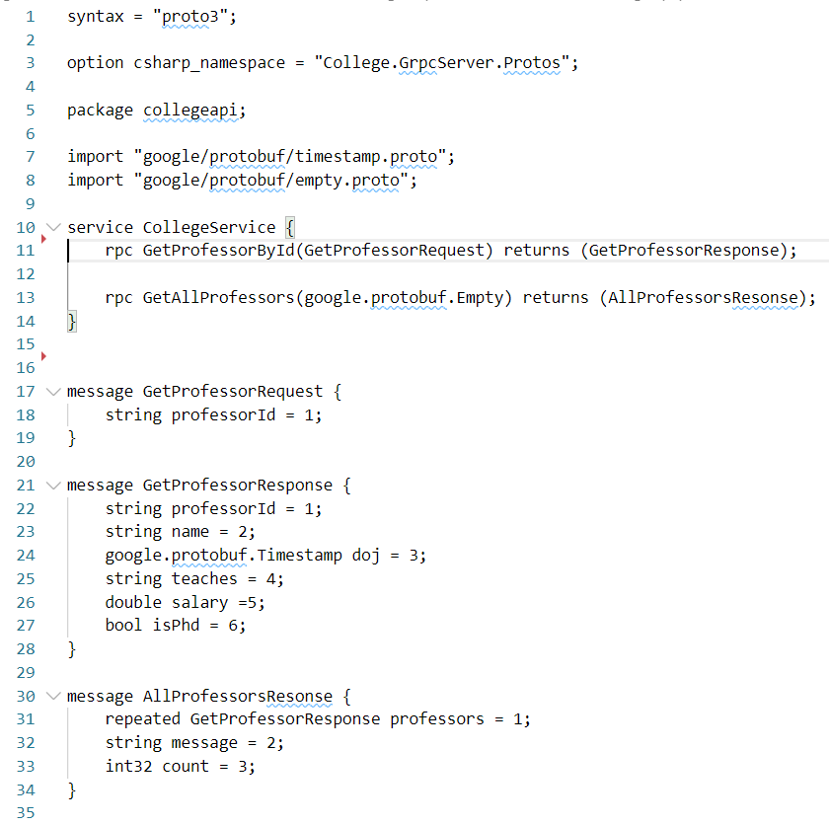
Adding .proto file to Implement GetById() and GetAll()
C# Corner

Slide 8
Adding .proto file to Implement GetById() and GetAll()
Demo
Adding .proto file to Implement
GetById() and GetAll()
C# Corner

Slide 9
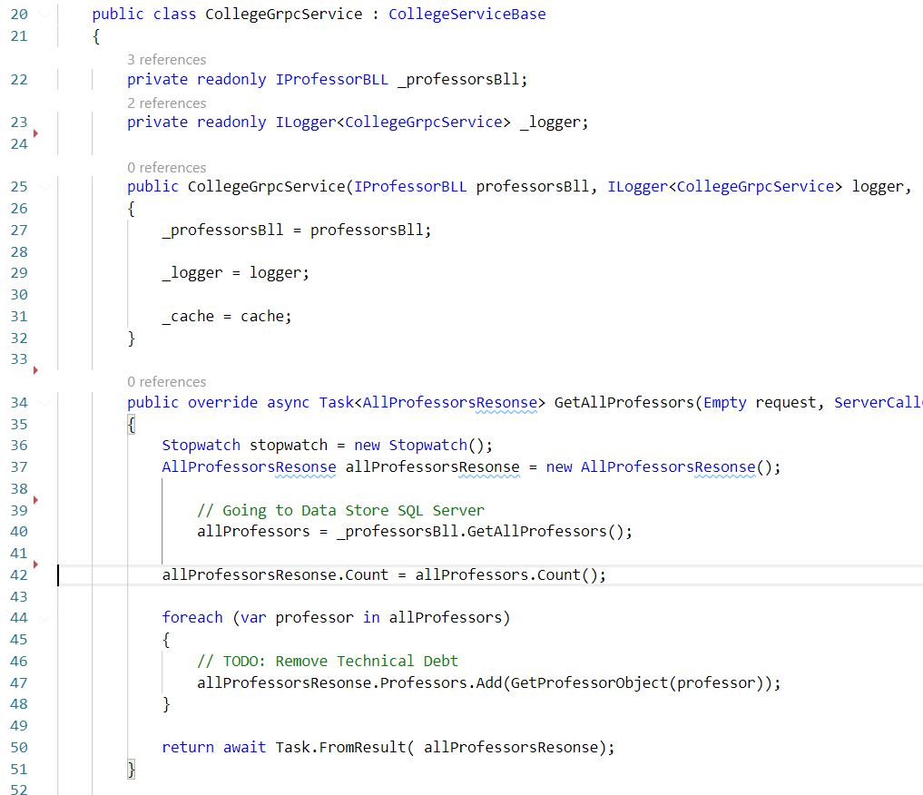
Implement gRPC Service for GetById() and GetAll()
C# Corner

Slide 10
Implement gRPC Service for GetById() and GetAll()
Demo
Implement gRPC Service for
GetById() and GetAll()
C# Corner

Slide 11
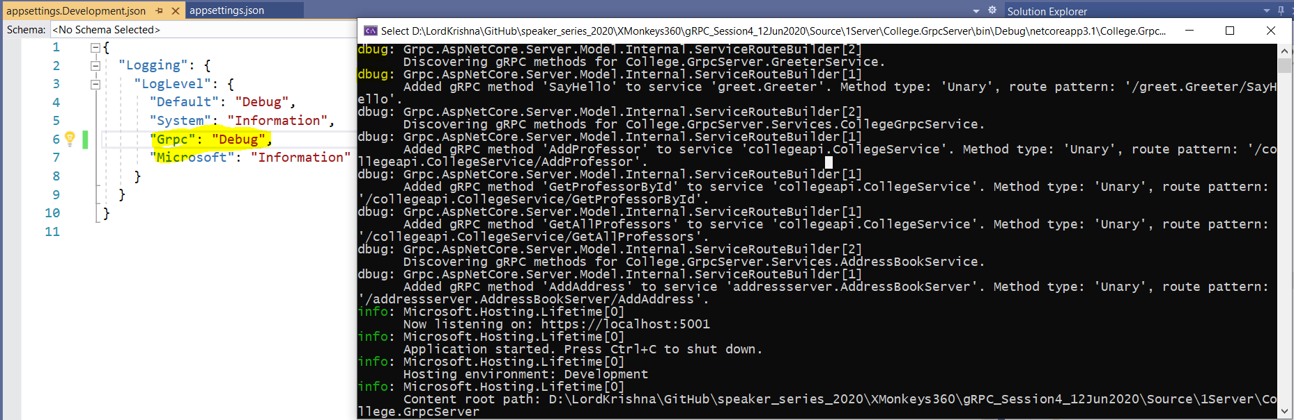
Adding gRPC Logging inside Server
C# Corner

Slide 12
Adding gRPC Logging inside Server
Demo
Adding gRPC Logging
inside Server
C# Corner

Slide 13
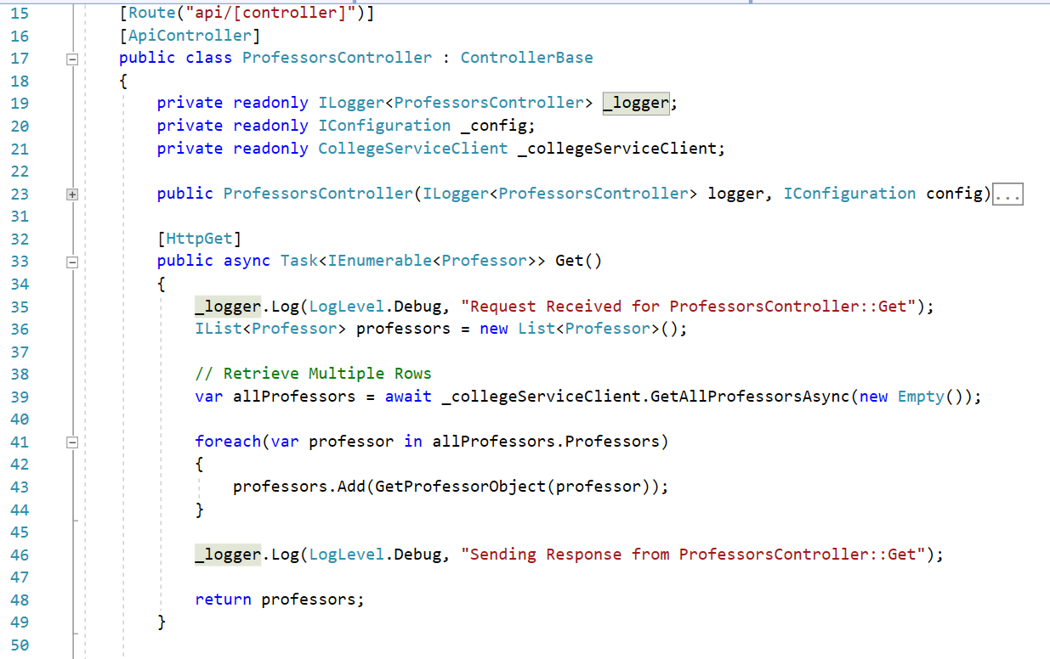
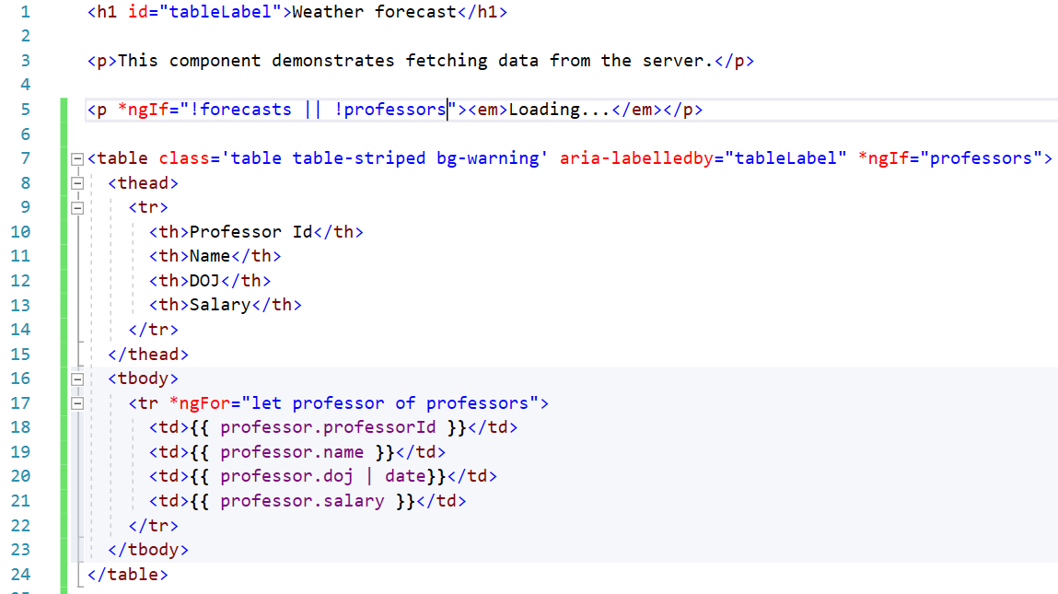
Adding gRPC Client inside .Net Core Angular App
C# Corner

Slide 14
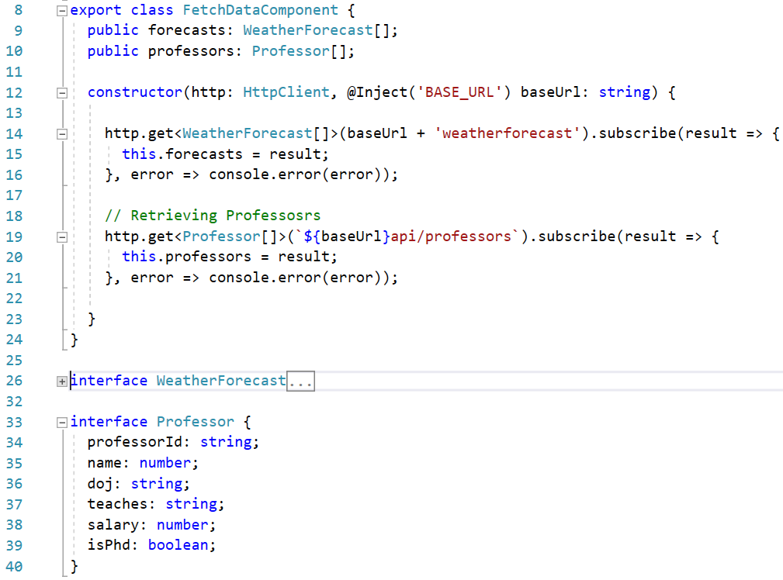
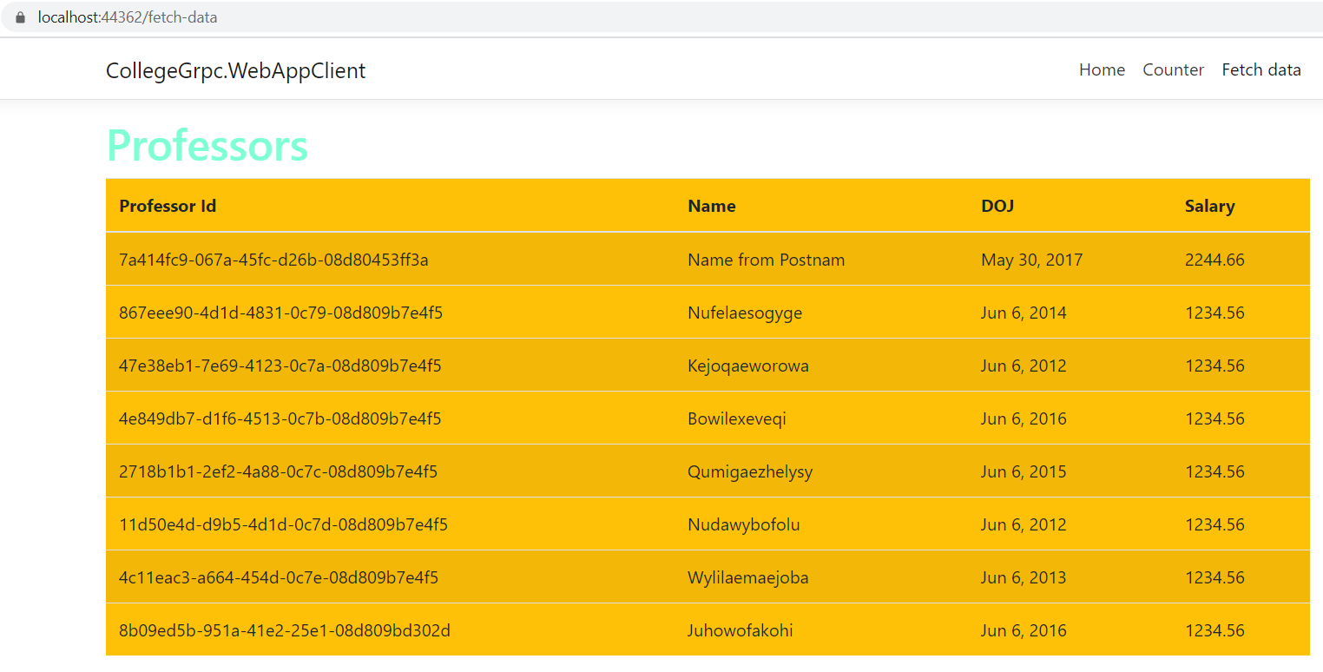
Adding gRPC Client inside .Net Core Angular App
C# Corner

Slide 15
Adding gRPC Client inside .Net Core Angular App
Demo
Adding gRPC Client inside
.Net Core Angular App
C# Corner

Slide 16
What is next?
What is next ???
What we will discuss in next session (27-Jun-2020) ….
Using the Redis Cache from Azure.
Using the SQL Server from Azure.
Improvising the Project into Layers.
Add, Edit, Delete methods added to Web API
Invalidate the Cache when Add/Edit/Delete.
Updating the Angular UI to accommodate Add/Edit/Delete.
C# Corner

Slide 17
Q & A
C# Corner

Slide 18
Thank You
Viswanatha Swamy
LinkedIn: https://www.linkedin.com/in/viswanatha-swamy-b57326128/
Twitter: https://twitter.com/vishipayyallore
C# Corner

